Slide 1


Slide 2
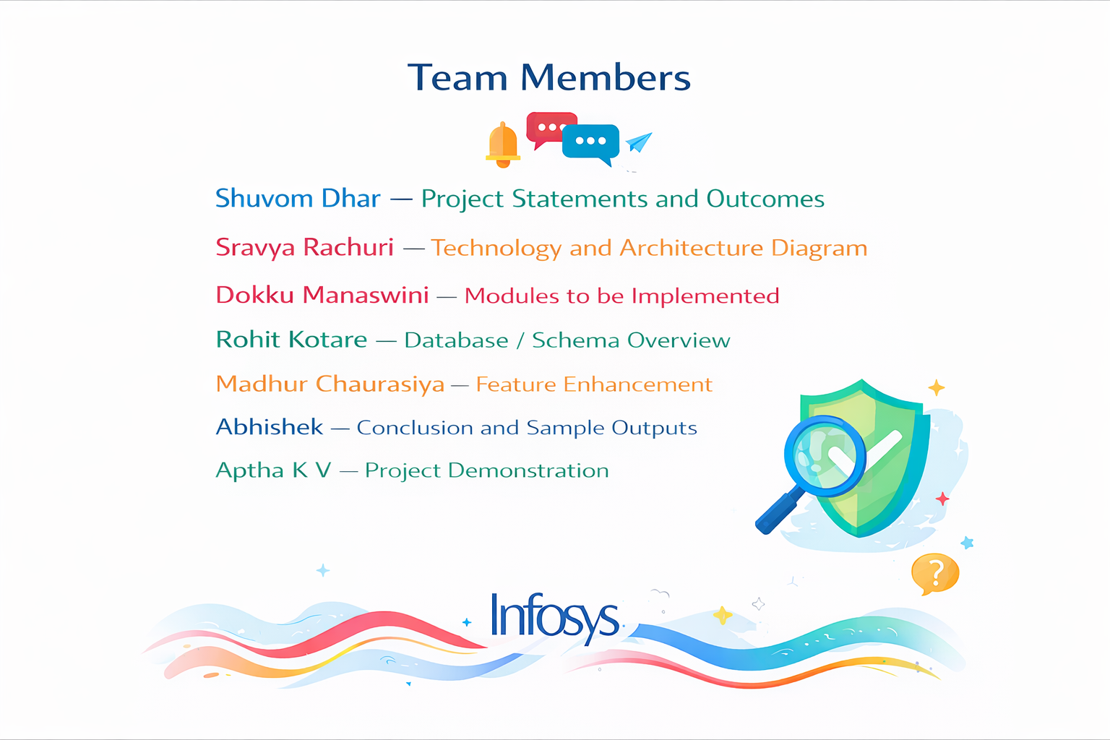

Slide 3
Project Statement
Accuracy
High accuracy with complex language. The tool classifies news content as Reliable, Suspicious, or Fake
HEADING HERE
NEED FOR AN AUTOMATED SOLUTION
There is a strong need for an automated system that can quickly analyze and verify large volumes of digital news content.
Multilingual
Multilingual misinformation. This tool will support multiple languages for verification.
USE OF NLP AND GEMINI AI
The system uses advanced Natural Language Processing (NLP) techniques along with Google Gemini AI for intelligent analysis.
AI Explainability
This project proposes an AI-based Fake News Detection and Verification Tool to automatically analyze news articles and online content.
Efficiency
Efficient large-scale data processing. This tool can preprocess large scale of data efficiently.

Slide 4
Accurate Identification
Precise classification of fake and real news using ML and NLP.
1
2
Improved Performance
High accuracy, precision, recall, and F1-score in classification.
Real-time Verification
Instant detection and verification of news from multiple sources.
3
SYSTEM OUTCOMES
User-Friendly Interface
Easy input and visualization of results for all users.
4
Reduced Misinformation
Reliable verification outcomes to curb the spread of fake news.
5
SUPPORT ON ROLE BASIS
Supports role-based access with separate user and admin functionalities
6

Slide 5
ADMIN MANAGEMENT
User management and access control
Monitoring of system-wide analyses
Overview of platform usage and performance
USER AUTHENTICATION & PROFILE MANAGEMENT
Secure user registration and login system
Role-based access for User and Admin
User profile management and session handling
08
01
ANALYSIS HISTORY
Stores past analysis records
Allows users to view previous results
Supports historical tracking and comparison
07
NEWS CONTENT INPUT MODULE
Accepts news content as text or URL
Extracts content from online articles
Prepares data for further analysis
02
MODULES TO BE IMPLEMENTED
07
RESULT VISUALIZATION
Displays analysis results in a user-friendly format
Shows confidence, credibility, and sentiment scores
Provides detailed analysis reports
NLP PREPROCESSING
Text cleaning and normalization
Tokenization and sentiment detection
Identification of linguistic patterns
03
06
04
NEWS CLASSIFICATION
Classifies content as Reliable, Suspicious, or Fake
Uses AI-driven evaluation results
Ensures fast and accurate classification
AI-BASED NEWS VERIFICATION
Integration with Google Gemini AI
Analysis of factual consistency
Generation of confidence and credibility scores

Slide 6
Technology
Web & Backend Technologies
Flask / FastAPI
JWT Authentication
Docker deployment
04
APIs & Databases
Google Fact Check Tools API
PolitiFact API
SQL / NoSQL storage
03
Machine Learning /Deep Learning
Transformer models: BERT, RoBERTa, DistilBERT
Fine-tuning for classification
02
NLP Technologies
Tokenization, Stopword removal
Lemmatization (spaCy, NLTK)
Named Entity Recognition (NER)
Dependency Parsing
01

Slide 7
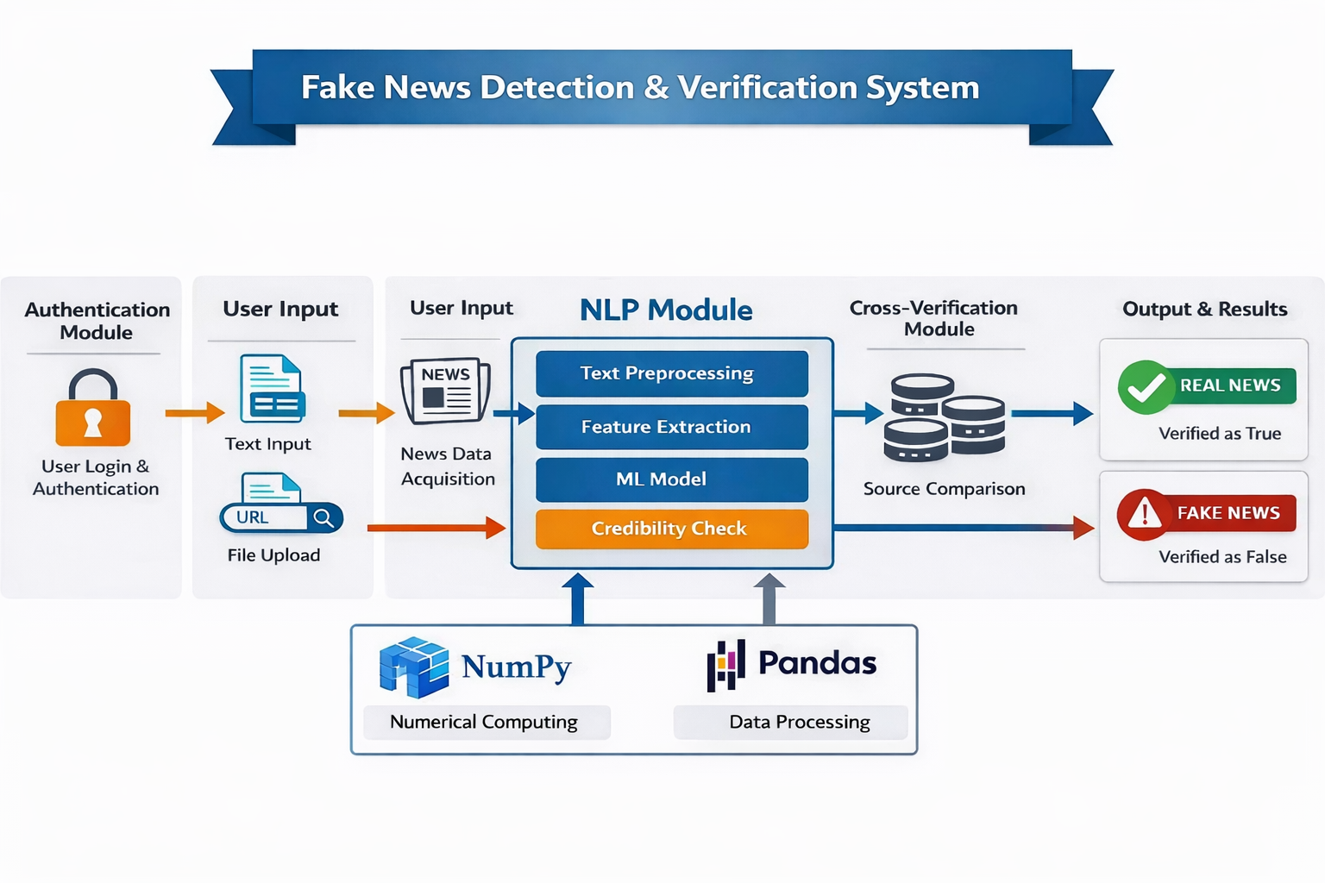
ARCHITECTURE DIAGRAM

Slide 8
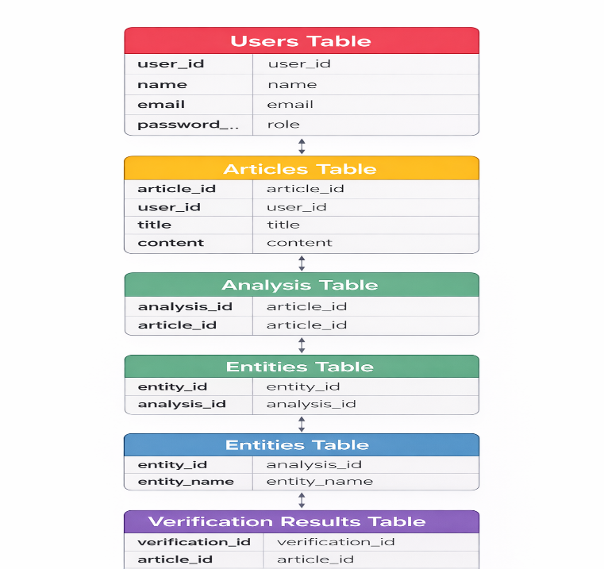
Database / Schema Overview
Stores user account details such as user ID, name, email, password, and role (user/admin).
Users Table
Stores news articles or social media content submitted by users for analysis.
Articles Table
Stores cleaned and preprocessed text after NLP steps like tokenization and stopword removal.
Analysis Table
Stores named entities (people, places, organizations) extracted from the text using NER.
Entities Table
Stores the final analysis results including credibility score, classification, and verification sources.
Verification Results Table

Slide 9
Feature Enhancement
Multilingual Support
Enable detection of fake news in multiple regional and international languages.
01
Advanced Transformer Models
Integrate newer and more powerful transformer models to improve accuracy.
02
Real-Time Detection
Provide instant verification using browser extensions or mobile apps.
.
03
Enhanced Explainability
Give clearer reasons and better visual highlights for fake predictions.
04
Cloud Deployment
Deploy the system on cloud platforms for scalability and high performance.
05
Expanded Fact-Checking Integrate more trusted APIs to improve verification reliability.
06
Performance Optimization
Reduce response time and improve system efficiency for large data handling.
07
Continuous Model Training
Regularly retrain the model with updated datasets to maintain accuracy..
08

Slide 10
1
The Fake News Detection & Verification Tool offers an end-to-end AI-based solution for identifying and verifying misinformation in real time.
2
It effectively combines NLP, deep learning models, and trusted fact-checking sources to improve accuracy and reliability.
CONCLUSION
4
3
It promotes digital literacy by enabling users to critically evaluate news and online information.
The system helps enhance information credibility and reduces the spread of false or misleading content.
5
The project provides practical, hands-on experience with modern AI technologies applied to large-scale, real-world challenges.

Slide 11
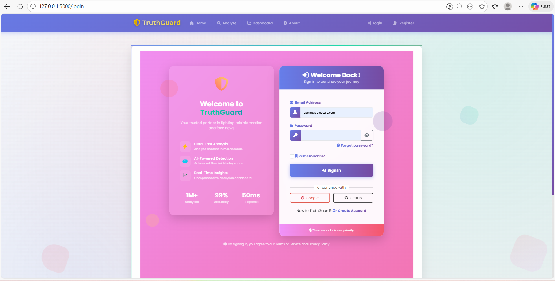
Sample Outputs
Login page

Slide 12

Home page

Slide 13
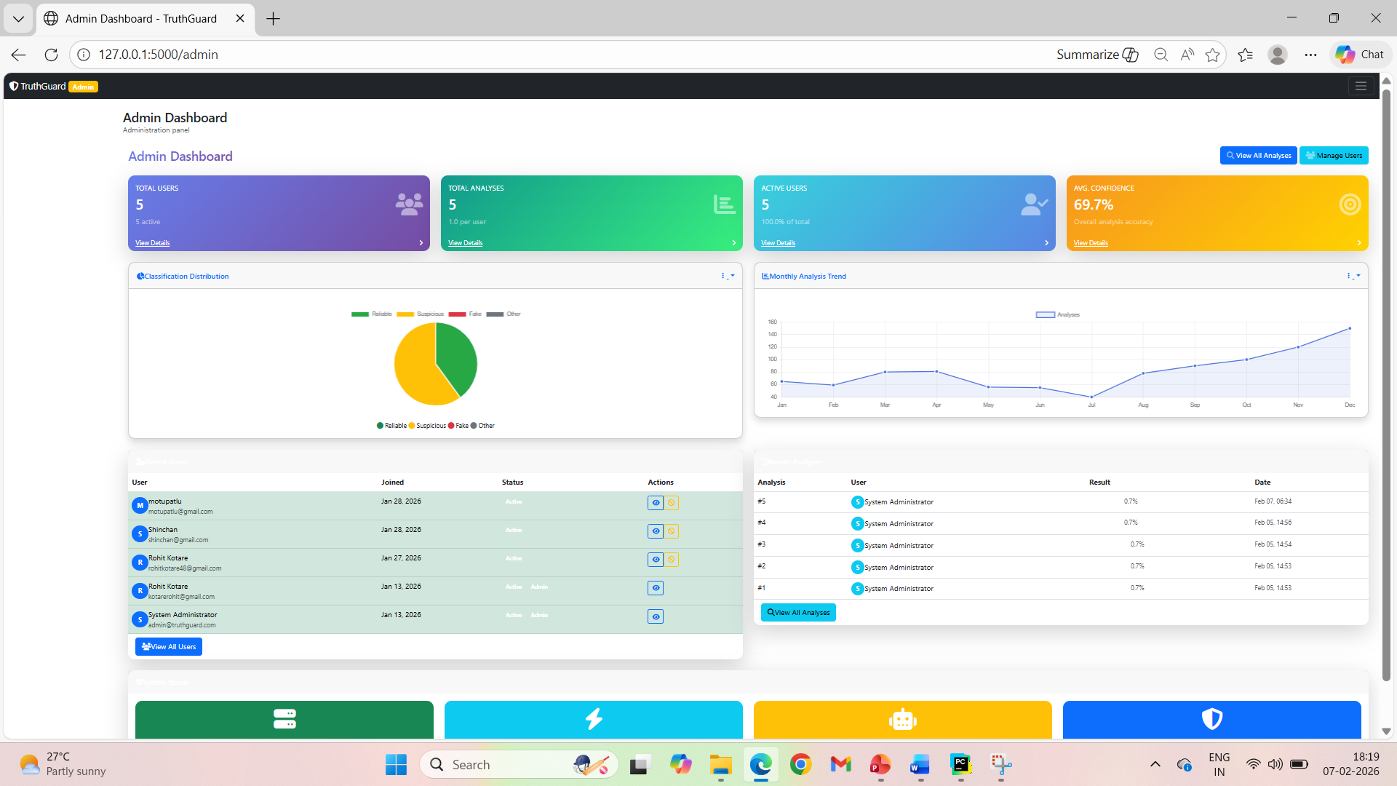
Admin Dashboard

Slide 14
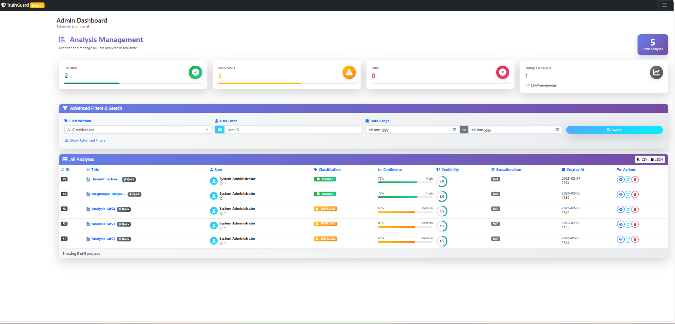
Analysis Management

Slide 15
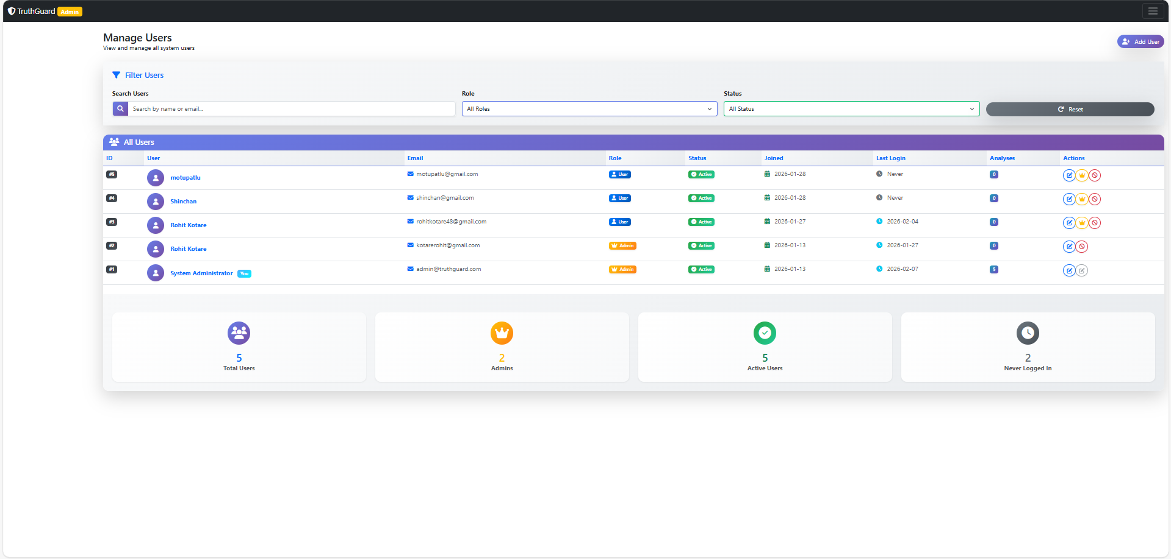
Users

Slide 16


