Slide 1
Software-Defined Radio Modem
Fourth Year Design Project

Slide 2
Motivation
Applications require remote data access:
  No existing landlines
  Only low data rates required
  Other existing wireless solutions too costly
Examples
  Scientific research
  Autonomous weather data collection
  Remote industrial process automation

Slide 3
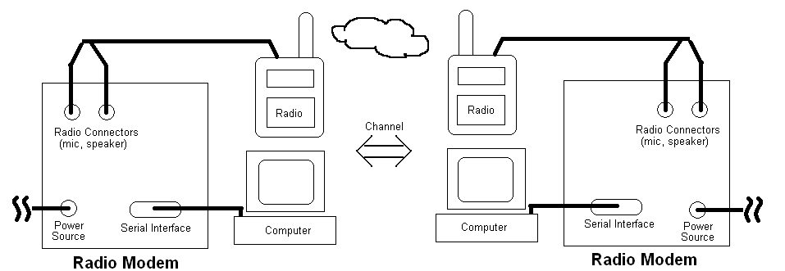
Concept

Slide 4
Operation
TODO: Insert diagram of “double modulation”

Slide 5
Requirements
Must interface with other equipment via RS-232 serial link
Must operate within standard voice bandwidth (300 Hz – 3 kHz)
Must provide a reasonable data rate over average channel conditions

Slide 6
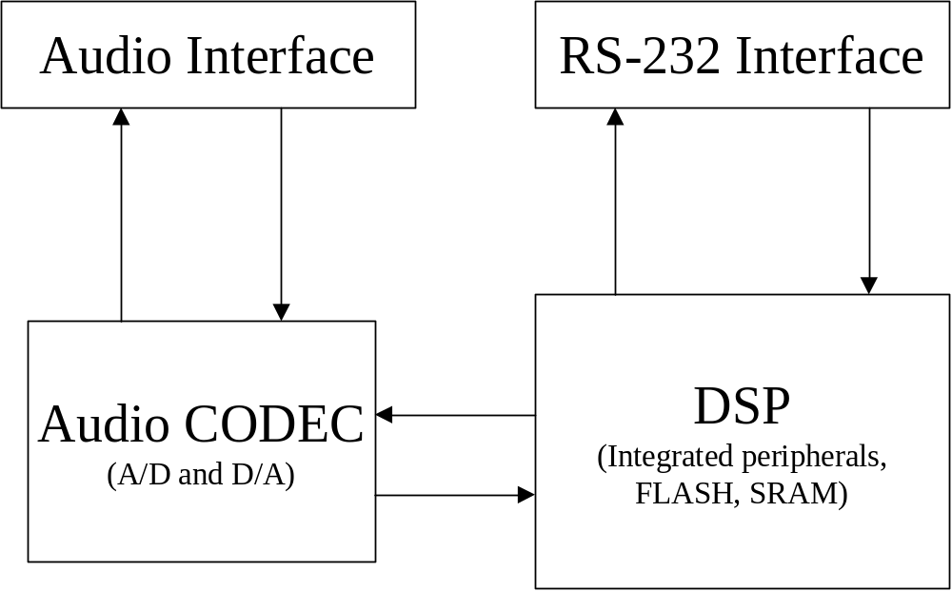
Hardware Design

Slide 7
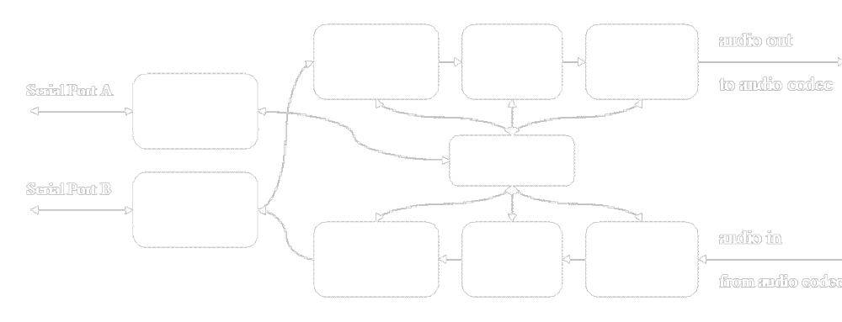
Software Modem Design

Slide 8
Demonstration
Two UHF voice radios

Slide 9
Questions

