Slide 1


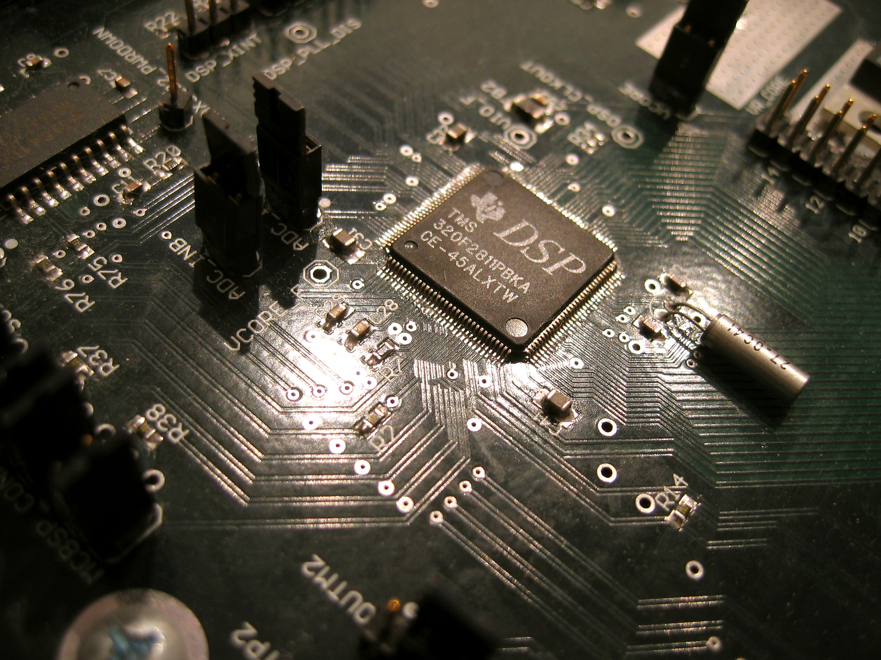
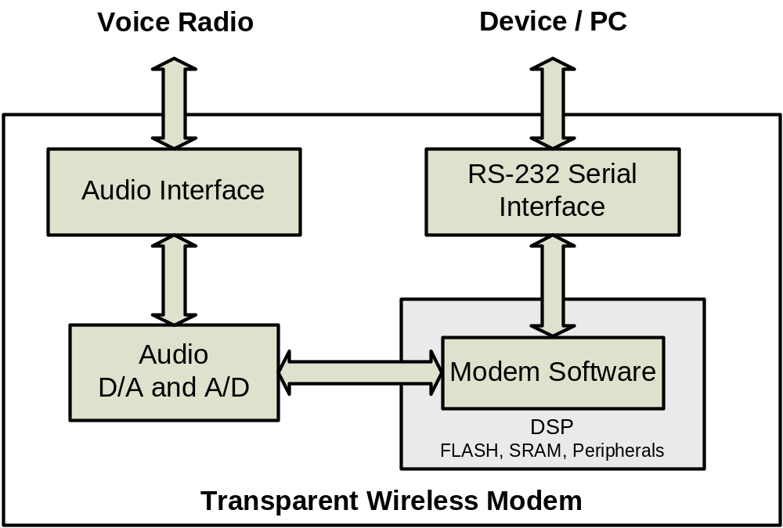
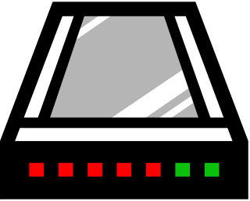

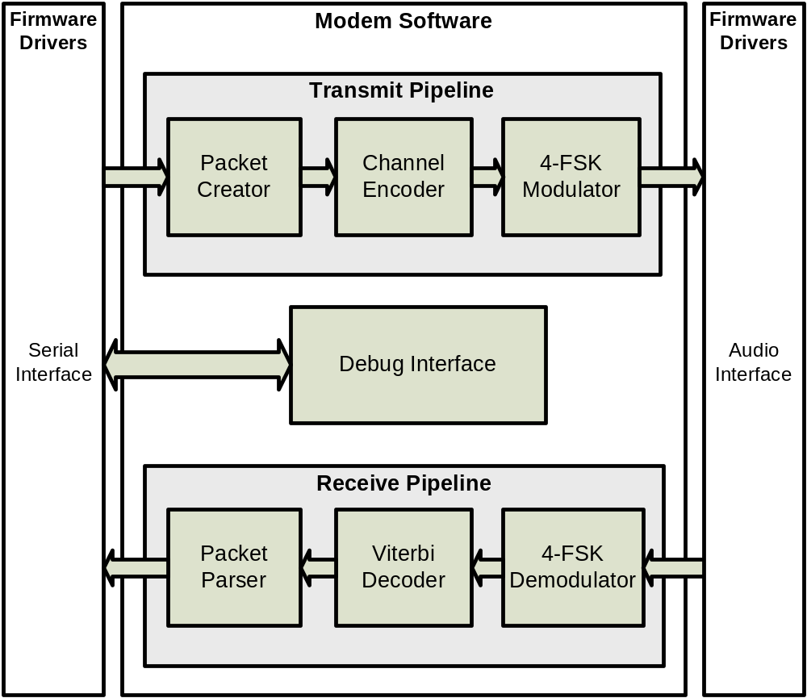

Transparent Wireless Modem
Objective
Principle of Operation
Hardware Design
  This project makes wireless data communication in remote or developing areas possible when other technologies are too expensive or impractical.
Sender transmits digital data to modem
Implementation
1
  The Transparent Wireless Modem transmits digital data wirelessly through off-the-shelf voice-band radios. The resulting wireless link behaves like a serial connection between two remote locations.
MarconiModem
Sender
2
Modem transforms digital data into audible tones
Applications
  Scientific Research: Weather data collection, remote experiments.
  Developing Nations: Affordable ad-hoc wireless data links in areas without existing infrastructure.
  Industrial Processes: Monitoring and controlling remote plant or process.
3
Software Design
Radio
transmits
tones wirelessly
Radio receives transmitted tones
Features and Benefits
4
  Flexible and Scalable: Can be used with small low-power radios or large high-power radios.
  Transparent Operation: End-to-end wireless data link behaves like a simple half-duplex serial connection.
  Affordable: Uses off-the-shelf radios for a cheaper solution than other wired or wireless technologies.
  Reliable: Error correction automatically detects and corrects errors over noisy radio channels.
5
MarconiModem
Modem transforms audible tones back into digital data
Receiver
Project Team: Stefan Janhunen, Shu Wu, Aaron Cheung, Gang Liu
Project Advisor: Professor Weihua Zhuang
References: S. Haykin, Digital Communications, John Wiley & Sons, Inc., 1988.
T. McDermott, Wireless Digital Communications: Design and Theory, TAPR Corporation, 1998.
University of Waterloo

