Slide 1


Transparent Wireless Modem
Fourth Year Design Project Presentation
Date: Wednesday, January 18th, 2006
Team:
Aaron Cheung
Stefan Janhunen
Shu Wu
Gang Liu
Project Consultant:
Professor Weihua Zhuang

Slide 2
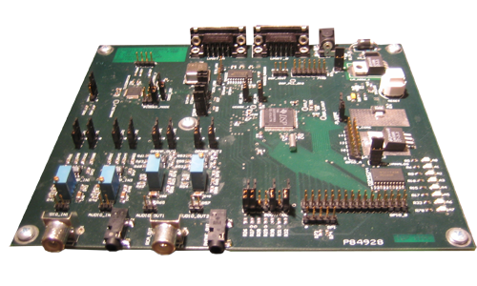
Agenda
Motivation and Operating Concept
Requirements and Hardware Design
Software Design and Testing/Verification

Slide 3
Motivation
Usage Scenario
  Low data-rate application
  Other existing wireless solutions too costly
  Existing voice radios available
Examples
  Autonomous data collection
  Ad-hoc communication in developing areas
  Remote industrial process control

Slide 4


Operating Concept
Serial
connection
Audio
connection
Voice Radio
Modem
Sender
RF
connection
Receiver
Voice Radio
Audio
connection
Modem
Serial
connection

Slide 5
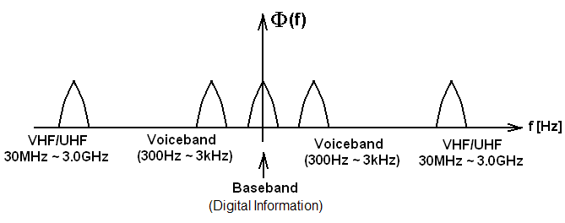
Operating Concept

Slide 6
Project Requirements
Transparent operation over RS-232
Compatible with voice-band radios
Reliable over noisy channels
Acceptable for text or low-rate data

Slide 7
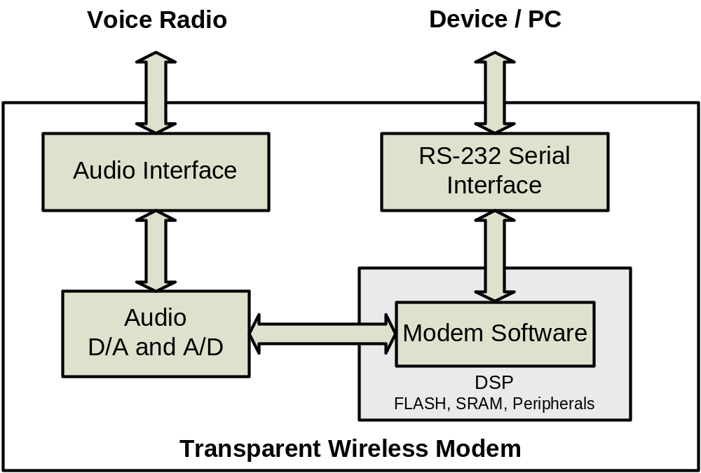
Hardware Overview

Slide 8
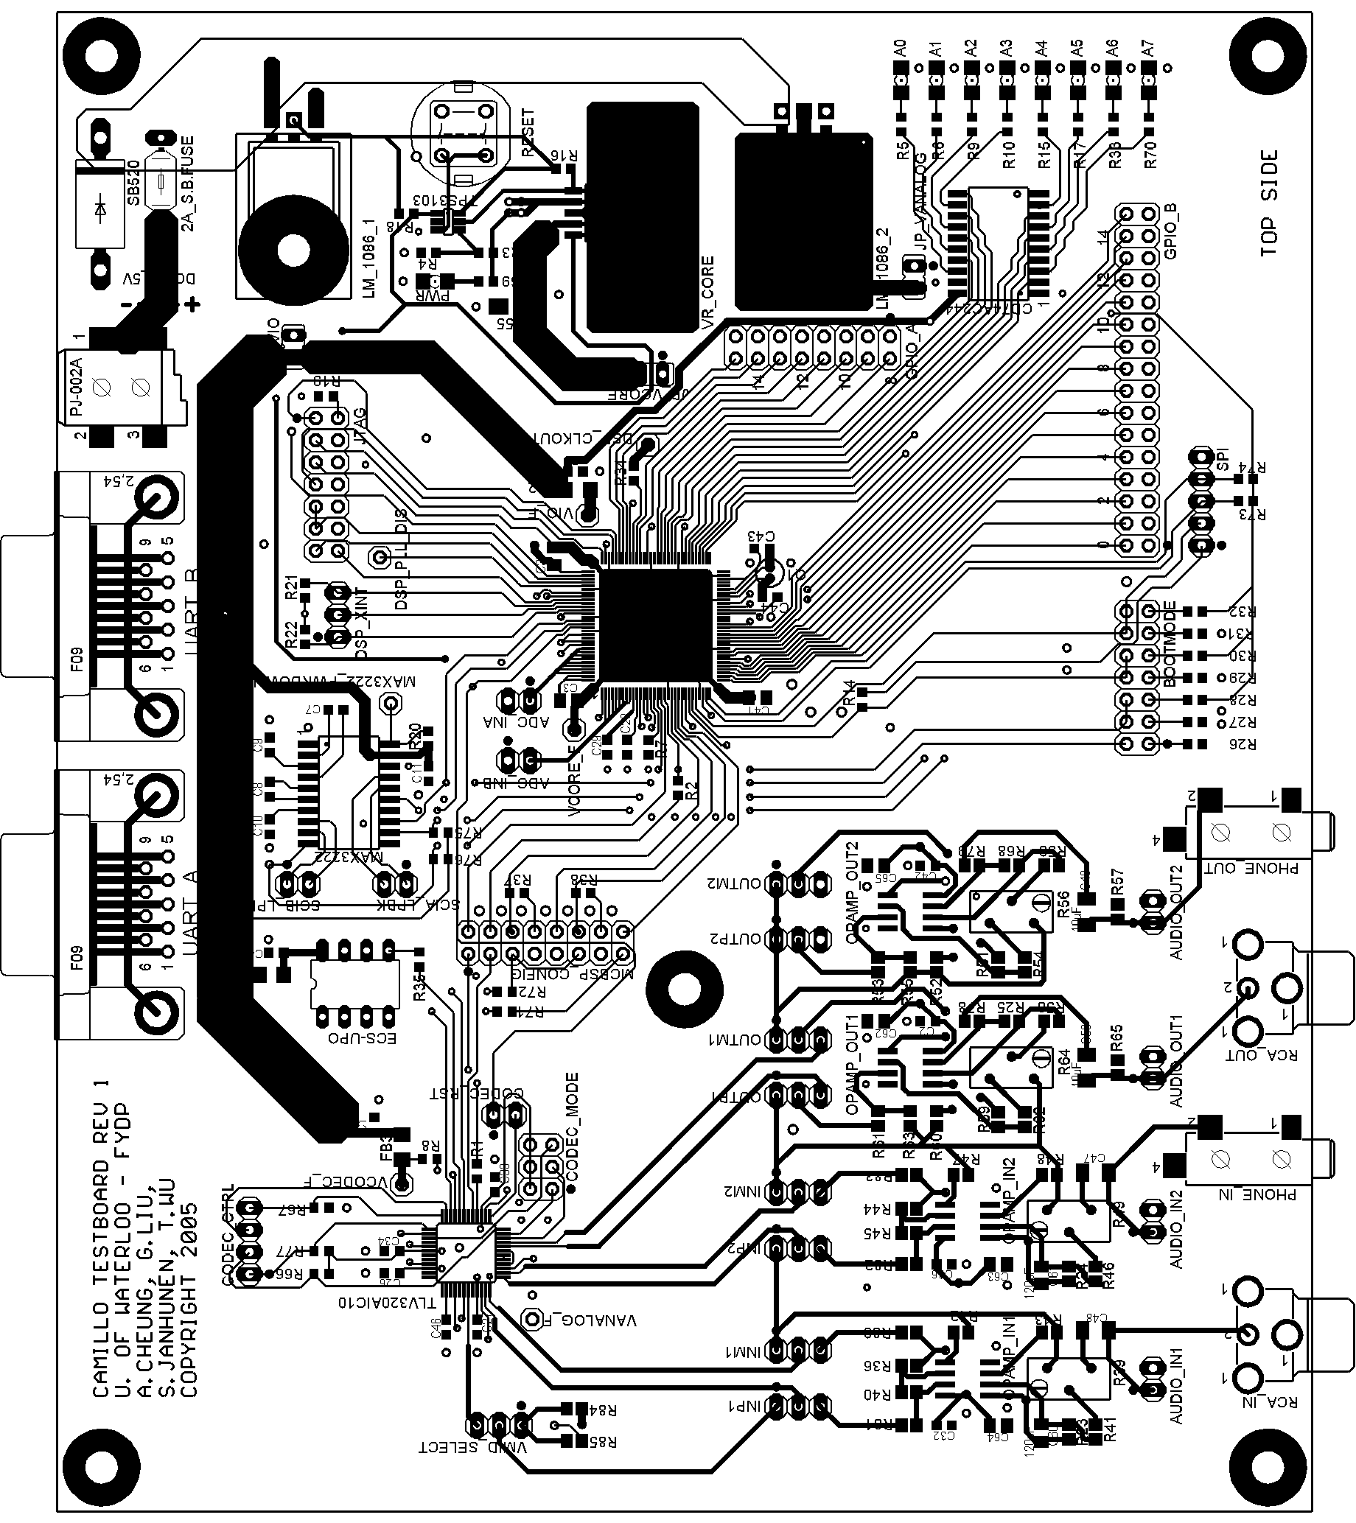
Hardware Overview
Requirements
  Analog audio interface
  RS-232 serial interface
  DSP to allow software processing
Design Objectives
  Few parts
  Low Cost

Slide 9
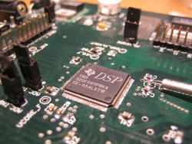
Software Overview
Digital Signal Processor
  Modulation
  Forward error correction
  Applications
Advantages
  Hardware independence
  Ease of implementation
  Flexibility
  Less expensive

Slide 10
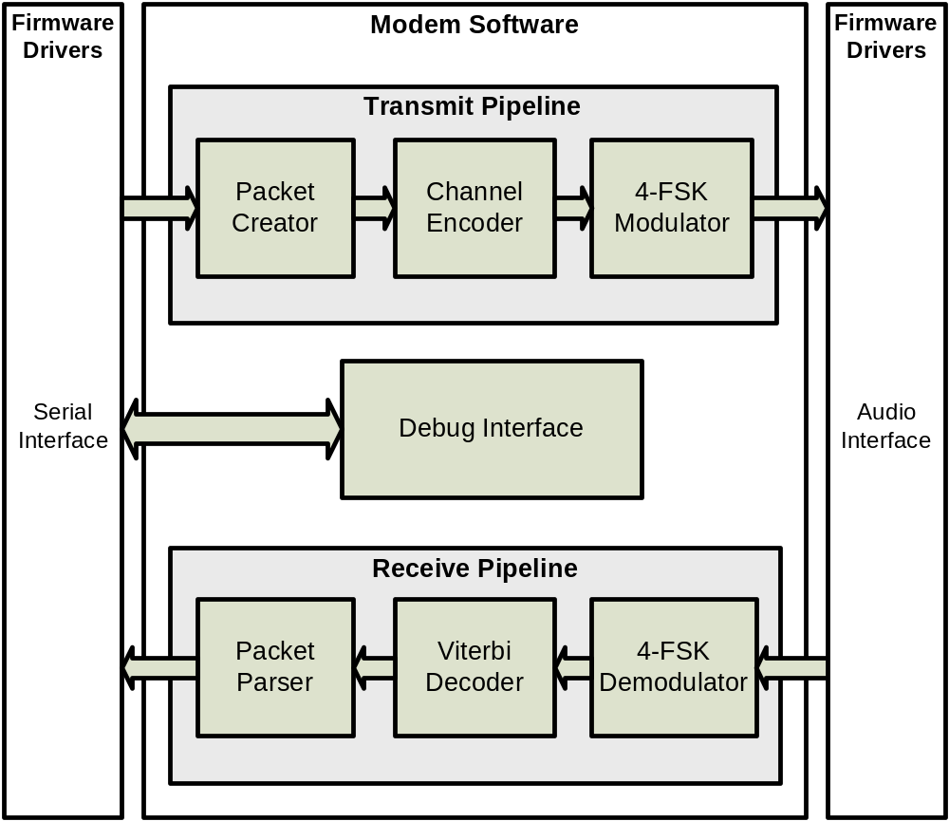
Software Overview

Slide 11
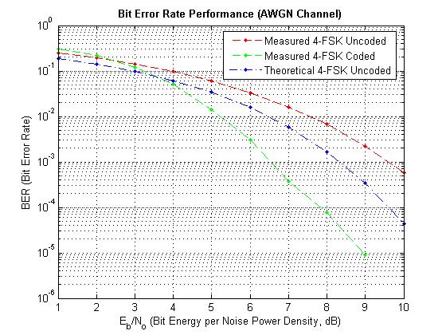
Testing and Verification
Testing
  PC simulation
  Modular testing
  Debug interface
  Bit error rate

Slide 12
Questions?
References
S. Haykin, Digital Communications, John Wiley & Sons, Inc., 1988.
T. McDermott, Wireless Digital Communications: Design and Theory, TAPR Corporation, 1998.

