Slide 1


Transparent Wireless Modem
Fourth Year Design Project Presentation
Date: Friday, January 16th, 2006
Team:
Stefan Janhunen
Aaron Cheng
Shu Wu
Gang Liu
Project Consultant:
Professor Weihua Zhuang

Slide 2
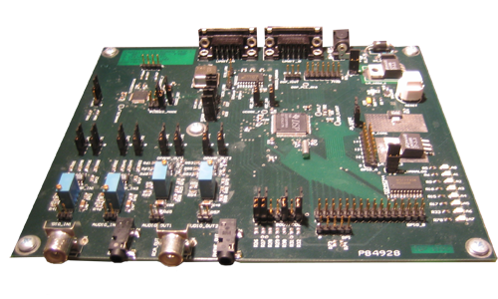
Agenda
Motivation, Operating Concept, Requirements
Hardware Design
Software Design

Slide 3
Motivation
Usage Scenario
  Low data-rate application
  Other existing wireless solutions too costly
  Existing voice radios available
Examples
  Autonomous data collection
  Ad-hoc communication in developing areas
  Remote industrial process automation

Slide 4


Operating Concept
Serial connection
Audio connection
2
Voice Radio
1
Sender
Modem
3
Radio Frequency connection
Modem
Receiver
Voice Radio
4
5
Audio connection
Serial connection

Slide 5
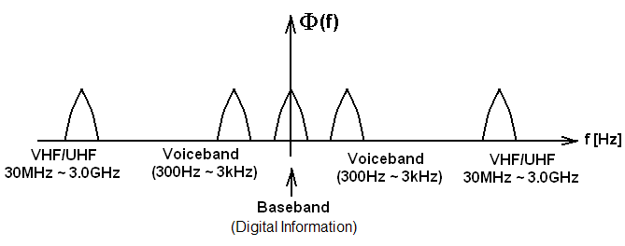
Operating Concept

Slide 6
Project Requirements
Transparent operation over RS-232 serial connection
Operates with standard voice-band radios
Robust operation over noisy channels
Acceptable throughput for text or low data-rate transfers

Slide 7
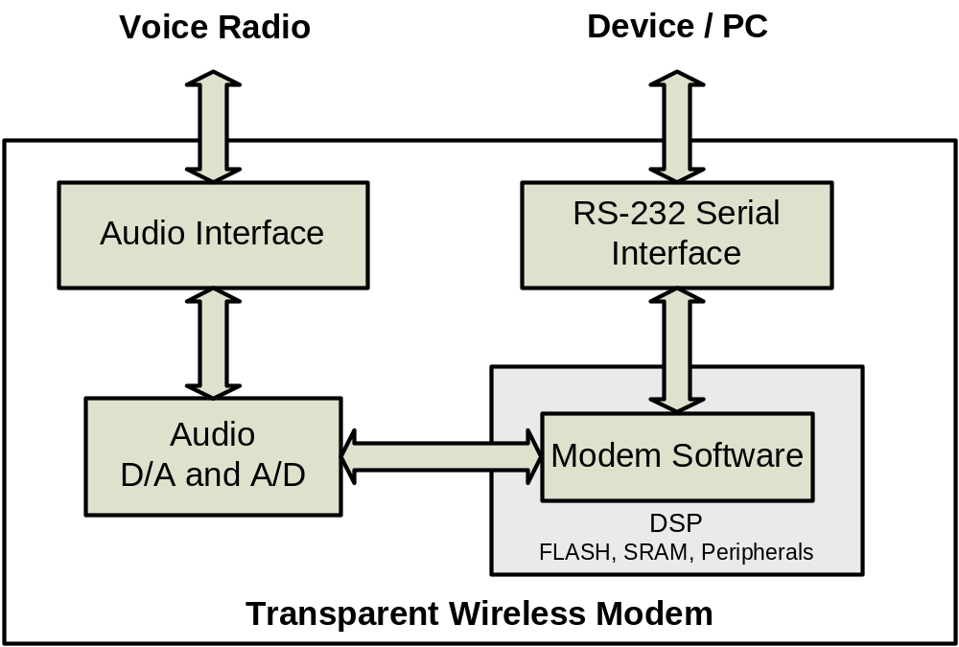
Hardware Overview

Slide 8
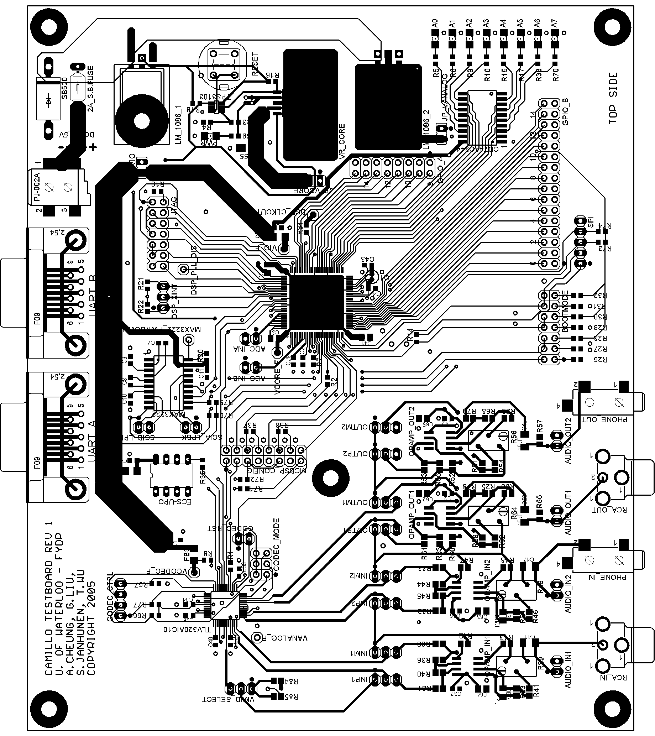
Hardware Overview
Requirements:
  Analog audio interface
  RS-232 serial interface
  DSP to allow software processing
Design Objectives:
  Few parts
  Low Cost

Slide 9
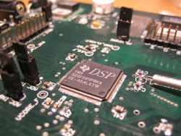
Software Overview
DSP (Digital Signal Processor)
  Modulation
  Forward error correction
  Applications
Advantages
  Hardware independence
  Ease of implementation
  Flexibility
  Less expensive

Slide 10
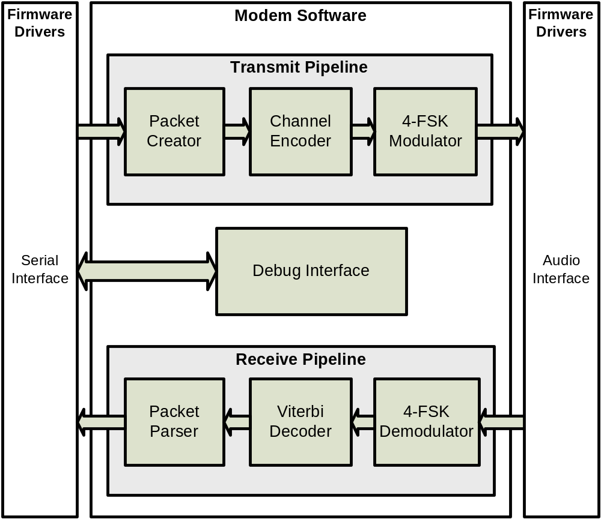
Software Overview

Slide 11
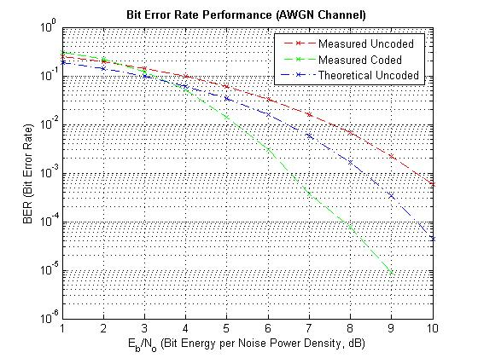
Testing and Verification
Testing
  PC Simulation
  Debug Interface
  Modular testing
  Bit Error Rate

Slide 12
Questions?

