Slide 1


Transparent Wireless Modem
Final Presentation
Date: Friday, January 16th, 2006
Team:
Stefan Janhunen
Aaron Cheng
Shu Wu
Gang Liu
Project Consultant:
Professor Weihua Zhuang

Slide 2
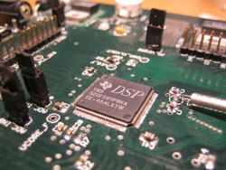
Agenda
Motivation
Concept, Requirements, and Operation
Hardware Design
Software Design

Slide 3
Motivation
Applications require remote data access:
  No existing landlines
  Only low data rates required
  Other existing wireless solutions too costly
Examples
  Scientific research
  Autonomous weather data collection
  Remote industrial process automation

Slide 4
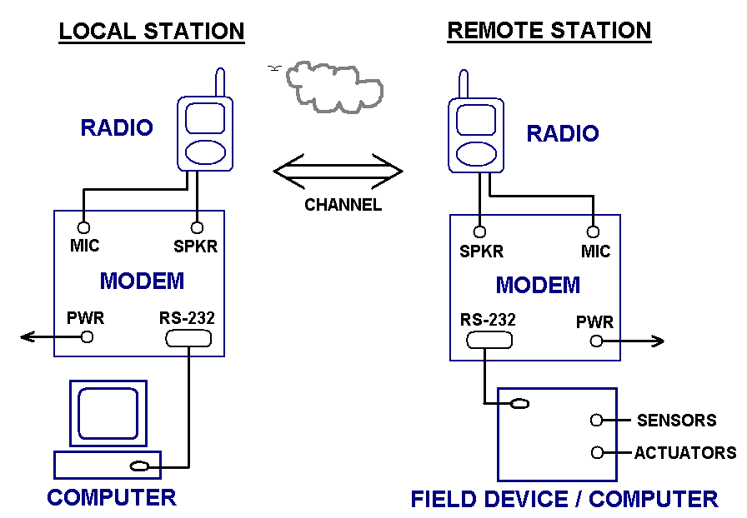
Concept

Slide 5
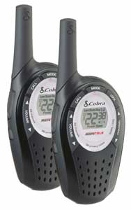
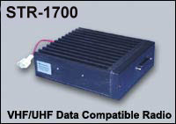
Range
Cobra PR-245
Power: 1W
Range: ~ 10 km
SRI STR-1700
Power: 35 W
Range: ~ 50 km

Slide 6
Requirements
Must interface with other equipment via RS-232 serial link
Must operate within standard voice bandwidth (300 Hz – 3 kHz)
Must provide a reasonable data rate over average channel conditions (few hundred to few thousand bits per second)

Slide 7
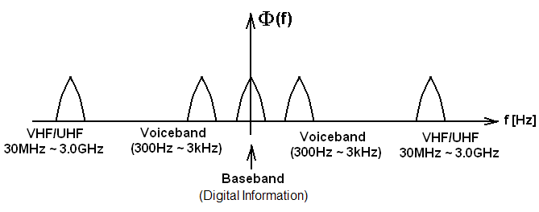
Operation

Slide 8
Hardware Design
Radio
Computer/Field Device
Audio Interface
RS-232 Interface
Audio CODEC
(D/A and A/D)
Modem Software
DSP
(Integrated peripherals,
FLASH, SRAM)
Radio Modem

Slide 9
Software Design
Audio out
To audio
codec
Framing and Packeting
Encoder
Modulator
Serial
Port
TRANSMIT PIPELINE
Transparent Data Interface
Audio in
from audio
codec
Framing and Packeting
Decoder
Demodulator
RECEIVE PIPELINE

Slide 10
Questions?

