Slide 1
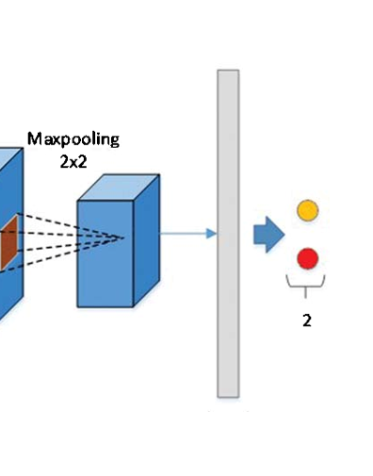

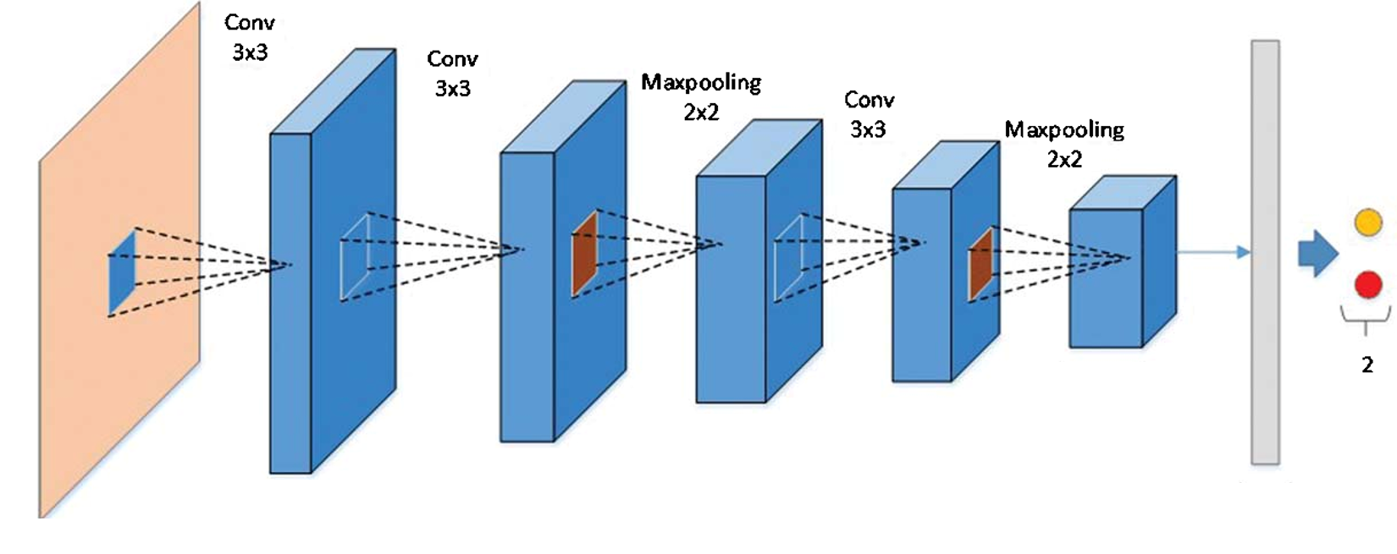

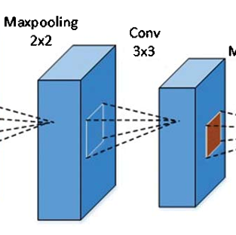
Layer 1
Layer 2
Layer 3
Layer 4
Layer 5
32
64
64
128
256
flatten
0 : PNEUMONIA
Dropout
= 0.2
ReLU
sigmoid
1 : NORMAL
Strides = 2
Strides = 2
Strides = 2
Strides = 2
Strides = 2
Strides = 1
Padding = same
ReLU
Strides = 1
Padding = same
ReLU
Strides = 1
Padding = same
ReLU
Strides = 1
Padding = same
ReLU
Strides = 1
Padding = same
ReLU
Train data =5216*(150,150,1)
optimizer = adam
loss = binary_crossentropy

