Slide 1

U.S. Housing Market
Shuwen Zhang
Sonali Fulzele
Roshni Chainani
Julia Nalyvaiko
@ 2019 Rutgers Data Science Bootcamp

Slide 2
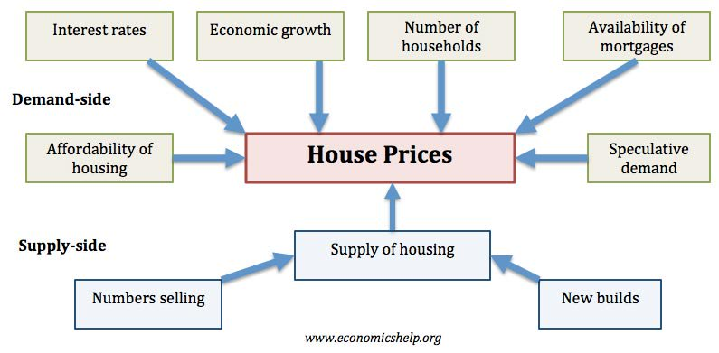
Background
Intrinsic factors
Market-side
@ 2019 Rutgers Data Science Bootcamp

Slide 3






Background
Extrinsic factors
@ 2019 Rutgers Data Science Bootcamp

Slide 4
Objective
What is the geographic distribution of the median house price over the U.S.?
How do the market-side, demand-side, supply-side factors influence median house price in the selected state?
Ranks of median house price vs extrinsic factors in a state?
@ 2019 Rutgers Data Science Bootcamp

Slide 5
Data gathering
Monthly residential data by states from realtor.com (33 variables during 2012-2019 in csv and JSON files)
Annual poverty percentage by states from United States Census Bureau
Crime rate (property crime and violent crime) from FBI Uniform Crime Reporting Statistics
State ranking from CNBC https://www.cnbc.com/id/100016697
Data Analysis
Python, PostgreSQL
@ 2019 Rutgers Data Science Bootcamp

Slide 6
Data Visualization
D3.js; Plotly.js; SVG; Chart.js; node.js; chart.js; jQuery
Let’s play

