Slide 1
CME Group
NASDAQ: CME
Current Share Price: $306.79
Implied Share Price: $333.20
Recommendation: BUY
20-30-75
211-160-1
115-163-72
179-157-105
FARMLAND
Julia Miao, Susan Ho, Ester Wang
March 11th, 2026
Data Cutoff Eff.
Market Close 10 Mar. 2026
All Figures in USD
Notes:
10 sec (Alan)

Slide 2




Team Introduction
Julia Miao
FARM 1B
Susan Ho
FARM 1B
Ester Wang
FARM 1B

Slide 3

Investment Thesis: CME Group Thrives in volatility
CME Group is a high-conviction BUY — durable volume growth, an unassailable market position, and underpriced catalysts support meaningful upside
01
STRUCTURAL ADVANTAGE
02
MACRO TAILWIND
03
GROWTH OPTIONALITY
CME's Moat Is Deeper Than the Market Appreciates
Post-2022 Volatility Creates a Durable Volume Environment
New Crypto & Clearing House Developments Are Underpriced by the Street
CME operates the world's largest derivatives exchange, serving institutional investors, corporate/commercial investors, market infrastructure and data clients. Network effects, ~$120B+ in annual client margin, high operating margins, and $803M in recurring market data revenue create a position nearly impossible to replicate.
Structural macro uncertainty (Fed rate policy, geopolitical tensions, and persistent inflation) is sustainably driving demand for CME's hedging products. Commodities ADV grew +12% in 2025. Treasury clearing market now mandated onto clearinghouses.
Institutional crypto adoption drove CME crypto ADV +92% YoY in Q4 2025. A new SEC-approved securities clearing house launching May 2026 opens the $40T+ U.S. equities clearing market, an entirely new revenue vertical not yet reflected in consensus estimates.
28.1M
Record FY2025 ADV
+6%
ADV Growth YoY
+92%
Crypto ADV YoY
Current Price
Implied Price
Upside
WACC
EV/EBITDA
Peer Median
$306.79
$333.20
+8.6%
7.6%
19.4x
16.5x
Notes:
Thesis of the pitch

Slide 4

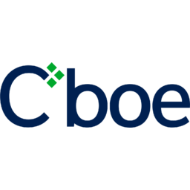
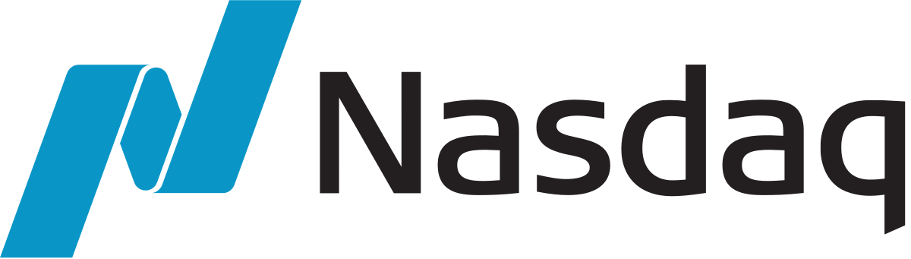
Business Overview and Competitive Landscape
CME Group operates the world's largest derivatives exchange by volume with average 2025 daily volume over 28 million contracts
Lists futures and options contracts across 6 asset classes: interest rates, equity indexes, FX, energy, metals, and agriculture
Revenue model has 3 components: transaction/clearing fees, market data, subscriptions, and access fees
FY2025 revenue was $6.5B, net income $4.1B, operating margin ~65%
Owns and operates its own clearinghouse
Financial exchange and market infrastructure industry:
Trading venues
Clearing and settlement
Market data and analysis
CME operates in all three layers and is highly diversified
Industry Landscape:
High fixed costs to build, low marginal costs to scale
Network effects are strong: any increase in liquidity supports development and revenue
Switching costs are high for contracts
Revenue is directly tied to trading volumes and increased volatility
Competitors:
Key Financials
Ticker | NASDAQ: CME
Share Price | $306.34
Total Revenue | $6.5 billion
Clearing and Transactions | 87%
Market Data Revenue | 12%
Total Enterprise Value | $119 billion
Market Capitalization | $110 billion
Owns NYSE, more diversified and competes in energy and credit derivatives; less dominant in derivative
Focused on equity options and equity index products in US, own VIX; less dominant in derivatives
Nasdaq, mainly operates in equity markets and financial technology and data services; also in risk management tools and analytics
Notes:
Pull data. Link excel. Share the excel file with others

Slide 5
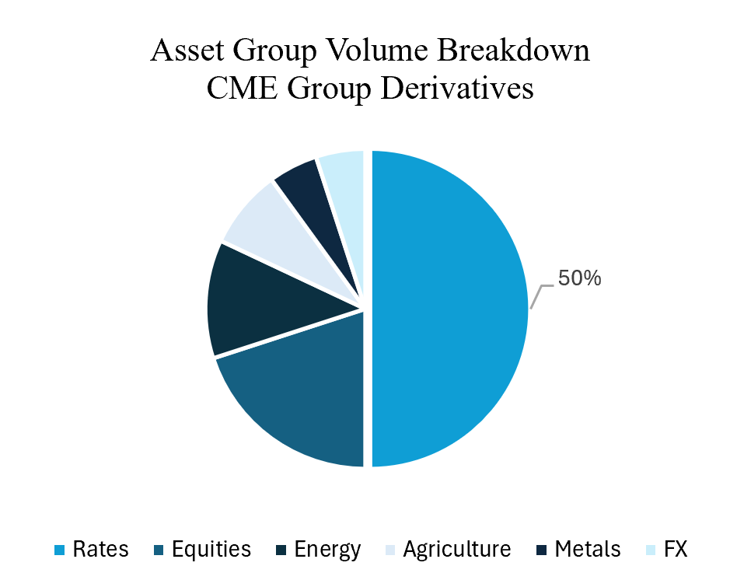
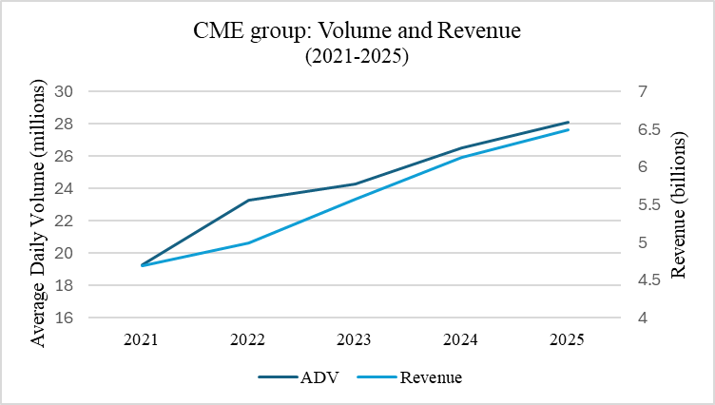
CME Group Analysis
CME Group is focused in Rates, unlike most other competitors: its dominance is unchallenged in its main asset class
Its diversified revenue streams, both in trading volumes and clearing and data services, allows its revenue to be consistently high regardless of global events, as it’s unlikely every sector is quiet
CME Group’s revenue is directly linked to daily trading volume, almost exactly proportionally
Notes:
Competitors. Weekness and Strength.
CAGR.

Slide 6
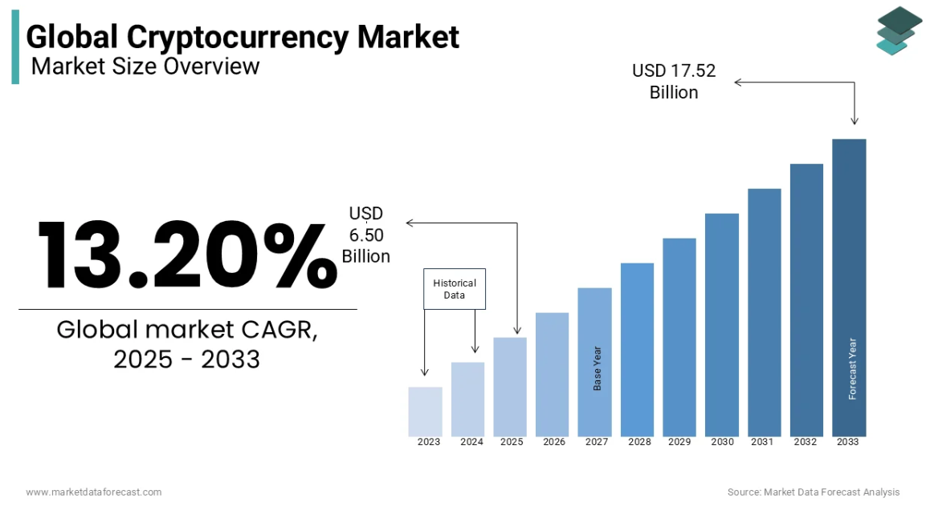
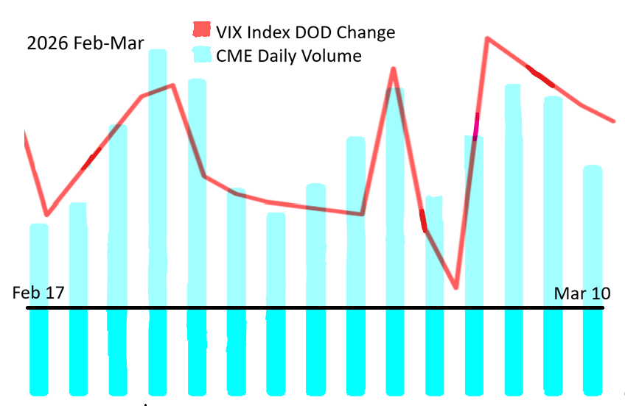
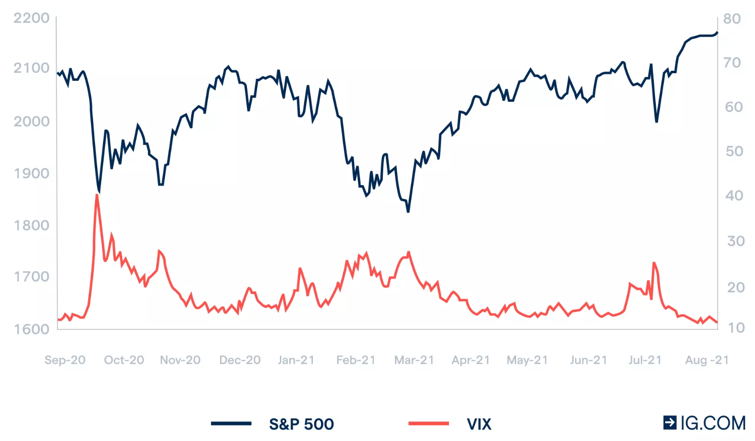
Macro Context and CME Group
Macro environmental drivers:
Fed rate uncertainty driving record interest rate futures volume; 2-3 more fed cuts in next 2 years
Geopolitical risk (Middle East, Russia-Ukraine, US-China trade) elevating commodity price volatility; commodities volume up 12% in 2025
Institutional crypto futures adoption accelerating
SEC/regulatory mandate pushing US Treasury clearing onto central clearinghouses; $900B daily market, CME directly positioned to capture this
Global market volatility structurally higher than pre-2022 era
CME daily volume follows almost exactly with the VIX: increased vol = increased volumes = increased revenue for CME
Notes:
Competitors. Weekness and Strength.
CAGR.

Slide 7
Catalysts and Growth Driver
Sustained macro volatility and aggressive expansion into the cryptocurrency and retail market drives the record-breaking volume growth
Catalysts that impact the long-term growth
Near term Catalysts
Long-term Growth Drivers
01
CME received SEC approval to launch a securities clearing house in 2026. This opens an entirely new revenue-earning section beyond derivatives.
Securities Clearing House
28.1M
Source of Variance
+92%
Record FY2025 ADV
+6% YoY
Highest-ever annual average daily volume of 28.1M contracts. Growth is broad-based across interest rates, equities, and commodities.
Crypto Derivatives ADV
Institutional adoption of crypto derivatives accelerated sharply, with crypto ADV reaching over $13B in daily notional value in Q4 2025.
CME launched round-the-clock crypto derivatives trading in early 2026 to align with digital asset market hours. Crypto ADV surged 92% YoY in Q4 2025 to over $13B in daily notional value.
02
24/7 Crypto Derivatives Trading
$803M
+18% / +6%
Market Data Revenue
+3.5%
In FY2025, CME experienced a 3.5% annual price increase and growing global demands from quant funds and banks. This represents ~12% of total revenue
Asia-pacific / EMEA ADV
International expansion reduces its dependence on the US macro conditions. Asia-Pacific ADV grew 18%, and EMEA grew 6% in Q4 2025. This reaches a combined 8.3M contracts daily.
03
CME partnered with Google Cloud to build a tokenized collateral platform. It enabled clients to use tokenized cash and non-cash assets as margins, lowering the capital requirements
Google Cloud Tokenization
Notes:
15 sec (Ben)
Growth Catalyst

Slide 8
Risks & Mitigation
CME Group has manageable risks – structural moats and diversified revenue streams substantially limit the downside.
Risks
Mitigant
Impact
Market Volatility Cyclicality
Transaction revenue is structurally tied to volatility. If traders hedge less, ADV declines.
Diversified across interest rates, equities, commodities, energy, and crypto. $803M in subscription-based market data revenue (12% of FY2025 total) is non-transactional, providing a stable floor regardless of trading volumes.
Medium
Cyclical drag offset by recurring revenue base and broad asset class mix.
Policy Shifts
US tariff and trade policy uncertainty clouds agricultural and energy commodity volumes.
Low
Regulatory relationships are structurally embedded; global diversification limits concentration.
Deep, embedded regulatory relationships. Global footprint across EMEA and Asia-Pacific limits single-jurisdiction exposure and provides a natural policy hedge.
Cloud Migration Risk
Multi-year cloud transition causes dual infrastructure costs, latency, and potential service disruptions.
Phased migration approach — core matching engines already migrated in earlier waves. Rigorous DR protocols, parallel-run testing, and contractual SLAs with Google substantially reduce systemic failure risk.
Medium
Execution risk real but well-managed; no client-impacting incidents to date.
DeFi Disintermediation
DeFi offers permissionless on-chain perpetuals. Causes potential risks if the institution shifts towards them
Cross-margining saves clients ~$120B+ annually in posted margin, creating very high switching costs. Regulated status is a hard requirement for most institutional investors globally.
Medium
DeFi risk is real for the crypto vertical, but the regulated moat remains very strong overall.
The risks are mostly industry-wide — CME Group's network effects and diversified revenue make it resilient.
Sources: Analysis
Notes:
20 sec (Michael)

Slide 9
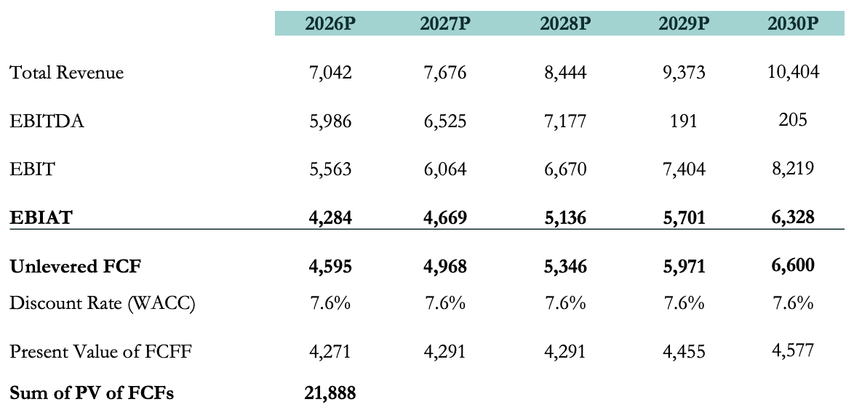
Intrinsic Valuation:
Discounted Cash Flow Analysis Summary
Implied Share Price
Terminal Growth Rate | 2.75%
Terminal Value | 139,971
Present Value of the Terminal Value | 97,067
Present Value of Free Cash Flow | 21,888
Enterprise Value | 118,955
(-) Net Debt | -995
Equity Value | 119,950
FDSO (mm) | 360
Implied Price per Share | 333.20
Weighted Average Cost of Capital
Market Cap (m) |  |  | 114,430
Risk Free Rate |  |  | 4.11%
Market Risk Premium |  |  | 6.00%
Beta |  |  | 0.6
Cost of Equity |  |  | 7.7%
Interest Expense |  |  | 173.4
Total Debt |  |  | 3422.3
Cost of Debt |  |  | 5.1%
WACC |  |  | 7.6%
Key Assumptions
Rev. Growth
EBITDA Margin
EBIT Margin
Revenue Growing at a CAGR of 8.0% over the N5Y
EBITDA Margin Growing at 85%
EBIT Margin Growing at 79%
Sources: Analysis
Notes:
20 sec (alan)

Slide 10
Intrinsic Valuation:
Sensitivity Analysis
Weighted Implied Share Price
WACC/Terminal Growth Rate | 2.50% | 2.75% | 3.50%
7.0% | 361.33 | 379.62 | 450.14
7.6% | 319.06 | 333.20 | 384.90
8.0% | 296.12 | 307.79 | 350.57
Bear Case
Base Case
Bull Case
WACC: 8.0%
Terminal Growth Rate: 2.50%
Share Price: $296.12
WACC: 7.6%
Terminal Growth Rate: 2.75%
Share Price: $333.20
WACC: 7.0%
Terminal Growth Rate: 3.50%
Share Price: $ 450.14
Sources: Analysis
Notes:
20 sec (alan)

Slide 11
Relative Valuation
Comps Analysis
Companies | Market Cap | Enterprise Value | TTM EBITDA | Price/Earnings | EV/EBITDA
Intercontinental Exchange (NYSE: ICE) | 94.15B | 110.82B | 6,709 | 28.73 | 16.52x
Nasdaq (NASDAQ: NDAQ) | 50.05B | 56.16B | 3,131 | 28.50 | 17.94x
Cboe Global Markets (BATS: CBOE) | 31.32B | 30.65B | 1,741 | 28.71 | 17.60x
London Stock Exchange Group (LON: LSEG) | 58.50B | 68.79B | 6,085 | 36.55 | 11.30x
Deutsche Borse (ETR: DB1) | 51.59B | 58.82B | 4,055 | 22.23 | 14.50x
Mean | 57.12B | 65.05B | 4,344 | 28.94 | 15.57x
Median | 51.59B | 58.82B | 4,055 | 28.71 | 16.52x
CME Group (NASDAQ: CME) | 114.43B | 113.31B | 5,834 | 28.59 | 19.42x
CME trades at 19.4x EV/EBITDA, a ~17% premium to the peer median (16.5x).
Premium reflects market leadership in derivatives, high operating margins, and resilient transaction-driven revenue model.
100 GBP = 134.31 USD
100 EUR = 116.18 USD
Notes:
20 sec (alan)

Slide 12
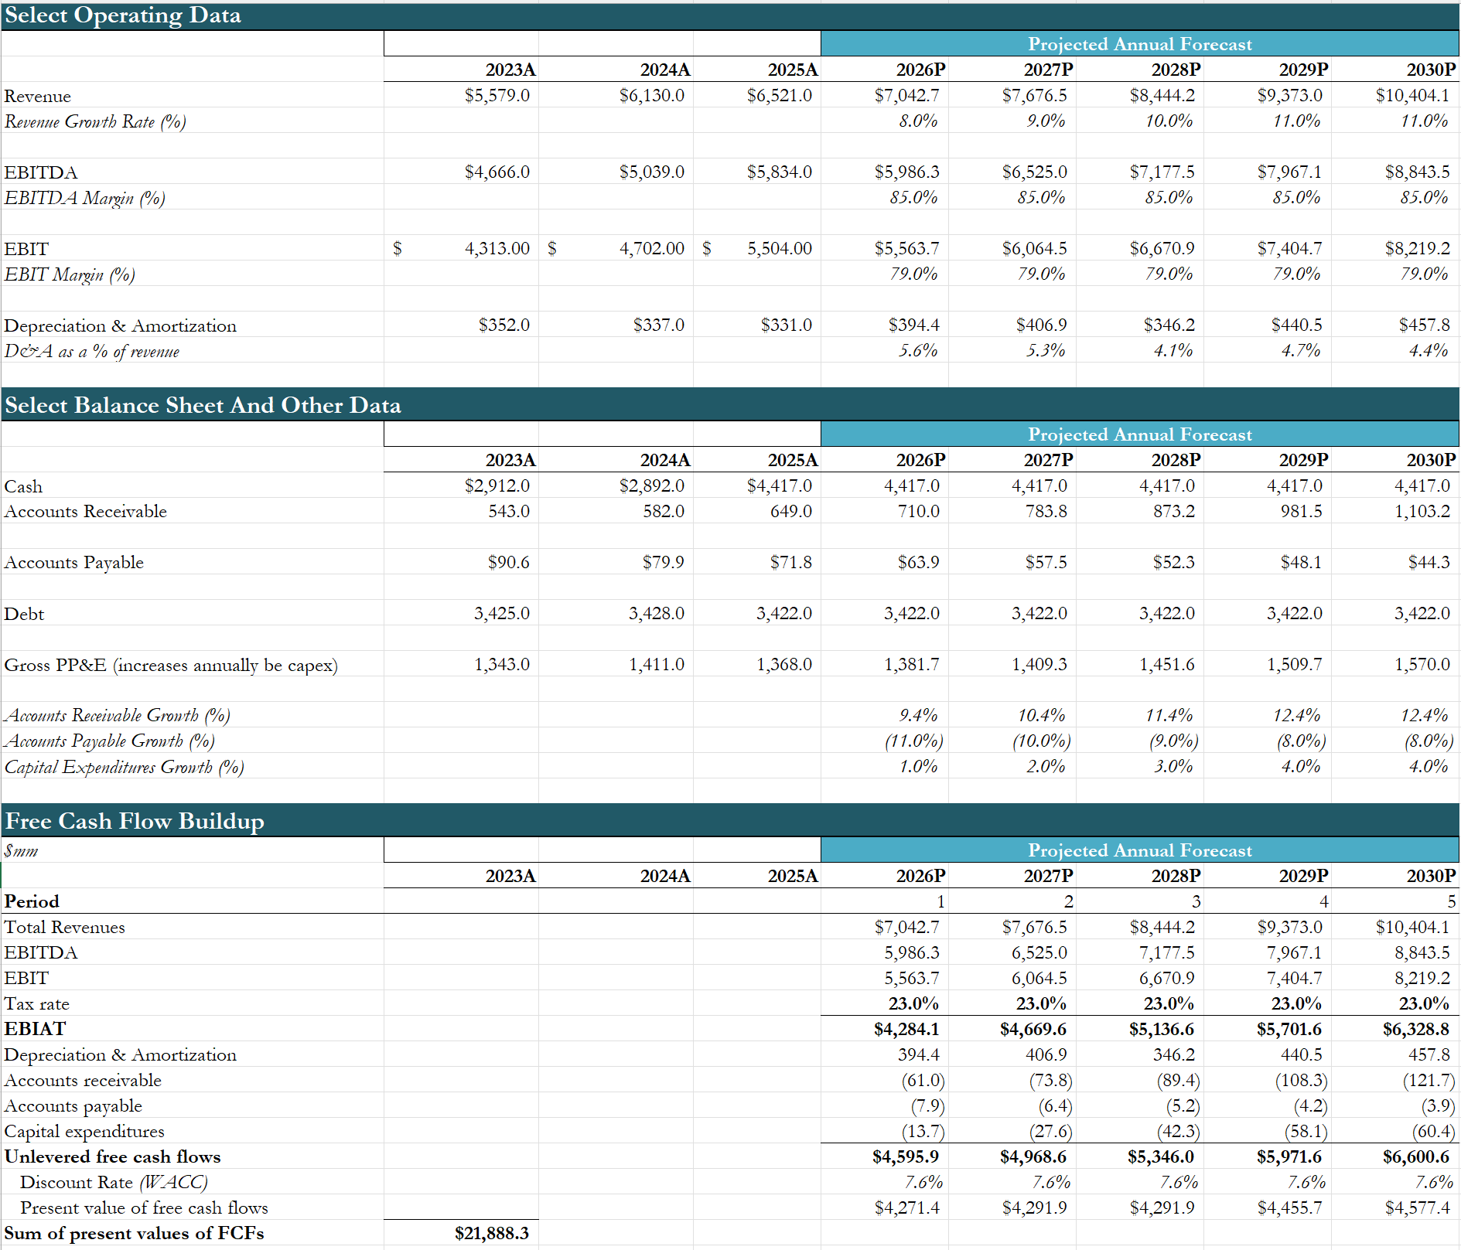
DCF (I of II)

Slide 13
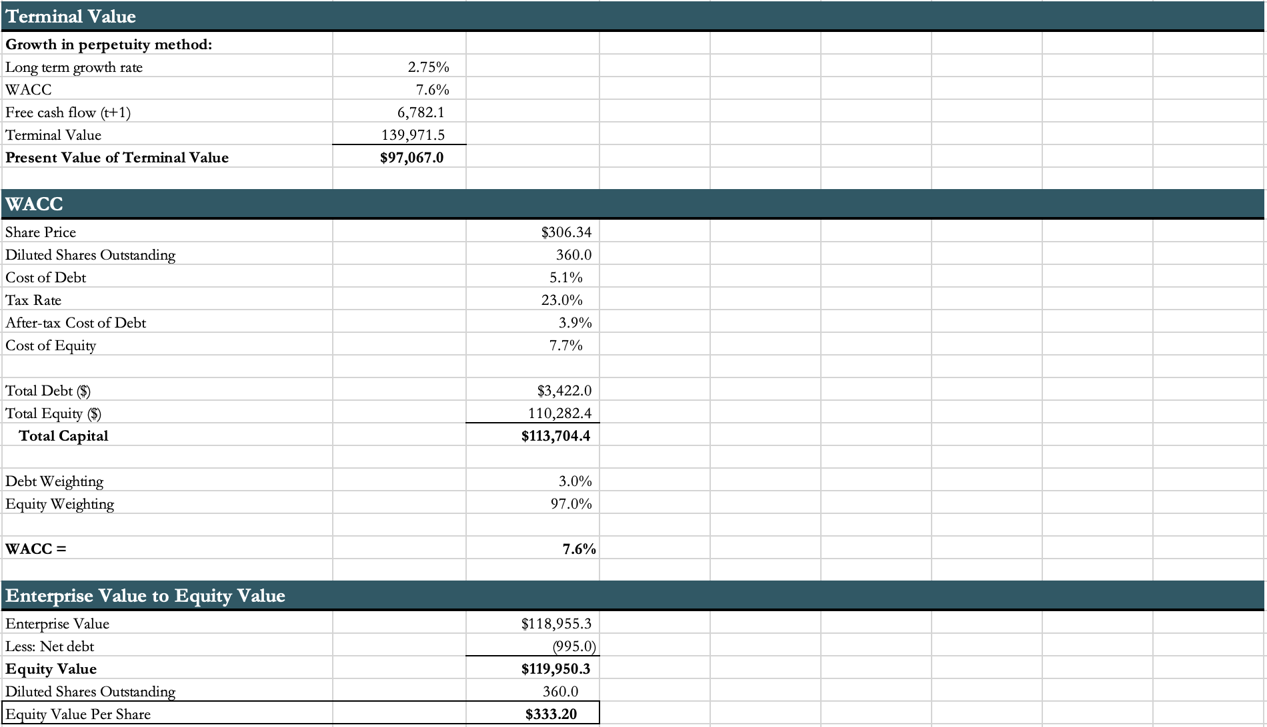
DCF (II of II)

