Slide 1
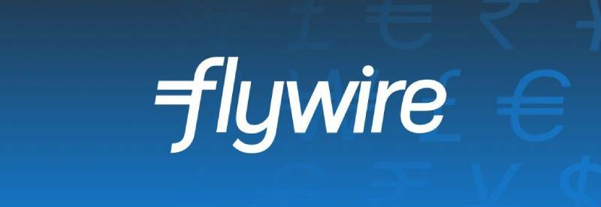
Flywire Corp. (NASDAQ: FLYW)
Sector: FinTech – Global Payments & Financial Software
Julia Miao, Susan Ho, Ester Wang

Slide 2




Team Introduction
Julia Miao
FARM 1A
Susan Ho
FARM 1A
Ester Wang
FARM 1A

Slide 3
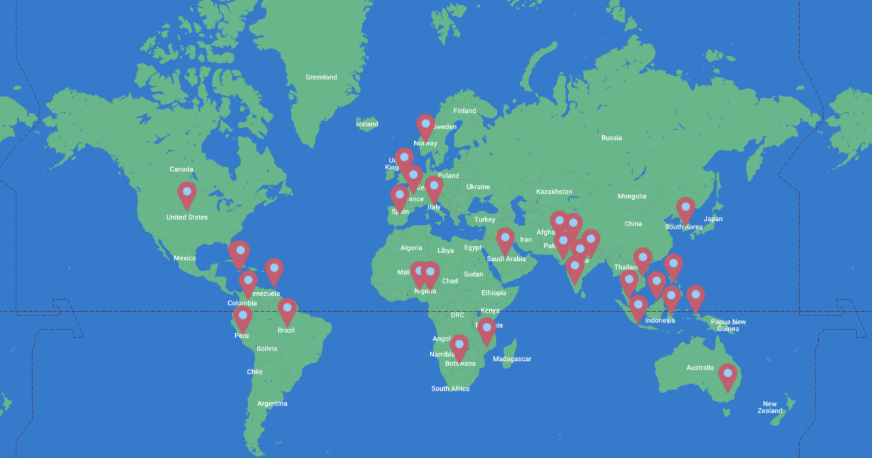
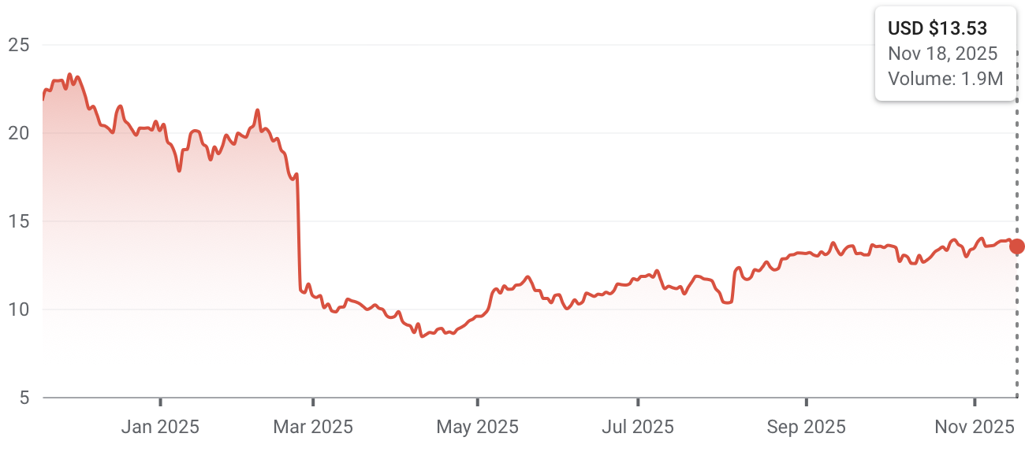
Company Overview & Investment Thesis
Founded in 2011, Flywire is a Boston-based payments platform known for enabling secure, localized tuition payments for universities worldwide.
Investment Thesis Summary
Geographic Presence
Flywire is a vertical payments and software platform with durable growth drivers and a competitive moat. Benefiting from structurally rising cross-border payments demand, especially in higher education, and at the same time expanding into healthcare, travel and B2B to diversify revenue streams. Flywire’s “payments + software” model creates high switching costs and strong client retention. With improving operating leverage, accelerating SaaS growth, and potential for margin expansion, Flywire offers an attractive risk-reward profile for long-term investors.
Stock Chart

Slide 4
Macro Context
Higher interest and inflation tightens global business budgets
Automation = efficiency = lower costs
Non-discretionary spending less affected by recessionary outlook
Regulatory pressure increasing in cybersecurity (AML/KYC)
Raises entry barriers & increases strength of Flywire's moat
7M, projected 10M international students
$60B medical cross-border tourism
FX volatility managed through hedging

Slide 5
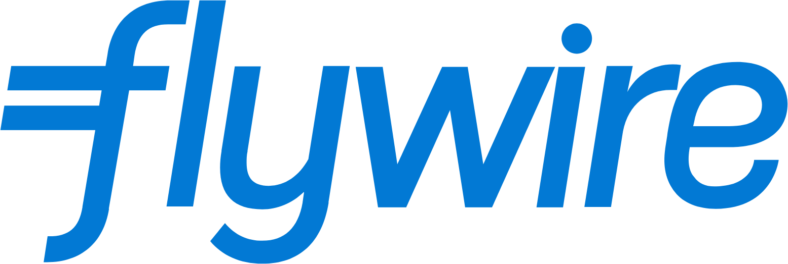



Competitive Landscape
Digitization of global B2B payments market
$150 Trillion+
Vertical specialists are rewarded by regulatory tailwinds
Market Cap: $1.65B
Full stack: software + payments
Domain expertise, international integration
Valuation: $91.5B
Horizontal payment systems
Focused on retail level transactions
Valuation: $1.1B
Software focused
No proprietary global payment network
Valuation: $602M
Education vertical only
Small network, limited global reach

Slide 6
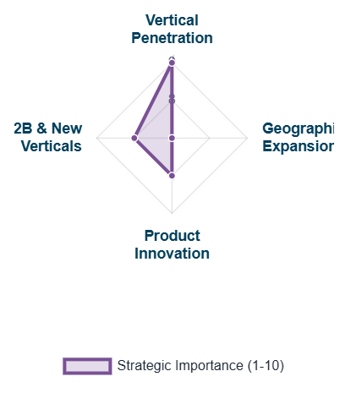
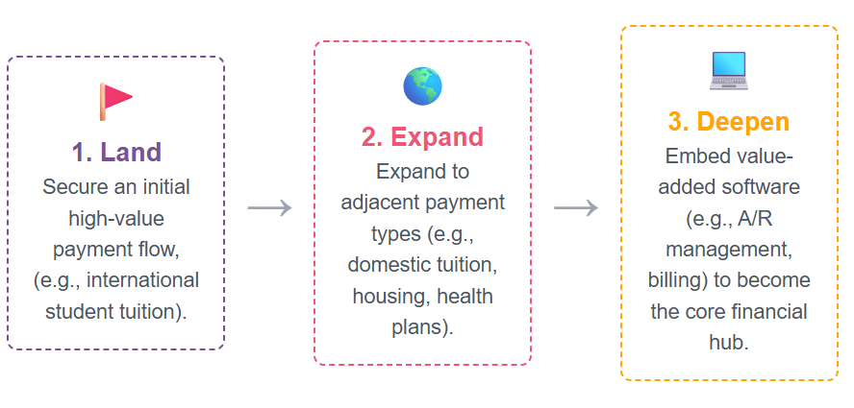
Catalysts and Growth Drivers
Accelerated Client Wins
Operating Leverage & Margin Expansion
Strategic Partnership Integration
Near-Term Catalysts (12-18 Months)
Long-Term Growth Drivers (3-5+ Years)

Slide 7
Key Risks & Mitigants
Risks
Mitigants
Flywire operates in 240+ countries and 140+ currencies, thus facing FX volatility and compliance regulations. FX swings may create recurring margin pressure.
Flywire reduces FX risk through localized settlement rails, hedging programs, and reporting FX-neutral metrics, the global compliance teams also help to manage regulatory complexity.
Flywire derives over 50% of revenue from higher education, which is related to international student enrollment. Visa caps can directly reduce tuition payment volume.
Flywire is diversifying into healthcare, travel and B2B to help reduce reliance on international student volumes.
Sertifi expands Flywire’s travel vertical but carries integration risk, with over 70% of M&A failing to meet synergy goals, which may delay the expected SaaS revenue growth.
Flywire adopts an integration playbook from previous successful acquisitions and targets acquisitions that can expand high-margin SaaS revenue.

Slide 8
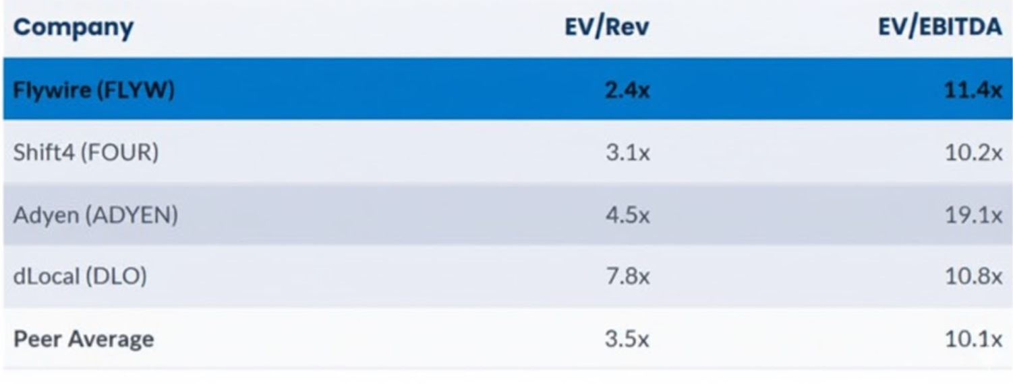
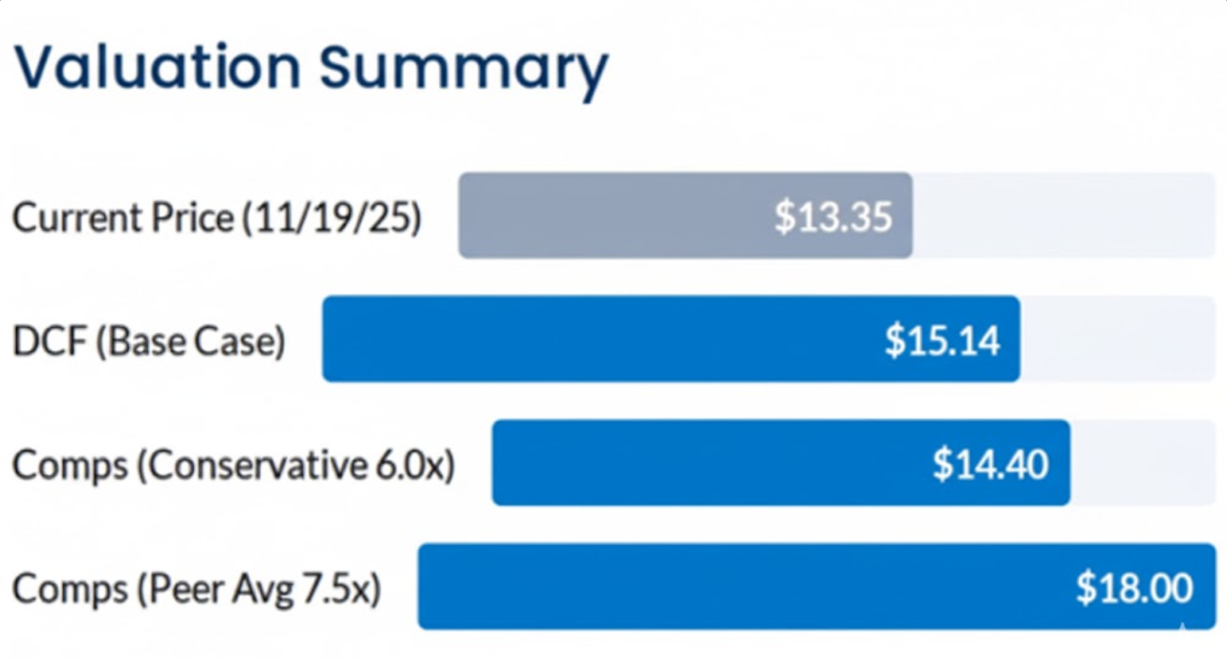
Valuation: A Significant Dislocation
Comparable Companies Analysis
Discounted Cash Flow
10-Yr Revenue CAGR: ~14.5% (Tapers from high 20s in near term)
Terminal Adj. EBITDA Margin: ~25.0% (Conservative expansion from current low double digits)
WACC (Cost of Capital): 10.5%
Terminal EV/EBITDA Multiple: 14.0x
Flywire currently trades at an EV/Revenue multiple of 2.4x, which is a ~31% discount compared to its Peer Average of 3.5x.
Market Mispricing: The market is failing to price in the rapid margin expansion expected in 2026-2027.

Slide 9
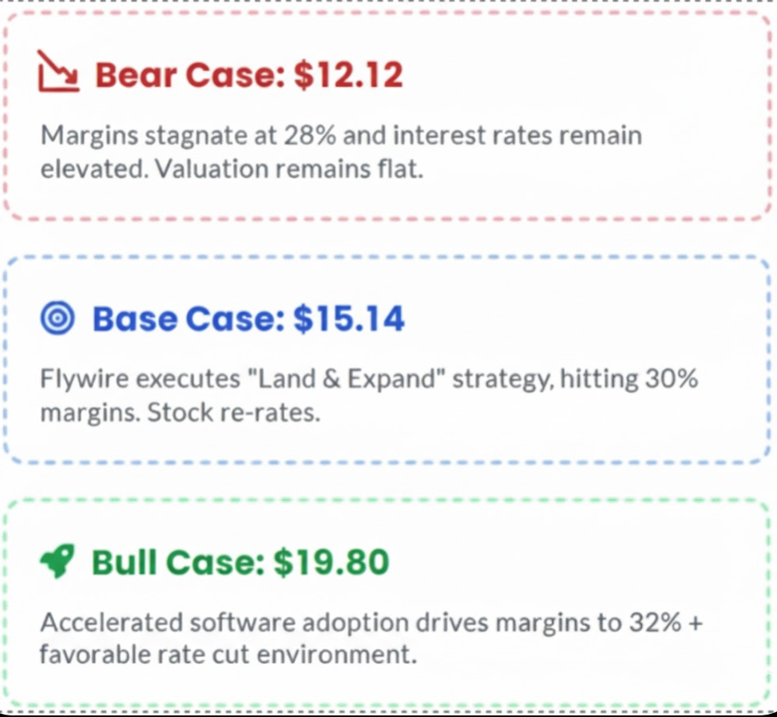
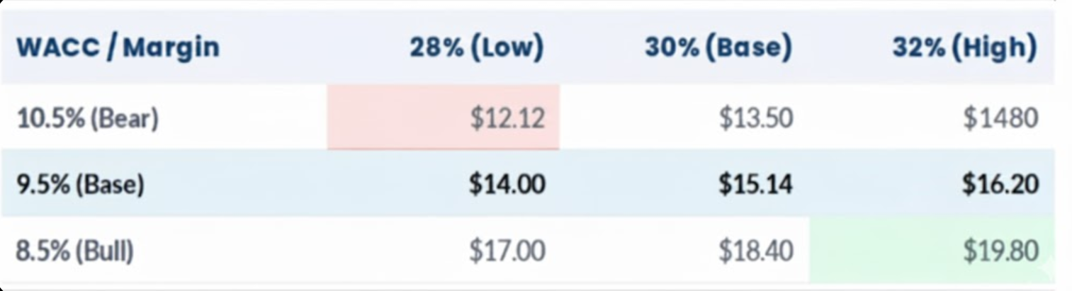
Financial Analysis: Scenarios & Sensitivity
DCF sensitivity Analysis (Implied Price)
Scenarios Analysis
We tested our $13.35 base case against the two most important assumptions: WACC and Terminal Margin.
Resilient Model: Even in a pessimistic scenario (11.5% WACC), the DCF model implies a value of $10.95, which is ~18% below the current stock price of $13.35. This suggests the market is currently pricing in performance that is slightly better than the DCF Bear Case

Slide 10
BUY
Our recommendation: based on macro environment factors, valuation asymmetry, and growth potential in Flywire's landscape

Slide 11
References
https://www.flywire.cc/news/flywire-reports-third-quarter-2025-financial-results
https://stripe.com/en-ca/newsroom/news/stripe-2024-update
https://www.flywire.com/industries/education/solution/payment-plans
https://www.flywire.com/news/flywire-showcases-leadership-in-u-s-higher-education-sector-at-its-second-annual-client-conference
https://ir.flywire.com/news-releases/news-release-details/flywire-announce-third-quarter-2025-results-november-4-2025
https://www.flywire.com/news/flywire-reports-second-quarter-2025-financial-results
https://www.nasdaq.com/press-release/cash-rich-ultra-luxury-travelers-boost-spend-seek-wellness-2025-flywire-survey
https://www.flywire.com/industries/education
https://www.flywire.com/news/flywire-deepens-collaboration-with-ellucian-to-deploy-software-and-payment-solutions-to-banner-through-integrations-via-ellucian-ethos
https://www.datainsightsmarket.com/companies/FLYW
https://coinlaw.io/stripe-statistics/
https://pitchbook.com/profiles/company/10722-43#comparisons
https://www.blackstone.com/news/press/higher-education-technology-company-ellucian-to-be-acquired-by-blackstone-and-vista-equity-partners/
https://www.nelnetinvestors.com/financial-information/annual-reports/default.aspx

