Slide 1
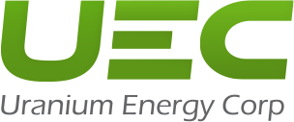
Uranium Energy Corp
NYSE: UEC
Current Share Price: $16.12
2 Year PT: $26.5 | Implied Upside: 12.6% | IRR: 32.7%
20-30-75
211-160-1
115-163-72
179-157-105
SHES CAPITAL
Emily Yan, Hanna Wang, Sherry Zhang, Susan Ho
February 7th, 2026
Notes:
10 sec (Alan)

Slide 2
Disclaimer
The analyses and conclusions of the SHES Capital contained in this presentation are based on publicly available information. SHES Capital recognizes that there may be confidential information in the possession of the companies discussed in the presentation that could lead these companies to disagree with SHES Capital's conclusions. This presentation and the information contained herein are not a recommendation or solicitation to buy or sell any securities.
The Analyses provided may include certain statements, estimates, and projections prepared with respect to, among other things, the historical and anticipated operating performance of the companies, access to Capital markets and the values of assets and liabilities. Such statements, estimates, and projections reflect various assumptions by SHES Capital concerning anticipated results that are inherently subject to significant economic, competitive, and other uncertainties and contingencies and have been included solely for illustrative purposes. No representations, express or implied, are made as to the accuracy or completeness of such statements, estimates or projections or with respect to any other materials herein. Actual results may vary materially from the estimates and projected results contained herein.
The sole responsibility for the content of this publication lies with the authors. Its contents do not reflect the opinion of the presenting students respective educational institution. We assume no responsibility or liability for any error, inaccuracy, omission or comment contained in this publication or for any use that may be made of such information by the reader.
All figures reported in $USD.
ICLR presents an attractive risk/reward opportunity given it’s currently trading at 8x LTM EV/EBITDA
Sources: Analysis
Notes:
30 sec (Kabir)

Slide 3
I.
I.
Executive Overview
Executive Overview
Notes:
3 sec (Kabir)

Slide 4
Executive Overview
Purchase a great business in a growing industry for a fair price
Why This Opportunity Exists:
UEC is the fastest-growing North American producer with the largest federally licensed capacity, but its aggressive counter-cyclical acquisitions (such as Sweetwater) and refusal to sign minimum-price contracts have led to a decline in market risk perception.
UEC's valuation multiples are compressed because stagnant short-term spot prices obscure the strategic value of its assets:
  Unhedged: The market penalizes UEC for its lack of long-term contracts, failing to recognize that this 100% unhedged structure is a scarce feature that provides asymmetric leverage against spot price squeezes compared to capped peers.
  Inventory and dilution: Investors ignore the strategic utility of UEC's approximately $698 million current balance sheet (inventory/cash), viewing it as a trading book rather than a non-dilutive bridge that can help the company finance mine restarts without harming shareholder value.
Investors are myopically focused on daily spot price fluctuations, ignoring the "floor-and-ceiling" contract limits of major peers that cap their upside, while UEC remains the only large player with 100% unhedged exposure to the inevitable price breakout.
What Investors are Missing:
Strategic Independence & Unhedged Beta: In a structural supply deficit, fixed-price contracts are a liability that caps upside. UEC is the only U.S. major with 100% unhedged exposure, meaning every $1 rise in spot price flows directly to the bottom line, perfectly aligned with U.S. energy security initiatives to ban Russian uranium.
Bypassing the need for massive mill construction: Using the In-Situ Recovery (ISR) model, UEC feeds satellite deposits into existing, fully permitted central plants.
Non-dilutive funding bridge: UEC’s ~1.4M lb physical uranium inventory allows it to sell inventory at a profit to fund the Burke Hollow/Christensen Ranch restarts without tapping the equity markets.
ICLR presents an attractive risk/reward opportunity given it’s currently trading at 8x LTM EV/EBITDA
Sources: Analysis
Notes:
Opportunity : news + financial reports, triends. Summary of what's coming up next.
Missing: Our thoughts. Why do we believe it's a good stock to invest in.

Slide 5
I.
Business Overview
Notes:
3 sec (Michael)

Slide 6





Business Overview
Uranium Energy Corp is a leading U.S. mining company that develops low-cost ISR projects and supplies nuclear fuel for clean energy sectors.
Business Description
UEC is a U.S.-focused uranium mining company advancing a secure, domestic uranium supply to support clean energy and energy security.
Operates a low-cost, environmentally responsible In-Situ Recovery (ISR) model, enabling scalable production with reduced capital intensity and operational risks.
UEC holds a diversified portfolio of fully permitted projects across Texas and Wyoming, supported by Irigaray Central Processing Plant (CPP), one of the largest uranium processing facilities in the United States.
Establishing UEC as the only vertically integrated uranium company in the U.S., combining mining and processing with future refining and conversion.
Key Financials
Historical Financials
Ticker | NASDAQ: UEC
Share Price | $18.62
Total Enterprise Value | $9.15B
Market Capitalization | $9.60B
Management
Segmentation Breakdown
Amir Adnani, CEO & Founder
Orchestrated numerous acquisitions.
Customer Revenue Concentration
Geographical Footprint
Operations in 82 Facilities and 29 Countries
Scott Melbye, Executive VP
Industry veteran & lobbyist.
Sources: Capital IQ, Company Filings
Notes:
Pull data. Link excel. Share the excel file with others

Slide 7
Market Solutions
Global CRO delivering full range of both operational and service-oriented support to satisfy all client needs
Service/Operations
Production Models
Hub-and-Spoke ISR Platform
Conventional Production
Physical Inventory Program
Operating Hubs
Operations
South Texas Hub (Hobson)
Wyoming Hub (Irigaray)
Athabasca Basin (Roughrider)
U.S. Hardrock (Sweetwater)
Processing and Infrastructure
Resource Development and Exploration Pipeline
Strategic Supply Solutions
Commercial and Trading Models
100% Unhedged Exposure
Long-Term Contract & Spot Sale
Data-Driven Investor Relations
Services
Development and Sustainability Solutions
Low-Carbon ISR Profile
U.S. Strategic Uranium Reserve (DOE)
Satellite-to-Hub Strategy
Global Supply Chain & Logistics
UEC ensures America’s energy independence through scalable, hub-and-spoke operations and a hedging-free business strategy.
Sources: Company Filings
Notes:
Business overview – Revenue breakdown

Slide 8
II.
Industry Overview & Setup
Notes:
3 sec (Michael)

Slide 9






Competition in the Industry
Despite other competitors, UEC remains in the Uranium mining market due to their current low-cost ISR technology in producing the uranium and maintaining strong balance sheet
0.0 % CAGR
0.0% CAGR
166.4% CAGR
1627.3% CAGR
Consolidated UEC Domestic Market
UEC focuses on domestic U.S. production aligns with government initiatives to secure supply chains, particularly by reducing reliance on foreign sources.
Globally: Competitive Environment
UEC is a fully licensed in-situ recovery uranium producer, utilizing low-cost ISR technology and hub-and-spoke model to capitalize rising global demand.
Demand in Uranium from AI industry and the US govenrment
UEC is ranked in the top 5th percentile when assessed on it sustainability practices against global diversified metals and mining companies.
Active in mining, and development
Pre-production, permitting, and developing ISR projects
Competitive Landscape
Large Scale
As of early 2026, UEC has a strong, debt-free balance sheets with over $200 million in cash.
Position as the only vertically integrated company in America from mining to conversion.
Low Integration
Vertically Integrated
Low Scale
Large, Low-Cost Uranium
Producers Gain Share
Notes:
Competitors. Weekness and Strength.
CAGR.

Slide 10

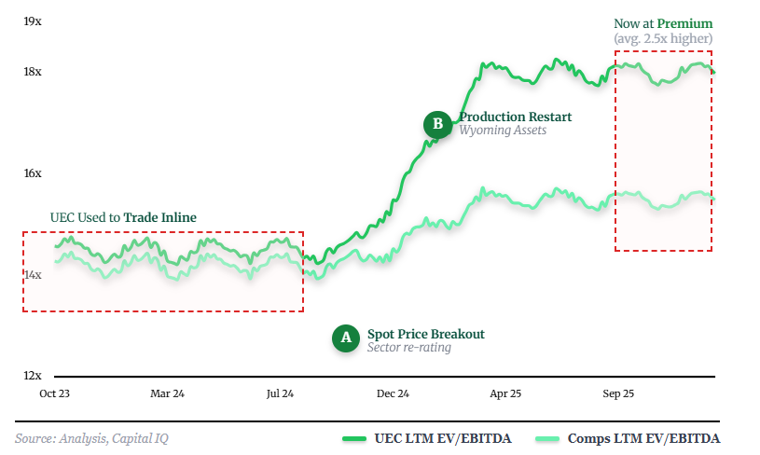

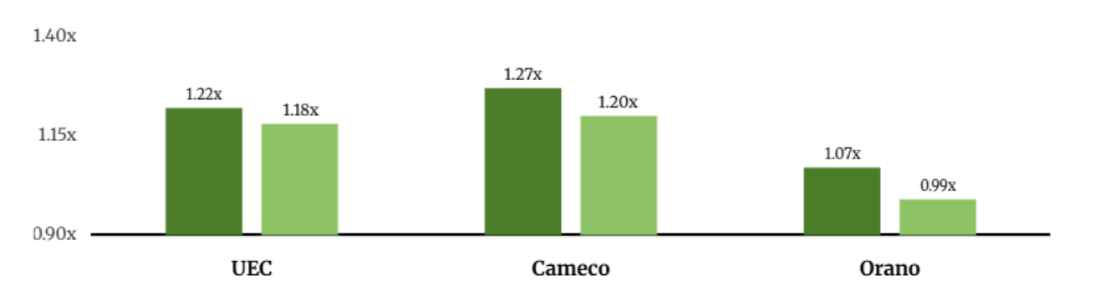
Thesis Setup: The American First Strategy Premium
The market treats UEC as a standard junior miner basket case, correlating it with speculative explorers rather than valuing its strategic infrastructure.
UEC’s EV/EBITDA has expanded ~40% and now trades on average ~2.5x higher than peers
Street Believes UEC is Structurally Inferior...
...But Street Misreads Headwinds as Structural Issues
Lack of Long-term Contracts
1
2
Aggressive ramp-up and overconfidence
1
The Prohibiting Russian Uranium Imports Act forces an immediate pivot to domestic sources, creating a structural vacuum that UEC is positioned to fill.
3
Capex blowout and labor cost due to inflation
2
With new mill permitting taking 7-10 years, UEC’s existing infrastructure grants it an insurmountable speed-to-market advantage.
Street fails to recognize that ICON’s setbacks are temporary hard-hitting headwinds rather than competitive disadvantages meaning
ICON Deserves to Trade In line with Peers
Sources: Analysis, Company Filings, Equity Research, S&P Capital IQ
Notes:
Thesis of the pitch

Slide 11
III.
Investment Thesis
Notes:
3 sec

Slide 12
Thesis I: Lack of Long-term Contracts
UEC's unhedged approach enable them to sell their uranium on the spot market rather than relying on traditional long-term, fixed-price contracts
Structural Realization of Sector Wide Tailwinds Push Stock Decline
1
UEC controls ~12.1M lbs./yrs of fully permitted capacity. Since it's already permitted, UEC does not need to sign low-price
1
2
2
Spot prices are around $85/lbs. while traditional contracts typically pay only $50-$60/lbs. UEC's unhedged capacity allows it to sell 100% of its output at a premium to the spot price
3
3
Most of CCO's orders are already under long-term contracts. Its large production volume is limited by early price agreements, limits its bargaining power in the bull market
Street View vs. Our View
Alternative Data Proves Competitiveness
UEC is a "high risk" asset because it lacks a guaranteed income floor from long-term contracts, making its cash flow highly vulnerable to declines in spot prices.
Street
Hub-and-Spoke Dominance
The unhedged strategy of UEC transforms it from a utility investment into a massive call option hedging uranium prices, with leverage 2-3 times that of similar hedging products.
Permitted Speed-to-Market
Our View
Sources: Analysis, Capital IQ, Company Filings, IBIS World
Notes:
60 sec (Kabir)

Slide 13
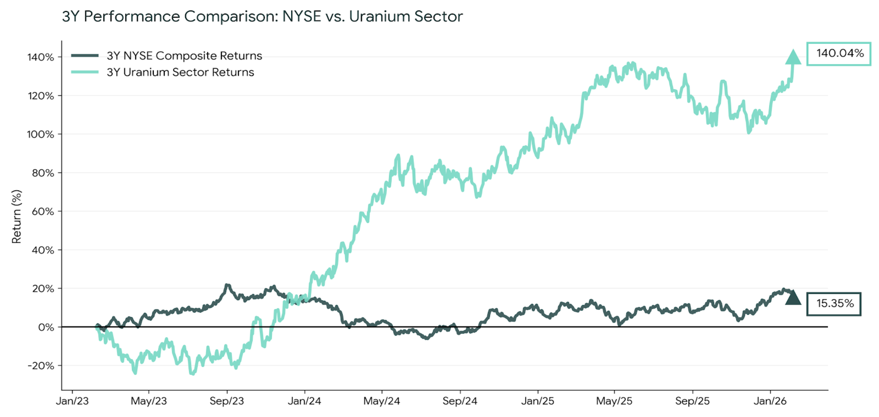
Thesis I: Lack of Long-term Contracts
After years of underperformance, the uranium sector reached at a major inflection point, impacting the spot price of uranium to move up
Why Softer Uranium Returns?
140.04%
1
Investors see less stable revenue and predictable margins
Projects have experienced delays
causing investor concern
2
15.35%
3
Myopic focus on AI diverting attention away from the sector
… but we have reasons for optimism that the sector is at a broader inflection point
What is Happening?
Uranium Market Sentiment
Source of Diversification
Impact
Utility contracting is delayed and more uranium demand is not met for future years
Less bargaining power for UEC because they have less stable "term contract book" than peers, making earnings more volatile
Uranium producers behave like growth companies, which value is driven by future production and future pricing.
Uranium equities are highly sensitive to market patience and trade on sentiment rather than fundamentals.
Sense of interest in uranium from broader investor base, primarily
provides exposure to a highly
inelastic commodity
BlackRock Investor Report
in uranium divestiture
Market may apply a valuation discount due to weaker earnings visibility and contracting uncertainty in the present.
17.9B
Catalysts
A
Earnings Beat in Revenue
B
Broader Healthcare Market Performance
Sources: Analysis, BCG, Blackrock, Bloomberg, Capital IQ, Company Filings, Precedence Research, Quatr Pro
Notes:
60 sec (Kabir)

Slide 14
Thesis II: Aggressive Ramp-Up and Overconfidence
Despite uneven revenue ramp, strong margins when producing indicate strong underlying economics.
Revenue Growth with Margin Inconsistency
Street View vs. Our View
UEC's aggressive expansion and vertical integration push into conversion appears overambitious given the limited production history and execution risks.
Street
While we recognize simultaneous ramp-up challenges, UEC's position as largest US producer with strong government support, zero debt, and $698M cash should enable successful execution into 2026/2027.
Our View
Government Policy Shift
Execution Concerns Optical, Not Structural
Federal Support
Amir Adnani, UEC President and CEO (May 2025)
FY24 Gross Profit = $0.04M
+611X
Margin expansion validates profitable scalability
FAST-41 Permitting
FY25 Gross Profit = $24.48M
FAST-41 made management accelerate Sweetwater and ramp Wyoming, underestimating required execution bandwidth.
"UEC is ready to support this transformation with secure, reliable, and 100% domestic uranium supply to power the future.”
FY24 Gross Profit Margin = 16.5%
+121.8%
FY25 Gross Profit Margin = 36.6%
Defense Production Act
Q2 2025
Revenue Ramp
First
Positive EBITDA since Q1 25
Policy-driven 4x demand expansion and DPA emboldened UEC to aggressively pursue multi-facility ramp and vertical integration.
Argument About Unproven Scalability
UEC’s 29,738% YoY revenue growth from Wyoming restart (199K lbs through Oct 2025) with 37% gross margins shows ISR viability, but limited track record at 12.1M lb scale.
191%
Catalysts
A
Uranium Price Surge
B
Government Regulatory Support
Sources: Analysis, Bloomberg, Capital IQ, Company Filings, Equity Research, Quatr Pro
Notes:
60 sec (Kabir)

Slide 15
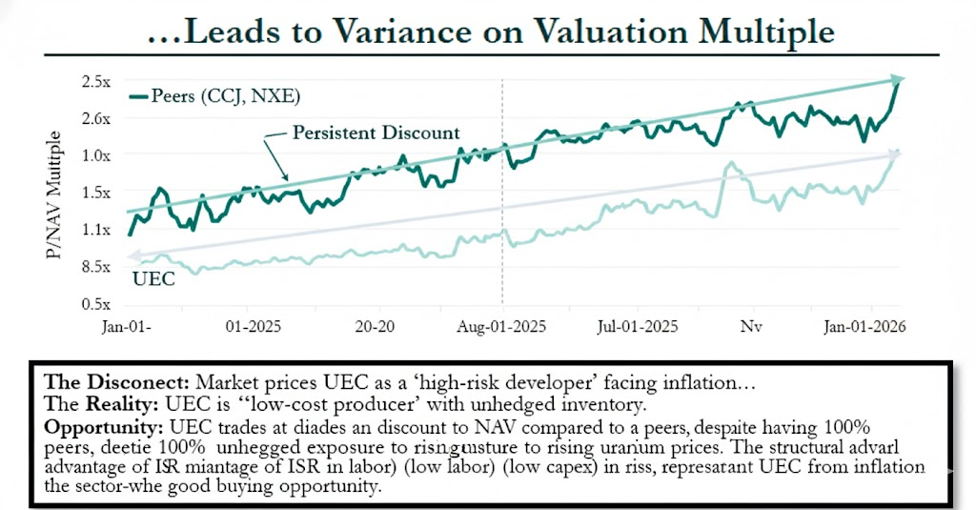
Thesis III: Capex Blowout and Labor Cost Due to Inflation
Street is concerning that UEC is facing capex and labor cost like other Uranium companies
The Street's concerns versus UEC's actual operations
More on UEC's Strategies
Short Sellers See
UEC’s Operations
ISR (In-Situ Recovery) mining helps avoiding massive earth-moving fleets and heavy labor. Headcount is a fraction of conventional mines.
Sector-Wide Inflation
ISR avoids massive earth-moving fleets
UEC utilizes Hub-and-Spoke strategy with 3 central plants (Irigaray, Hobson, Sweetwater) already built, avoiding hundreds of millions in new Capex.
"Unprofitable" Resources
vs
3 Central plants are already built
Recent restart achieved Cash Cost of ~$30/lb, confirming high margins against ~$80/lb spot price.
Restart with expensive infrastructure.
High margin despite restarting cost
Sentiment & Credibility Overhang
Undamaged Margin & Leverage
UEC already holds fully permitted capacity of 4M lbs/yr in Texas and Wyoming, expediting future permitting and insulating them from regulatory limbo.
Recent Operational Updates Remove Overhang
The fiscal 2025/2026 filings confirms that the "Blowout" has not materialized:
Cash Cost
~$29.90 – $36.41 per pound (vs. Spot Price ~$80.00/lb).
Capex
Restart costs were minimal "refurbishment" rather than greenfield construction.
Balance Sheet
~$321M in liquid assets, Zero Debt.
The Securities class-action lawsuit carries no material risk for the business while discounting by 2.4x turns of EBITDA, this represents a good buying opportunity
Sources: Analysis, Company Filings, The Roseen Law Firm, , Reuters
Notes:
60 sec (Ben)

Slide 16
IV.
Valuation
Notes:
3 sec (Alan)
Quant

Slide 17
Intrinsic Valuation
Discounted Cash Flow Analysis
Income Statement |  |  |  |  | 2020A | 2021A | 2022A | 2023A | 2024A | 2025A | 2026E | 2027E | 2028E | 2029E | 2030E
Revenue |  |  |  |  | 0 | 0 | 231 | 164 | 0.224 | 66 | 198 | 1172 | 911 | 1172 | 1435
Expenses
G&A​ |  |  |  |  | 9 | 12 | 15 | 20 | 21 | 27 | 31 | 33 | 36 | 39 | 45
D&AD​ |  |  |  |  | 0.31 | 0.393 | 1.38 | 2 | 2.18 | 4.47 | 8.5 | 15 | 30 | 53 | 45
Mineral Property Expenditure |  |  |  |  | 0 | 4 | 10 | 19 | 32 | 66 | 50 | 84 | 152 | 227 | 246
Operating Expenses |  |  |  |  | 0 | 17 | 3 | 40 | 56 | 98 | 89 | 133 | 218 | 319 | 375
EBIT​DA |  |  |  |  | -14 | -15 | 5 | -3 | -29 | -88 | 108 | 409 | 693 | 853 | 1060
 |  |  | 2026E | 2027E | 2028E | 2029E | 2030E
EBIT |  |  | 100 | 394 | 663 | 800 | 975
(-) Cash Taxes |  |  | 2 | 3 | 17 | 21 | 39
NOPAT |  |  | 98 | 391 | 646 | 779 | 844
(+) D&A |  |  | 8 | 15 | 30 | 53 | 85
EBITDA |  |  | 106 | 406 | 676 | 832 | 929
(-) Capex |  |  | 8 | 21 | 36 | 47 | 57
(+) Changes in NWC |  |  | 22 | 54 | 91 | 41 | 36
Unlevered FCF |  |  | 120 | 443 | 731 | 828 | 1002
Present Value of FCFF |  |  | 110 | 378 | 576 | 603 | 673
Sources: Analysis
Notes:
20 sec (Alan)

Slide 18
Intrinsic Valuation:
Discounted Cash Flow Analysis Cont’d
Implied Share Price
Present Value of the Terminal Value | 12021
Present Value of Free Cash Flow
Enterprise Value | 6332
(+) Cash | 1438
(-) Debt | 0
Equity Value | 7771
# of Shares Outstanding | 474200
Implied Price per Share | 16.39
Weighted Implied Share Price
 | Share Price | Weight
Bear | 11.50 | 20%
Base | 16.39 | 60%
Bull | 22.00 | 20%
Average Weighted Share Price |  | 16.53
Decision
We see UEC as a compelling long with upside across bear, base, and bull cases, implying a 15%-18% 2-year IRR. Our base-case valuation supports a 16.50 price target, offering 30-40% upside, with additional upside potential under a higher uranium price.
Weighted Average Cost of Capital
Market Cap (B) |  |  | 7.79
Cost of Equity
Risk Free Rate |  |  | 4.21%
Market Risk Premium |  |  | 8.35%
Beta |  |  | 1.4
Cost of Equity |  |  | 10.0%
Debt |  |  | 0
Cost of Debt
Interest Rate |  |  | 2.1%
Tax Rate |  |  | 3.4%
Cost of Debt |  |  | 0%
WACC |  |  | 8.25%
We have high conviction that UEC will meet base-case expectations and outperform, with downside risk limited by conservative market assumptions around uranium prices and execution risk that already reflected in the current share price.
Key Assumptions We Believe In
Rev. Growth
Margin Expansion
Multiple Rerate
Revenue Growing at a CAGR of 9.4% over the N5Y
GM and EBITDA normalize to pre-FSP levels as production reaches steady state
EV/EBITDA Returns to
Industry Avg.
Sources: Analysis
Notes:
20 sec (alan)

Slide 19
V.
Catalysts & Risks
Notes:
3 sec (Ben)

Slide 20
Variant View & Catalysts
Rational behind our differentiated view and the key catalyzed causing future price correctionsv
Our View vs. Street View - Holding Q1 26 to Q1 28
Catalysts
Street
View
Our
View
Source of Variance
Thesis I and II Provide Earnings Beat on Revenue and Margin inflection
Over the next 1-2 years, look for revenue and margins to stop compressing and begin normalizing as ISR production and uranium contracting ramps more deliberately than feared.
KPI
Revenue
+12%
YoY
+16%
YoY
2%
Mexico license ramp and US charter optionality not captured in Street view
Uranium Price and Contracting Environment Improves
Realized pricing improves as utilities re-enter the contracting cycle, supporting higher revenue visibility and margin normalization without relying on sport price appreciation
2%
Cohort economics driving ARPAC expansion while cost-to-serve stays flat
Gross Margin
+39%
YoY
+42% YoY
EV/
EBITDA
7.5x
9.5x
U.S-based ISR assets warrant a premium to global peers given lower geopolitical risk and strategive uranium exposure
Resolution or Visible De-Risking of Ongoing Lawsuit
Improved production visibility and cash flow stability support a re-rating toward peer multiples, reflecting lower geopolitical risk and the strategic value of U.S.-based uranium supply.
Sources: Analysis
Notes:
15 sec (Ben)
Growth Catalyst

Slide 21
Risks & Mitigation
UEC has some risks which should be acknowledged, but there are ways to cover the risks
Thesis Risks
Mitigant
Realization/Impact
Spot Price Risk
UEC 's revenue is tied to the current spot price of Uranium
They have 1.36 million lbs of physical uranium in storage, which provides Inventory-Based Liquidity, maximizing realized prices during peaks.
Geopolitical Risk
Potential supply chain disruptions from the global ban on Russian uranium
UEC captures a domestic security premium from Western utilities that are aggressively de-risking away from Geopolitical risks.
Financial Dilution Risk
Aggressive ramp-up schedules and management overconfidence regarding production timelines
UEC has a debt-free balance sheet, ensuring production scales incrementally while maintaining a massive liquidity cushion to absorb any operational delay without financial distress.
Operational Transitioning Risk
Wellfield delays during its transition to active production could cause missed targets and increased costs
UEC utilizes a model and a fully refurbished central plant, allowing them to maintain steady production by shifting focus between multiple sites projects to cover for delay.
The risks are mostly industry-wide, UEC’s current stock setup is ideal for our bet
Sources: Analysis
Notes:
20 sec (Michael)

Slide 22
VI.
Appendix
Notes:
3 sec (the end) (Kabir)

Slide 23
Intrinsic Valuation
Discounted Cash Flow Analysis
Income Statement |  |  |  |  | 2020A | 2021A | 2022A | 2023A | 2024A | 2025E | 2026E | 2027E | 2028E | 2029E | 2030E
Revenue |  |  |  |  | 0 | 0 | 231 | 164 | 0.224 | 66 | 198 | 1172 | 9108 | 1172 | 1435
Expenses
G&A​ |  |  |  |  | 9 | 12 | 15 | 20 | 21 | 27 | 31 | 33 | 36 | 39 | 45
D&AD​ |  |  |  |  | 0.31 | 0.393 | 1.38 | 2 | 2.18 | 4.47 | 8.5 | 15 | 30 | 53 | 45
Mineral Property Expenditure |  |  |  |  | 0 | 4 | 10 | 19 | 32 | 66 | 50 | 84 | 152 | 227 | 246
Operating Expenses |  |  |  |  | 0 | 17 | 3 | 40 | 56 | 98 | 89 | 133 | 218 | 319 | 375
EBIT​ |  |  |  |  | -14 | -15 | 5 | -3 | -29 | -88 | 108 | 409 | 693 | 853 | 1060
 |  |  | 2026E | 2027E | 2028E | 2029E | 2030E
EBIT |  |  | 100 | 394 | 663 | 800 | 975
(-) Cash Taxes |  |  | 2 | 3 | 17 | 21 | 39
NOPAT |  |  | 98 | 391 | 646 | 779 | 844
(+) D&A |  |  | 8 | 15 | 30 | 53 | 85
EBITDA |  |  | 106 | 406 | 676 | 832 | 929
(-) Capex |  |  | 8 | 21 | 36 | 47 | 57
(+) Changes in NWC |  |  | 22 | 54 | 91 | 41 | 36
Unlevered FCF |  |  | 120 | 443 | 731 | 828 | 1002
Present Value of FCFF |  |  | 110 | 378 | 576 | 603 | 673
Sources: Analysis
Notes:
20 sec (Alan)

Slide 24
DCF (II of II)
Weighted Implied Share Price
 | Share Price | Weight
Bear | 11.50 | 20%
Base | 16.39 | 60%
Bull | 22.00 | 20%
Average Weighted Share Price |  | 16.53
Weighted Average Cost of Capital
Market Cap (B) |  |  | 7.79
Cost of Equity
Risk Free Rate |  |  | 4.21%
Market Risk Premium |  |  | 8.35%
Beta |  |  | 1.4
Cost of Equity |  |  | 10.0%
Debt |  |  | 0
Cost of Debt
Interest Rate |  |  | 2.1%
Tax Rate |  |  | 3.4%
Cost of Debt |  |  | 0%
WACC |  |  | 8.25%
Implied Share Price
Present Value of the Terminal Value | 12021
Present Value of Free Cash Flow
Enterprise Value | 6332
(+) Cash | 1438
(-) Debt | 0
Equity Value | 7771
# of Shares Outstanding | 474200
Implied Price per Share | 16.39
Sources: Analysis

Slide 25
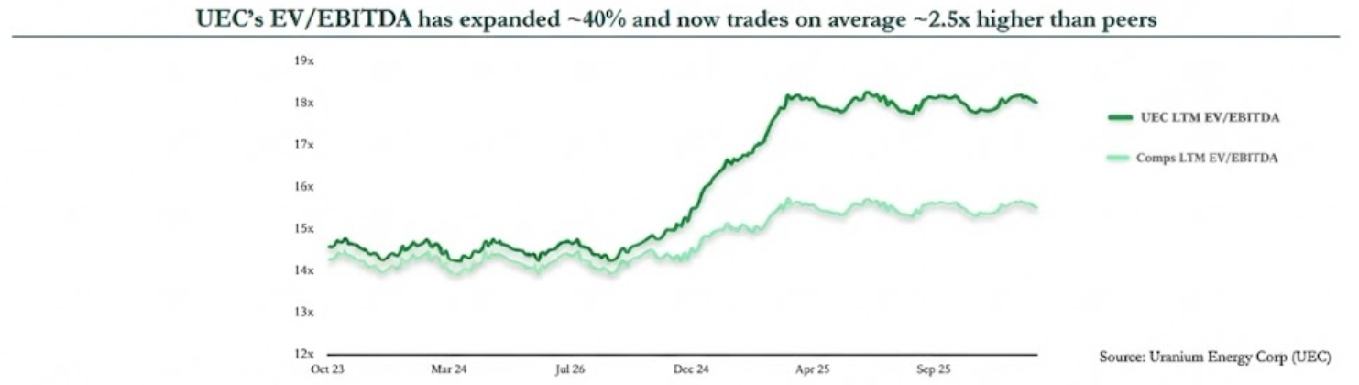
Relative Valuation
Companies | Market Cap | Enterprise Value | TTM EBITDA | Price/Earnings | EV/EBITDA
Kazatomprom (LSE: KAP) | 22,700,000,000 | 21,740,000,000 | 1,055,588,000 | 18.76 | 10.42x
Boss Energy Ltd (ASX: BOE) | 809,490,000 | 762,230,000 | -11,033 | 21.07 | 20.83x
Denison Mines Corp (TSE: DML) | 5.130,000,000 | 4,940,000,000 | -183,784 | 34.08 | 27.66x
Cameco Corp (NYSE: CCJ) | 57,960,000,000 | 58,120,000,000 | 1,070,623 | 150.17 | 73.50x
Ur-Energy Inc (NYSE: URG) | 716,870,000 | 667,250,000 | -83,674 | -8.61 | -15.13x
enCore Energy Corp (NYSE: EU) | 662,550,000 | 656,130,000 | -47,968 | -11.43 | -49.70x
Mean | 14,663,151,667 | 14,480,935,000 | 176,055,361 | 34 | 11.26x
Median | 2,969,745,000 | 2,851,115,000 | -29,501 | 20 | 15.63x
Uranium Energy Corp (NYSE: UEC) | 8,990,000,000 | 8,540,000,000 | -72,754 | 167 | −66.8x
Sources: Analysis, Capital IQ

