Slide 1




Meet the Team!
Julia
Miao
Math/FARM 1A
Susan
Ho
Math/FARM 1A
Ester
Wang
Math/FARM 1A

Slide 2

Teva Pharmaceuticals Industries Ltd. (NYSE: TEVA)
Recommendation: Buy | $35.18
Data cutoff eff.
Market close 26 Nov. 2025
All figures in $USD

Slide 3
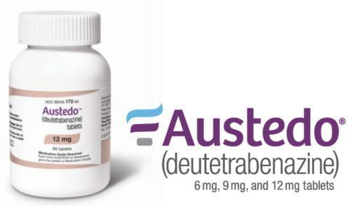
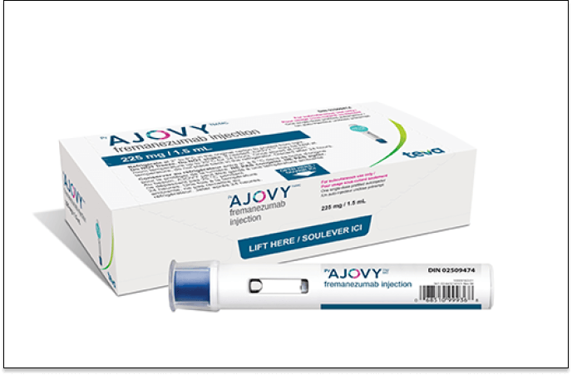
Company Overview
Market Cap: $30.20 B
Revenue (ttm): $16.78B
EV: $43.83B
  Teva is one of the world’s largest pharmaceutical companies, operating across over 60 countries.
  The business has three major segments:
  Generics: where Teva remains No.1 globally by volume
  Specialty Medicines: Austedo and Ajovy
    Austedo: 2025 revenue: $2.05 ~ $2.15 B
    expanding in the market for migraine prevention
    Grown for 11 consecutive quarters
  Biosimilars and complex generics: rapidly expanding area of development.

Slide 4
Investment Thesis
Teva is positioned for strong upside as accelerating specialty growth and improving financial strength reshape the company’s long-term trajectory.
Company
Global Market
for bone‑health indications across Europe.
Approval for biosimilars
EC authorization for PONLIMSI and DEGEVMA for bone-health indications across Europe.
TEVA Rise
Consumers looking to put expensive gift purchases on credit
Partnership
With Heze Hong Kong to commercialize azithromycin (Sumamed®).
Debt Optimization
Launched tender offers to repurchase up to $2B in senior notes

Slide 5
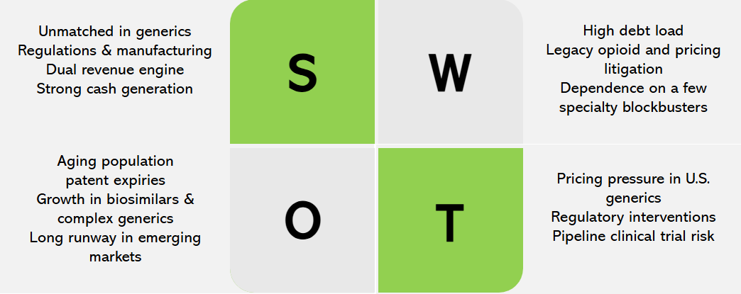
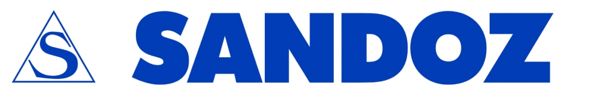






Competitive Landscape
Generics
Specialty

Slide 6
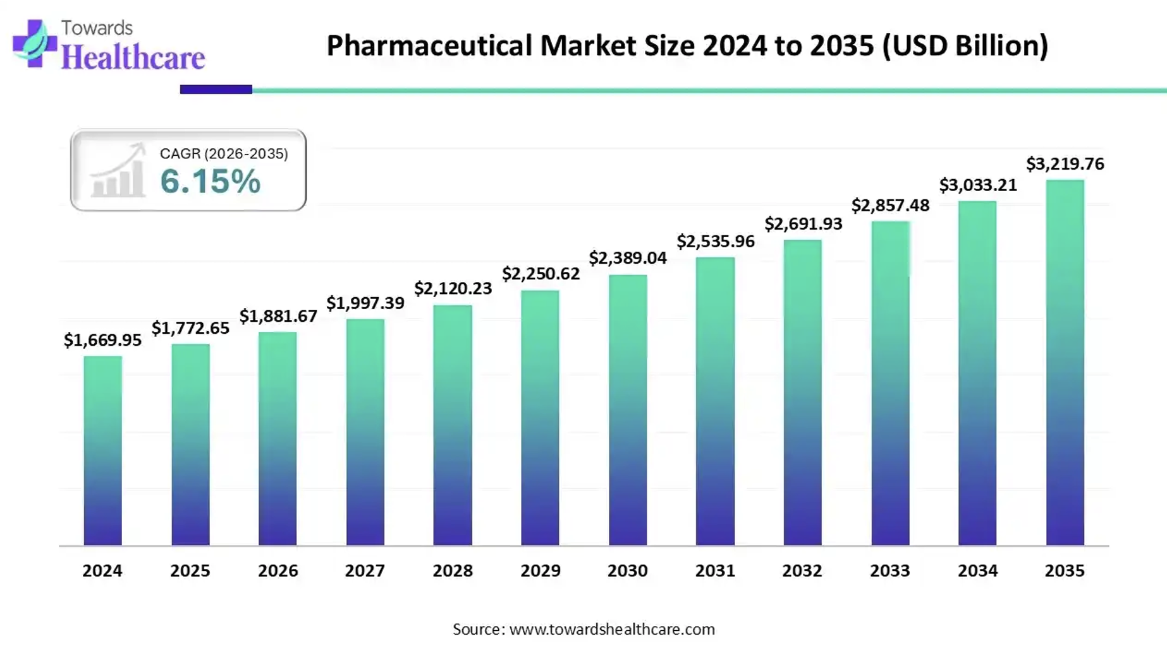
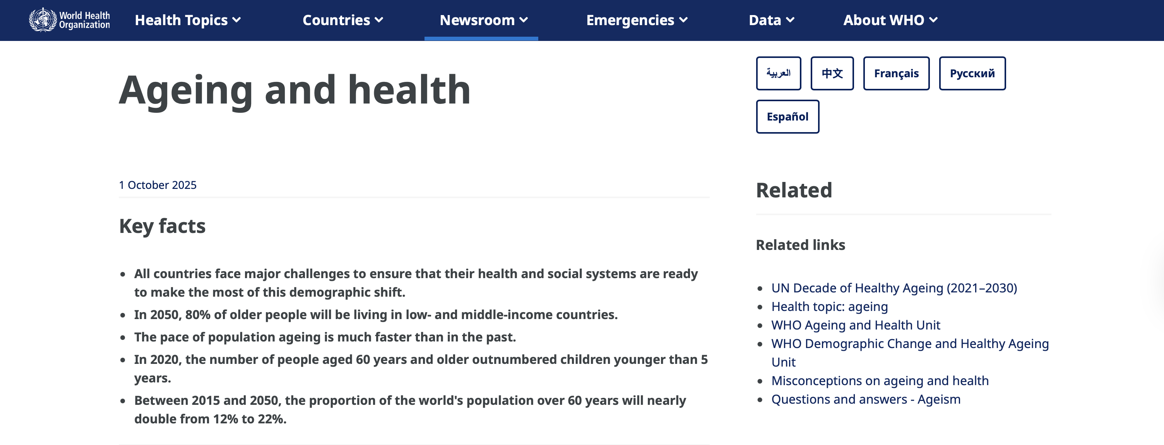
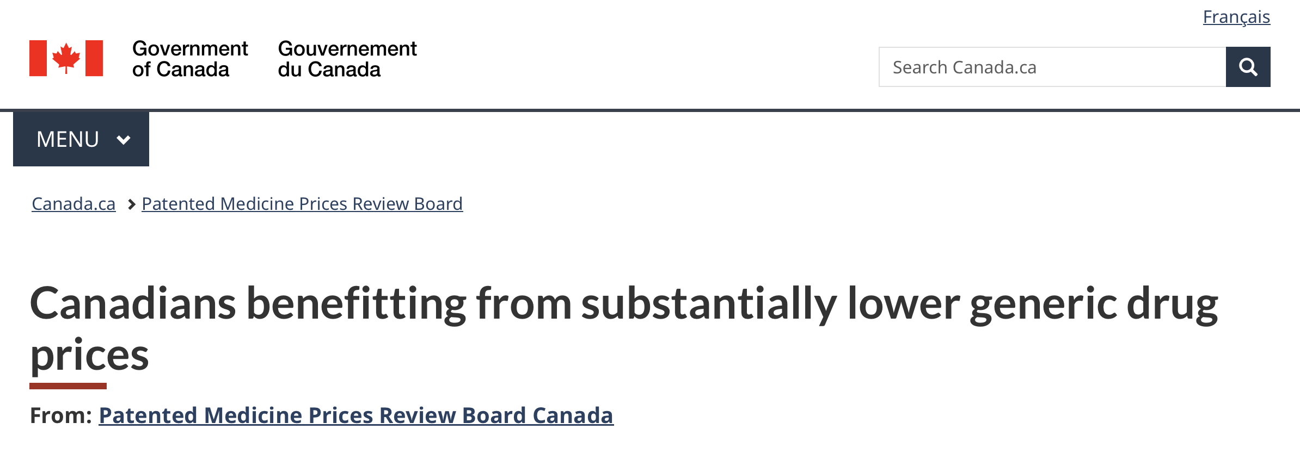
Macro Context
Global aging population and growing pharmaceutical market.
Growing chronic disease prevalence and rising demands for more affordable medication.
Generic drugs are significantly more affordable than brand-name drugs.
The Inflation Reduction Act targeted high-cost brand-name drugs instead of generic drugs.
Teva generates most of its revenue in USD but pays out in various currencies.

Slide 7
Price Correction Catalysts - External Factors
Inflation
Inflation causes lower interest rate, making it cheaper for Teva to refinance, thus costing lower interest expense and therefore higher EPS. Lower production costs but a fixed price, resulting in higher profit.
Industry Stabilization & Market Consolidation
The generic drug pricing is stable, and the market is consolidated. Teva, Sandoz and Viatris dominate the market, resulting in less competition with other smaller companies.
Major drug patent expiries
$100B+ worth of branded drugs losing exclusivity, causing a biosimilar boom, and Teva is one of the leading biosimilar companies which directly benefits from it.
Growing Demand for Affordable Healthcare
Individuals are looking for more affordable therapies, and governments want to cut the health care costs. Generic drugs meet this requirement, and Teva is the dominant generic drug maker.

Slide 8
Price Correction Catalysts - Internal Factors
Biosimilar Revenue
Teva launched at least 7 biosimilars in 2025, and each launch adds high-margin revenue.
Restructuring and Cost Optimization
Years of restructuring have lowered SG&A, optimized manufacturing footprints, and improved supply-chain efficiency. By cutting jobs, closing manufacturing sites globally, and consolidating production into lower-cost India & EU facilities, TEVA reduced annual costs by $3+ billion.
Highly Positive Results
The most recent data is showing no safety problems that held back older treatments, making Teva’s drugs much more attractive for patients. High-revenue, high-margin product that boosts Teva’s earnings over the next few years.
Opioid Litigation Overhang Removed
No more uncertainty and lower risk.

Slide 9
Key Risks and Mitigants
Risks
Mitigants
Teva's ~$16 billion gross debt load limits financial flexibility and prevents the stock from earning a higher valuation multiple.
Active capital allocation priority FCF to debt paydown, S&P credit upgrades, and proactive liabilities management.
Pivot to Growth Strategy, shifting from traditional low margin generics to higher margin innovative and biosimilar portfolio.
Austedo already delivering double digit growth, with Ajovy and Uzedy high margin opportunities, shifting to > 50% of incremental EBITDA from specialty products.
Global diversification in ~60 countries, complex generics and biosimilars focus with higher barriers to entry and slower price erosion. Currently captures 40-50% of market share in recent launches.
Competitive and pricing pressures from other generics and regulatory bodies (IRA).

Slide 10
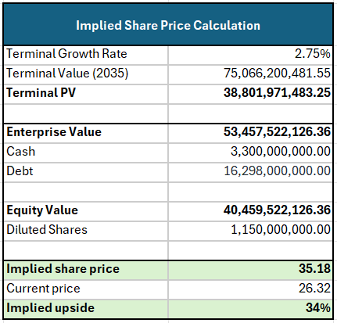
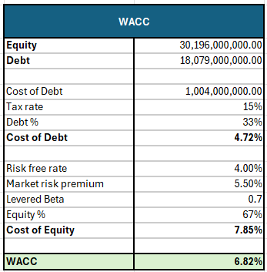
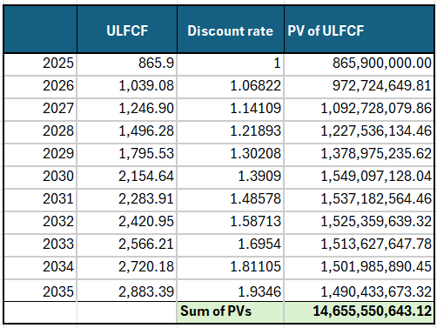
Valuation - DCF Summary
Key Assumptions:
Recent 20% growth for next few years based on pivot to growth strategy, later converging to industry average CAGR 6-7%
Terminal growth at 2.75% due to defensiveness of healthcare industry
Improved credit metric with leverage <3x by 2027 and operating margin to approach 30% by 2027 (aligned with analyst predictions and executive goals)

Slide 11
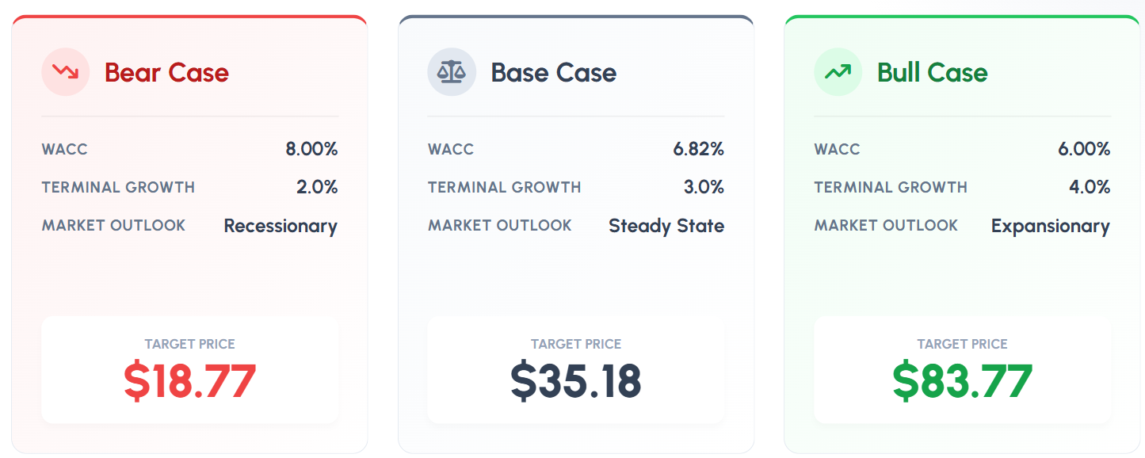
Valuation – DCF Sensitivity Analysis
WACC/Terminal Value | 2% | 2.75% | 4%
6% | 39.10 | 47.66 | 83.77
6.82% | 28.94 | 35.18 | 44.44
8% | 18.77 | 22.98 | 28.82

Slide 12
Valuation - Comps Analysis
 |  | Market Data |  |  | LTM Financials |  |  | Valuation
Company | Ticker | Share Price | Shares Out. | Enterprise Value | Revenue | EBITDA | Net Income | EV/Revenue | EV/EBITDA | LTM P/E
Viatris | NASDAQ: VTRS | 10.64 | 1150 | 25.72B | 14124 | -599 | -3691 | 1.82 | 11.16 | 28.56
Sandoz | OTCMRKTS: SDZ | 69.97 | 430 | 34.09B | 10587 | 1051 | 227 | 3.22 | 32.43 | 133.29
Dr. Reddy’s | NYSE: RDY | 13.99 | 832 | 11.42B | 342149 | 98493 | 58620 | 2.97 | 10.33 | 20.12
Sun Pharma | NSE: SUNPHARMA | 20.29 | 2400 | 45.03B | 5970 | 1833 | 1161 | 7.39 | 23.56 | 40.64
Cipla | NSE: CIPLA | 17.08 | 807 | 12.56B | 3064 | 898 | 604 | 4.01 | 13.76 | 22.39
Median |  |  |  |  |  |  |  | 3.22 | 13.76 | 28.56
Teva | NYSE: TEVA | 26.32 | 1150 | 37.65B | 16775 | 2842 | 713 | 2.61 | 15.42 | 40.97
Commentary:
Comps criteria: selected global generics and biosimilar manufacturers (U.S., Europe, India) with similar business models and meaningful exposure to complex generics and specialty pharma.
Median used due to outliers and negative values etc.
Conclusion: Teva trades below peers on all key valuation multiples, indicating clear upside potential.
- Figures in USDmm (except for shares out. and enterprise value)
- 100USD=8927.35INR

Slide 13
References
https://ised-isde.canada.ca/site/canadian-life-science-industries/en/biopharmaceuticals-and-pharmaceuticals/pharmaceutical-industry-profile
https://www.towardshealthcare.com/insights/branded-generics-market-sizing
https://s24.q4cdn.com/720828402/files/doc_financials/2025/q3/Teva-Factsheet-Q3-2025.pdf
https://finance.yahoo.com/news/teva-teva-9-2-schizophrenia-131128896.html
https://ca.finance.yahoo.com/quote/VTRS/financials/
https://ca.finance.yahoo.com/quote/VTRS/key-statistics/
https://finance.yahoo.com/quote/SDZNY/financials/
https://ca.finance.yahoo.com/quote/SDZNY/key-statistics/
https://ca.finance.yahoo.com/quote/RDY/financials/
https://ca.finance.yahoo.com/quote/RDY/key-statistics/
https://finance.yahoo.com/quote/SUNPHARMA.BO/financials/
https://ca.finance.yahoo.com/quote/SUNPHARMA.BO/key-statistics/
https://ca.finance.yahoo.com/quote/CIPLA.NS/financials/
https://finance.yahoo.com/quote/CIPLA.NS/key-statistics/
https://ca.finance.yahoo.com/quote/TEVA/key-statistics/
https://ca.finance.yahoo.com/quote/TEVA/financials/
DCF GOOGLE SHEETS (MINI APPENDIX)
https://docs.google.com/spreadsheets/d/1wM2PD5J1CP2Ob1UAkIKMeq9QTLmLpa0ukd55B0Hn9TA/edit?usp=sharing
https://docs.google.com/presentation/d/1EYsv8gz-s74an0slMyH2LnYIaml56l4agOXAujTAIF8/edit?usp=sharing

