Slide 1
COMP 5411 Programming Assignment 1

Slide 2
Tasks
1. Implement Explicit Laplacian smoothing:
Using uniform weights
Using cotangent weights
2. Implement Implicit Laplacian smoothing:
Using uniform weights
Using cotangent weights

Slide 3
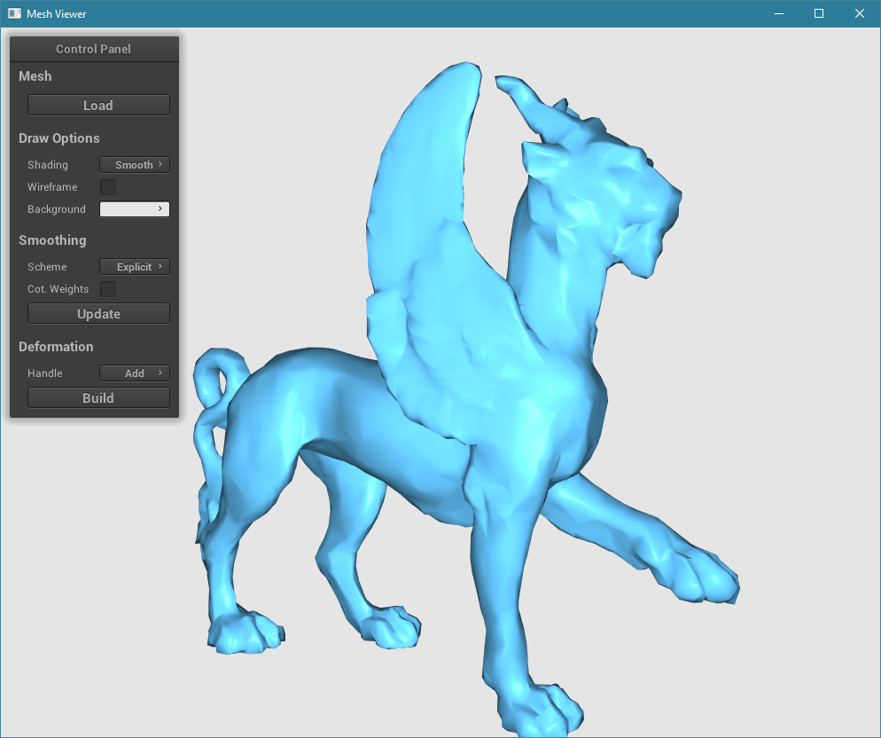
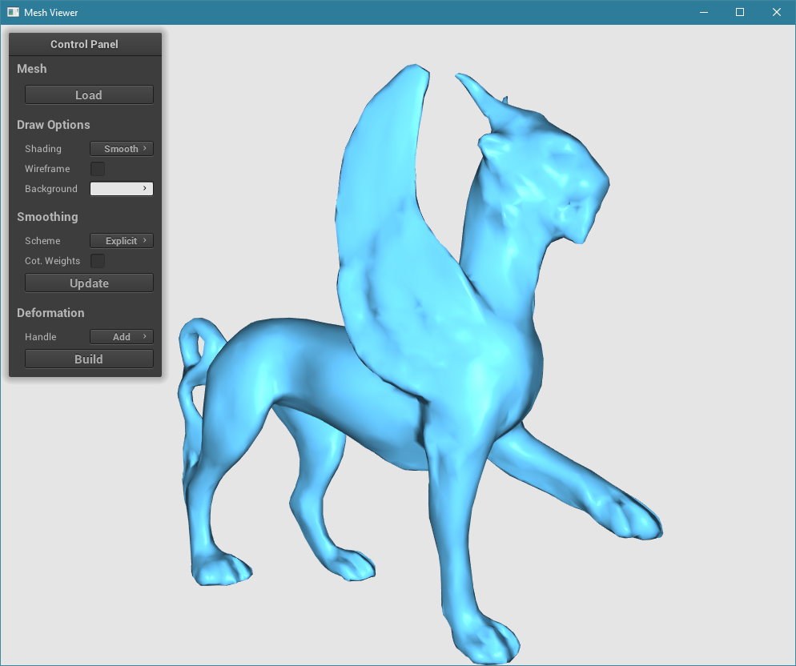
Tasks
1. Implement Explicit Laplacian smoothing:
Corresponding function in the code:
Mesh::umbrellaSmooth()
2. Implement Implicit Laplacian smoothing:
Corresponding function in the code:
Mesh::implicitUmbrellaSmooth()

Slide 4
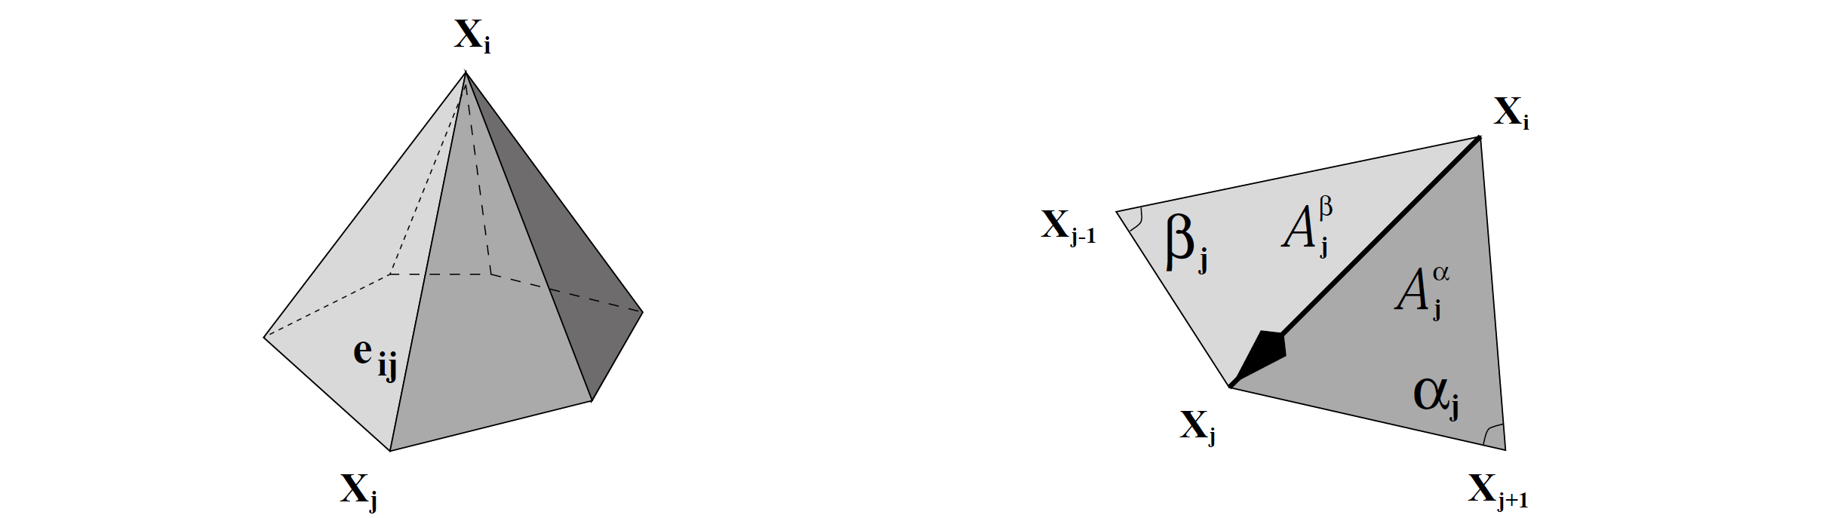
Explicit Laplacian Smoothing
Fairing operator (uniform)
In matrix form
Uniform Laplacian, where t is time stamp.

Slide 5

Explicit Laplacian Smoothing
Instead of uniform-weight Laplacian, use cotangent-weight Laplacian
In matrix form

Slide 6
Explicit Laplacian Smoothing
The matrix element of L
L is sparse and has the following elements:
For sparse matrix construction in Eigen, please refer to http://eigen.tuxfamily.org/dox/group__TutorialSparse.html#title3

Slide 7
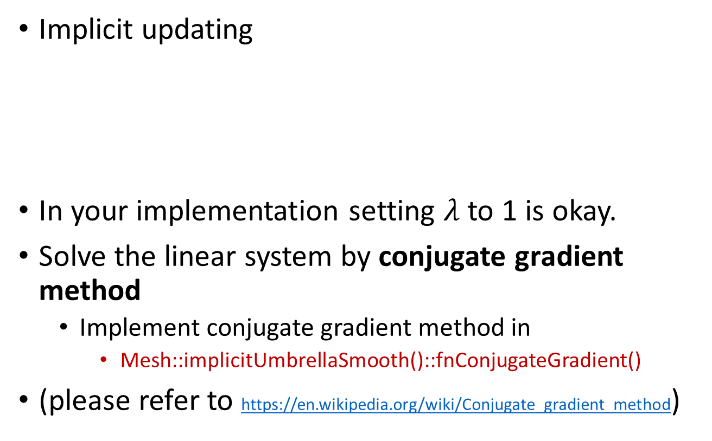
Implicit Laplacian Smoothing
Implicit updating
In your implementation setting $λ$ to 1 is okay.
Solve the linear system by conjugate gradient method
Implement conjugate gradient method in
Mesh::implicitUmbrellaSmooth()::fnConjugateGradient()
(please refer to https://en.wikipedia.org/wiki/Conjugate_gradient_method)
You need to solve a sparse linear system.

Slide 8
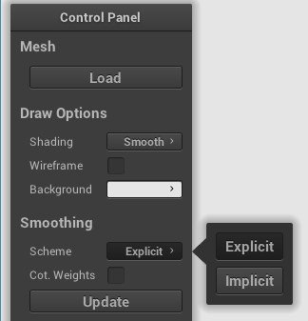
Mesh Viewer
Commands
Explicit or implicit smoothing
Use uniform or cot. weights
Perform one step smoothing

