Slide 1
COMP 5411 Programming Assignment 2

Slide 2
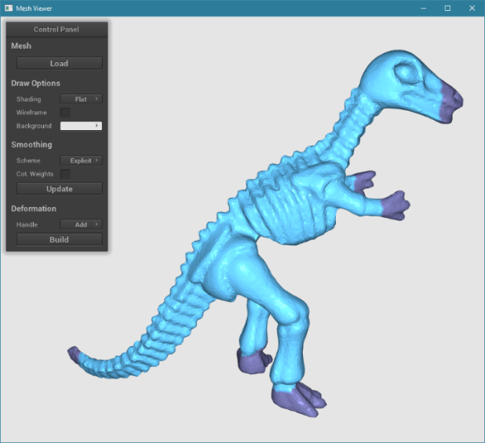
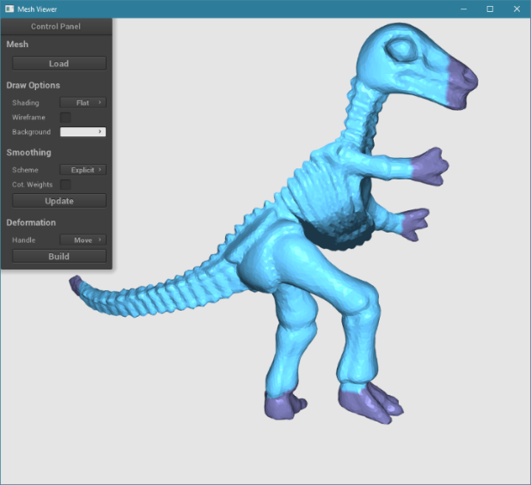
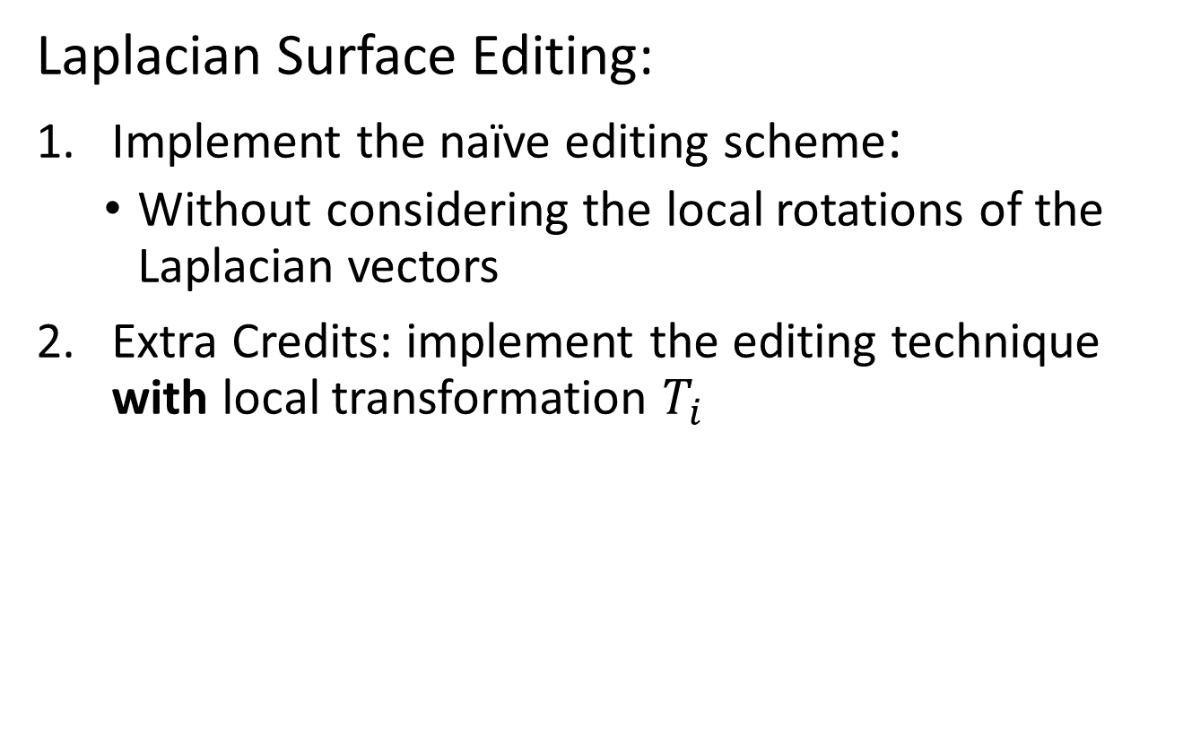
Tasks
Laplacian Surface Editing:
Implement the naïve editing scheme:
Without considering the local rotations of the Laplacian vectors
Extra Credits: implement the editing technique with local transformation $T_{i}$

Slide 3
Tasks
Corresponding functions in the code:
Deformer::buildSystemMat()
Deformer::deform()
(Note: you may need to add new member variables to Deformer)
Reference:
http://igl.ethz.ch/projects/Laplacian-mesh-processing/Laplacian-mesh-editing/

Slide 4
Problem Definition
Goal of Laplacian editing
Reconstruct the surface w.r.t. the moved handles
Preserve surface details (i.e., Laplacian vectors)
Images from Sorkine et al.’s paper

Slide 5
Mathematic Model
The naïve editing scheme is modeled as an optimization problem with constraints.
Constraints, i.e., handles
Unknown positions
Original Laplacian vectors
New vertex positions
Preserve details
Constrain the handles

Slide 6
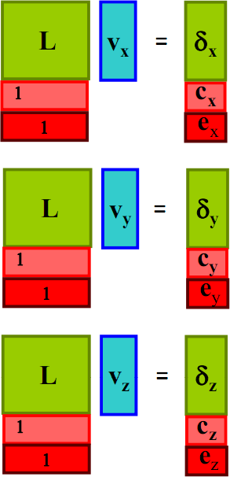
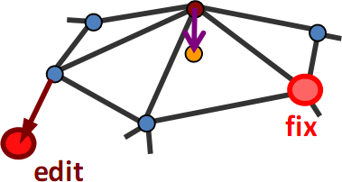
Least-squares Solution
Consider the simplest case
One point as handle
One point fixed

Slide 7
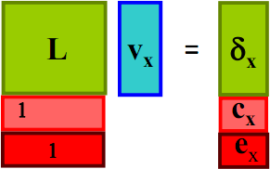
Least-squares Solution
How to solve the linear system?
In least-squares sense
A x = b
A^{T} A x = A^{T} b
Pre-factorize it.
Corresponding to code
“mCholeskySolver->
compute(systemMat);”
in Deformer::buildSystemMat.
Recompute it when handles move.
Call, for example,
“mCholeskySolver->solve(A^{T}b)” to obtain x efficiently in Deformer::deform.

Slide 8
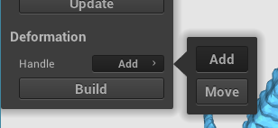
Mesh Viewer
Commands
Handle mode
Build system matrix and pre-factorize it

Slide 9
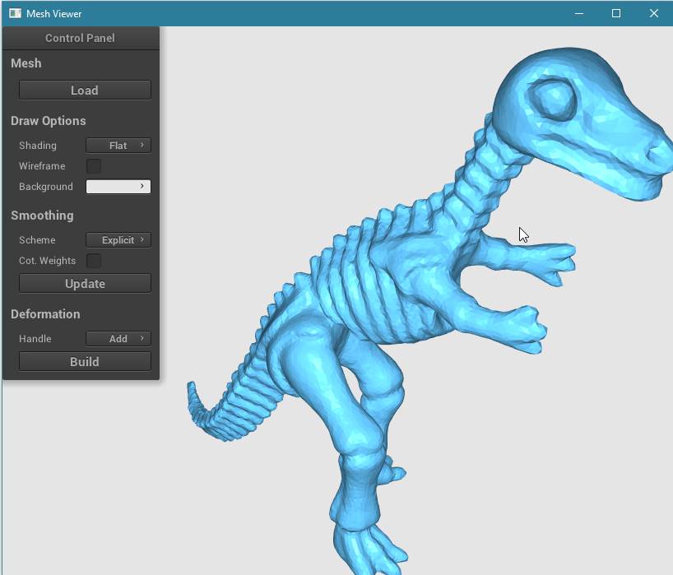
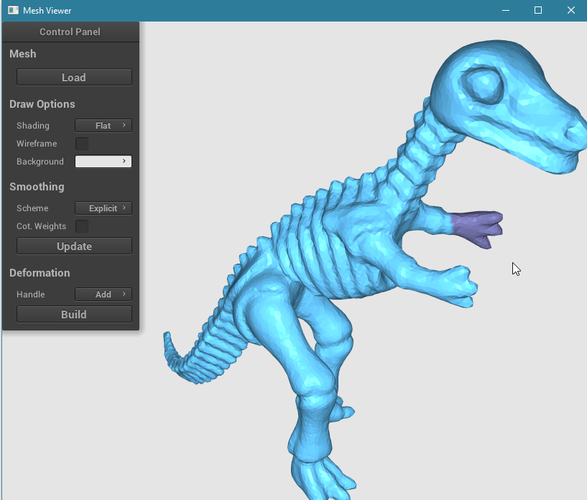
Mesh Viewer
Mesh editing process:
First, switch handle mode to “Add”
Second, use right mouse button to drag&release a rectangle over a mesh region as handles

Slide 10
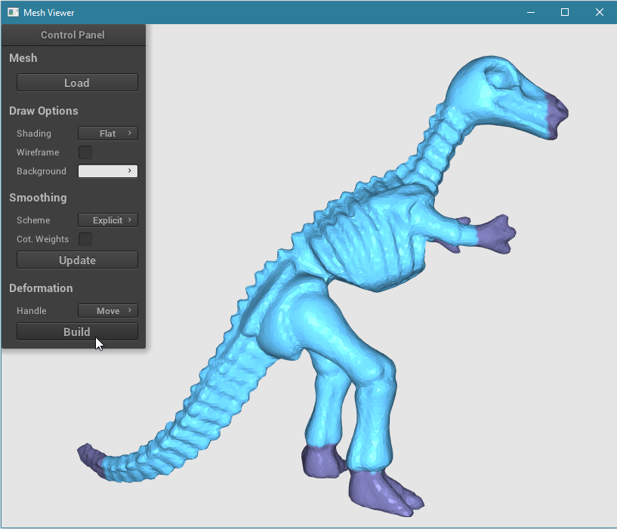
Mesh Viewer
Mesh editing process:
Third, after adding several handles (>= 2), switch handle mode to “Move” and click the “Build” button

Slide 11
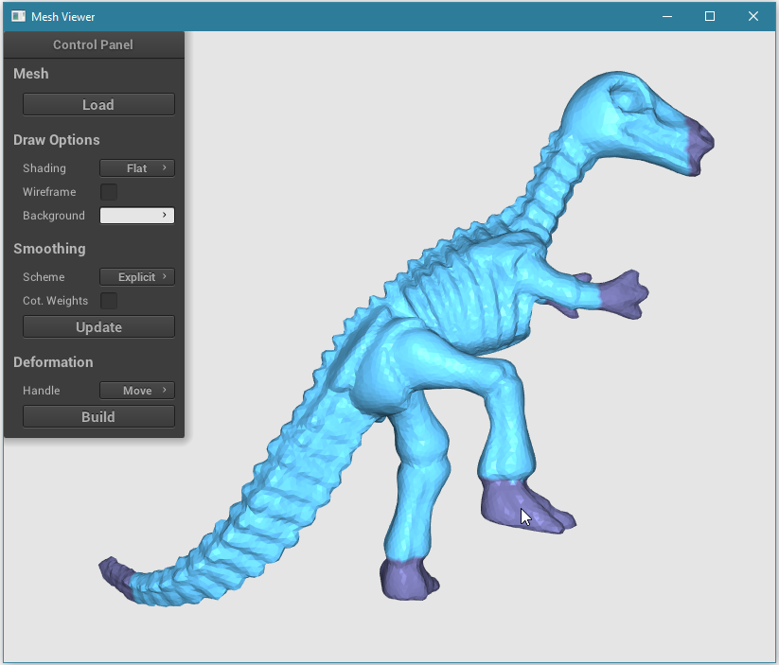
Mesh Viewer
Mesh editing process:
Fourth, use right mouse button to drag one of the handles to new positions for editing. (Note that you can still use left mouse button to change viewpoints.)

Slide 12
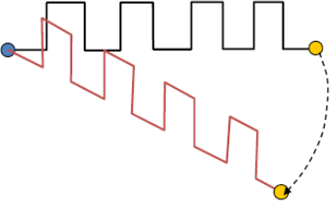
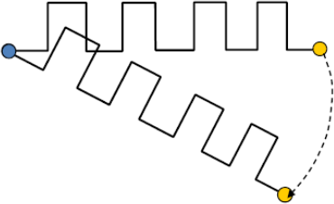
Extra Credit
Laplacian editing with local transformations
Solve for orientations
local transformations
Without T_{i}
With T_{i}

Slide 13
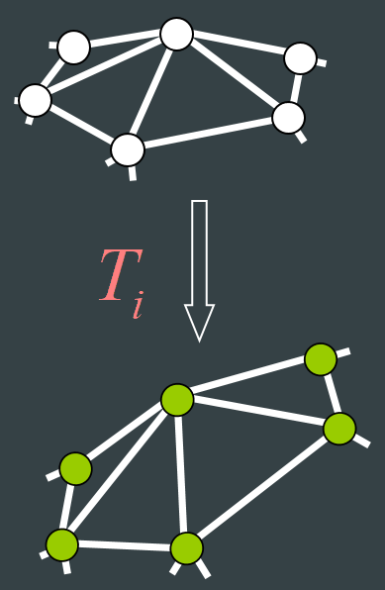
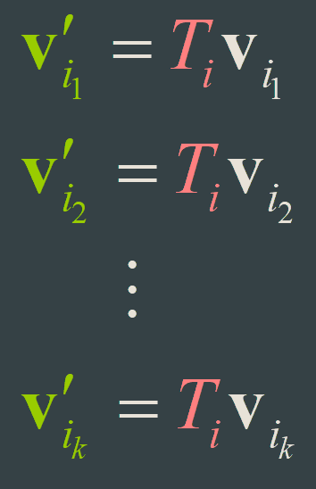
Formulate T_{i}
Based on the local (1-ring) neighborhood
Linear dependence on the unknown v_{i}’
Members of the 1-ring
of i-th vertex
From Sorkine et al.’s slides

Slide 14
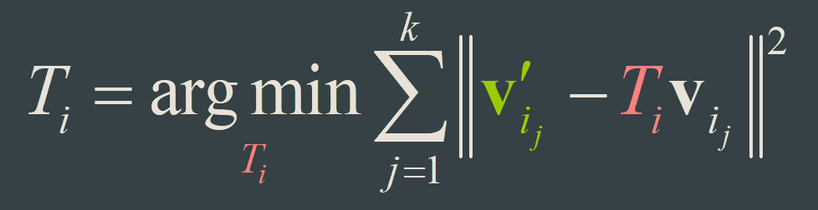
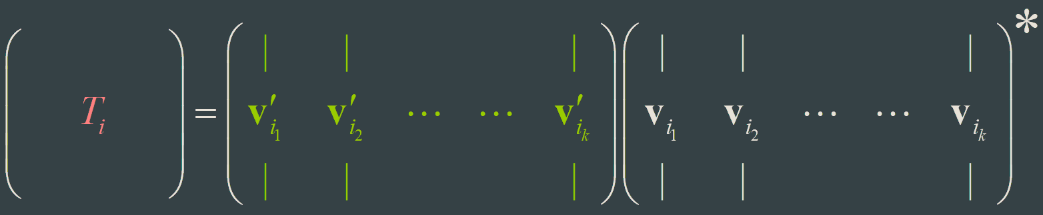
Formulate T_{i}
Define T_{i} simply by solving
From Sorkine et al.’s slides

Slide 15
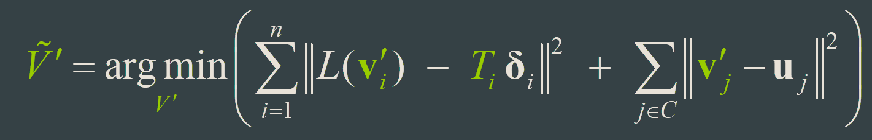
Formulate T_{i}
Plug the expressions for T_{i} into the least-squares reconstruction formula
Linear combination
of the unknown v_{i}’
From Sorkine et al.’s slides

Slide 16
Integrate T_{i}
In matrix form
Refer to the paper for detailed implementation.
This should be changed since we have T_{i} now.

Slide 17
Implementation Issue
The approximated transformation T_{i} used in the paper Laplacian Surface Editing cannot handle large deformations.
It is normal to obtain the distorted deformation result when large deformation happens.

Slide 18
Some Notes from Assignment 1
Start early.
Submit your work through CASS.
Last submissions through emails will NOT be graded.
No need to include folders, like “data”, “include”, or files generated by Cmake in your zipped file.
Please do include the folder “src”.
The exact deadline in CASS is 23:55.
Please do not wait until the last minute.
Do NOT copy solutions from others.

