Slide 1
COMP 5411 Getting started with Programming No need to submit

Slide 2
Tasks
1. Compute some statistics for a mesh:
Number of vertices
Number of half-edges
Number of faces
Number of boundary loops
Number of connected components
Number of genus

Slide 3
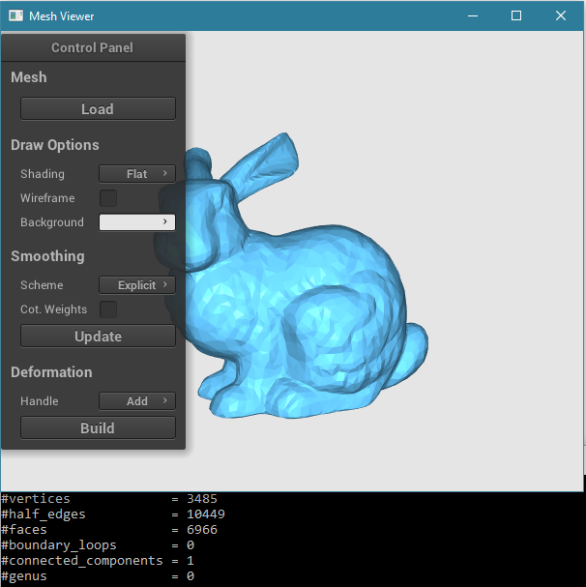
Tasks
1. Compute some statistics for a mesh:
Corresponding functions in the code:
Mesh::collectMeshStats()
Mesh::countBoundaryLoops()
Mesh::countConnectedComponents()

Slide 4
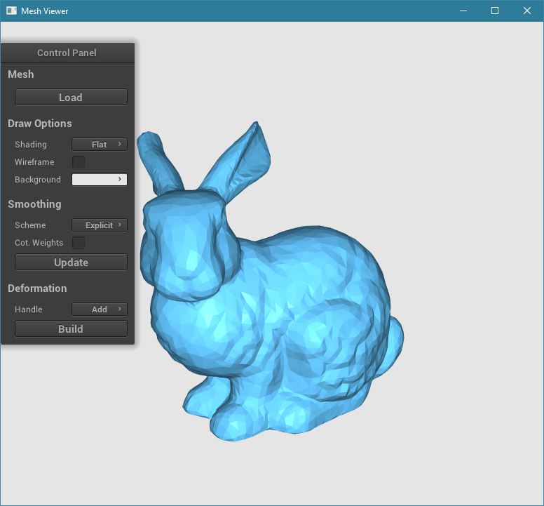
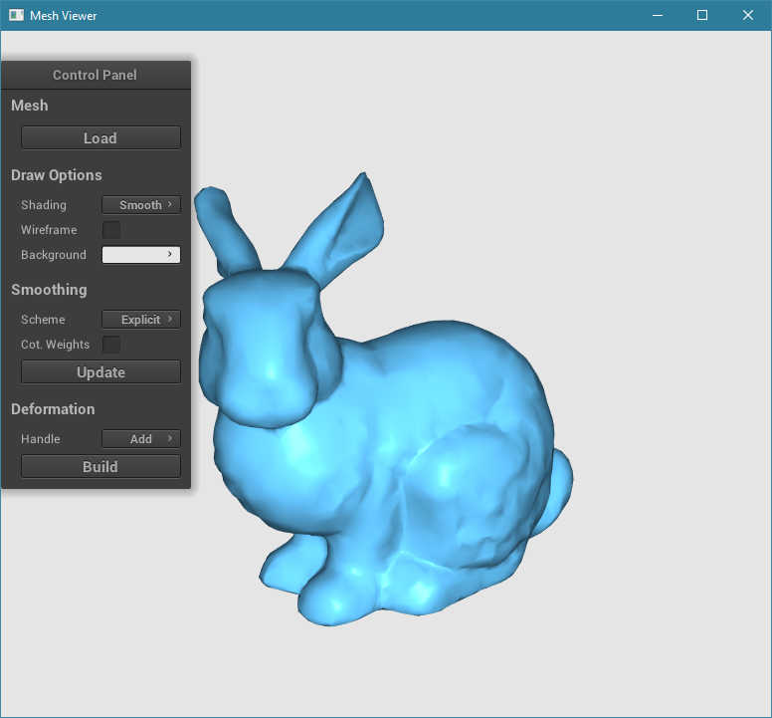
Tasks
2. Compute each vertex normal for smooth shading:
Corresponding functions in the code:
Mesh::computeVertexNormals()

Slide 5
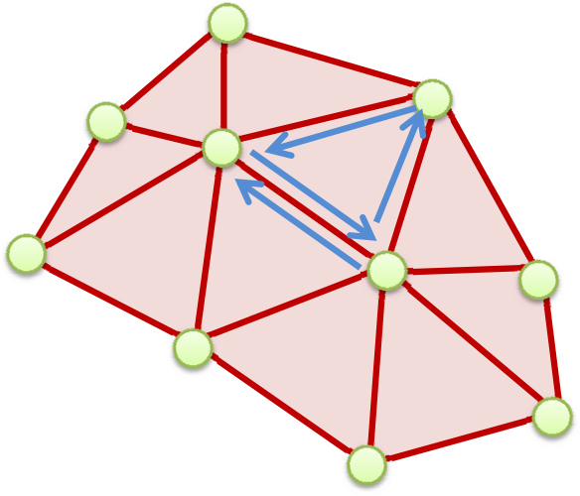
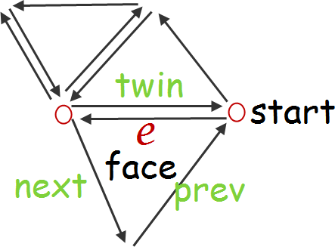
Half-edge Data Structure
class HEdge{
private:
Hedge *mTwin, *mPrev, *mNext; // Twin/previous/next half edges
Vertex *mStart; // Start vertex
Face *mFace; // Left face
public:
…
}

Slide 6
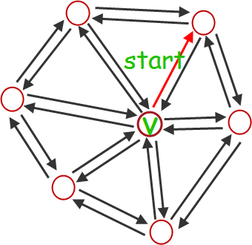
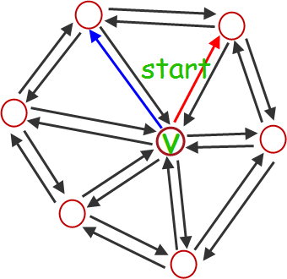

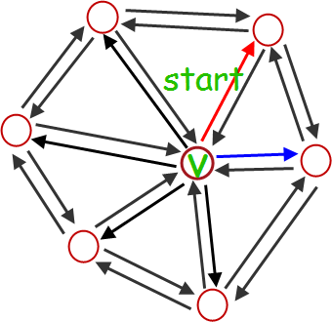
Half-edge Data Structure
Two useful classes implemented for you:
OneRingHEdge
OneRingVertex
For example:
Visit one-ring half-edges
…

Slide 7
Half-edge Data Structure
Useful function
Vertex::valence()
Let you know the valence (# of neighboring vertices) of a vertex.

Slide 8
Vertex Normal Computation
Commonly, it is computed as the normalized average of the surface normals of the faces that contain that vertex.
The average can be weighted, for example, by the area of the face.
You may try other computing schemes and compare, e.g. angle-based
Reference: Jin, S., Lewis, R. R., & West, D. (2005). A comparison of algorithms for vertex normal computation. The Visual Computer.
Store the computed normal using
Vertex::setNormal()

Slide 9
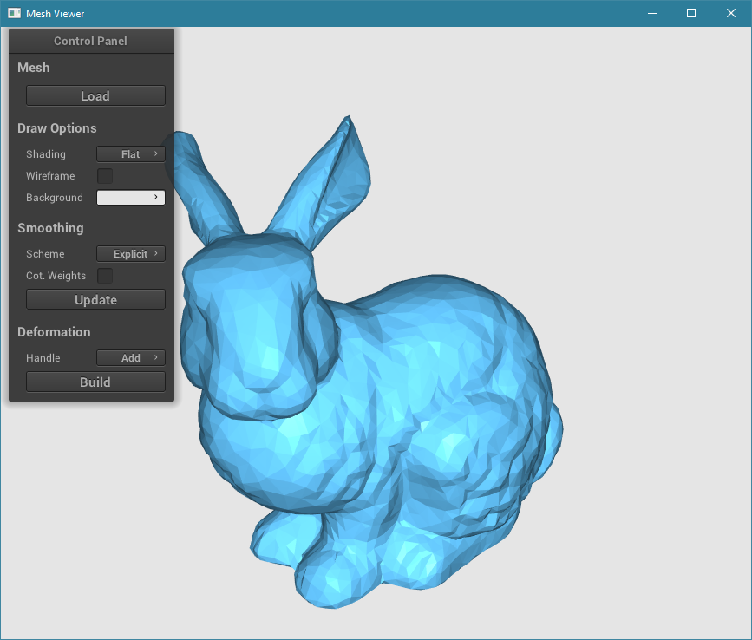
Mesh Viewer
Left mouse button: rotation
Middle mouse button: zoom in/out

Slide 10
Mesh Viewer
You only need to use the commands outlined by the red rectangle at this moment.

Slide 11
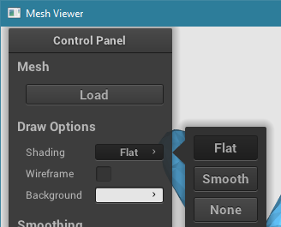
Mesh Viewer
Commands
Load a mesh from folder named data
Shading mode
Display mesh edges

Slide 12
Programming
We use Eigen as a C++ linear algebra library for its functionality and data structures.
E.g. use Eigen::Vector3f to represent the 3D position of a vertex.
Reference
http://eigen.tuxfamily.org/
http://eigen.tuxfamily.org/dox/

