Slide 1
Deploy Python Project of Flask to AWS
By: shuxin.jin@hotmail.com

Slide 2
Agenda
Django is little difference, almost similar.

Slide 3
Install tools
Install one Putty tool
https://www.putty.org/
Install winPcap
https://www.updatestar.com/zh-cn/directdownload/winpcap/2074262
Method :https://www.cnblogs.com/cuish/p/4180632.html

Slide 4
Guide in the AWS documents
https://docs.aws.amazon.com/zh_cn/elasticbeanstalk/latest/dg/create-deploy-python-flask.html

Slide 5
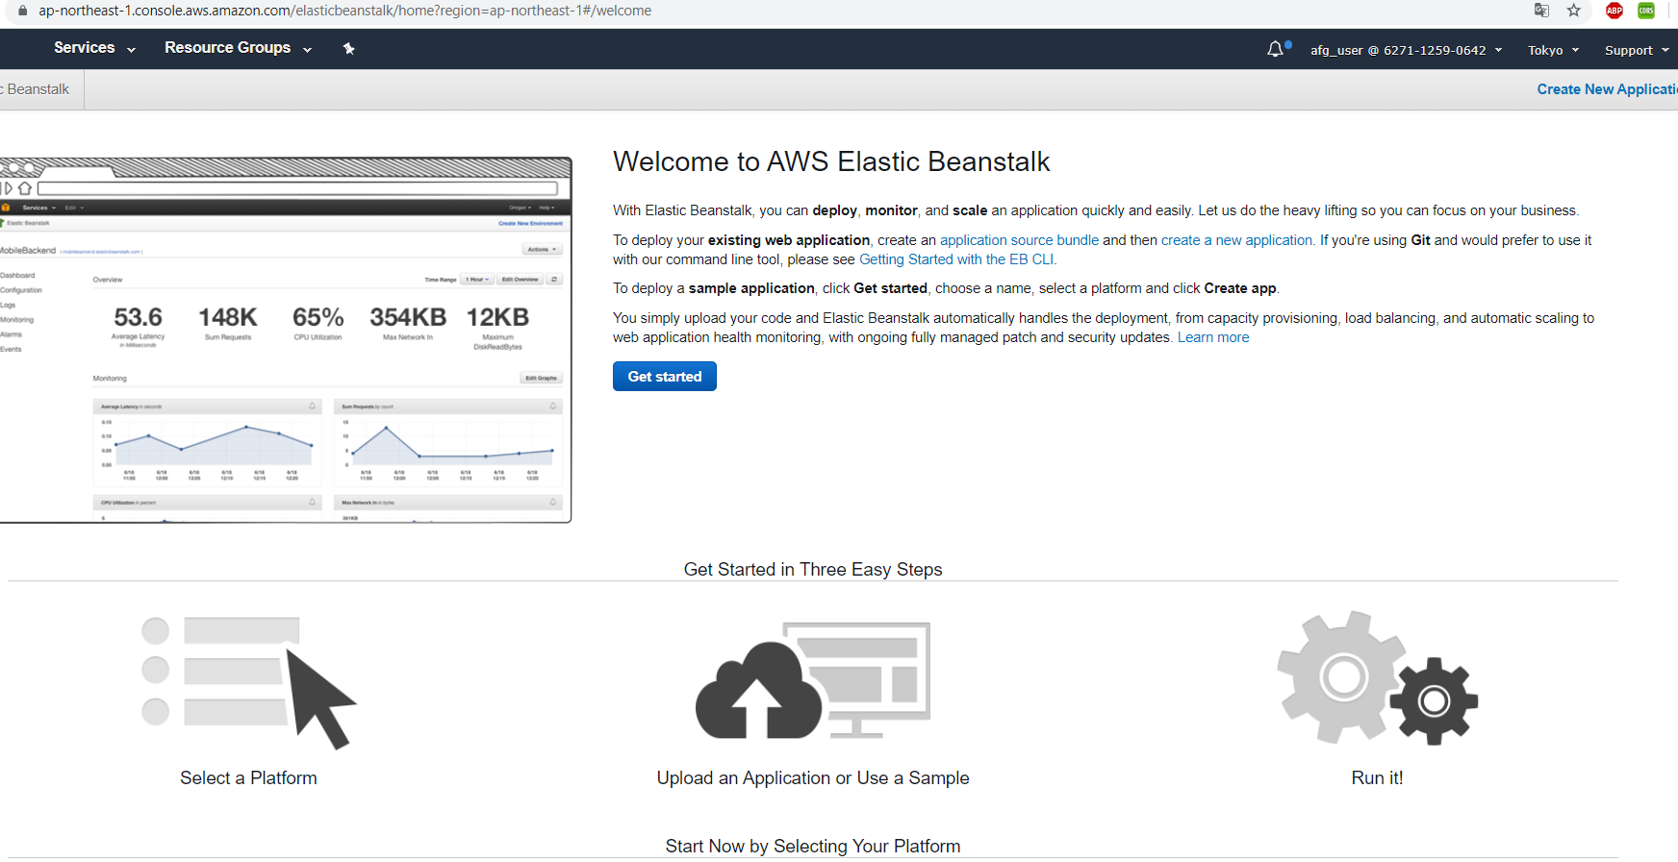
From your AWS control tab, enter into this page

Slide 6
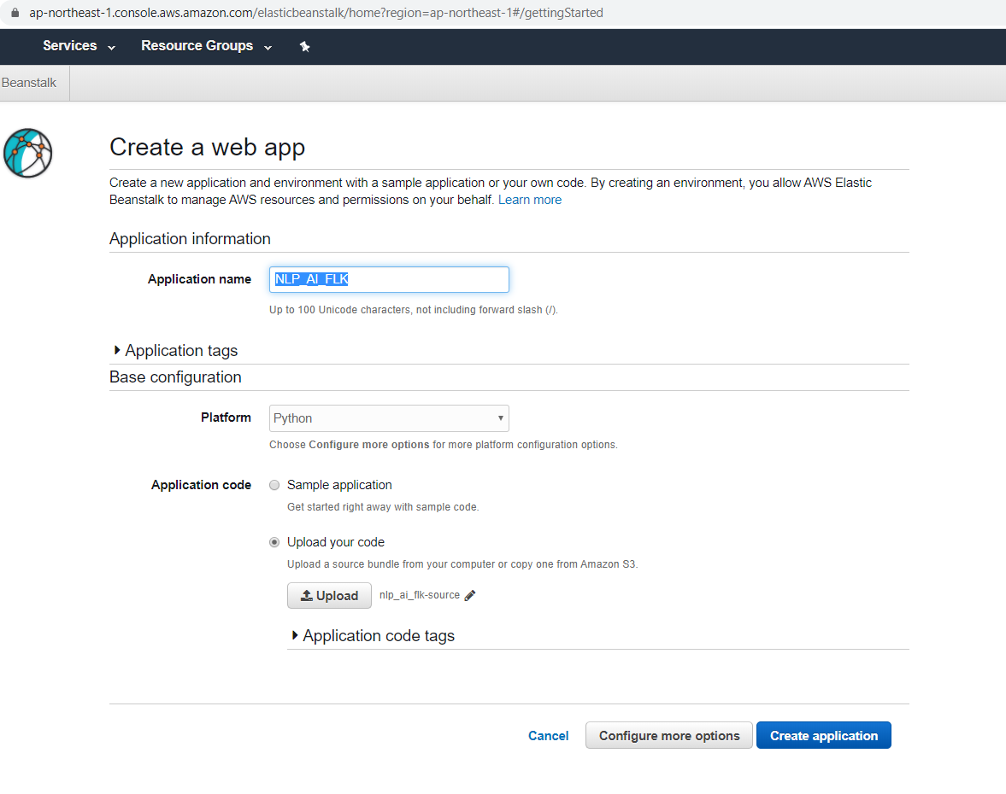
Your instance name

Slide 7
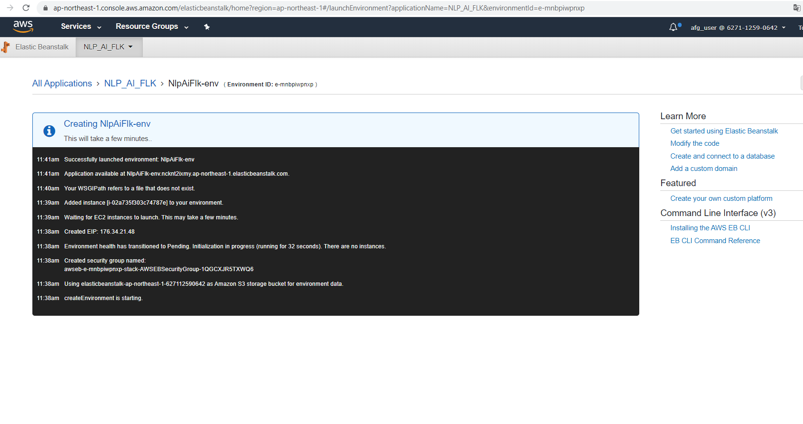
Option, checking

Slide 8
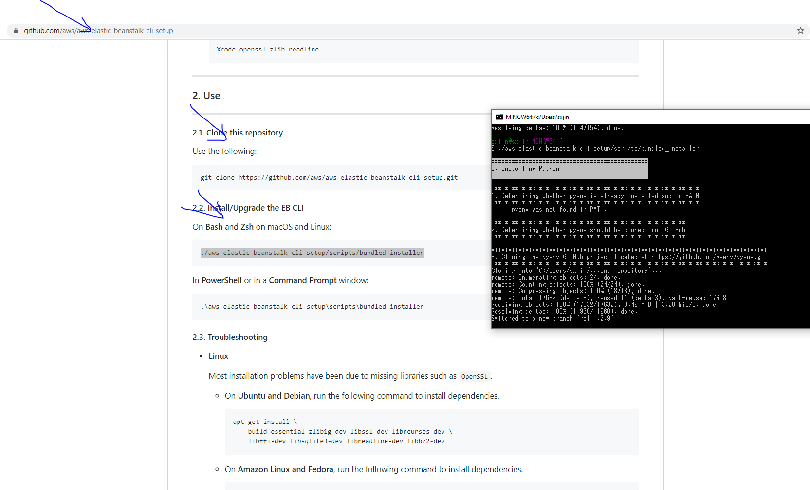

Slide 9
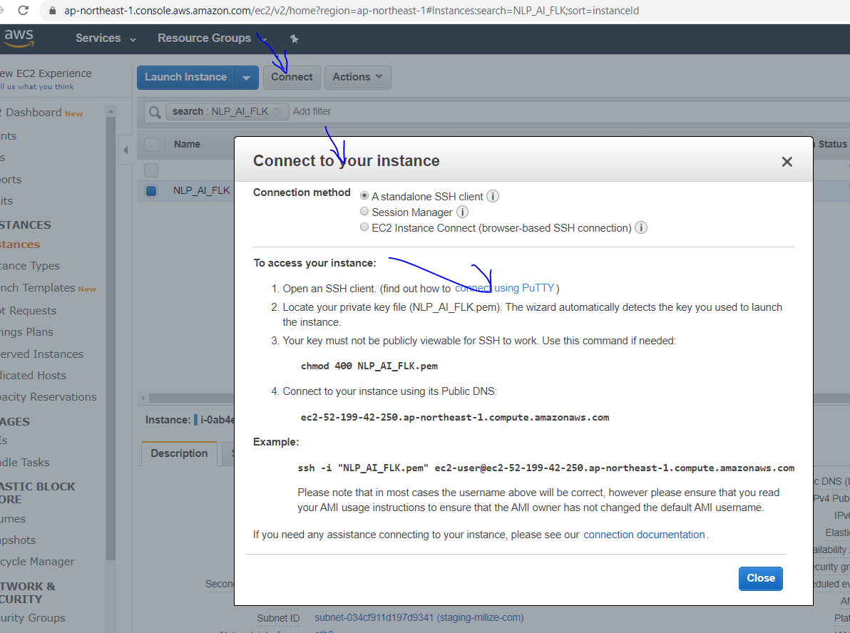
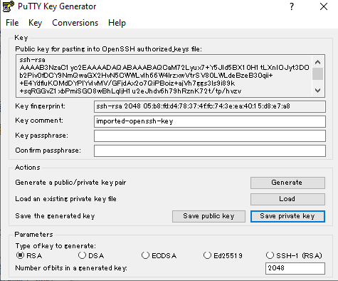
Tools connection

Slide 10
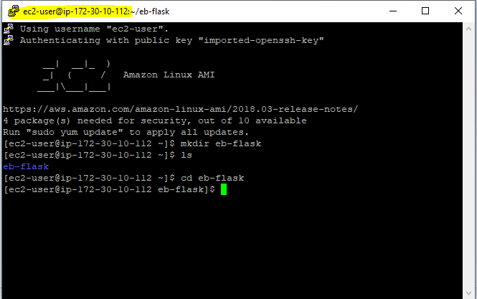
It is more convenience with winPcap

Slide 11
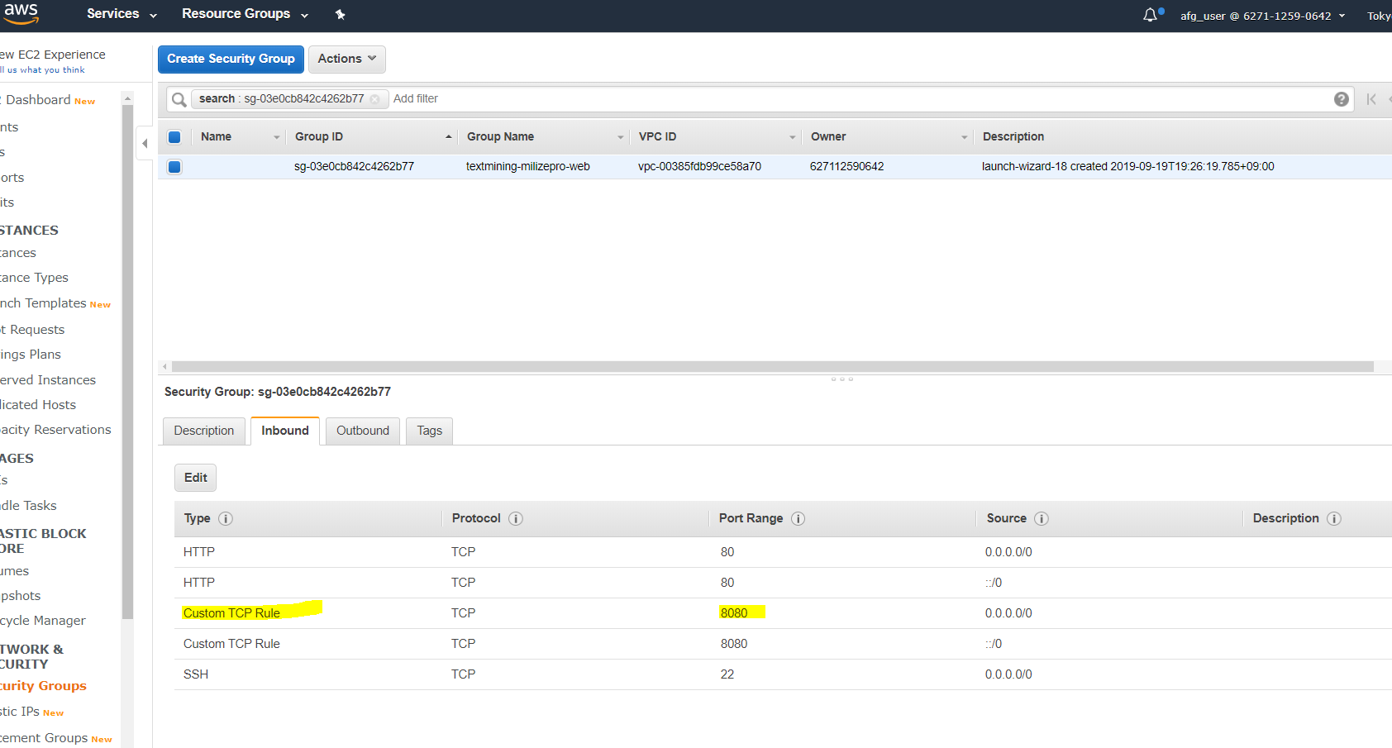
Should replace 8080 with 5000 , the flask depending port.
Inbound configuration

Slide 12
Option configuration
Windows install Python、pip and EB CLI
https://docs.aws.amazon.com/zh_cn/elasticbeanstalk/latest/dg/eb-cli3-install-windows.html

Slide 13
Flask
FLASK if __name__ == '__main__':
app.debug = True
app.run(host='0.0.0.0')

Slide 14
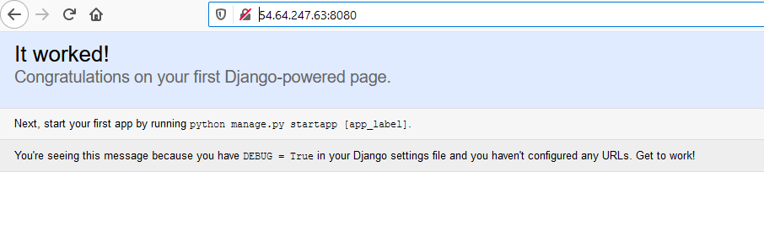
Draft
python application.py

Slide 15
Draft
sudo yum install python36 python36-pip
python3 --version
Make a link to pip3:
sudo ln -s /usr/bin/pip-3.6 pip3

Slide 16
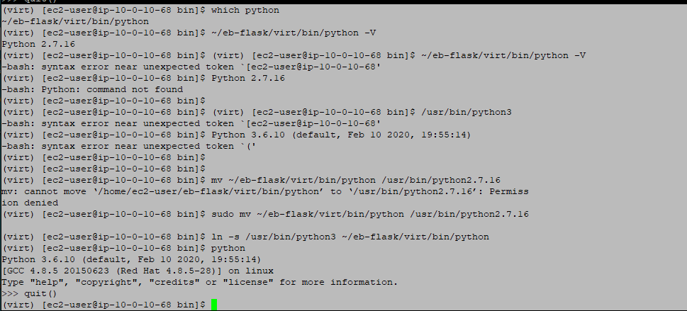
https://blog.csdn.net/u011798443/article/details/80825817
Upgrade to python3:
AWS python3 install please refer to helping doc

Slide 17
Soft link, NOT run this command,just mark
(virt) [ec2-user@ip-10-0-10-68 /]$ which pip
/usr/local/bin/pip
(virt) [ec2-user@ip-10-0-10-68 /]$ which pip3
~/.local/bin/pip3
(virt) [ec2-user@ip-10-0-10-68 /]$ pip3 --version
pip 20.0.2 from /home/ec2-user/.local/lib/python3.6/site-packages/pip (python 3.6)
(virt) [ec2-user@ip-10-0-10-68 /]$ pip --version
pip 9.0.3 from /usr/lib/python2.7/dist-packages (python 2.7)
ln -s /home/ec2-user/.local/lib/python3.6/site-packages/pip /usr/lib/python2.7/dist-packages

Slide 18
It is a python2.7 demo,need replace it with python3 version
https://docs.aws.amazon.com/zh_cn/elasticbeanstalk/latest/dg/create-deploy-python-flask.html

Slide 19
Thank You

