Slide 1
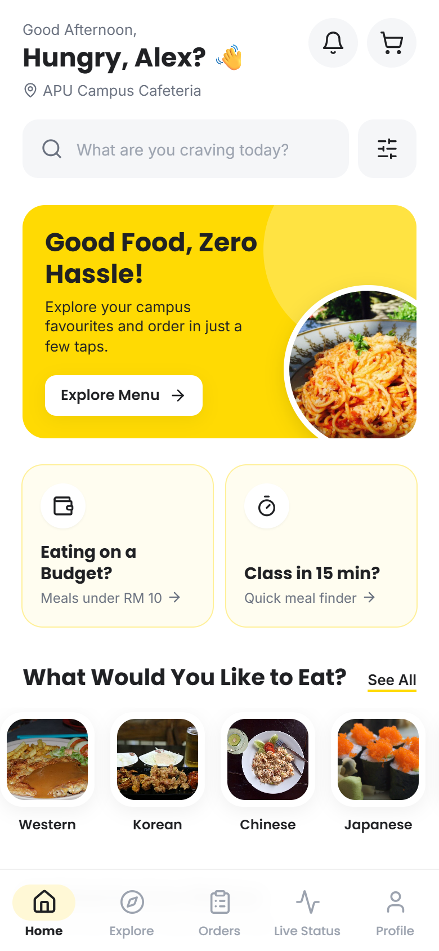

APBites
Your Campus. Your Cravings. Your Way.
Smart campus food ordering and live stall status for APU students and cafeteria vendors.
Smart Campus & Student Experience Hackathon
Notes:
Hi, we are the APBites team. APBites is a smart campus dining app for APU: students discover food, see how busy each stall is, order ahead and collect when it is ready, while vendors manage the whole flow from one dashboard. Everything you will see today is a working prototype, not mockups.

Slide 2




The lunch-break squeeze
Between back-to-back lectures, every minute in a queue counts.
Peak-hour queues
Wasted trips
The lunch rush crowds the same stalls at the same time.
Students walk to a stall only to find it closed or packed.
Little information upfront
No link to vendors
Menus, prices and prep times are not visible in advance.
No easy way to order ahead or know when food is ready.
Notes:
The problem every APU student knows: lunch breaks are short, and the queues are long because everyone eats at the same time. You walk over and the stall is closed or packed, you cannot see menus or prep times in advance, and there is no way to order ahead or hear from the vendor when food is ready.

Slide 3



Meet APBites
One app to discover campus food, see how busy each stall is, order ahead, and collect the moment it is ready.
Discover & order ahead
8 stalls, 80 dishes and 24 drinks in one place.
See live stall workload
Workload level and estimated wait for every stall.
Track & collect
Live order timeline and a pickup code at the counter.
Notes:
APBites puts it all in one app. Students browse every stall, see a live workload level and estimated wait, place a self-pickup order, and track it until a pickup code tells them it is ready. It is designed around the ten-minute gap between classes.

Slide 4
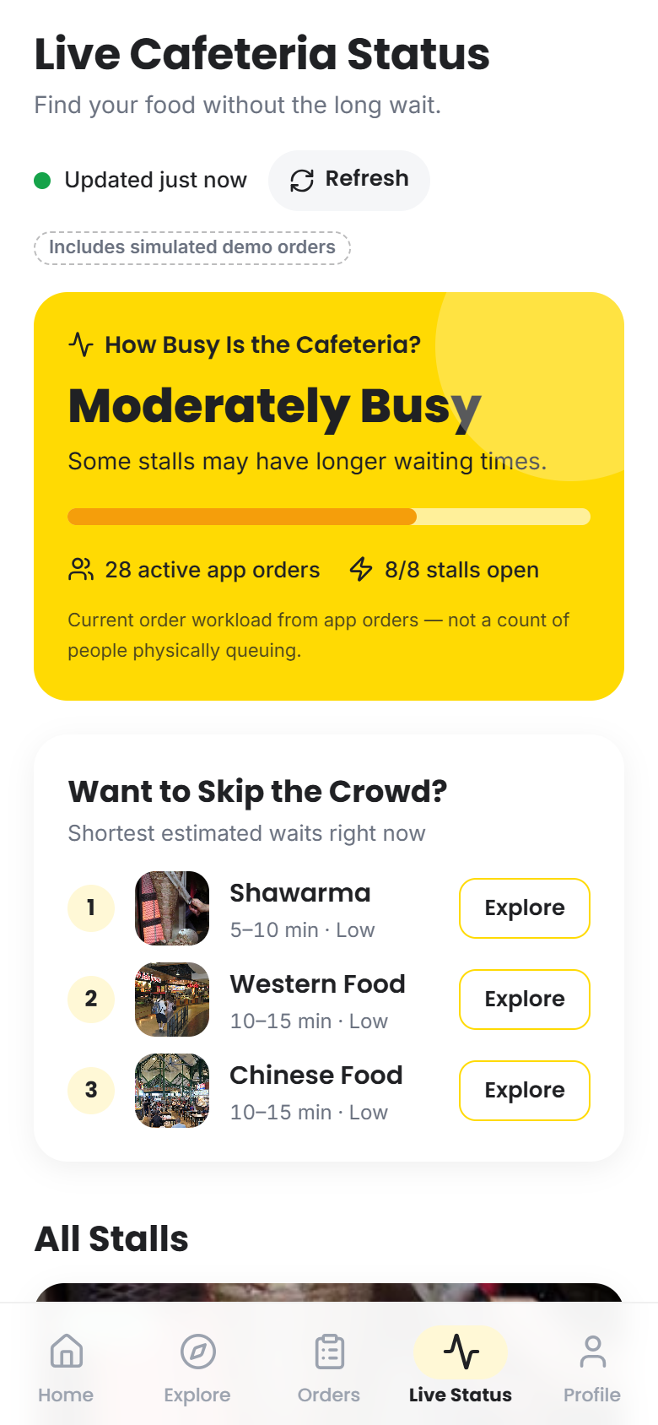
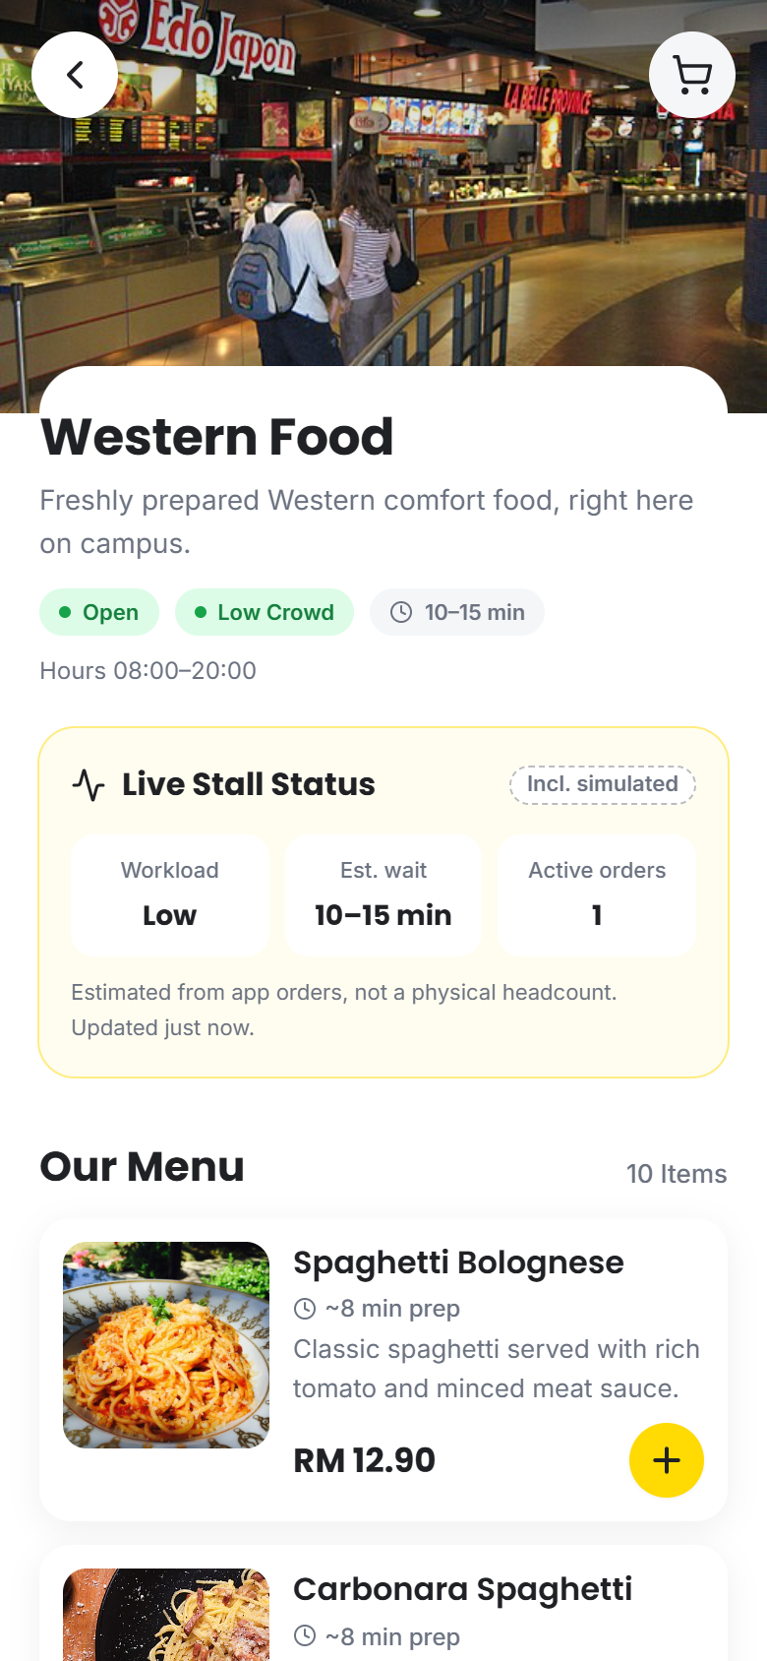
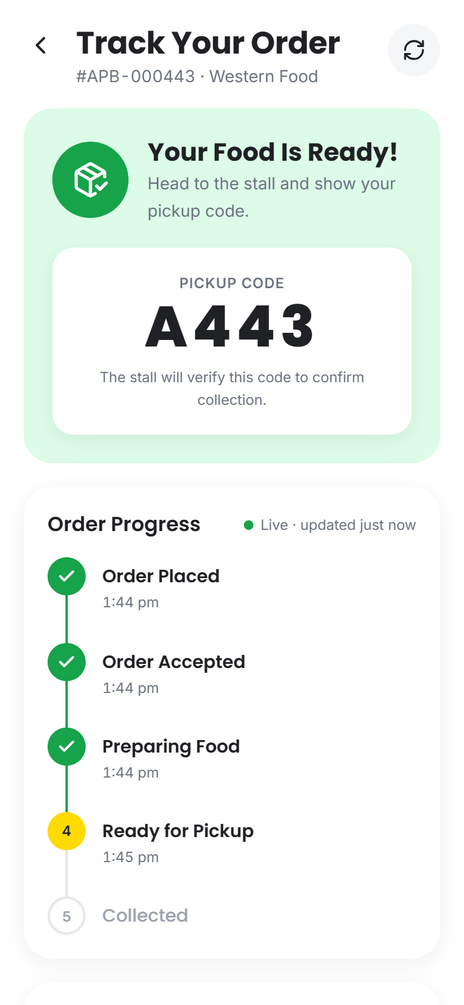
Built for the 10-minute break
1 Check live stall workload
2 Order ahead in a few taps
3 Collect with a pickup code
Notes:
Here are real screens from the prototype. First, Live Status: how busy the cafeteria is and which stalls have the shortest wait. Second, the stall menu with prices, prep times and sold-out states. Third, order tracking: once the vendor marks it ready, the student gets a pickup code.

Slide 5





From craving to collection
Discover
Check live
Order
Accept
Track
Collect
Browse 8 stalls and 104 items
Compare workload and wait
Self-pickup, ASAP or scheduled
Vendor confirms and starts cooking
Live timeline and ETA
Student shows code; vendor verifies
Student
Vendor
Every status change reaches the student instantly: no refreshing, no guessing, no wasted walk.
Notes:
This is the core journey we demo. The student discovers food, checks live workload, and orders. The vendor accepts and starts cooking, the student tracks it live, and collection is confirmed only when the vendor verifies the pickup code. Every step updates the other side in real time.

Slide 6
How we estimate the wait
Workload level
Estimated wait
queued prep time ÷ prep stations
+ your order’s prep time
Low
0–3 active orders
Moderate
4–7 active orders
High
8+ active orders
Worked example
4 orders queued × 6 min ÷ 2 stations = 12 min
+ 5 min for your meal
≈ 17 minutes until pickup
Thresholds and prep stations are set per stall by the vendor.
It measures app order workload, not a headcount. Vendors can report walk-in queues manually.
Notes:
Here is the smart-campus engine. For each stall we add up the prep time of queued orders, divide by how many orders the kitchen can cook in parallel, and add your own order. Four orders at six minutes on two stations is twelve minutes, plus five for your meal, about seventeen. Workload levels come from active orders against thresholds each vendor sets. We are explicit that this is digital order workload, not a headcount; sensors are on the roadmap.

Slide 7
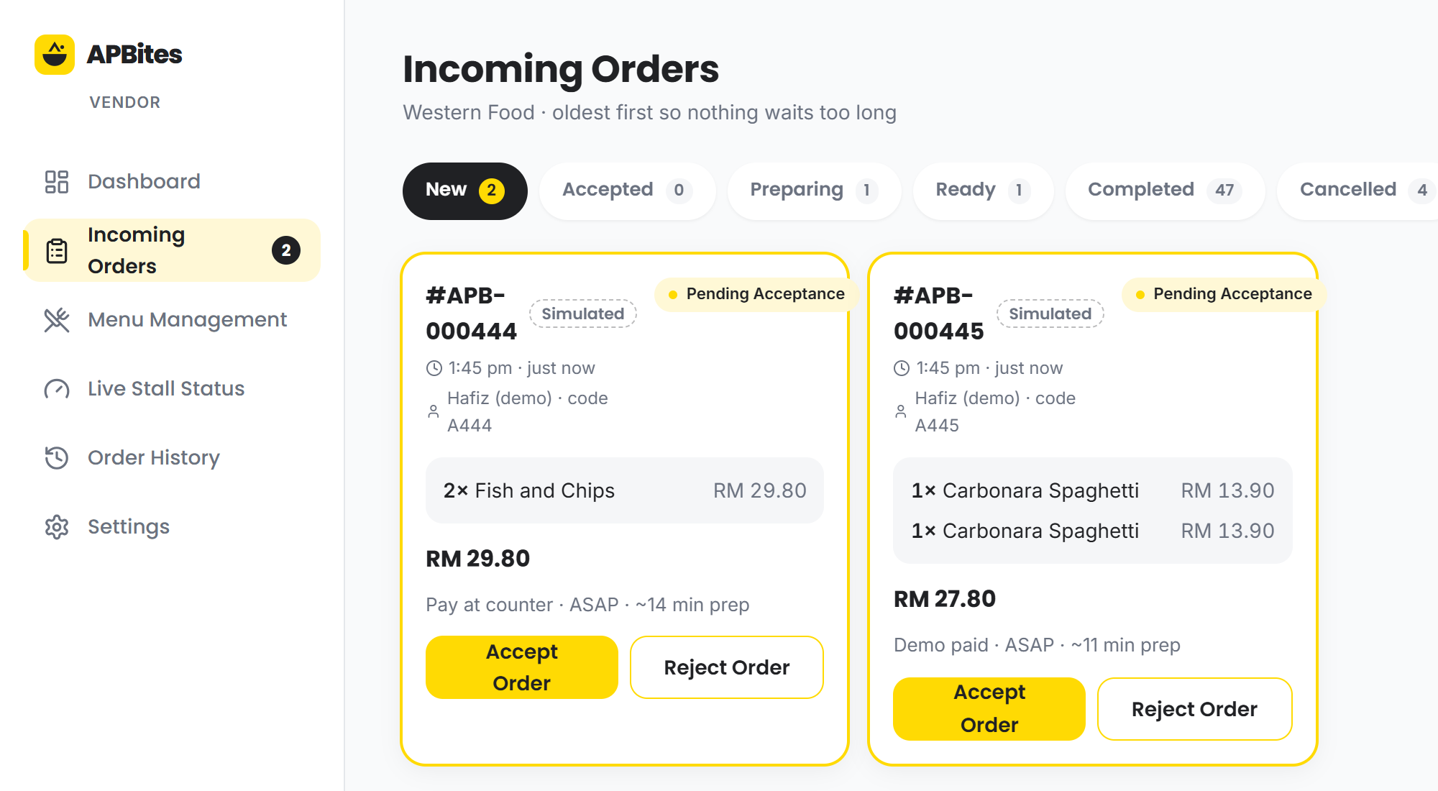


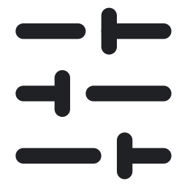

A dashboard vendors can run on
One-tap order flow
Accept, prepare, ready, collect.
Menu control
Sold-out toggles; add food and drinks.
Live status control
Pause orders, set stations and thresholds.
Analytics
Orders by hour and day, top items.
Notes:
Vendors get their own dashboard. New orders arrive instantly and move through accept, preparing, ready and collected in one tap each, with the pickup code verified at the end. Vendors control their menu and sold-out items, pause orders or adjust kitchen capacity, which feeds the student wait estimates, and see simple analytics.

Slide 8

Working end to end, today
8
104
30+
21/21
cafeteria stalls
menu items: 80 dishes, 24 drinks
screens across student and vendor apps
automated end-to-end checks passing
Demo mode runs entirely in the browser, with live sync between a student tab and a vendor tab. No backend setup is needed to try it.
Notes:
This is not a mockup. The prototype has eight stalls and 104 menu items, more than thirty screens across the student and vendor apps, and an automated end-to-end test covering ordering, vendor acceptance, live tracking, pickup verification and receipts, all passing. It runs entirely in the browser, so judges can try it with two tabs.

Slide 9





Under the hood
Front end
Service layer
Data store
Student and vendor apps: React, TypeScript, Tailwind
Role checks, server-side prices, valid status changes, versioning
Demo: browser storage with realtime sync across tabs
Designed to grow
The backend swaps in behind the service layer without redesigning the UI.
Next: Supabase
Later: IoT sensors
Postgres, auth, realtime and access policies
ESP32 people counters over MQTT
Notes:
Under the hood: a React and TypeScript front end, and a service layer that enforces what a real server would: role checks, recalculating prices at checkout, allowed status changes, and conflict detection. Today data lives in the browser for the demo. Because everything goes through that layer, we can swap in Supabase for auth, database and realtime, and later add IoT occupancy sensors, without rebuilding the UI.

Slide 10





Honest by design
Real statuses only
Simulated data is labelled
An order shows “Preparing” only after the vendor accepts it.
Demo traffic is always tagged as demo data.
Estimates, not promises
Server-side price checks
Wait times are clearly marked as estimates.
Totals are recalculated; stale prices are rejected.
Verified pickup
No fake ratings or crowds
Vendors confirm collection with the student’s code.
No made-up reviews, popularity or headcounts.
Notes:
Trust matters if students are going to rely on this between classes. We never fake state: an order is preparing only once the vendor accepts it, simulated demo traffic is labelled, wait times are presented as estimates, prices are re-checked at checkout, collection requires the pickup code, and we show no made-up ratings or crowd numbers.

Slide 11



Where we go next
Now
Hackathon MVP
Next
Campus pilot
Later
Smart campus
Student and vendor apps
Live workload and wait estimates
Order tracking and pickup codes
Drinks and smart meal finders
Real backend on Supabase
APU single sign-on
Cashless payments
Pilot with real stalls
IoT occupancy sensors
Predictions from order history
Push notifications
Bring-your-own-container perks
Notes:
Today we have a complete MVP. Next is a campus pilot: a real Supabase backend, APU single sign-on, cashless payments, and a trial with real stalls. Later, IoT occupancy sensors to measure physical crowds, predictions from order history, push notifications and sustainability perks.

Slide 12
Meet the team
The people behind APBites.
SX
KT
PL
Shu Xuan
Kelly Tan
Pang Liyen
Notes:
We are the APBites team: Shu Xuan, Kelly Tan and Pang Liyen. Together we designed and built the student app, the vendor dashboard and the live wait-time engine you have just seen.

Slide 13
Skip the queue.
Enjoy campus life.
Try the demo
github.com/shuxuan162-web/APBites
Student: student@mail.apu.edu.my / apbites123
Vendor: western.vendor@apbites.demo / vendor123
Notes:
APBites helps students skip the queue and enjoy campus life, and gives vendors a calmer, more predictable lunch rush. The demo is on GitHub with ready-made student and vendor accounts. Thank you, we are happy to take questions.

