Slide 1


Using Cross-table to Solve a Problem of Probability
Shuyang Lin
Data Science Institute at
Vanderbilt University

Slide 2


Question: Suppose there are 5 coins. 4 of the coins are fair with P(heads)=0.5, and 1 of the coins is biased with P(heads)=0.75. Suppose a coin is randomly selected and flipped 4 times resulting in 4 heads. What is the probability that the selected coin was biased? That is, what is P(biased coin selected | HHHH)?

Slide 3

Solution Part1: Step by Step Divide the problem into two independent step:
Select one coin
Two possible outcomes:
$$P\left(Fair\right)=\frac{4}{5}=0.8$$ | $$P\left(Biased\right)=\frac{1}{5}=0.2$$
Affect the 2nd step
2. Flip 4 times
Independent flips: $P(HHHH)={(P(H))}^{4}$
If fair in step 1: $P\left(HHHH | Fair\right)={\left(0.5\right)}^{4}=0.0625$
If biased in step 1: $P\left(HHHH | Biased\right)={\left(0.75\right)}^{4}=0.31640625$

Slide 4
Solution Part2: Cross-table
0.11328125
 | Coin
Outcome | Fair | Biased | Row Total
HHHH
Cell prob
Row prob
Col prob
Not HHHH
Cell prob
Row prob
Col prob
Column Total
0.05
➗
0.0625 * 0.8
0.06328125
0.11328125
The answer!
0.0625
0.31640625
0.8
0.2
1

Slide 5
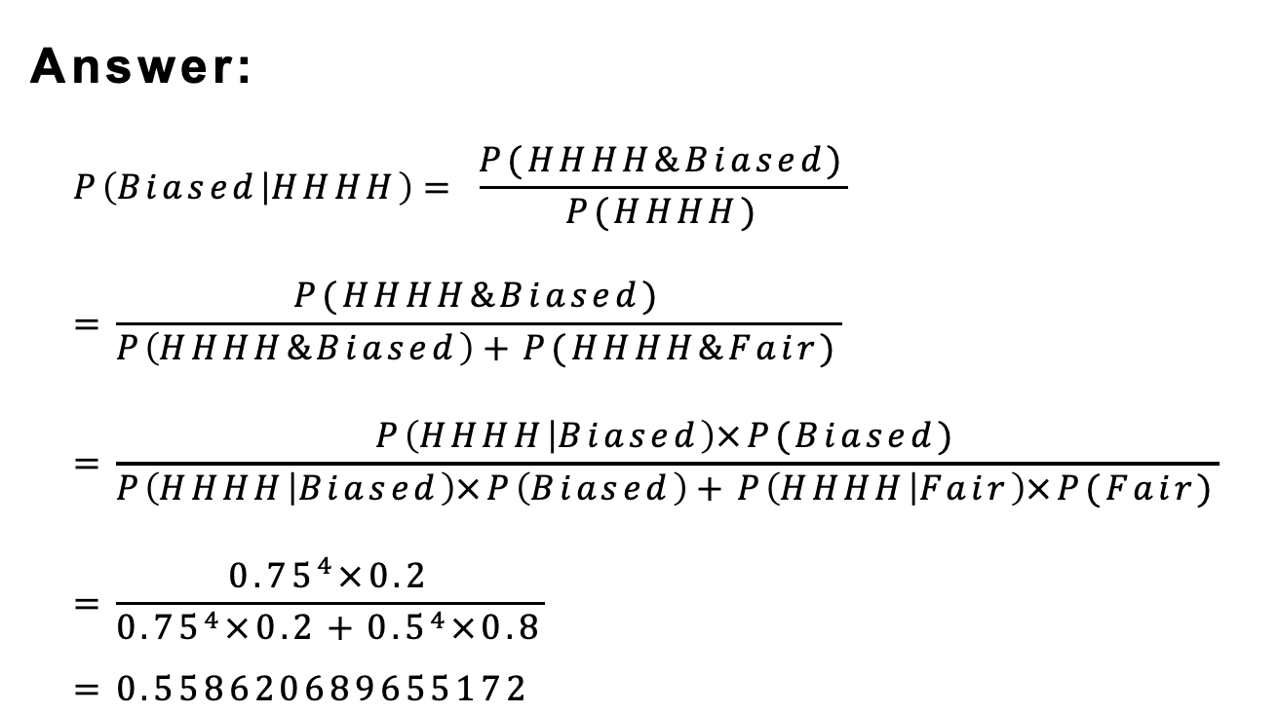
Answer: $$P\left(Biased | HHHH\right)= \frac{P(HHHH\&Biased)}{P(HHHH)} \\ =\frac{P(HHHH\&Biased)}{P\left(HHHH\&Biased\right)+P(HHHH\&Fair)} \\ =\frac{P\left(HHHH | Biased\right)×P(Biased)}{P\left(HHHH | Biased\right)×P\left(Biased\right)+P\left(HHHH | Fair\right)×P(Fair)} \\ =\frac{{0.75}^{4}×0.2}{{0.75}^{4}×0.2+{0.5}^{4}×0.8} \\ =0.558620689655172$$

