Slide 1
Master’s thesis - Minimizing the Power Consumption of Medical Applications
Shuyang Tian
ge73zac@tum.de
Supervisor: Nicolai Kröger
Nicolai.Kroeger@tum.de

Slide 2
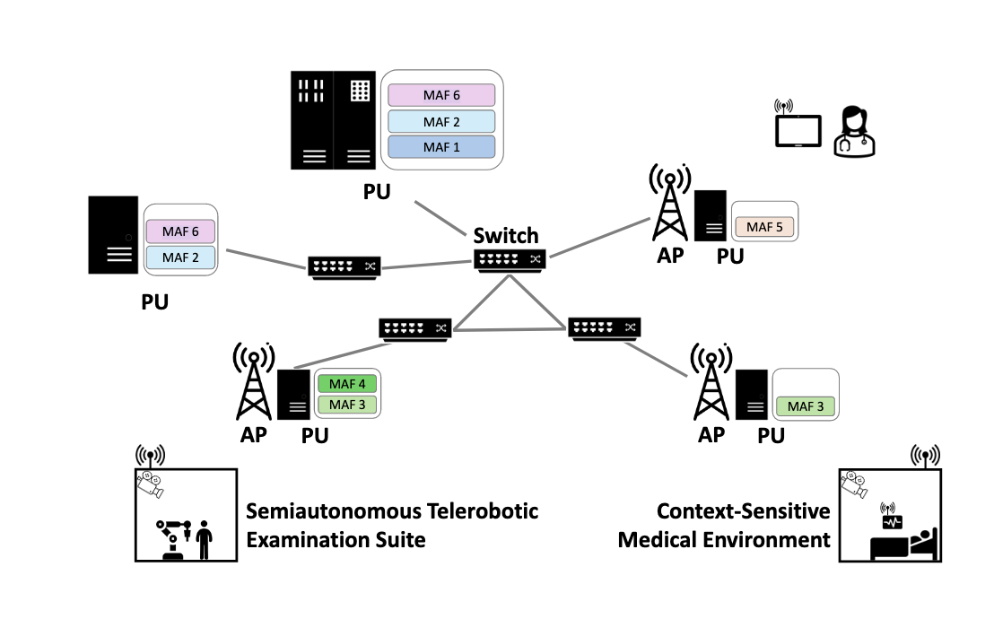
Research Background
Research Motivation:
Optimizing task scheduling & energy efficiency in medical applications
Reducing power consumption while maintaining low latency & reliability
Problem Definition：
The goal:
Minimize MAF computation energy
Optimize task scheduling across PUs
Ensure E2E latency constraints
Key Challenges：
Task Assignment
Task Chain
PU Load Balancing
PU Energy
Network architecture [1]

Slide 3
Comparison of Energy Optimization Methods
Paper | Energy Optimization | Method | Energy Model | Complexity | Task Chain Constraints
GACSM Algorithm [2] |  | Cuckoo Search + DVFS | Adjusts CPU voltage/frequency dynamically
PSO-Based Edge Server Placement [3] |  | Particle Swarm Optimization | Reduce idle energy by optimizing server placement.
Cloud Resource Allocation [4] |  | Heuristic-based scheduling + VM migration | PU energy ∝ Utilization (Linear model)
Thesis (MAF Optimization) |  | MIP-Based Optimization | PU energy ∝ Utilization (Linear model)

Slide 4
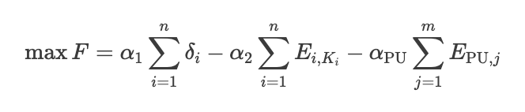
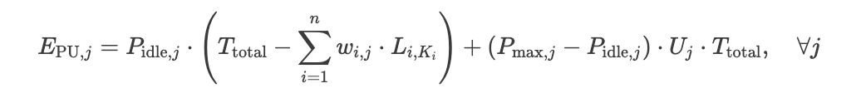
Proposed Model
Objective: Minimize MAF computation energy while ensuring E2E latency constraints.
Optimization Model:
PU total energy consumption model [4] [5]:
dle Energy: PU Energy consumption in the idle state
Active Energy: Dynamic energy consumption when calculating tasks

Slide 5
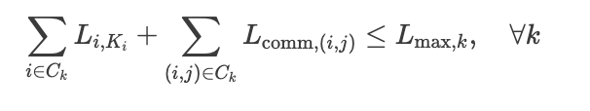
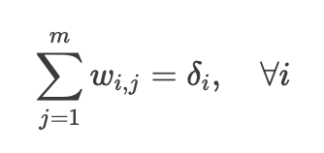
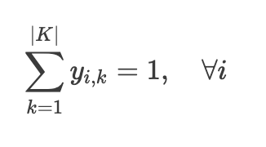
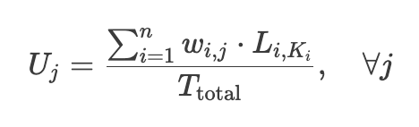
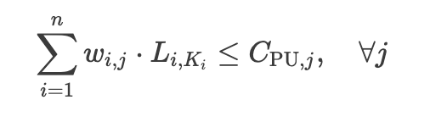
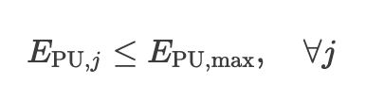
Key Constraints
Ent-to-End (E2E) Latency for Task Chains:
Each MAF chain follows a strict order (e.g Task 1 -> Task 2 -> Task 3 -> ….)
Task Assignment to a single PU:
Single Energy Level Selection per Task:
Task Execution Time Dependency on PU Utilization: [4]
PU Computational Capacity Constraint: [5]
PU Energy Consumption Limit:

Slide 6
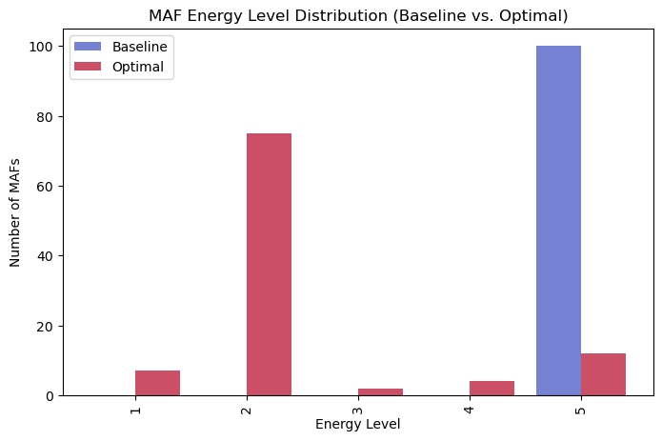
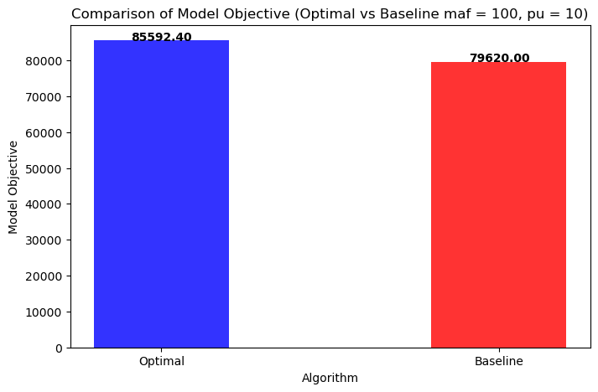
Preliminary Results
MAF Task: n = 100; PU : m = 10; Energy Levels: K = 5; Chains : z = 10;
Baseline: Maximum energy level vs Optimal: Free choice of energy level

Slide 7
Future Work – Testing with Different Data
Testing with Different MAF Workloads
Simulate different numbers of MAF tasks (e.g., small-scale vs. large-scale workloads).
Compare energy consumption, latency, and PU utilization.
Varying Task Chain Structures
Run experiments with short chains, long chains, and highly interconnected chains.
Evaluating Different PU Capacities and Constraints
Simulate low-power vs. high-performance PUs.
Sensitivity Analysis on Optimization Weights
Adjust different weight combinations.

Slide 8
Bibliography
[1] Kröger, Nicolai, et al. "Processing Modular Application Functions in Future Medical 6G Radio Access Networks." First International Workshop on 6G Emerging Technologies, Architectures, and Applications. 2024.
[2] Deng, Zexi, et al. "Energy-aware task scheduling on heterogeneous computing systems with time constraint." IEEE Access 8 (2020): 23936-23950.
[3] Li Y, Wang S. An energy-aware edge server placement algorithm in mobile edge computing[C]//2018 IEEE International conference on edge computing (EDGE). IEEE, 2018: 66-73.
[4] Beloglazov A, Abawajy J, Buyya R. Energy-aware resource allocation heuristics for efficient management of data centers for cloud computing[J]. Future generation computer systems, 2012, 28(5): 755-768.
[5] Soualah O, Mechtri M, Ghribi C, et al. Energy efficient algorithm for VNF placement and chaining[C]//2017 17th IEEE/ACM International Symposium on Cluster, Cloud and Grid Computing (CCGRID). IEEE, 2017: 579-588.

Slide 9

Questions?

