Slide 1
CITI MARKETS HONG KONG · HT SALES TRADING · INTERNSHIP FINAL PROJECT
Flow & Positioning Monitor
Turning the desk's own execution flow into monthly positioning colour — an internal dashboard for the floor, and an automated report for clients.
THE PROBLEM
WHAT WAS BUILT
THE PROOF
Clients ask what is crowded. Nobody can measure it, and our franchise sends them nothing.
One Python engine producing two products from a single set of underlying data.
Six desk scenarios in which the tool answered a question the floor could not otherwise answer.
HK cash equities · reporting window August 2025 – July 2026 · directional and qualitative only
Shuyun Lyu · August 2026

Slide 2
1 · MOTIVATION
The problem: four gaps that leave the desk answering from memory
Clients ask
what is crowded
Crowding cannot
be measured
The daily short-
interest report
Peers already send
flow colour
Answered from one
salesperson's memory
A research score that
describes last quarter
Shows the short base,
but contains no flow
Our franchise sends
nothing to clients
THE COMMON ROOT
Each gap exists because the three things that would answer the question sit in three separate places and are never joined: the street's short base lives on Bloomberg, our clients' intentions live in our own blotter, and the marginal buyer lives in the Connect data.
The objective was therefore never another screen. It was the join — produced monthly, and delivered in two forms: a dashboard for the floor and a report for the client.

Slide 3
2 · MAIN OBJECTIVE
Combine the data we already own, and turn it into positioning colour for clients
The desk already holds every input needed to answer the question. They simply sit in separate systems and are never brought together on one page, for one month, in language a client can use.
OUR OWN EXECUTED FLOW
THE MAINLAND BID
THE STREET'S SHORT BASE
What our clients actually did — direction and conviction by sector, by name and by cohort
Southbound Connect flow per stock — the marginal buyer in this market
Short interest, days-to-cover and momentum from Bloomberg
POSITIONING COLOUR FOR CLIENTS — delivered monthly, in two forms
An internal dashboard the floor reads before a client call, and a concise monthly report that goes to the client directly. Both are generated from the same underlying data by the same script.
The discipline that keeps it defensible
We flag candidates, never verdicts
Every claim is traceable
A name is raised because two flows disagree, or because the exit is narrow — not because a score says so.
Each sentence in the client report is generated from a computed value, so the desk can always show the working.

Slide 4
3 · HOW IT IS BUILT
Four sources, one engine, two products, one scheduled run
CTA line-by-line
THE ENGINE
PRODUCT 1 · INTERNAL
Every high-touch and program ticket: name, side, notional, month
Net flow
The full HTML dashboard
Buy − Sell − Short-sell, shown only as ratios and direction
Notionals included and every window selectable. This is where the floor goes before a client call to see rotation, the name screens and the flow trend.
EE aggregate only
Short interest
Sector × month and client type × month — a compliance boundary
Short shares ÷ float, expressed as a percentage
Days-to-cover
Southbound database
Short shares ÷ 30-day average volume
PRODUCT 2 · EXTERNAL
Per-stock Connect net flow from one internal source
The monthly client report
Price vs flow
Month-end price against the prior month-end, versus our side
Concise and qualitative, with no notionals. Generated by the same script for the latest completed month and ready for an Outlook distribution.
Bloomberg via xbbg
RSI 14D, short interest, float, 30-day volume, price, turnover
Narrative
Four deterministic templates filled with computed values — never generative
One command produces both outputs, and the reporting month advances automatically to the last completed month, so next month's edition requires no code change.

Slide 5
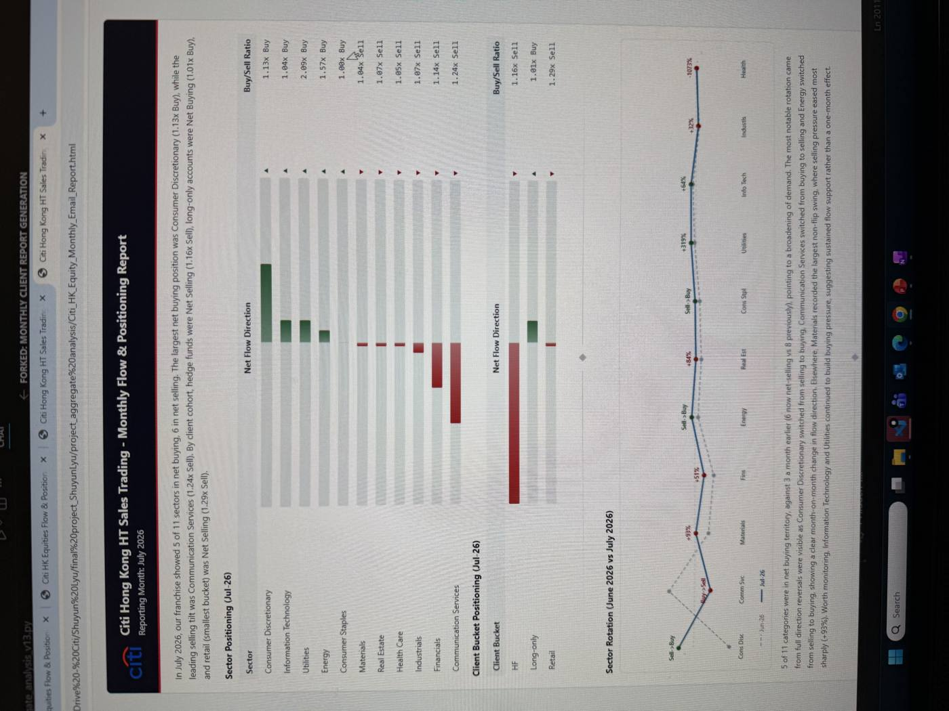
3B · THE DELIVERABLE
Product one: the monthly client report that leaves the building
Jul-26 edition
Four commentary layers, written by the script
A
EXECUTIVE PARAGRAPH
Opens the report. Ranks sectors by net flow, counts how many are net-bought against net-sold, names the leading buying and selling tilt, and states each client cohort's side and ratio.
B
ROTATION COMMENTARY
Sits under the two rotation charts. Compares this month with last: the breadth change, every full direction reversal, the largest non-flip swing, categories still building conviction, and where selling pressure eased.
C
PRICE VERSUS FLOW
Sits under the first quadrant chart. Places each name into buy-up, buy-down, sell-up or sell-down, keeps the three largest per quadrant, and writes the interpretation only for quadrants that are populated.
D
CITI VERSUS SOUTHBOUND
Sits under the second quadrant chart. Places each name by our side against the mainland's, then flags shared conviction as crowding risk and opposite sides as an onshore-offshore divergence worth watching.
Citi HK Equities — Monthly Flow & Positioning Report, generated automatically for the latest completed month and sized for an Outlook body.
Identical inputs always produce identical wording, so the text can be reviewed once and trusted every month.

Slide 6
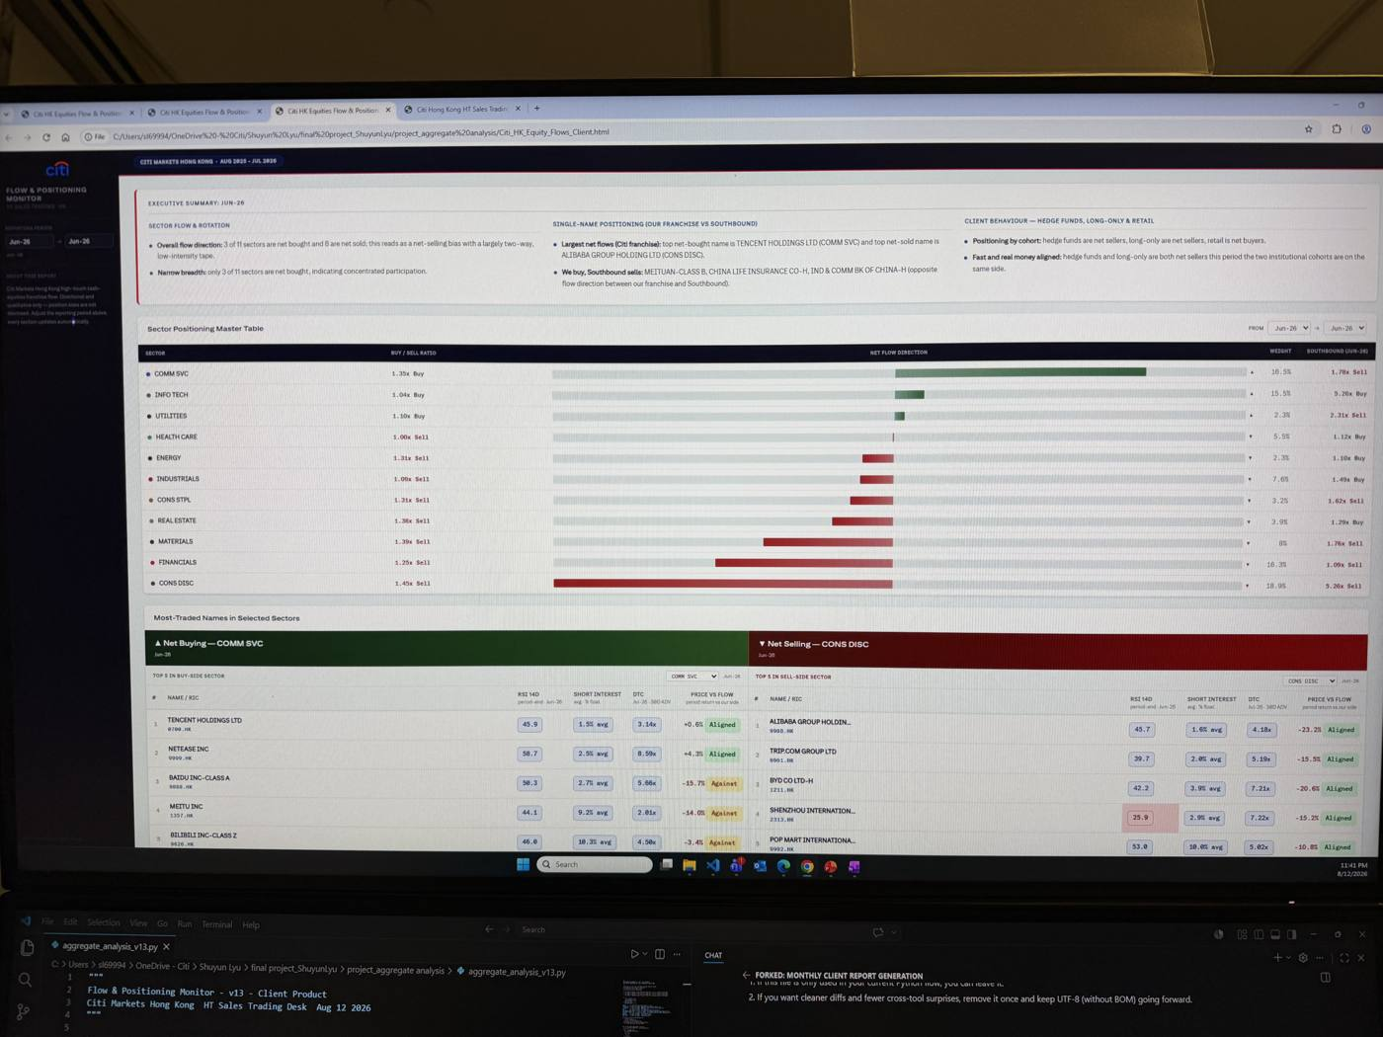
3C · THE DESK TOOL
Product two: the internal dashboard the floor reads before a client call
Any window
Executive summary
Three columns written for the selected window: sector flow and rotation, single-name positioning against southbound, and client behaviour by cohort.
Sector positioning master table
Buy/sell ratio, net flow direction, book weight and the southbound ratio for the same sector, side by side on one row.
Most-traded names
Top five within the leading buy and sell sectors, and the top ten across all sectors, each carrying RSI, short interest, days-to-cover and price versus flow.
Price-versus-flow monitor
Every name plotted by our side against its price move, with the two contradiction corners boxed and ranked.
Franchise-versus-southbound map
The four positioning quadrants with the named lists that sit behind each one.
Trajectories and cohorts
Monthly direction, cumulative paths by sector, any-two-month comparison, and the client-type panel expandable to sub-types.
Same engine, same underlying data — only the audience and the disclosure level differ.
Flow & Positioning Monitor — the full internal build. Notionals are retained here and every panel recomputes for any window inside the rolling twelve months.

Slide 7
4 · SCENARIO 1 — THE TWELVE-MONTH REGIME
Institutions sold through a rising market — the flow against its benchmark
Aug-25 – Jul-26
CLIENT / DESK QUESTION
“Flows into Hong Kong look strong. Is that true of institutional money, or only of the mainland bid?”
THE FLOW | THE BENCHMARK
Net sellers in ten of twelve months, deepest in January at the war shock and June in the chip rout. Buying appeared only in September and April. | The index made a four-year high in October and still ended the window near where it started — strength our clients sold into for a full year.
Index path: four-year high above 27,000 intramonth in October; 22,672 at the June low; 25,009 by 17 July. Month-end closes are indicative — pull exact prints from Bloomberg before presenting. Hang Seng TECH traced the same shape with roughly twice the amplitude.
The two lines on one page are the argument: a rising benchmark over a persistently selling franchise means the rally was carried by the mainland bid, not by institutions — so institutional re-entry is fresh fuel, and the cushion in any sell-off is southbound's to hold.

Slide 8
4 · SCENARIO 2 — THE MONTHLY ROTATION
Three sectors reversed outright, and the mainland did not always follow
Jun vs Jul-26
CLIENT / DESK QUESTION
“Out of what, into what — and was the mainland with you or against you?”
THE HAND-OFF
THE SHARED TRADE
THE DISAGREEMENT
Communication Services is the only bar that crosses zero in opposite directions on the two charts. We moved from 1.35x buying to 1.24x selling exactly as the mainland moved from 1.78x selling to 6.91x buying.
Consumer Discretionary flipped to buying on both sides at once, as the delivery subsidy war cooled and PMI reached 52.0. When both feeds turn together, the demand is broader than our own book.
Materials stayed a modest sell for us while southbound bought at 17.49x, and Energy split the other way. Breadth widened from three of eleven sectors bought to five.

Slide 9
4 · SCENARIO 3 — THE THEME BEHIND THE ROTATION
The AI complex sold off across four GICS sectors — a positioning reset, not a fundamental break
Jun → Jul-26
CLIENT / DESK QUESTION
“Comm Svc was your top buy in June and your top sell in July. What actually changed?”
THE AI COMPLEX, REBUILT FROM THE NAME SCREEN — the sector table hides it, because these names sit in four different GICS buckets
INFO TECH
COMM SVC
CONS DISC
INDUSTRIALS
Kingboard Lam. −70.3%
NetEase +2.7%
Alibaba +26.0%
CATL −11.3%
Victory Giant −47.2%
Baidu −3.4%
Trip.com +17.6%
Knowledge Atlas −53.1%
Tencent (Jun buy)
JD.com +28.1%
Sunny Optical −8.1%
Xiaomi +33.0%
Hardware chain and new AI listings — the epicentre
Platforms: bought in June, sold in July
Cloud and e-commerce — counted as consumer
Battery tech, also AI-adjacent capex
Price move over July, from the top-traded screen. Verify the Kingboard print before presenting — a fall of that size in one month warrants a second look at the price reference.
1 · THE CATALYSTS
2 · WHY IT READS AS A RESET
3 · WHERE THE MONEY WENT
Two record capital events pulled money out of the incumbents. SK Hynix listed ADRs on Nasdaq on 10 July, raising US$26.5bn — the largest US share sale ever by a foreign company — and closed its debut +13%. CXMT then priced Asia's biggest IPO of 2026 at US$8.6bn and opened +466% on 27 July. Fresh AI supply, same wallet.
Results were not the problem. Samsung posted a record second quarter with operating profit up more than eighteen-fold, and Asian chips were sold anyway. Mid-July reporting described AI names as short-term overheated with near-term catalysts exhausted, while staples and financials rose in the same sessions. Earnings up, prices down is positioning unwinding — not a change in fundamentals.
Out of the crowded AI complex and into under-owned consumer. Consumer Discretionary went from our heaviest sell in June (1.45x) to our top buy in July (1.13x), and southbound flipped with us from 5.26x selling to 1.22x buying. Utilities doubled its buying and Energy reversed to buy — the reset funded the defensive and the under-owned alike.
This is the slide the sector table alone could never produce: regrouped by theme rather than by GICS label, June's buying and July's selling are the same trade being put on and taken off — and our franchise used the reset to rotate, not to exit.

Slide 10
4 · SCENARIO 4 — ONE MAP, FOUR VERDICTS
One exemplar per quadrant, and the four columns that decide the verdict
Jul-26
CLIENT / DESK QUESTION
“We are buying and the price is falling. Is that new demand — or shorts covering into us?”
WE BUY · PRICE FALLING
WE BUY · PRICE RISING
THE FOUR COLUMNS
KINGBOARD LAMINATES
XIAOMI CORP-B
Flow × price
gives the quadrant — who is being paid
RSI 52.3
SI 19.6%
ΔSI −25.4%
DTC 1.96x
RSI 50.3
SI 8.7%
ΔSI +83.8%
DTC 6.34x
COVERING MET OUR BID
SQUEEZE LOADING
Δ short base
names who is on the other side: covering, or fresh shorts
The largest short base on the page, but it shrank as the price fell and the exit is under two sessions. Part of our buying met shorts taking profit, not fresh sellers — so this is a value call, not a squeeze.
Shorts nearly doubled into a 33% rally while our clients bought, and the door is six sessions wide. RSI is only 50, so the tape is not yet stretched — the squeeze has room to run.
Days-to-cover
how fast they can leave — a trap or a doorway
WE SELL · PRICE RISING
WE SELL · PRICE FALLING
RSI 14D
whether the tape was already stretched before any of it
AIA GROUP
KNOWLEDGE ATLAS
RSI 55.8
SI 1.0%
ΔSI −48.8%
DTC 4.17x
RSI 48.4
SI 6.9%
ΔSI +271.9%
DTC 1.39x
AND AGAINST THE MAINLAND
COVERING-LED STRENGTH
BEAR CONVICTION, FAST EXIT
315 of the mapped names sit in disagreement with southbound against 265 in agreement. We buy what the mainland distributes — Kingboard, Xiaomi, Lenovo — and sell into its bid in Knowledge Atlas, Z AI and NetEase. Agreement marks the crowded names; disagreement marks the view.
The base halved as the price rose, so covering — not fresh demand — absorbed our supply. Covering is finite: when it ends the bid disappears. Weeks later the offshore-levy headline validated the exit.
We sold, shorts multiplied nearly fourfold, and the price collapsed. But a day-wide exit means any bounce is violent and brief — conviction without a trap.
our franchise: buying (top row) · selling (bottom row)
the tape: price fell (left) · price rose (right)
Two names sit in the same quadrant of the tool and mean opposite things: Kingboard's shorts were leaving, Knowledge Atlas's were arriving. Without the change in the short base, both would simply read “we sold and it fell.”

Slide 11
4 · SCENARIO 5 — THE CLIENT COHORTS
June to July: hedge funds held their line, real money crossed it
Jun vs Jul-26 · 12M path
CLIENT / DESK QUESTION
“Is this move fast money or real money — a trend, or a contested level?”
Replace with a direct export of the dashboard's cumulative-by-bucket panel before presenting — the shape is traced, the exact path is the tool's.
HEDGE FUNDS — the trend
LONG-ONLY — the turn
RETAIL — the mirror
One-way de-grossing: the cumulative line steps down in almost every month of the year. June to July it merely eased, from 1.23x to 1.16x selling.
Accumulated the March–April war lows, funded that out in June's rout, then crossed to a 1.01x net buy at July's breakout — its first buy in months, and marginal by design of the word.
Bought the June dip at 1.23x, sold the July rip at 1.29x — the smallest bucket, excluded from the signal, but a neat sentiment mirror of long-only.
June's alignment — both institutional cohorts selling — is why bounces faded. July's divergence marks a contested level, not yet a trend. Built purely from our own tickets: no vendor can print this pair.

Slide 12
5 · VALUE TO THE DESK
The three questions the desk is asked — now answered on sight
✓
“What is crowded?”
✓
“How is the street positioned?”
✓
“What rotated, and why?”
Scenario 4's quadrant map names the crowded longs and shorts, with the change in the short base and days-to-cover testing whether the exit is narrow. Candidates with evidence, refreshed monthly.
Scenario 1 sets the regime — a year of institutional selling under a rising benchmark — and Scenario 5 shows which cohort is doing it and when real money turned.
Scenarios 2 and 3 trace the sector reversals and the theme inside them, with the mainland's flow on the same axes for contrast.
Positioning colour for a call
one seat's memory
the whole franchise, any window, in about a minute
Verifying a single name
30–60 minutes of ad-hoc Bloomberg work
RSI, short base, exit and southbound pre-joined on the row
What the client receives
nothing, while peers send monthly flow reports
an automated, disclosure-safe monthly report in the inbox
The moat is structural: everyone receives the same short-interest report and anyone can watch southbound — but only this desk can cross both with its own franchise flow, and that ingredient cannot be bought.

Slide 13
6 · AUTOMATION · 7 · LIMITATIONS
Built to run every month, and explicit about what it cannot say
1 · DROP
2 · RUN
3 · GUARD
4 · SEND
The month's CTA extract and the two aggregate files land, and the southbound database refreshes.
One command. The reporting month advances automatically and both products are produced together.
Bloomberg fields are cached, so re-runs cost no quota and missing data renders as not-available.
The dashboard goes to the floor and the report goes into the Outlook distribution.
Approximately fifteen minutes of effort per month once the file drops are scheduled.
LIMITATION | WHAT IT MEANS IN PRACTICE | HOW IT COULD BE IMPROVED
Our flow is a sample, not the market | It reads our own clients accurately and leans on southbound as the market-wide anchor, so every output is a candidate rather than a verdict. | Blend in exchange-level short-interest and turnover data to widen the denominator.
Electronic execution joins at aggregate only | Compliance prevents line-by-line sharing, so single names cover high-touch and program trading, and sector can never be crossed with client type. | Nothing to fix — it is a hard boundary and the design already works around it.
The two flow feeds overlap | Onshore institutions trade through us and through Connect, so same-direction readings are overlap-sensitive while contradictions stay conservative. | Bound the overlap explicitly and footnote same-sign signals in the client report.
Directional-only cuts both ways | The absence of notionals makes the report safe to send but means it cannot size risk, and rotation into ADR lines is invisible to Hong Kong flow. | Keep notionals in the internal build, and add an ADR overlay for dual-listed names.
Next steps: schedule the run two business days after month-end, add an alert when a name enters the contradiction watch-list, and tune the report's wording with the desk before the first client distribution.

Slide 14
IN CLOSING
The problem solved, in one sentence
The desk was being asked what is crowded and had only memory to answer with. It now has a monthly product, built on flow no competitor can see, that names candidates and shows the evidence behind each one — and a client report that finally puts our franchise colour in front of accounts, as peer banks already do.
INTERNAL
EXTERNAL
EVIDENCE
HONESTY
A dashboard the floor opens before a client call, with notionals and every window.
An automated monthly report, qualitative and ready for distribution.
Six scenarios in which the tool answered a question the floor could not.
Candidates rather than verdicts, with the limitations stated up front.
The ask: run the monthly report to two or three accounts for one cycle, schedule the refresh two business days after month-end, and give me thirty minutes of desk feedback on its wording.
Thank you — the live tool is one click away. Shuyun Lyu · HT Sales Trading · Citi Markets Hong Kong

Slide 15
APPENDIX
Technical process, data treatment, report generation, and market references

Slide 16
APPENDIX A
How the data was assembled and cleaned
STEP | WHAT WAS DONE | WHY IT MATTERS
Ingestion | CTA line-by-line extract, the two aggregate CSVs, the southbound SQLite database and Bloomberg fields are read by dedicated reader functions. | A single entry point per source makes a schema change a one-line fix.
Universe filtering | [PLACEHOLDER — describe exclusions applied: ETFs, warrants, dual counters, any minimum-size threshold] | Keeps the name-level screens focused on single stocks that clients actually discuss.
Identifier mapping | [PLACEHOLDER — how RIC / Bloomberg ticker / HK code are reconciled across the four sources] | Without one canonical key, southbound and Bloomberg cannot be joined to our flow.
Currency and scaling | Southbound net flow is held in HKD and converted with a live USDHKD rate, falling back to 7.78 if unavailable. | Keeps the two flow feeds directly comparable on one axis.
Missing-data policy | Bloomberg fields are cached to disk; anything unavailable renders as not-available and is never back-filled or interpolated. | A blank cell is honest; an invented number is not, and clients see this file.
Validation | [PLACEHOLDER — reconciliation checks run, e.g. sector totals against desk blotter, month coverage assertions] | Catches a half-loaded month before a report is generated.

Slide 17
APPENDIX B
Metric definitions, Bloomberg fields and window treatment
METRIC | BLOOMBERG FIELD | FORMULA | MULTI-MONTH WINDOW | SINGLE MONTH
RSI 14D | RSI_14D | monthly series value | last non-null month in the window | that month's value
SI shares | SHORT_SELL_NUM_SHARES | monthly level feeding the metrics below | monthly series | same
SI notional (USDmn) | + PX_LAST, USDHKD | (SI × price) ÷ (1e6 × USDHKD) | average across selected months | one-month value
Short interest (% float) | + EQY_FLOAT | SI ÷ (float × 1e6) × 100 | average across selected months | one-month value
Days-to-cover | + VOLUME_AVG_30D | SI ÷ ADV30 | latest available, not window-based | latest available
SI shares change (%) | SHORT_SELL_NUM_SHARES | (SI_end ÷ SI_ref − 1) × 100 | last month in window against the month before it started | selected month against prior month
Price change (%) | PX_LAST | (PX_end ÷ PX_ref − 1) × 100 | end of window against the pre-window anchor | selected month against prior month
THREE POINTS OF DISCIPLINE
Short interest is a level rather than a flow, so the change metric compares two points in time and is never summed across days. Days-to-cover is the one metric that reports the latest available reading rather than the selected window, and is labelled accordingly. Free float is a periodically revised vendor estimate that excludes strategic holdings, so where float estimates are unstable — recent listings, heavily state-owned names — days-to-cover is the more reliable of the two exit measures.

Slide 18
APPENDIX C
How the client report is generated inside the script
1 · SELECT MONTH
THE FOUR COMMENTARY LAYERS
The reporting month defaults to the most recent completed month, and the twelve-month window rolls forward with it.
A · Executive paragraph
Ranks sectors by net flow, counts how many are net-bought and net-sold, identifies the leading buy and sell tilt, and states each client cohort's side and ratio.
2 · COMPUTE FACTS
Sector, cohort and single-name metrics are calculated once and reused by both outputs, so the dashboard and the report can never disagree.
B · Rotation commentary
Compares the current month with the previous one: breadth change, full direction reversals, the largest non-flip swing, categories still building, and easing selling pressure.
3 · WRITE COMMENTARY
C · Price versus flow
Four rule-based layers fill fixed templates from those computed values: the executive paragraph, the rotation commentary, and the two quadrant commentaries.
Places each name into buy-up, buy-down, sell-up or sell-down, keeps the largest three per quadrant, and writes the interpretation for the quadrants present.
4 · RENDER AND SEND
D · Citi versus southbound
Charts and tables are written into a self-contained HTML file sized for an Outlook body, with no external dependencies.
Places each name into both-buy, both-sell, we-buy-they-sell or they-buy-we-sell, keeps the largest three per quadrant, and flags crowding and divergence.
The commentary is algorithmic template generation, not probabilistic language generation: identical inputs always produce identical wording, which is what makes the text auditable before it is sent to a client.

Slide 19
APPENDIX D
Known issues, assumptions and further work
ITEM | STATUS | PLANNED TREATMENT
Percent change across a sign flip | A category moving from net-sell to net-buy produces a percentage that has no interpretation. | Suppress the figure and label the move as a reversal instead.
Direction-aware swing wording | The largest-swing sentence uses one phrase regardless of whether conviction improved or faded. | Branch the wording on the sign of the change.
Retail cohort weighting | Retail is the smallest bucket and its swings can dominate a chart axis. | Retain for completeness, label as smallest bucket, exclude from the signal.
Feed overlap | Onshore institutions may trade through both our franchise and Connect. | Footnote same-direction readings; contradictions remain conservative.
Dual-listed names | [PLACEHOLDER — ADR line rotation is invisible to Hong Kong line flow] | [PLACEHOLDER — describe intended overlay if pursued]
Further work | [PLACEHOLDER — your own list: scheduling, alerting, additional metrics] | [PLACEHOLDER]

Slide 20
APPENDIX E · REFERENCES
Market events cited in this deck
Hang Seng four-year high; October 2025 rare-earth and tariff shock
https://markets.financialcontent.com/stocks/article/marketminute-2025-10-13-hong-kongs-hang-seng-plunges-below-26000-amidst-resurgent-us-china-trade-tensions
Busan truce and suspension of rare-earth export controls
https://www.thompsonhinesmartrade.com/2025/11/u-s-and-china-reach-deal-to-ease-trade-tensions/
US-Iran war: Brent crude rising roughly 51% during March
https://www.cnbc.com/2026/04/21/oil-price-iran-war-middle-east.html
Oil round-tripping to pre-war levels by early July
https://www.aljazeera.com/news/2026/7/8/oil-prices-surge-as-us-strikes-iran-reversing-fall-to-pre-war-levels
June AI-chip rout: Hang Seng at 22,672, seventh weekly loss
https://www.bbntimes.com/companies/hong-kong-stock-exchange-weekly-review-hang-seng-falls-1-8-to-22-672-as-ai-chip-rout-and-ipo-market-uncertainty-overshadow-quarter-end-recovery-hopes
July recovery to 25,009 and Hong Kong PMI at 52.0
https://www.nakitte.com/briefs/hangseng-2026-07-20/
Kingboard Laminates' fourth copper-clad-laminate price rise of 2026
https://finance.biggo.com/news/5339bae1-2900-4293-94f5-1944f85805e0
Southbound buying over HK$5bn of Tencent across three sessions
https://finance.biggo.com/news/580fb11a-3543-498f-94d9-72f8ae24cb5d
AIA down 6.6% on reports of a 20% offshore-policy levy, 6 August
https://www.scmp.com/business/banking-finance/article/3363106/shares-major-hong-kong-insurance-finance-firms-tumble-following-report-20-levy
Record China biotech out-licensing, including CSPC and AstraZeneca
https://www.drugdiscoverytrends.com/chinese-firms-landed-6-of-26-major-pharma-deals-in-16-months-worth-53-billion/
Meituan first-quarter loss narrowing as the delivery subsidy war cooled
https://insideretail.asia/2026/06/02/meituan-posts-another-loss-but-says-food-delivery-wars-are-beginning-to-abate/
May-June short base fuelling July's counter-trend rally
https://www.moomoo.com/community/feed/prince-when-the-hang-seng-index-breaks-through-the-bull-117018511147013
CXMT: Asia's largest 2026 IPO (US$8.6bn); +466% Shanghai debut, 27 July
https://www.cnbc.com/2026/07/27/cxmt-china-market-debut-chipmaker-ipo.html · reuters via money.usnews.com 26 Jul
Mid-July profit-taking in overheated AI names; HSI −1.78% to 24,562
https://finance.biggo.com/news/71a28029-87b9-4d81-b421-2187b5ba0b12
Chip/tech profit-taking while staples & financials rose; UBS: earnings trend intact
https://www.brecorder.com/news/40431305/china-hk-stocks-close-down-on-chip-and-tech-profit-taking
All sources are publicly available and were verified when this deck was prepared. Flow figures are Citi franchise data and are not sourced externally.

