Slide 1


Natural Language Processing Sub-word Tokenization

Slide 2
Outline
Recap
Word Segmentation
Sub-word Tokenization
Sub-word Tokenization

Slide 3
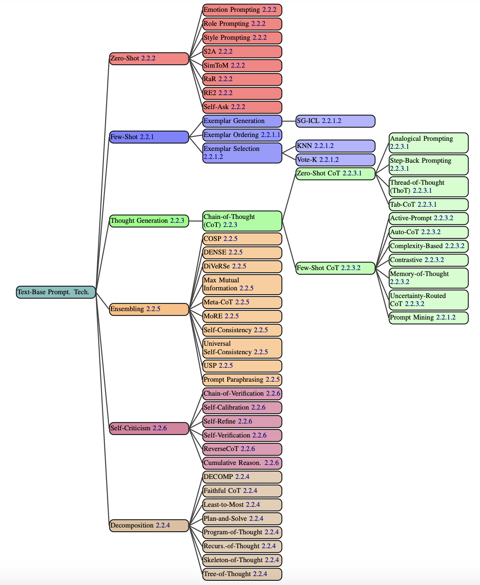
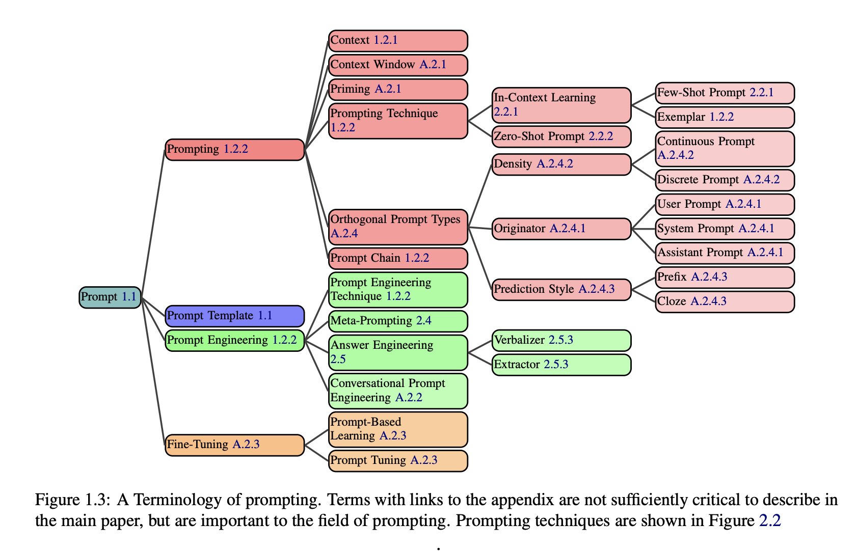
News
The Prompt Report: A Systematic Survey of Prompting Techniques, https://arxiv.org/pdf/2406.06608

Slide 4
Recap: Word Representations
Probability
apple
I
love
an
_
elephant
eraser
…
Vocabulary
Sub-word Tokenization

Slide 5
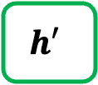
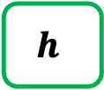
Recap: Word Representations (Details)
Hidden size: 100
Vocab
Prob
a
...
apple
...
b
...
banana
...
elephant
...
eraser
...
...
zoo
0.0001
...
0.600
...
0.0001
...
0.0003
...
0.300
...
0.05
...
...
0.0001
$$h$$
Classification Layer
Hidden size: Vocab_size
RNN
RNN
RNN
$$h′$$
Vocab
size
I
love
an
Sub-word Tokenization

Slide 6
Basic Pipeline of Natural Language Processing
Build the vocabulary
Learn the representations
(Training)
Perform predictions
(Testing)
Size(vocabulary)
BERT: 30522 GPT-2 / GPT-3: 50257 T5: 32,128
Sub-word Tokenization

Slide 7
How to build the vocabulary?
Segment words based on delimiters (e.g., white spaces).
Then we can collect the words from training corpora.
Vocabulary
Word | ID
and | 0
apples | 1
I | 2
like | 3
love | 4
pineapples | 5
. | 6
<UNK> | 7
I love apples. I like apples and pineapples.
(You can also perform stemming after word segmentation!)
Unknown words (not shown up in the training corpora)
Sub-word Tokenization

Slide 8
Issues of Delimiter-based Segmentation
Only work for Western languages.
Cannot work for Chinese, Japanese, ...
Cannot handle unseen words (not shown up in the training corpora)
A misspelled word contains morphological information but become an unknown word.
Sub-word Tokenization

Slide 9
Issues of Delimiter-based Segmentation (Continued.)
For machine translation, there is not always a 1-to-1 correspondence between source and target words since compound words may exist in target language.
For example, sewage water treatment plant (English) -> Abwasserbehandlungsanlage (German)
Sub-word units are favored.
sewage water
treatment
plant/facility
Sub-word Tokenization

Slide 10
Common Sub-word Tokenization Algorithms
Byte Pair Encoding (BPE) (Sennrich et al., 2016)^{[1]}
^{GPT series}
WordPiece (Schuster and Nakajima, 2012)^{[2]}
^{BERT, T5}
Unigram Language Model (Kudo, 2018)^{[3]}
[1] Sennrich, Rico, Barry Haddow, and Alexandra Birch. "Neural Machine Translation of Rare Words with Subword Units." Proceedings of the 54th Annual Meeting of the Association for Computational Linguistics (ACL), 2016.
[2] Schuster, Mike, and Kaisuke Nakajima. "Japanese and korean voice search." 2012 IEEE international conference on acoustics, speech and signal processing (ICASSP). IEEE, 2012.
[3] Kudo, Taku. "Subword Regularization: Improving Neural Network Translation Models with Multiple Subword Candidates." Proceedings of the 56th Annual Meeting of the Association for Computational Linguistics (ACL). 2018.
Notes:
Fasttext 用BPE

Slide 11
Segmentation vs. Tokenization
All tokenization is segmentation, but not all segmentation is tokenization.
Segmentation can be:
Word segmentation from a sentence
Sentence segmentation from a document
Tokenization can be:
Word segmentation from a sentence (then `words` become `tokens`)
Sub-word tokenization from a word or sentence

Slide 12
Sub-word Tokenization (1)
Given a training corpus, we first turn each word into a sequence of characters (separated by spaces)
Training corpus
Word | Frequency
l o w </w> | 5
l o w e r </w> | 2
n e w e s t </w> | 6
w i d e s t </w> | 3
low low low low low lower lower newest newest newest newest newest newest widest widest widest
</w> is a special end-of-word symbol, allowing us to restore the original tokenization.
Sub-word Tokenization

Slide 13
Sub-word Tokenization (1)
Initialize the vocabulary with the existing characters:
low low low low low lower lower newest newest newest newest newest newest widest widest widest
Initial vocab: </w>, d, e, i, l, n, o, r, s, t, w
Sub-word Tokenization

Slide 14
Sub-word Tokenization (2)
Find the character pair with the highest frequency
Word | Frequency
l o w </w> | 5
l o w e r </w> | 2
n e w e s t </w> | 6
w i d e s t </w> | 3
Found “e s” with the highest frequency 6+3=9
Current Vocabulary: </w>, d, e, i, l, n, o, r, s, t, w
Sub-word Tokenization

Slide 15
Sub-word Tokenization (3)
Add the pair with the highest frequency to the vocab
Word | Frequency
l o w </w> | 5
l o w e r </w> | 2
n e w e s t </w> | 6
w i d e s t </w> | 3
Current Vocabulary: </w>, d, e, i, l, n, o, r, s, t, w, es
Word Embeddings and Language Modeling

Slide 16
Sub-word Tokenization (4)
Merge the characters by replacing all words in the corpus with the newly added pair.
Word | Frequency
l o w </w> | 5
l o w e r </w> | 2
n e w es t </w> | 6
w i d es t </w> | 3
Current Vocabulary: </w>, d, e, i, l, n, o, r, s, t, w, es
Word Embeddings and Language Modeling

Slide 17
Sub-word Tokenization (2)
Repeated (2)-(4)
according to `num_merges`
Find the character pair with the highest frequency
Word | Frequency
l o w </w> | 5
l o w e r </w> | 2
n e w es t </w> | 6
w i d es t </w> | 3
Found “es t” with the highest frequency 6+3=9
Current Vocabulary: </w>, d, e, i, l, n, o, r, s, t, w, es
Word Embeddings and Language Modeling

Slide 18
Sub-word Tokenization (3)
Repeated (2)-(4)
according to `num_merges`
Add the pair with the highest frequency to the vocab
Word | Frequency
l o w </w> | 5
l o w e r </w> | 2
n e w es t </w> | 6
w i d es t </w> | 3
Current Vocabulary: </w>, d, e, i, l, n, o, r, s, t, w, es est
Word Embeddings and Language Modeling

Slide 19
Sub-word Tokenization (4)
Repeated (2)-(4)
according to `num_merges`
Merge the characters by replacing all words in the corpus with the newly added pair.
Word | Frequency
l o w </w> | 5
l o w e r </w> | 2
n e w est </w> | 6
w i d est </w> | 3
Current Vocabulary: </w>, d, e, i, l, n, o, r, s, t, w, es, est
Word Embeddings and Language Modeling

Slide 20
Sub-word Tokenization (2)
Repeated (2)-(4)
according to `num_merges`
Find the character pair with the highest frequency
Word | Frequency
l o w </w> | 5
l o w e r </w> | 2
n e w est </w> | 6
w i d est </w> | 3
Found “est </w>” with the highest frequency 6+3=9
Current Vocabulary: </w>, d, e, i, l, n, o, r, s, t, w, es, est
Word Embeddings and Language Modeling

Slide 21
Sub-word Tokenization (3)
Repeated (2)-(4)
according to `num_merges`
Add the pair with the highest frequency to the vocab
Word | Frequency
l o w </w> | 5
l o w e r </w> | 2
n e w est </w> | 6
w i d est </w> | 3
Current Vocabulary: </w>, d, e, i, l, n, o, r, s, t, w, es, est, est</w>
Word Embeddings and Language Modeling

Slide 22
Sub-word Tokenization (4)
Repeated (2)-(4)
according to `num_merges`
Merge the characters by replacing all words in the corpus with the newly added pair.
Word | Frequency
l o w </w> | 5
l o w e r </w> | 2
n e w est</w> | 6
w i d est</w> | 3
Current Vocabulary: </w>, d, e, i, l, n, o, r, s, t, w, es, est, est</w>
Word Embeddings and Language Modeling

Slide 23
Sub-word Tokenization (2)
Repeated (2)-(4)
according to `num_merges`
Find the character pair with the highest frequency
Word | Frequency
l o w </w> | 5
l o w e r </w> | 2
n e w est</w> | 6
w i d est</w> | 3
Found “l o” with the highest frequency 5+2=7
Current Vocabulary: </w>, d, e, i, l, n, o, r, s, t, w, es, est, est</w>
Word Embeddings and Language Modeling

Slide 24
Sub-word Tokenization (3)
Repeated (2)-(4)
according to `num_merges`
Add the pair with the highest frequency to the vocab
Word | Frequency
l o w </w> | 5
l o w e r </w> | 2
n e w est</w> | 6
w i d est</w> | 3
Current Vocabulary: </w>, d, e, i, l, n, o, r, s, t, w, es, est, est</w>, lo
Word Embeddings and Language Modeling

Slide 25
Sub-word Tokenization (4)
Repeated (2)-(4)
according to `num_merges`
Merge the characters by replacing all words in the corpus with the newly added pair.
Word | Frequency
lo w </w> | 5
lo w e r </w> | 2
n e w est</w> | 6
w i d est</w> | 3
Current Vocabulary: </w>, d, e, i, l, n, o, r, s, t, w, es, est, est</w>, lo
Word Embeddings and Language Modeling

Slide 26
Finish Sub-word Leaning
Assume `num_merges`=4 (we just repeated four times.)
`num_merges` is a hyperparameter that you need to set for BPE.
The learned vocabulary is: </w>, d, e, i, l, n, o, r, s, t, w, es, est, est</w>, lo

Slide 27
Tokenization with Learned BPE
The learned vocabulary is: </w>, d, e, i, l, n, o, r, s, t, w, es, est, est</w>, lo
We first turn each word into a sequence of characters with </w> placed at the end of a word, the same as the first step during the learning phase.
Then we can merge the characters according to the learned vocabulary.
Examples:
l o w </w>
lo
w
</w>
w i d e s t </w>
w
i
d
est</w>

Slide 28
Properties of BPE
The final learned vocabulary size = initial size + `num_merges`
Initial vocab: </w>, d, e, i, l, n, o, r, s, t, w
Learned vocab: </w>, d, e, i, l, n, o, r, s, t, w, es, est, est</w>, lo
This algorithm is based on statistics, so frequent sub-word units in provided corpora will be put to the learned vocabulary.

Slide 29
Why do we need Sub-word Tokenization?
With sub-word tokenization algorithms, we can handle representations for unknown words (or mis-spelled words / compound words).
In machine translation, the compound word issues between source and target languages can be alleviated.
State-of-the-art pre-trained language models (e.g., GPT-3, BERT) adopt sub-word tokenization algorithms before pre-training.

Slide 30
Limitations of Sub-word Tokenization
(Not many disadvantages for sub-word tokenization)
The hyperparameter `num_merges` needs to be tuned.
Once the learned vocabulary is created, it becomes fixed. The algorithm needs to be re-run after adding new data.
How about Chinese?
Character-level encoding

