Slide 1

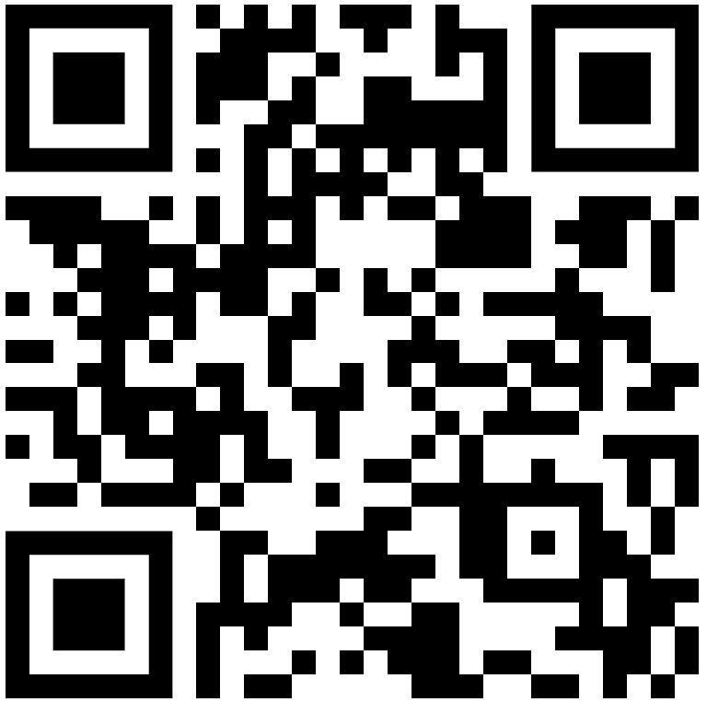
Working like a data scientist on Jupyter
https://github.com/shuzhao-li-lab/MANA2024
Shuzhao Li, Ph.D. (shuzhao.li@jax.org)
Joshua Mitchell M.D., Ph.D. (joshua.mitchell@jax.org)
Oct. 23, 2024. Tampa
Notes:
Mention annotation of feature tables. Maybe show example.

Slide 2

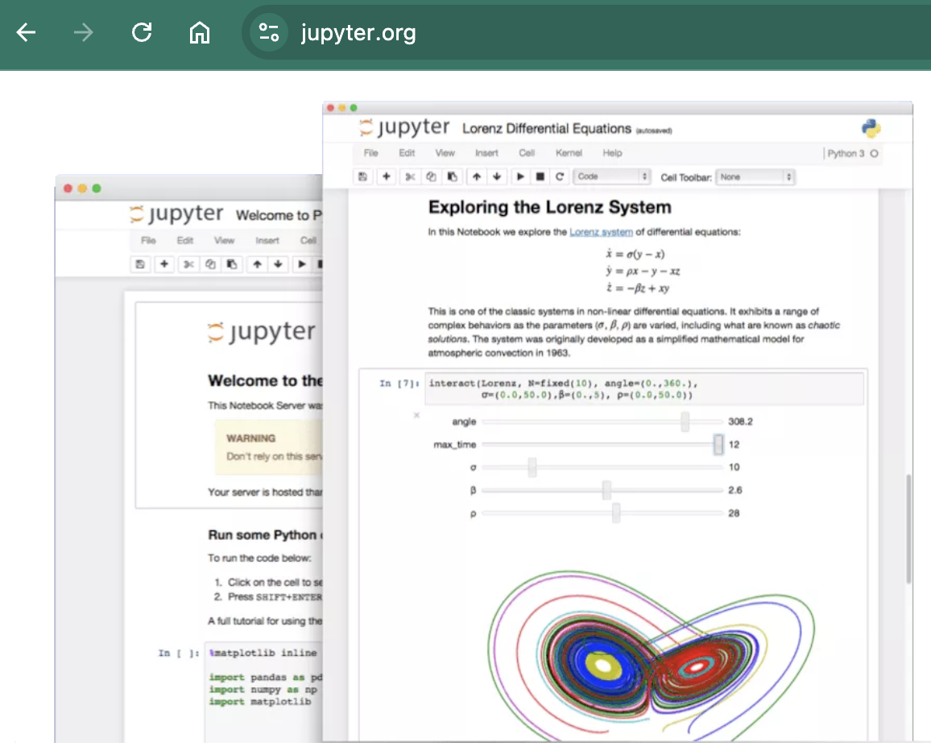
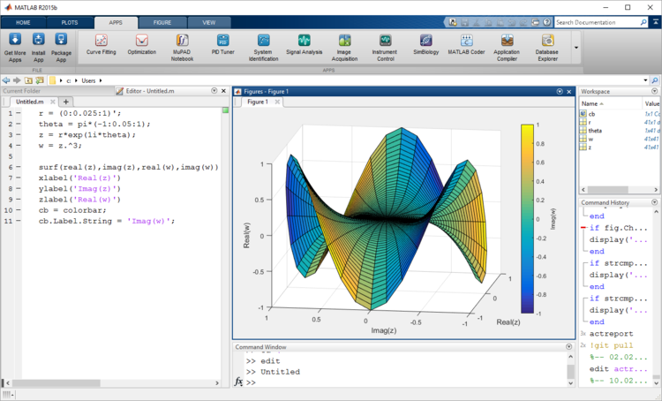
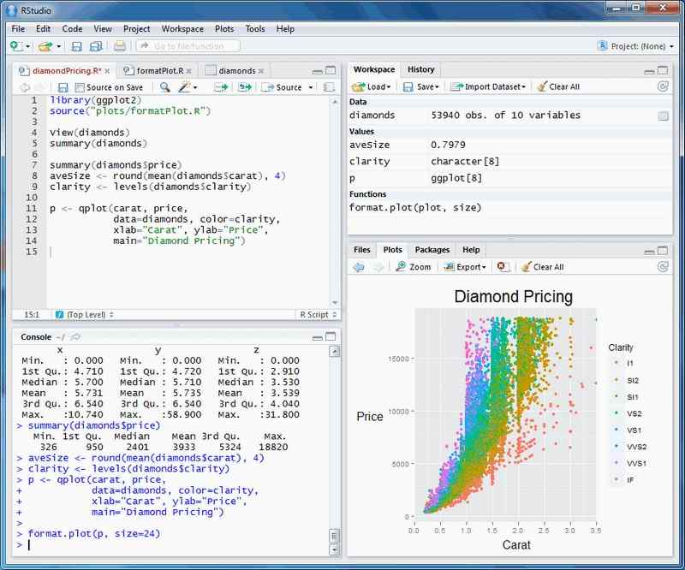
Jupyter notebooks: workbench for data scientists
jupyter.org
Inspirations:
Matlab,
Rstudio/Posit

Slide 3
Objectives
What are Jupyter notebooks, why & how to use them
Key concepts and terminology in handling metabolomics data.
Processing LC-MS metabolomics data (Asari, PCPFM)
Annotation concepts (Khipu)
Basic processing of stable isotope tracing data

Slide 4
Focus on work, not computing environment
Often good idea to get a friend to help setup
Know where data are, local directories or internet URL
Computing on local machines, vs servers
Colab is running on Google’s servers
Jupyter notebooks are better run on local machines
Jupyter notebooks support R and other languages; we use Python here for demo

Slide 5
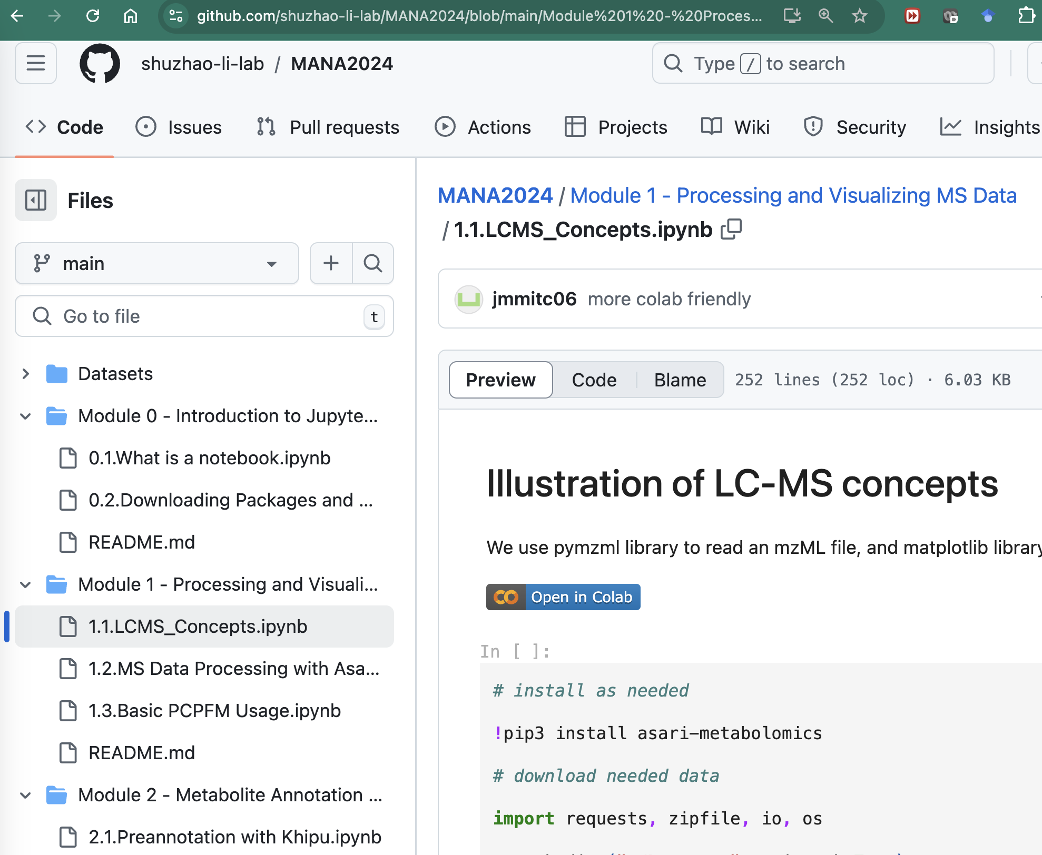
https://github.com/shuzhao-li-lab/MANA2024
Click this button to open in Colab
Can ignore warning not authored by Google

Slide 6
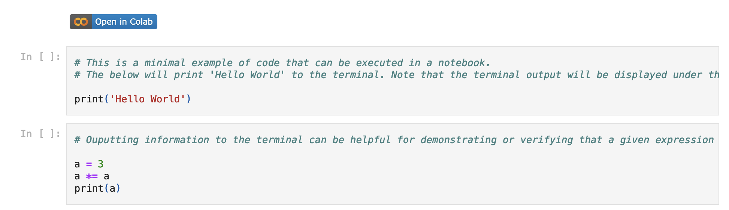
Module 0
Not part of live workshop
Reference for you to install software later

Slide 7
Module 1
In this module, we will look at spectral data, learn about pre-processing of metabolomics data (Asari).
Three notebooks, work through them in order:
1.1 – Illustration of LC-MS Concepts
1.2 – MS data processing in Asari
1.3 – Basic usage of PCPFM pipeline

Slide 8
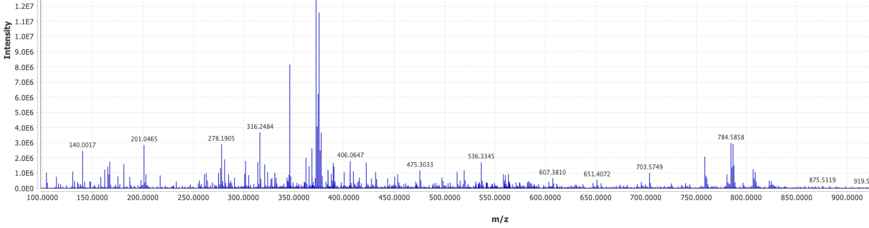
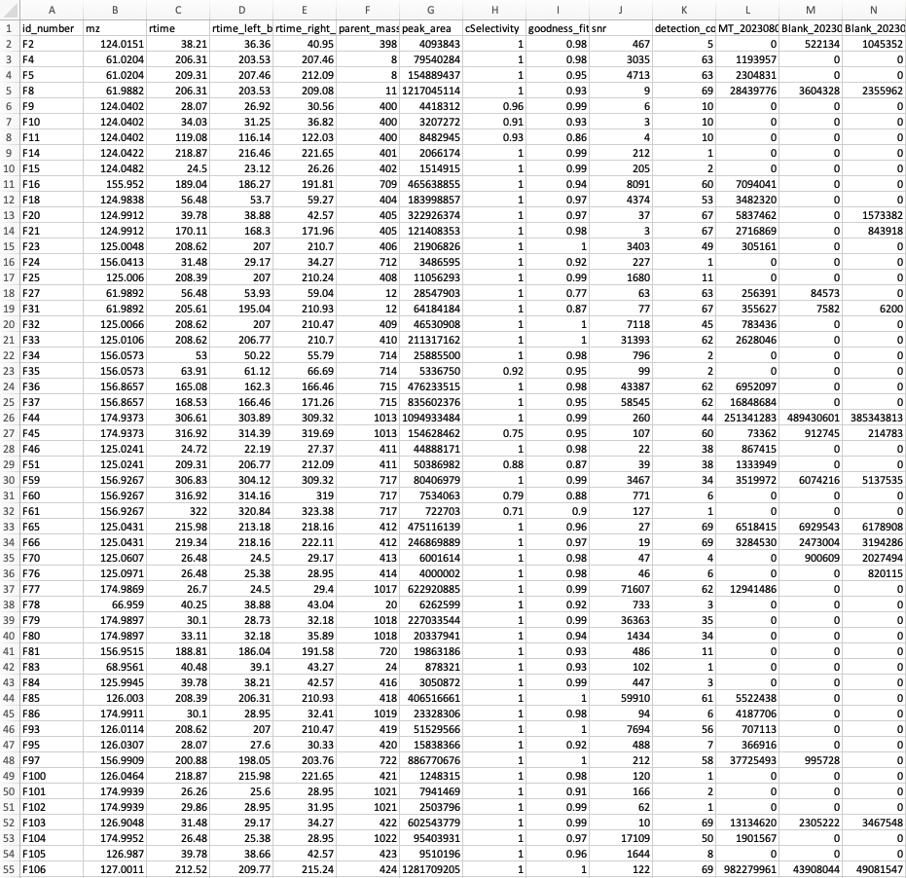
Preprocessing: from spectra to table
Sample 1
Sample 2
Feature Table
Pre-Processing
Sample 3
Sample 4
…

Slide 9
Module 2
In this module, we will learn about pre-annotation and annotation. We will also explore isotope tracing data and perform annotation both standalone and in the pipeline.
Three notebooks, work through them in order:
2.1 – Pre-annotation with Khipu
2.2 – Khipu and Stable Isotope Tracing Data
2.3 – Advanced usage of PCPFM pipeline.

Slide 10
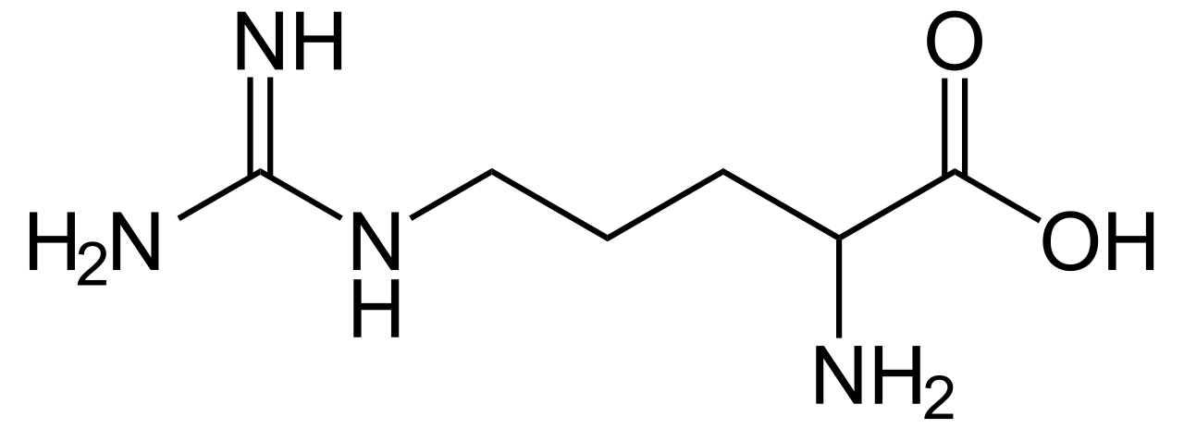
What is Pre-Annotation?
Traditional techniques, each feature is queried for annotation = 6 searches! More false positives
One Compound, Many Features
m, +H⁺
m, +Na⁺
m+¹³C₁, +H⁺
m, +ACN⁺
m+¹³C₂, +H⁺
m+¹³C₁, +Na⁺
m/z
Empirical Compound
Empirical compound means one query and fewer false positives.
Inferred Neutral Mass
Notes:
mzunit, CAMERA, binner perform a similar ‘pre-annotation’ but khipu performs the regression that allows for the inference of mass and yields a computable data structure.

Slide 11
Module 3
This module provides examples and templates for statistical tests and plots.
There are two notebooks:
3.1 – Statistical Testing
3.2 – Common Plots

