Slide 1
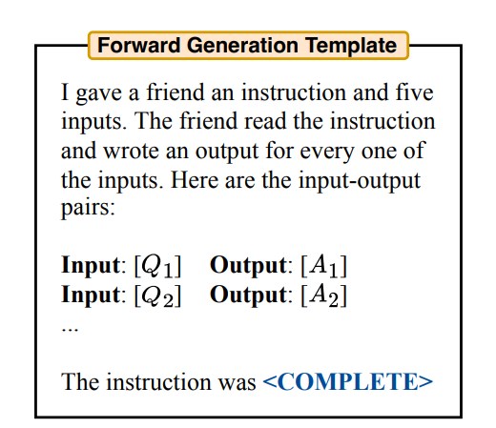
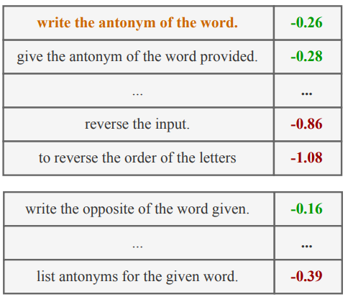
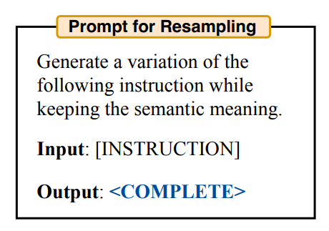
Prompt自动生成与优化方法
1.生成seed prompt
2.在训练集上用该prompt生成预测并打分
3.选择分数高的prompt让LLM根据这些prompt生成新的prompt

Slide 2
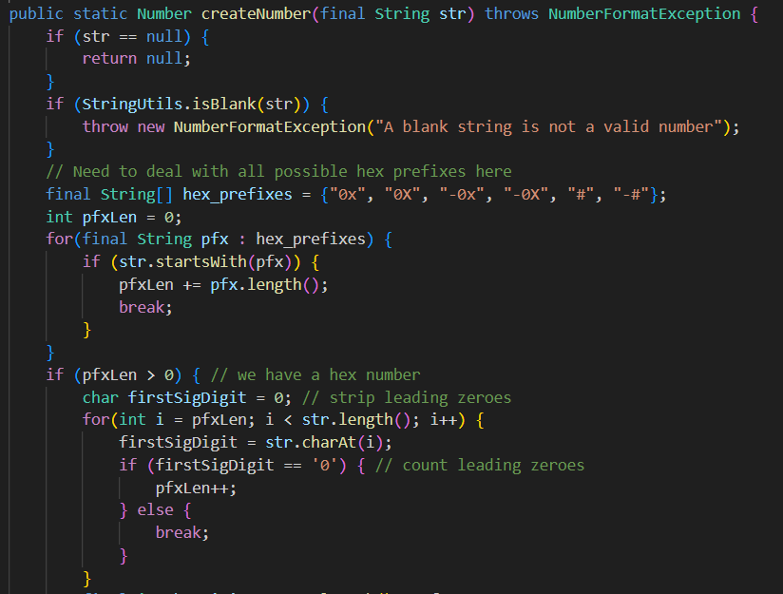
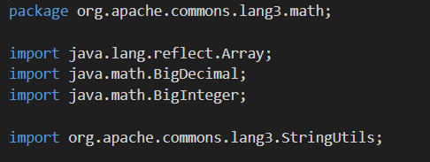
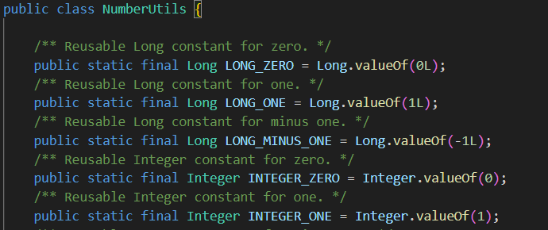
Defects4j test case
1.生成test case时prompt的内容
focal method
import
class context

Slide 3
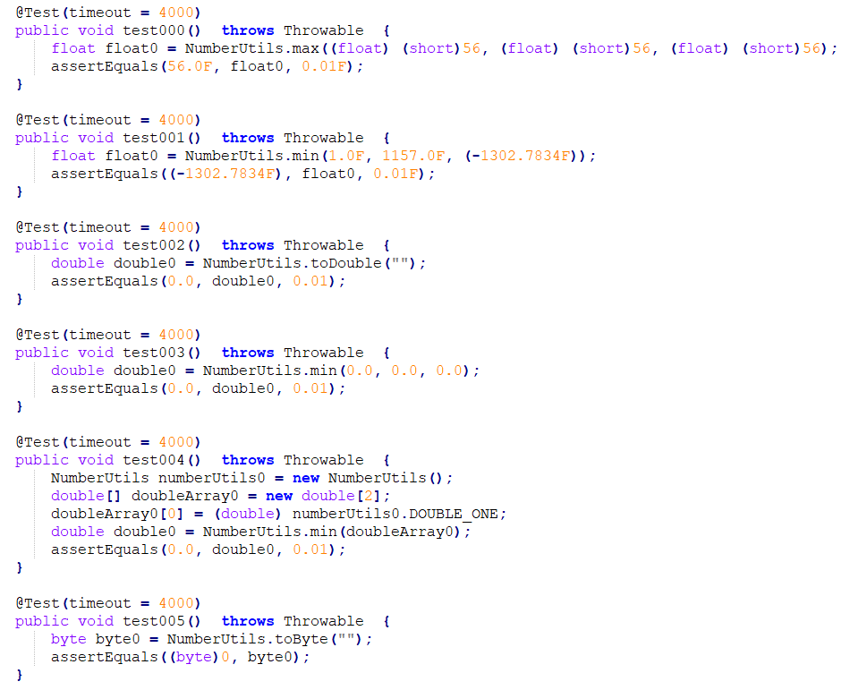
Defects4j test case
2.生成覆盖率高的test cases
一次生成10个
or
每次生成一个采样10次

Slide 4
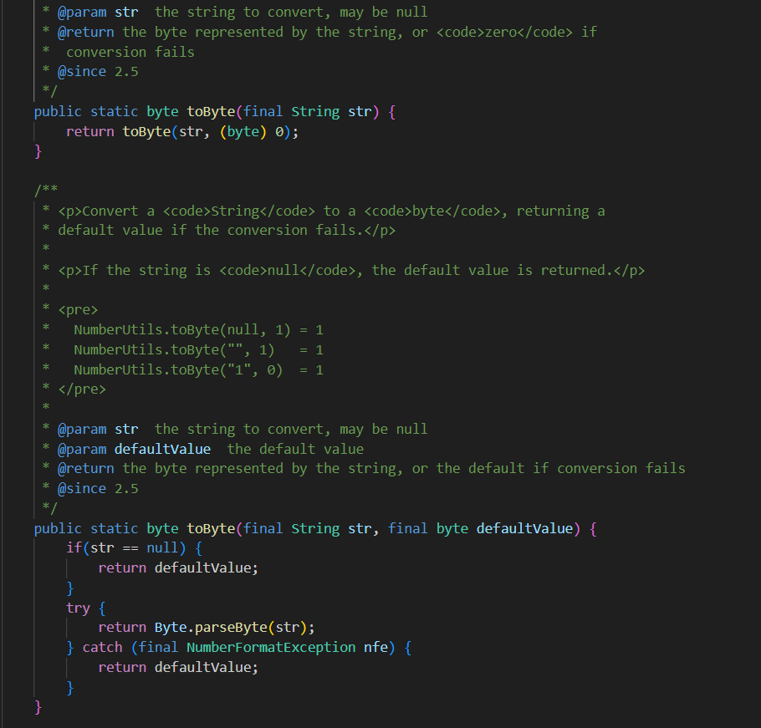
Defects4j test case
3.class level
选取3个project作为训练集，5个project作为测试集
生成时给一个focal method直接生成至多10个test case，尽可能提高coverage

Slide 5
prompt: Task Desctiption & Instructions:
You will be provided with a focal method, its import statements and the class signature. Your task is to generate up to no more than test cases for this focal method. Please try to improve the coverage of these test cases. One
example of generated test cases for other focal method is like this:
```java
@Test
public void test0001() throws Throwable {
double double1 = org.apache.commons.lang3.math.NumberUtils.toDouble("hi!");
assertTrue("'" + double1 + "' != '" + 0.0d + "'", double1 == 0.0d);
}```
Processing Lang-1
Processed_ut:240 Succuess_ut:188
Processing Math-5
Processed_ut:184 Succuess_ut:126
Processing Time-4
Processed_ut:126 Succuess_ut:40
line coverage: 75.03333333333333, condition coverage: 62.699999999999996

Slide 6
IfStatement
x<1
Boundary condition
if x<1:
return ‘b’
elif x==1:
return ‘a’
elif x>1 and x<5:
return ‘a’
elif x==5:
return ‘a’
elif x>5:
return ‘b’
consequent
alternate
Add new branches?
BlockStatement
return ‘b’
IfStatement
x==1
if x>=1 and x<=5:
return ‘a’
else:
return ‘b’
IfStatement
x>=1 and x<=5
consequent
alternate
consequent
alternate
BlockStatement
return ‘a’
IfStatement
x>1 and x<5
BlockStatement
return ‘a’
BlockStatement
return ‘b’
consequent
alternate
BlockStatement
return ‘a’
IfStatement
x==5
数值比较？
组合爆炸
consequent
alternate
BlockStatement
return ‘a’
IfStatement
return ‘b’

Slide 7
Boundary condition
1.不考虑函数调用
2.考虑函数调用
1.条件转换
(not A or B) and (C or not D) and (E or F)
(A or C) and (A or not D) and (B or C) and (B or not D)
2.条件枚举
True: (A or C) and (A or not D) and (B or C) and (B or not D)
(A, C) × (A, not D) ×(B, C) ×(B, not D)十六种情况
False: (not A and not C) or (not A and D) or (not B and not C) or (not B and D)
(not A and not C), (not A and D), (not B and not C), (not B and D)四种情况
3.边界条件分解
A and B
A: x>=y -> A1: x>y, A2: x=y
B: y>=z -> B1: y>z, B2: y=z
(A1 and B1), (A1 and B2), (A2 and B1), (A2 and B2)
A: func(x,y)/func(x,y)>2
3.出现在condition以外的情况
x= a>=b
if x==1
return ‘a’
else:
return ‘b’
BinaryExpression
def fun(a,b):
return a >=b
x= fun(a,b)
if x==1
return ‘a’
else:
return ‘b’

Slide 8
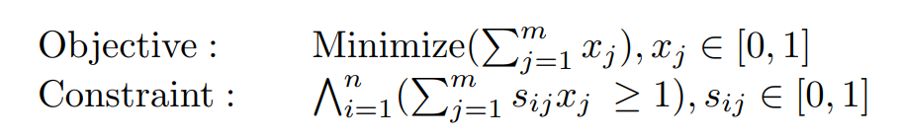
Test Suite Reduction
Set covering problem
Requirements
Methods
Code coverage
Mutant killings
Integer linear programming
Heuristic (Greedy, GE, GRE, HSG)
Problem:
over generation -> execution -> filtering
mainly used in regression testing

Slide 9
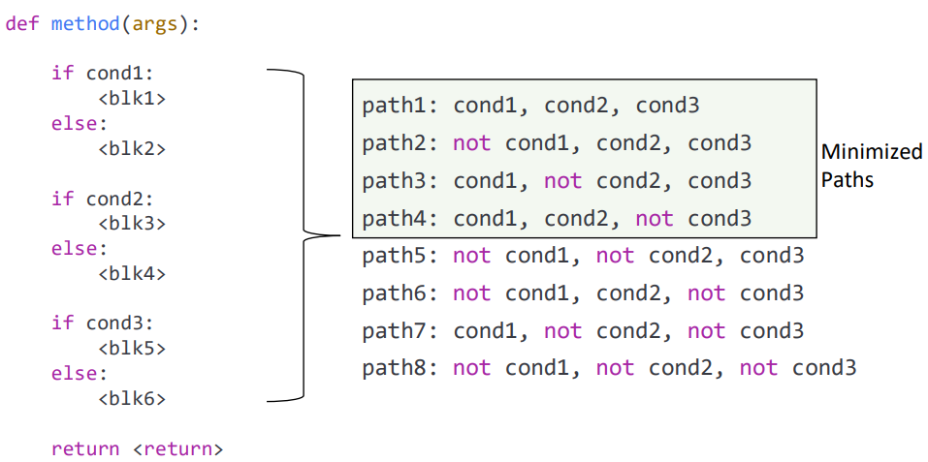
Test Suite Reduction
在生成前过滤
不考虑上下文的过滤和简化：
x>2 and x>1 -> x>2
x>2 and x<1 -> 过滤
考虑上下文的过滤：
Symbolic execution? (costly)
2.条件枚举
True: (A or C) and (A or not D) and (B or C) and (B or not D)
(A, C) × (A, not D) ×(B, C) ×(B, not D)十六种情况
False: (not A and not C) or (not A and D) or (not B and not C) or (not B and D)
(not A and not C), (not A and D), (not B and not C), (not B and D)四种情况
3.边界条件分解
A and B
A: x>=y -> A1: x>y, A2: x=y
B: y>=z -> B1: y>z, B2: y=z
(A1 and B1), (A1 and B2), (A2 and B1), (A2 and B2)
在生成时过滤
让LLM step-by-step的来分析每一行的变量的取值范围（extend scratchpad to the abstract level）？

Slide 10
Task Desctiption & Instructions:
You will be provided with a focal method along with its import statements and class signature, and a specific statement that you test case could trigger. Your task is to write a unit test case that could trigger the specific statement.
Please follow the instructions step-by-step to write unit test case that could trigger the specific statement: 1. From back to front list the interval of the key value on the path to trigger this statement, 2. Based on the analysis, decide whether the statement is reacable or not, 3. Based on the analysis, if reachable, return the unit test case in code block (```java ```).
Desired output format:
1. From back to front list the interval of the key variable on the path to the specific statement
Line<line_number>: <variable_name>:<value_range>, <variable_name>:<value_range>...
Line<line_number>: <variable_name>:<value_range>, <variable_name>:<value_range>...
...
2. Based on the analysis, decide whether the statement is reacable or not give your answer in block (```<yes or no>```)
```<yes or no>```
3. Based on the analysis, if reachable, return the unit test case in code block (```java ```)
```java
<unit test>
```

Slide 11
Import statements:
import java.lang.reflect.Array;
import java.math.BigDecimal;
import java.math.BigInteger;
import org.apache.commons.lang3.StringUtils;
Class signature:
public class NumberUtils {
public NumberUtils() {
super();
}
The statement that your test case could trigger:
return radix+pos;
Focal method:
public static BigInteger createBigInteger(final String str) {
if (str == null) {
return null;
}
int pos = 0; // offset within string
int radix = 10;
boolean negate = false; // need to negate later?
if (str.startsWith("-")) {
negate = true;
pos = 1;
}
if (str.startsWith("0x", pos) || str.startsWith("0x", pos)) { // hex
radix = 16;
pos += 2;
} else if (str.startsWith("#", pos)) { // alternative hex (allowed by Long/Integer)
radix = 16;
pos ++;
} else if (str.startsWith("0", pos) && str.length() > pos + 1) { // octal; so long as there are additional digits
radix = 8;
pos ++;
final BigInteger value = new BigInteger(str.substring(pos), radix);
return radix+pos;
} // default is to treat as decimal
final BigInteger value = new BigInteger(str.substring(pos), radix);
return negate ? value.negate() : value;
}

Slide 12
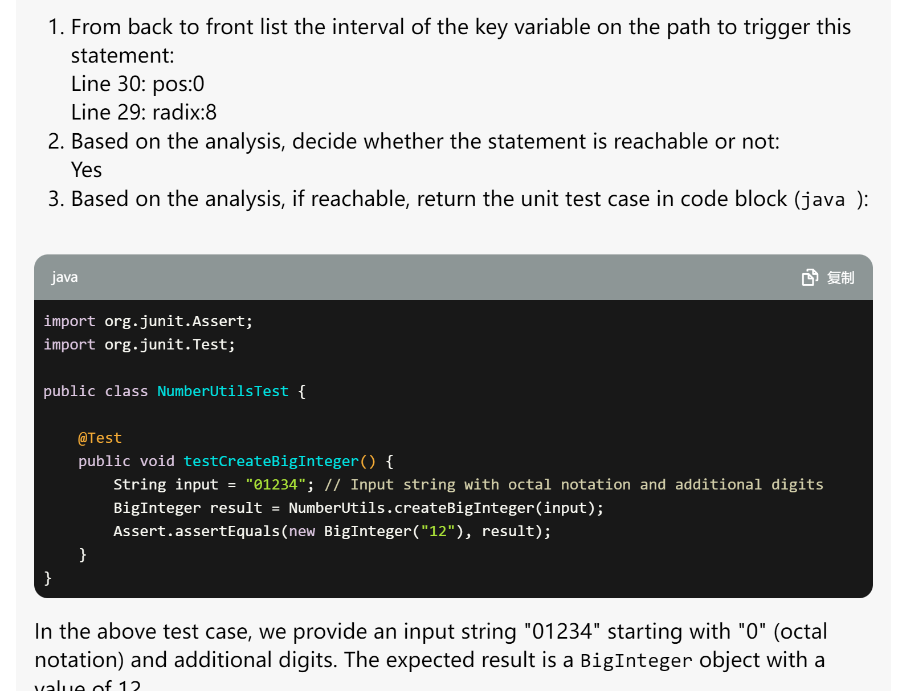
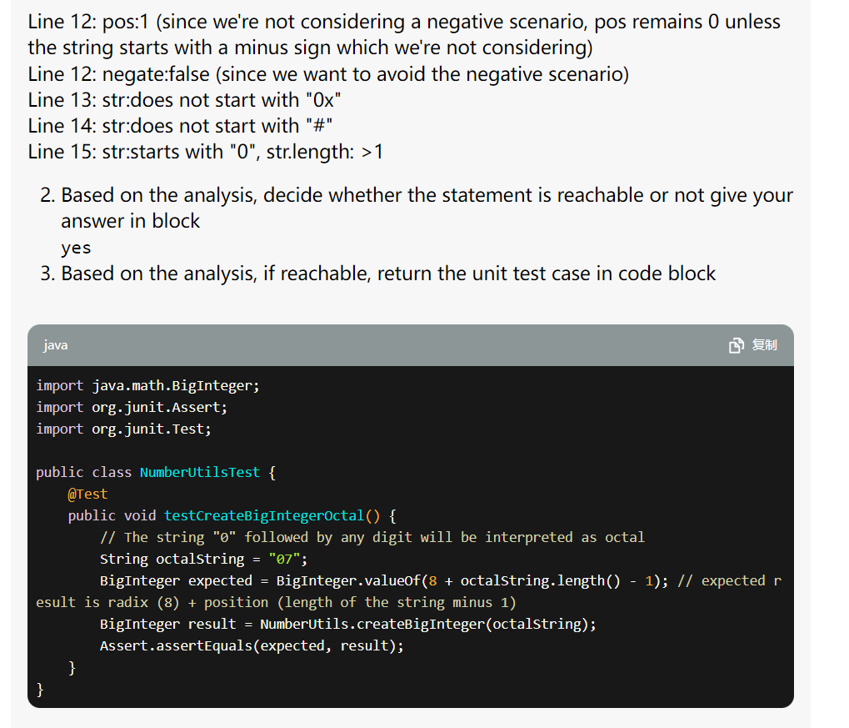
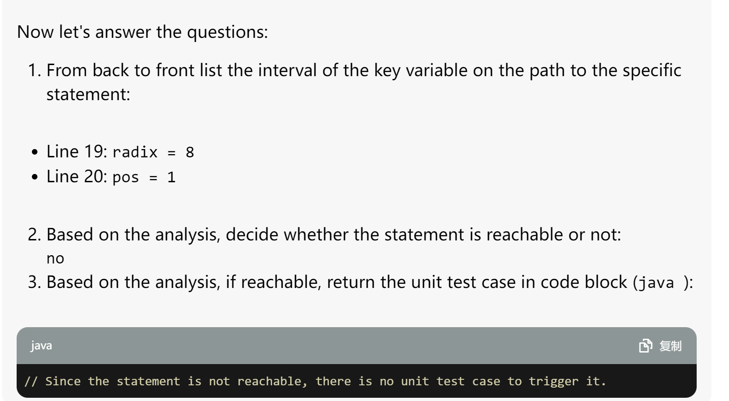

Slide 13
Task Desctiption & Instructions:
You will be provided with a focal method along with its import statements and class signature, and a specific statement that you test case could trigger. Your task is to write a unit test case that could trigger the specific statement.
Please follow the instructions step-by-step to write unit test case that could trigger the specific statement: 1. From back to front list the interval of the key value on the path to trigger this statement, 2. Based on the analysis, decide whether the statement is reacable or not, 3. Based on the analysis, if reachable, return the unit test case in code block (```java ```).
Desired output format:
1. From back to front list the interval of the key variable on the path to the specific statement
Line<line_number>: <variable_name>:<value_range>, <variable_name>:<value_range>...
Line<line_number>: <variable_name>:<value_range>, <variable_name>:<value_range>...
...
2. Based on the analysis, decide whether the statement is reacable or not give your answer in block (```<yes or no>```)
```<yes or no>```
3. Based on the analysis, if reachable, return the unit test case in code block (```java ```)
```java
<unit test>
```

Slide 14
Import statements:
import java.io.Serializable;
import java.util.ArrayList;
import java.util.List;
import org.apache.commons.math3.FieldElement;
import org.apache.commons.math3.exception.NotPositiveException;
import org.apache.commons.math3.exception.NullArgumentException;
import org.apache.commons.math3.exception.util.LocalizedFormats;
import org.apache.commons.math3.util.FastMath;
import org.apache.commons.math3.util.MathUtils;
Focal method:
public double abs() {
if (isNaN) {
return Double.NaN;
}
if (isInfinite()) {
return Double.POSITIVE_INFINITY;
}
if (FastMath.abs(real) < FastMath.abs(imaginary)) {
if (imaginary == 0.0) {
return FastMath.abs(real);
}
double q = real / imaginary;
return FastMath.abs(imaginary) * FastMath.sqrt(1 + q * q);
} else {
if (FastMath.abs(real) < FastMath.abs(imaginary) && real == 0.0) {
return FastMath.abs(imaginary);
}
double q = imaginary / real;
return FastMath.abs(real) * FastMath.sqrt(1 + q * q);
}
}
Class signature:
public class Complex implements FieldElement<Complex>, Serializable {
public Complex(double real) {
this(real, 0.0);
}
public Complex(double real, double imaginary) {
this.real = real;
this.imaginary = imaginary;
isNaN = Double.isNaN(real) || Double.isNaN(imaginary);
isInfinite = !isNaN &&
(Double.isInfinite(real) || Double.isInfinite(imaginary));
}

Slide 15
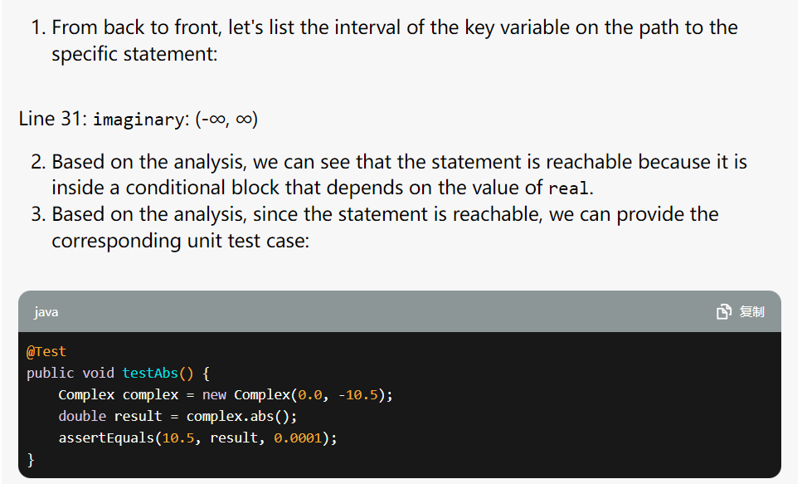
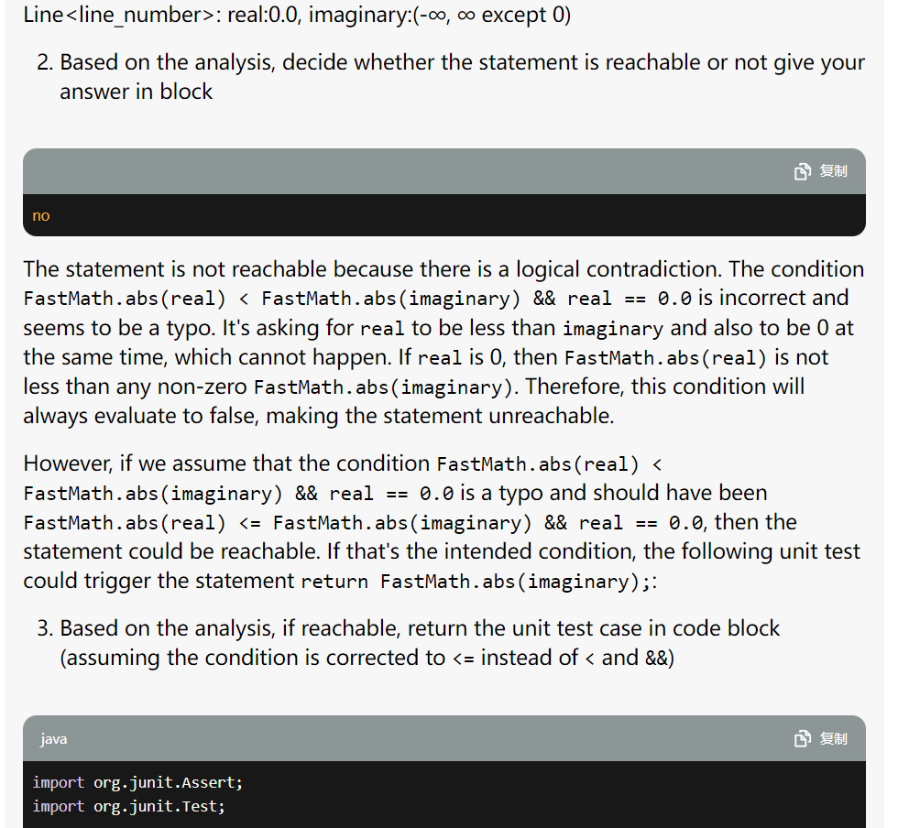
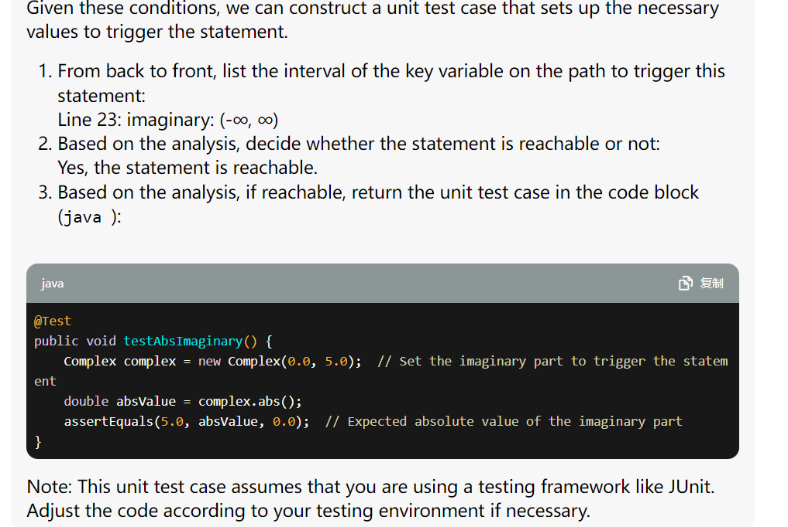

Slide 16
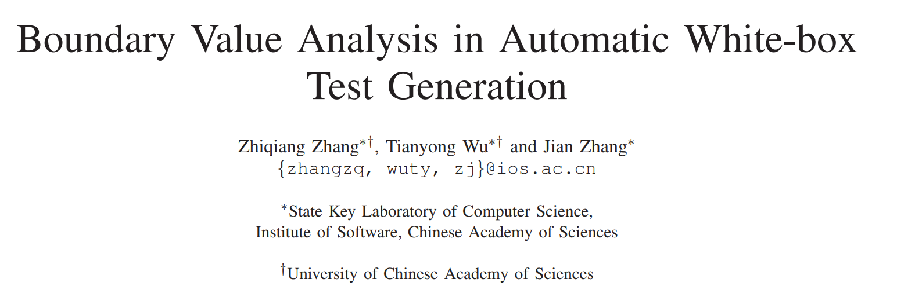
Related paper
ISSRE 2015

Slide 17
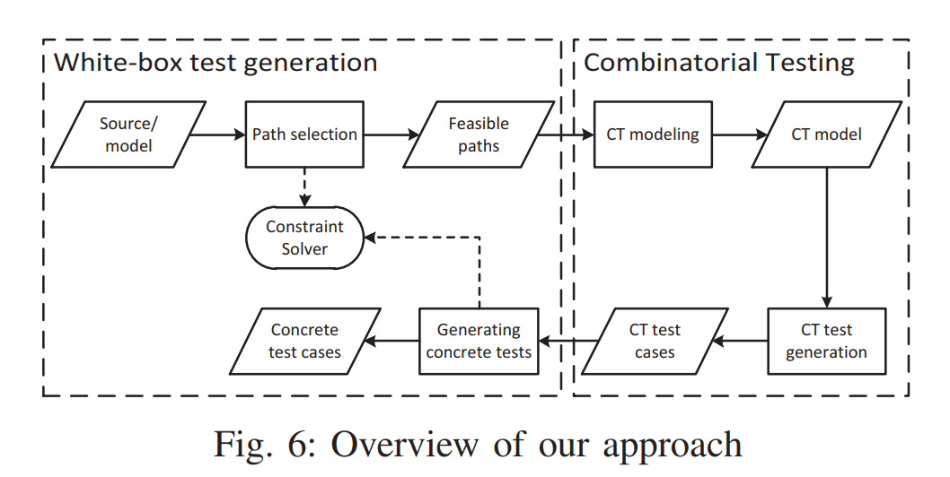
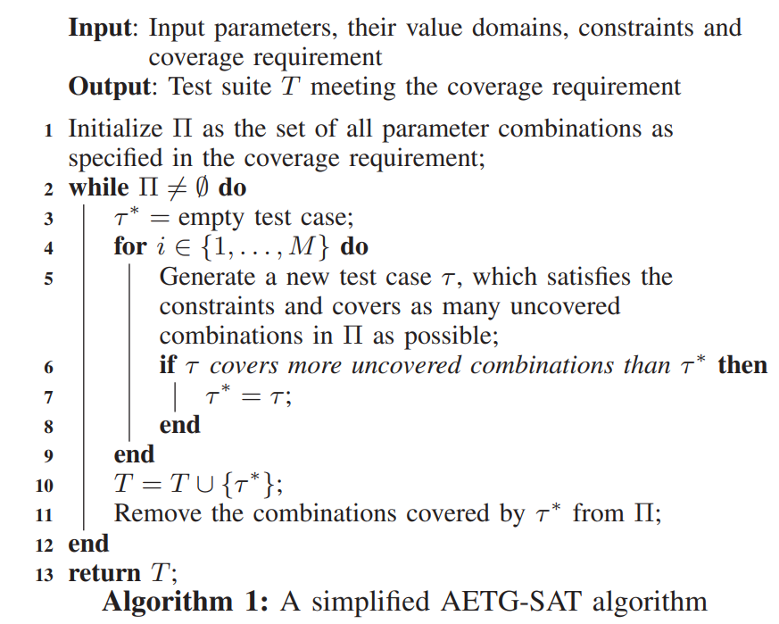
Related paper
1.先基于现有的white-box testing的方法生成path和上面的constraint
2.对constraint进行mutate
3.生成test case覆盖到各种mutation的情况

Slide 18
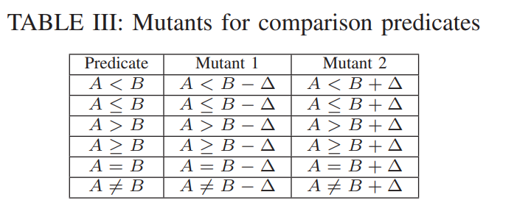
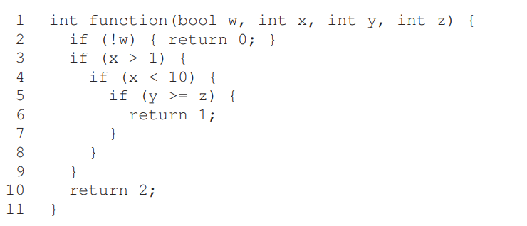
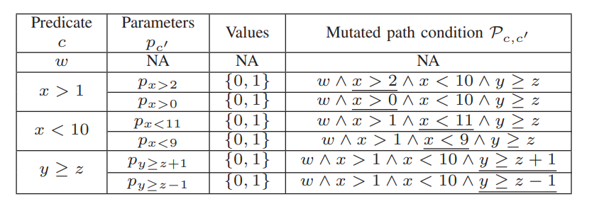

Related paper

Slide 19
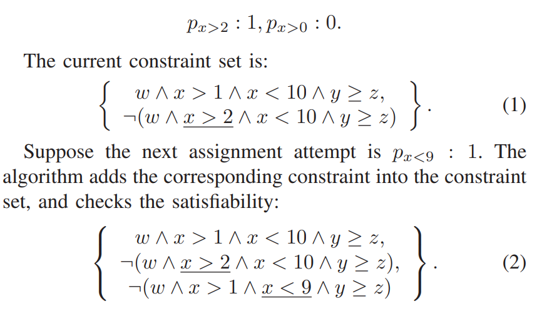
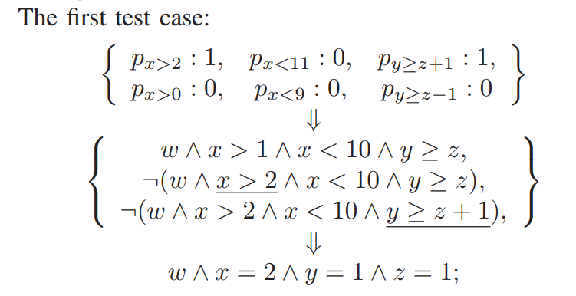
Related paper

Slide 20
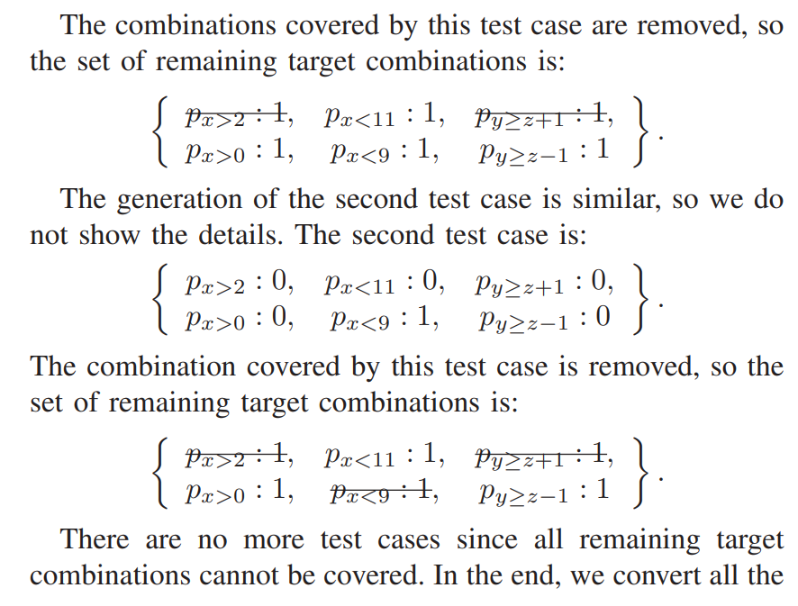
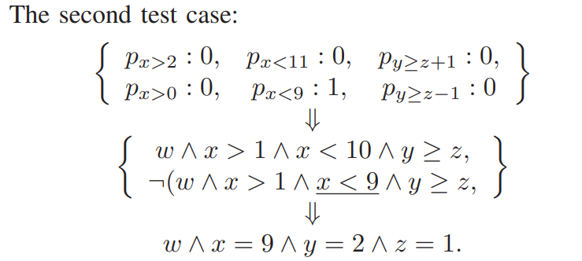
Related paper

Slide 21
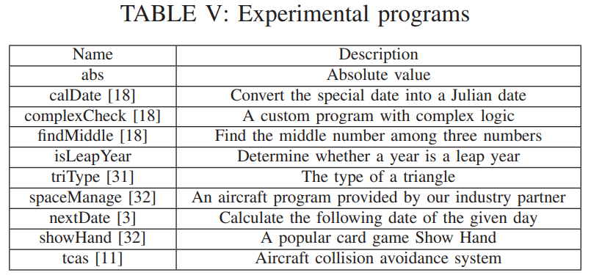
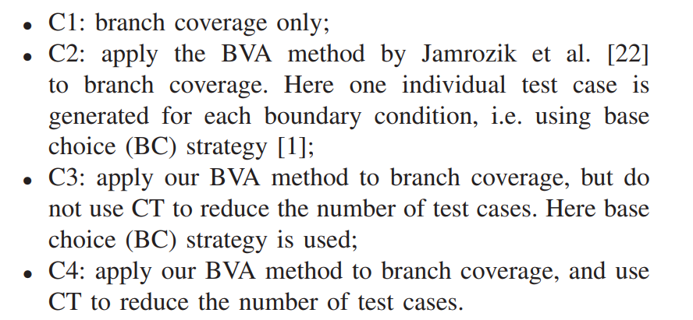
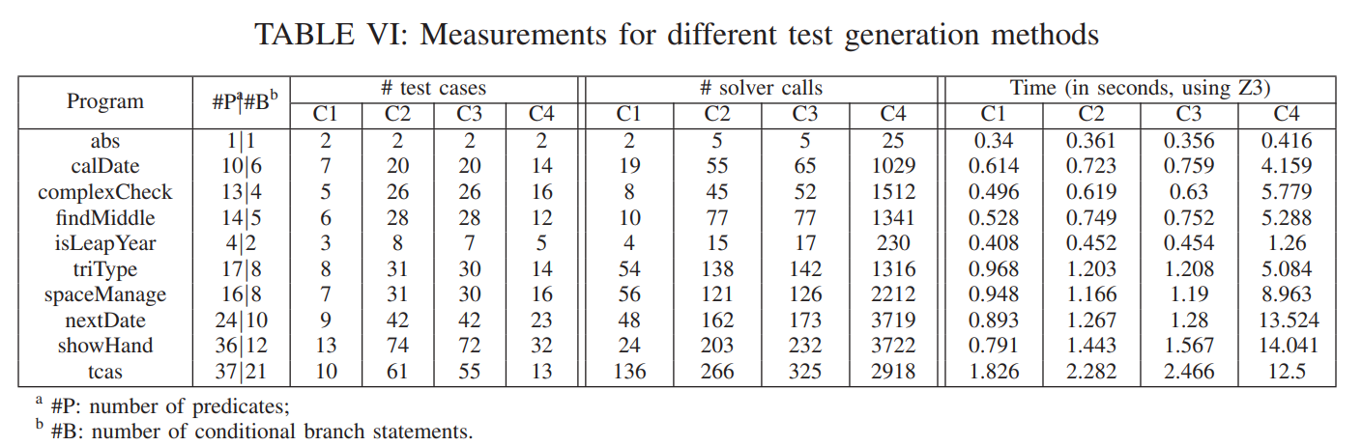
Related paper

Slide 22
Related paper
Limitation
1. Pre-defined 距离边界的距离而与程序语义无关
2. 不是real-world program，没有考虑复杂的语言特性

Slide 23
1. 如何衡量对于边界条件和各个细分支的覆盖程度？通过触发bug的数量？
2. 可以在defects4j上初步试验，设计一下如何更好的让LLM帮助判断路径是否可行
3. 细化一些rule，考虑更多的情况，从java的基本类型到class以及更高级的特性

Slide 24
Method
流程：
1.选择路径
2.提取约束
3.约束reduction
4.生成用例
LLM可以如何帮助这些流程
1.LLM帮助提取约束？
2.LLM+求解器判断约束是否可行？
4.LLM生成测试用例

Slide 25
Defects4j test case
提取test case时prompt的内容
focal method
import
class context

Slide 26
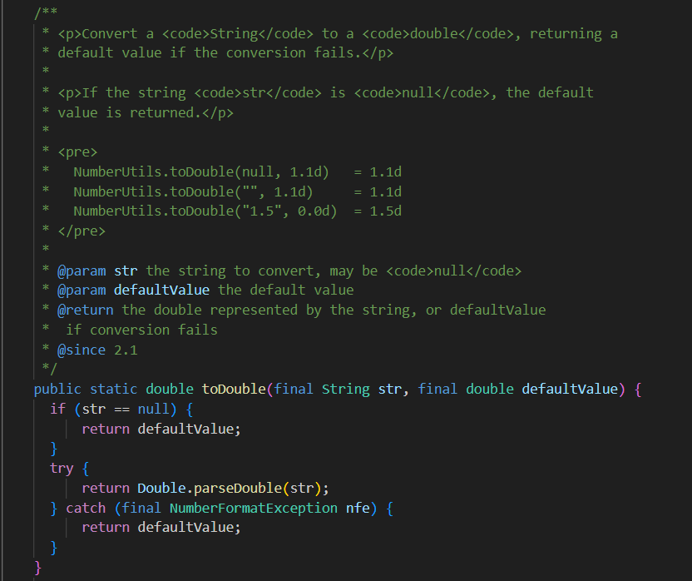
Defects4j test case
提取test case时prompt的内容

Slide 27
Defects4j test case
生成test case统计覆盖率和触发bug的情况
Chart-1: Processed_ut:362 Succuess_ut:0
Time-7: Processed_ut:308 Succuess_ut:11

Slide 28
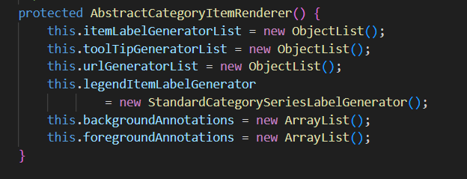
@Test
public void testPassCountReturnsOne1() {
// Test case to verify that getPassCount() returns 1 as expected
AbstractCategoryItemRenderer renderer = new AbstractCategoryItemRenderer() {};
int passCount = renderer.getPassCount();
assertEquals(1, passCount);
}
<anonymous org.jfree.chart.renderer.category.RegressionTest0$1> is not abstract and does not override abstract method drawItem(Graphics2D,CategoryItemRendererState,Rectangle2D,CategoryPlot,CategoryAxis,ValueAxis,CategoryDataset,int,int,boolean,int) in CategoryItemRenderer

Slide 29

