Slide 1
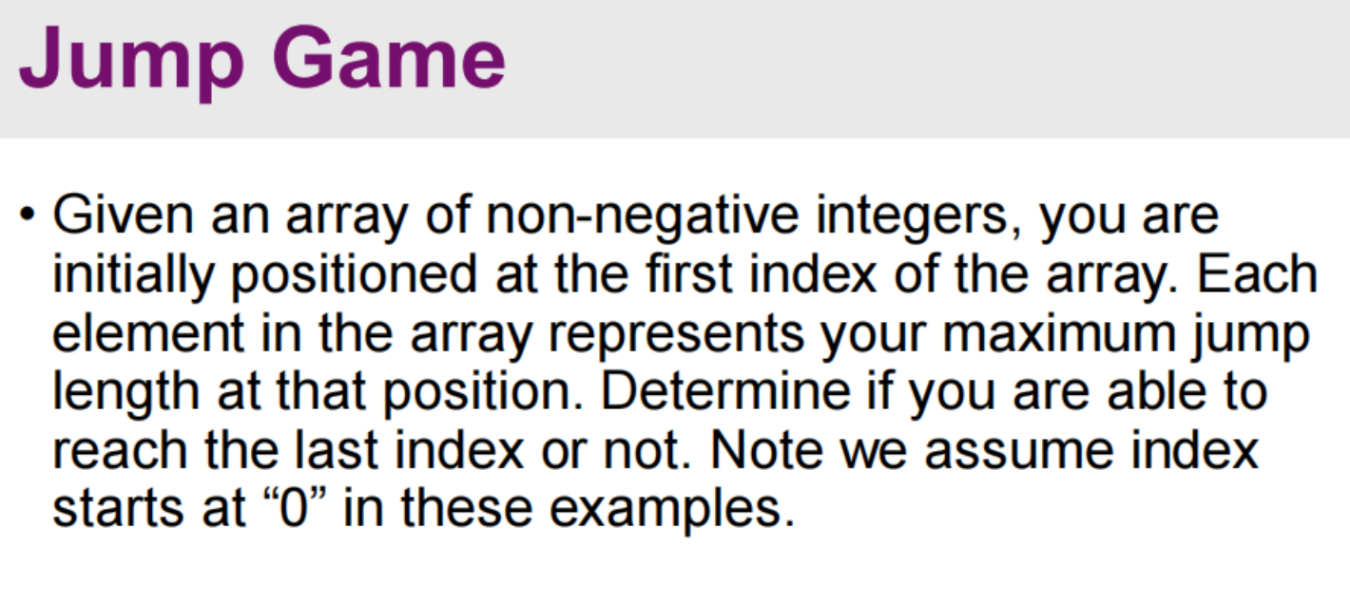
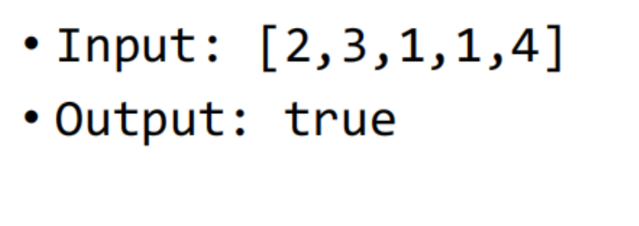
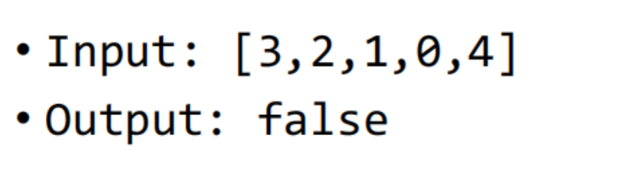
Test case generation

Slide 2
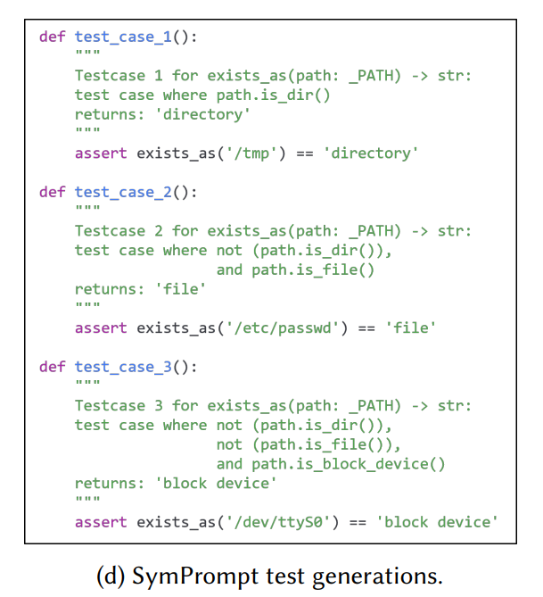
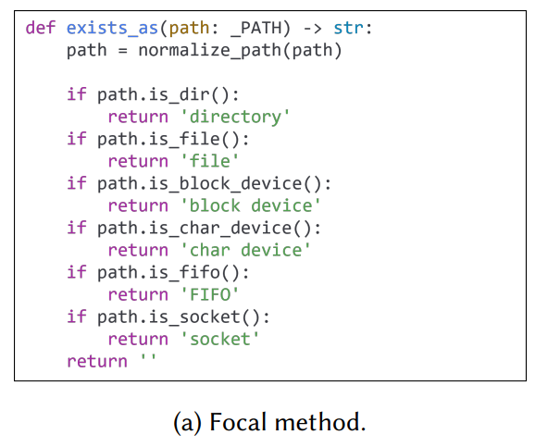
Test case generation
Coverage 覆盖率

Slide 3
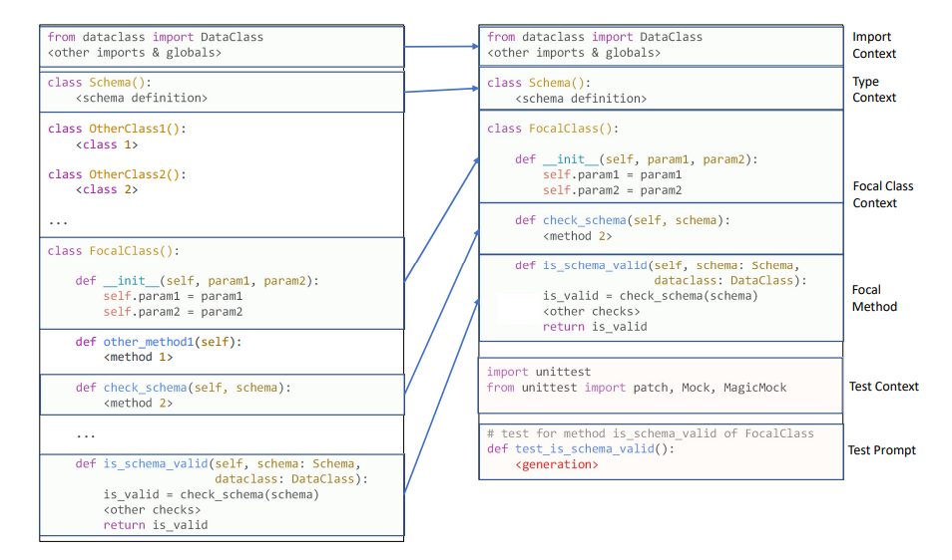
Test case generation
Prompt的设计

Slide 4
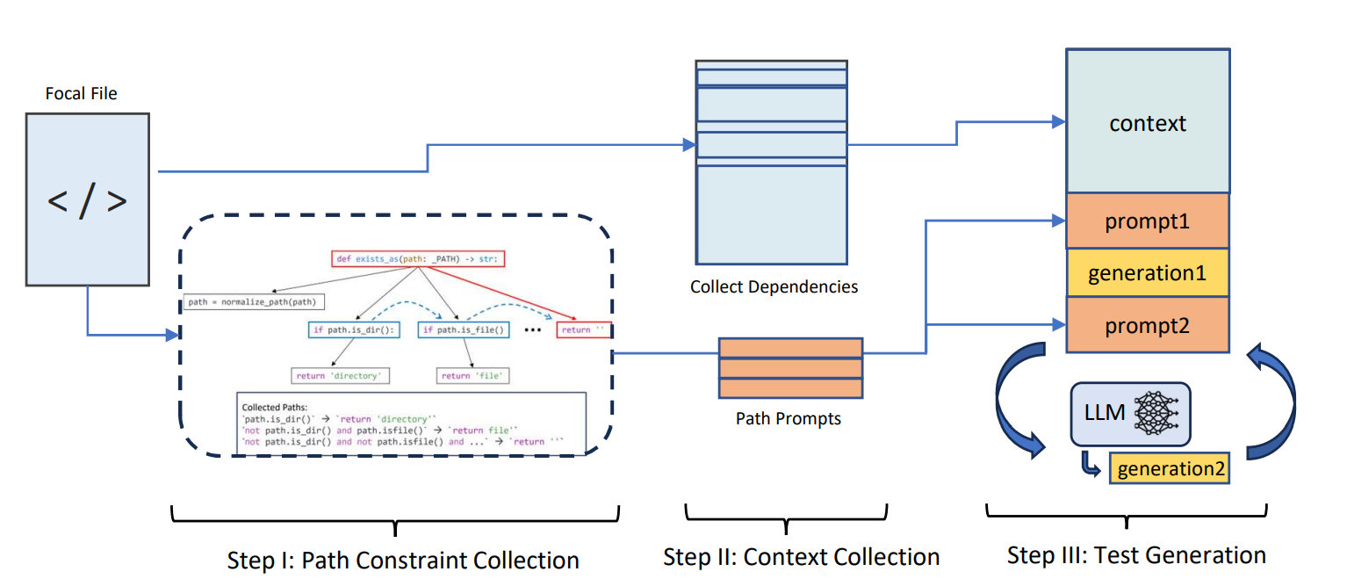
Test case generation
Code-Aware Prompting: A study of Coverage guided Test Generation in Regression Setting using LLM

Slide 5
Test case generation
Package:
openai
tree-sitter
import openai
openai.api_base = "https://api.chatanywhere.tech/v1"
openai.api_key = 'sk-2UUX6UbC3y8U4Ld4eltoCcpzytVCEovxKOsqtmTlqIATSOh0'
openai.ChatCompletion.create(model="gpt-3.5-turbo-0125", messages=messages)

