Slide 1
Predicting the Outcome for NHL Matches
Team Members:
Suhani Vaishnav 012489191
Sahana Alliyandiru Jayasheela 012416131
Mitesh Kumar 011524604
Canvas group : NHL Gamblers

Slide 2
Introduction
Objective : Sports analytics
Dataset : NHL game
Source : Kaggle
Data for 5 years
Dataset files | #Rows | #Columns
game_skater_stats.csv | 267854 | 22
game_shifts.csv | 5564594 | 5
game_goalie_stats.csv | 16062 | 19
game_plays.csv | 2369646 | 20
game_teams_stats.csv | 14882 | 15
player_info.csv | 2246 | 8
game_plays_players.csv | 3479482 | 5
team_info.csv | 33 | 6
game.csv | 7441 | 15

Slide 3
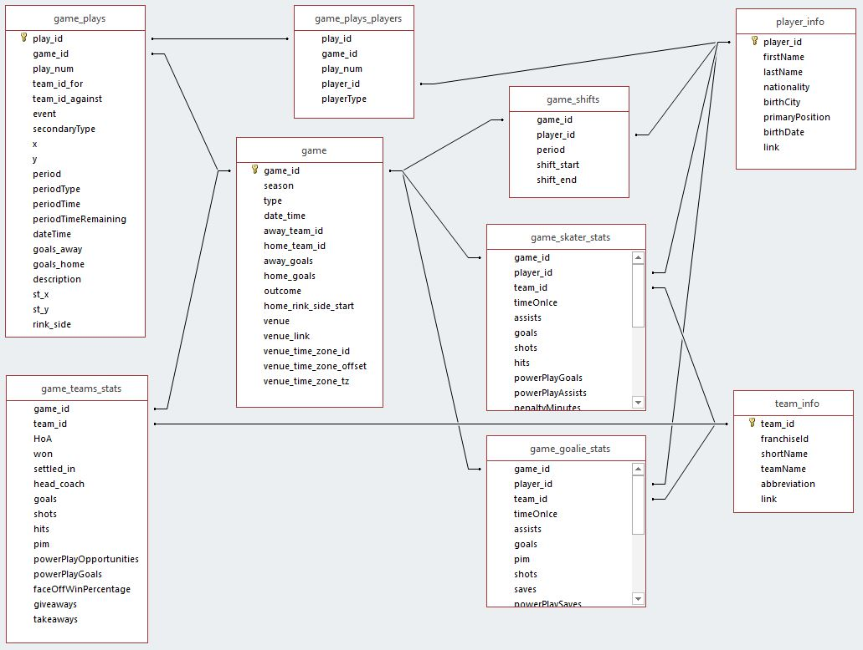
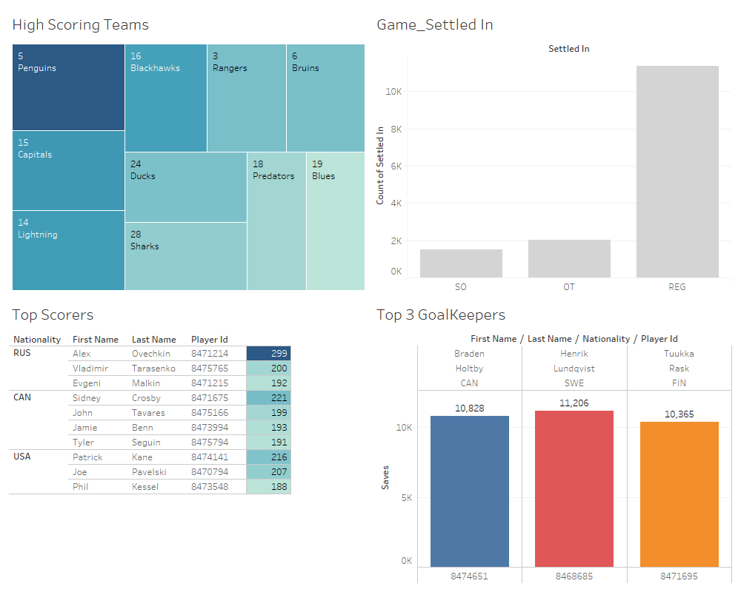
DATASET

Slide 4
System Design & Workflow
Choosing the right Dataset
Approach1 : Team stats
Data Preparation and Exploration
Joining the datasets as per requirements
Building the Model for prediction
Random Forest
Approach2 : Team stats and player-skater stats
Approach 3: Team stats, player_skater and player info
Removing categorical columns
Applying Dimensionaltiy reduction
AdaBoost
XGboost
Logistic Regression
Testing the model
Accuracy
F1 Score
GaussianNB
KNN

Slide 5
Preprocessing techniques
Dimensionality Reduction :
Implemented PCA
One-hot Encoding:
HoA : Home or Away
Settled_In : Regular time, Over time or ShootOut.
Label Binarizer:
For Target Label “ Won”
Merging: Relevant CSVs for each approach

Slide 6
Algorithms used
Random Forest
AdaBoost
XGBoost
Logistic Regression
Solver : lbfgs & liblinear
KNearestNeighbours

Slide 7
Results
Algorithm | Approach 1 |  | Approach 2 |  | Approach 3
 | Without PCA | With PCA | Without PCA | With PCA | Without PCA | With PCA
Random Forest | 0.74 | 0.59 | 0.78 | 0.68 | 0.99 | 0.99
AdaBoost | 0.76 | 0.64 | 0.76 | 0.69 | 0.90 | 0.91
Logistic Regression – solver ( lbfgs) | 0.77 | 0.58 | 0.76 | 0.76 | 0.90 | 0.89
Logistic Regression - solver (liblinear) | 0.78 | 0.64 | 0.76 | 0.76 | 0.89 | 0.89
KNNeighbours Classifier | 0.72 | .71 | 0.76 | 0.76 | 0.91 | 0.89
XGBoost | 0.76 | 0.64 | 0.78 | 0.77 | 0.91 | 0.92

Slide 8
Conclusion
Things that did not work : Adjusted Plus Minus approach
Things that worked : Predictions based on team and player statistics
Obtained list of few players contributing towards the outcome
Accuracy highlights the fact – the more the relevant data, the better the prediction

