Slide 1
Business Objective
As we all know the importance of maintaining consistency in any industry is difficult. And every organisation maintains a certain method of reaching the public to know if the service provided by them is acceptable?
So, in the present generation every company/Organisation holds a social media account. Now we will develop a sort of application which can help different customers to know the customer's interest, which is very important nowadays.
As a Data scientist, we will analyse the data available in YouTube to help our clients in different ways.
Our Objective is to Support a Car Industry on which factors they are lagging back while carefully analysing the comments of people who own the cars and the Positive and Negative Sentiments.

Slide 2
Project analysis slide 2
Project Analysis
Business Objective
Building Model
PROJECT
Data Scrapping
Visualizations
Cleaning/Preprocessing
Deployment

Slide 3
Project analysis slide 3
YouTube Video Comments for Car Company Reviews
Public Sentiment ANALYSIS
Youtube ANALYSIS
TECHNICAL ANALYSIS
Building the System Product
Helping the Automobile Industry for the Supply of the New Vehicle in Market through NLP techniques
Comments
And YouTube Video Data
Scrapping
Goggle Client API
Youtube Data API
Selenium
Beautifulsoup
For Scrapping Data

Slide 4
Project analysis slide 4
Project Architecture
YOUTUBE VIDEO URL LINK
Show the required Visuals on Dashboard
Fetch the Video Comments
Preprocess the Comments
NLP Visuals
USER INPUTS VIDEO URLS

Slide 5
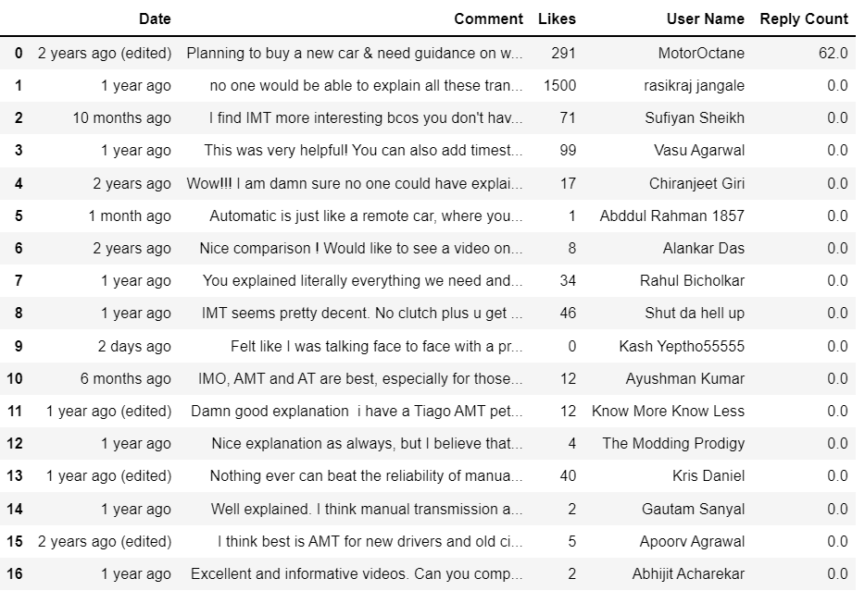
YouTube Channel Details Scrapping using:
GOOGLE API key & YOUTUBE DATA API Documentation for fetching Views and Comments for Manual Vs iMT Vs AMT Vs DCT Vs CVT Vs Automation Transmission Video!!!

Slide 6
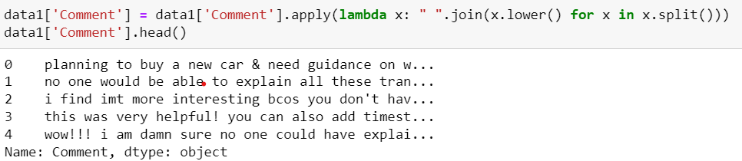
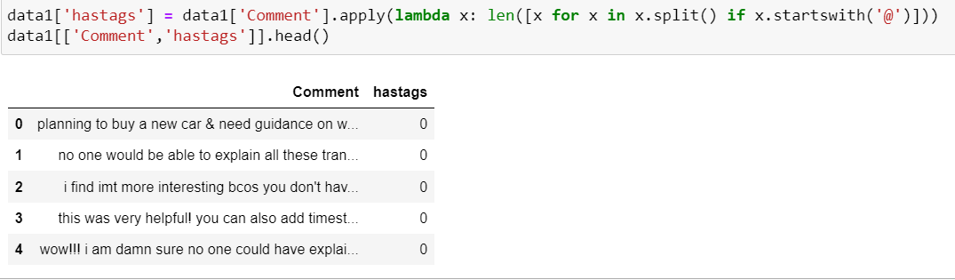
Data Pre-processing
Converting to Lower Case
Removing Punctuations

Slide 7
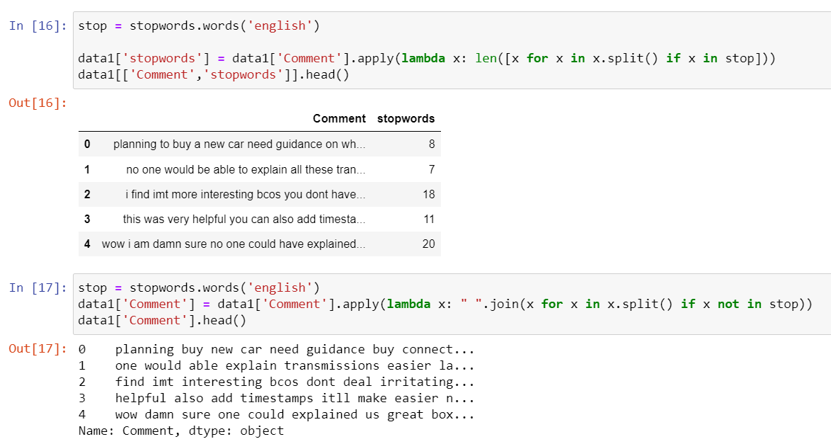
Removing STOP WORDS

Slide 8
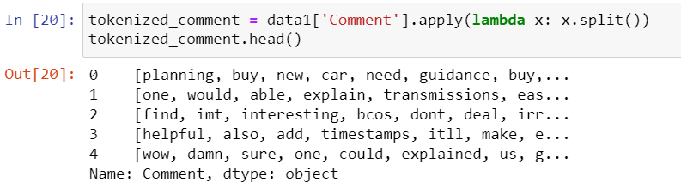
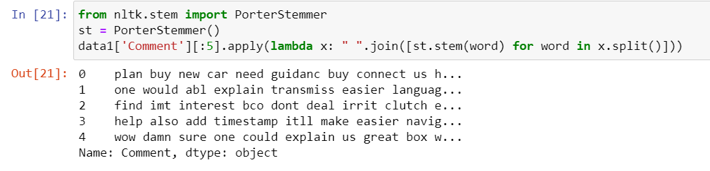
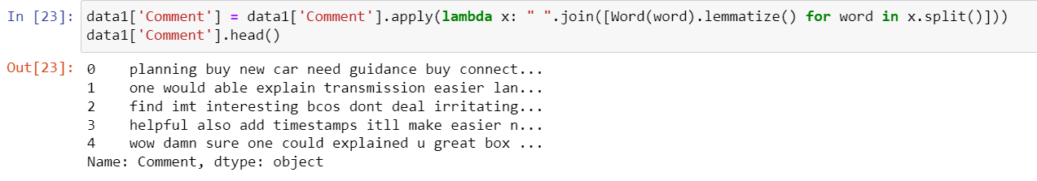
TOKENAZIATION
STEMMING
LEMMATIZATION

Slide 9
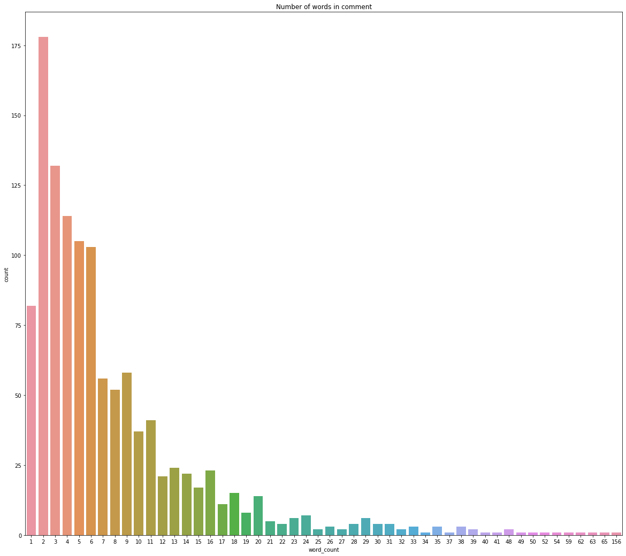
COMMENT ANALYSIS

Slide 10
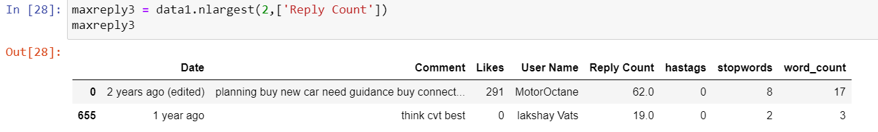
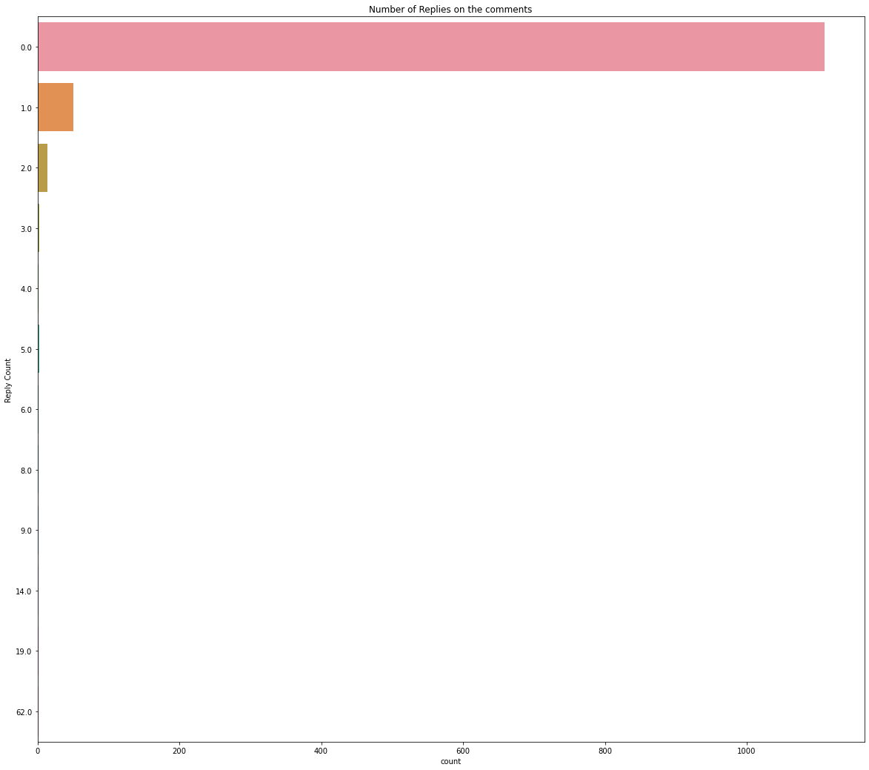
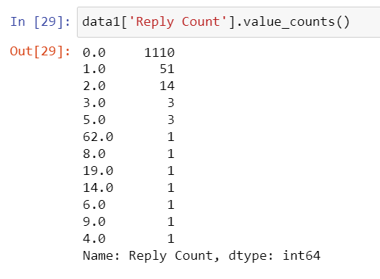
MAXIMUM NUMBER OF REPLY ON THE COMMENT

Slide 11
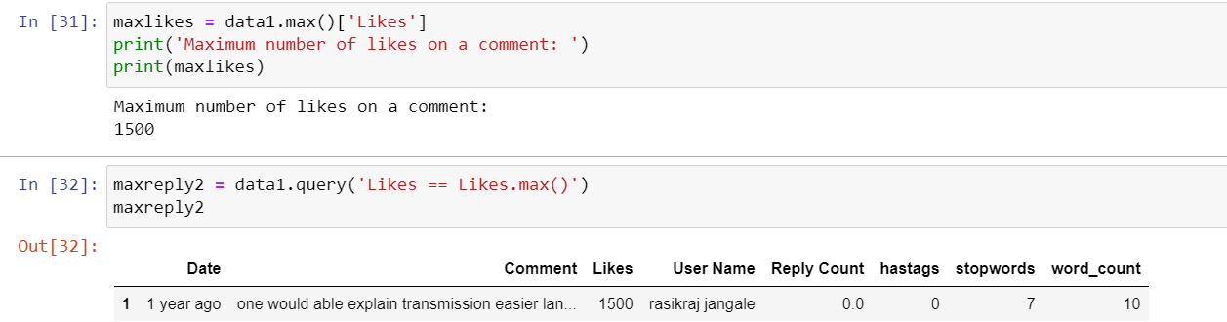
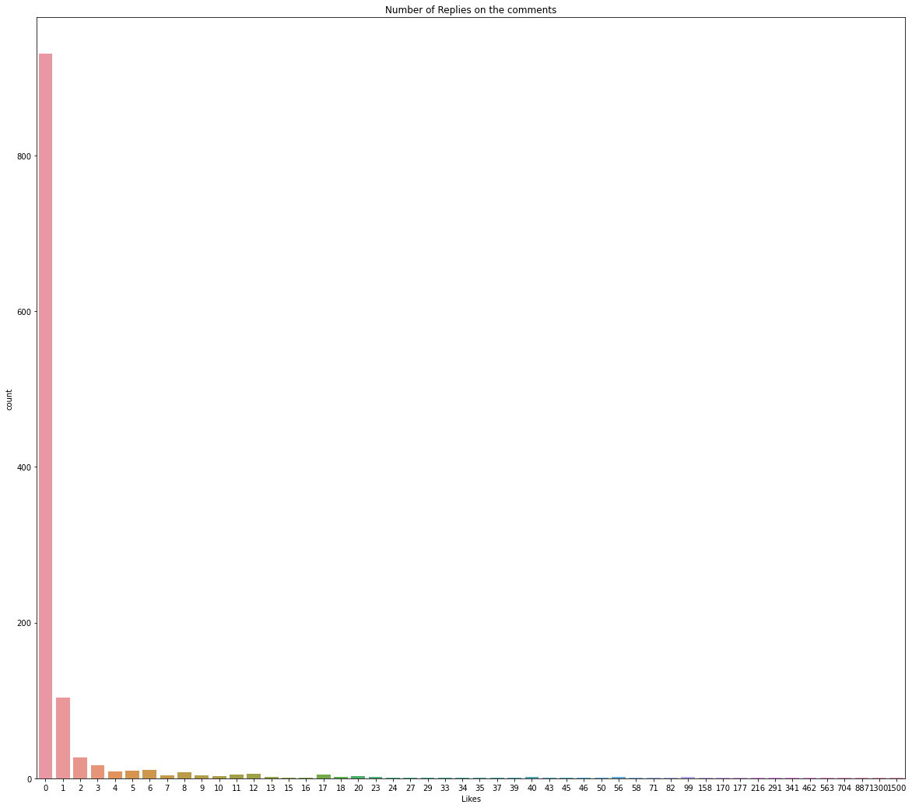
LIKES ANALYSIS

Slide 12
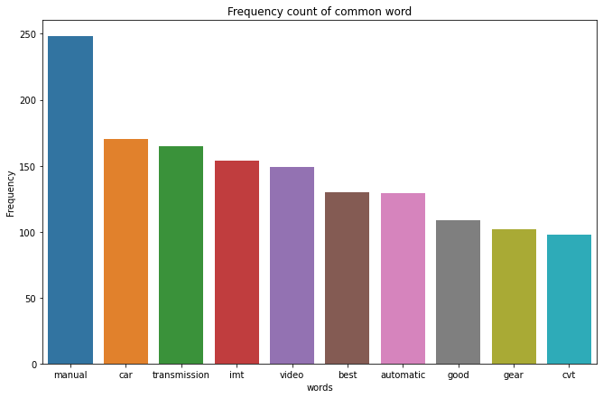
FREQUENTLY USED WORDS

Slide 13
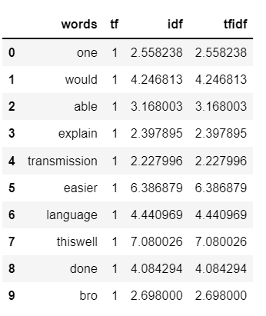
TF-IDF ANALYSIS

Slide 14
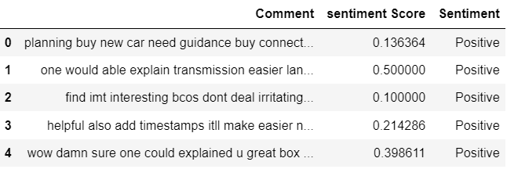
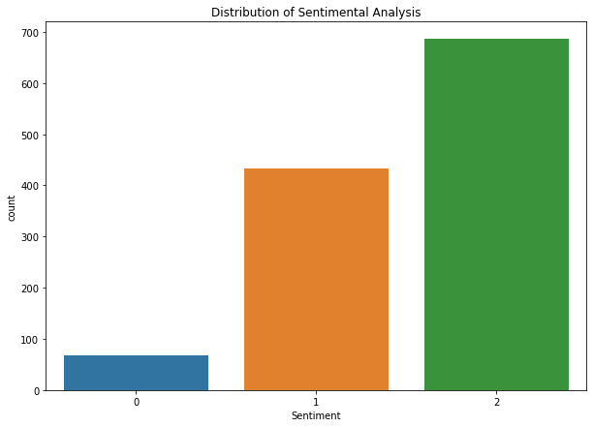
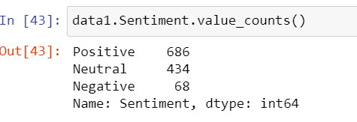
SENTIMENTAL ANALYSIS

Slide 15
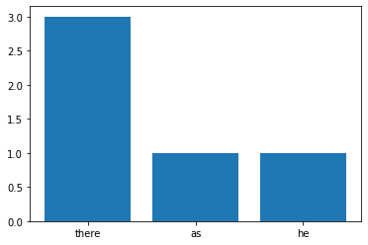
MOST COMMON STOP WORDS

Slide 16
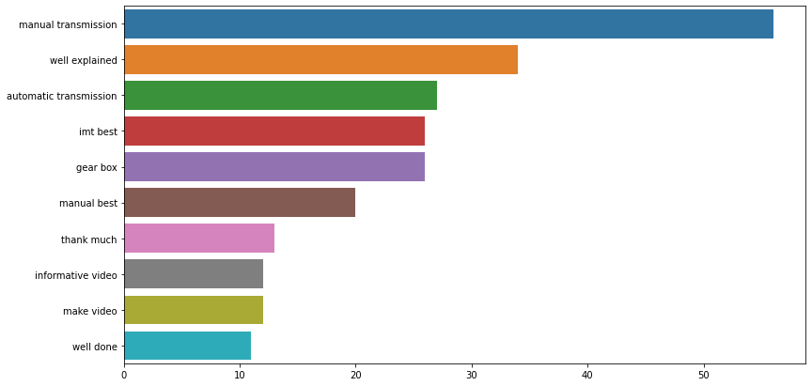
N-GRAM EXPLORATION

Slide 17
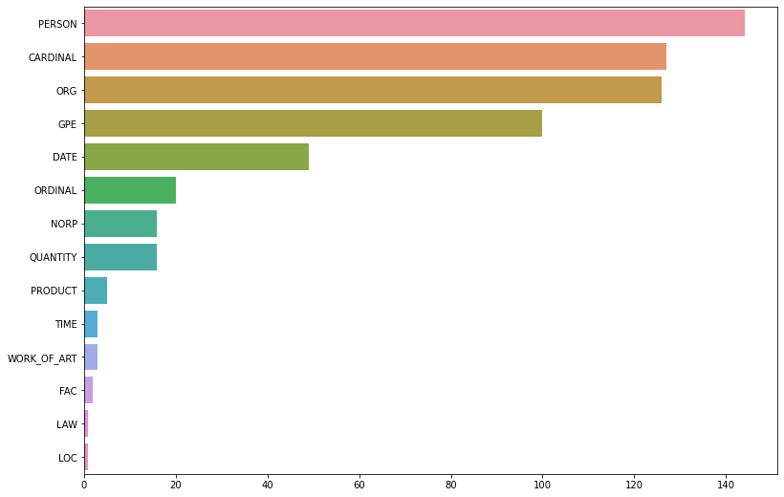
NAMED ENTITY RECOGNITION

Slide 18
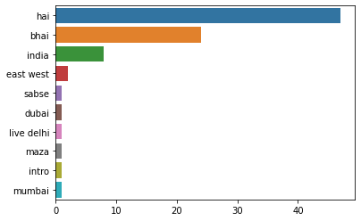
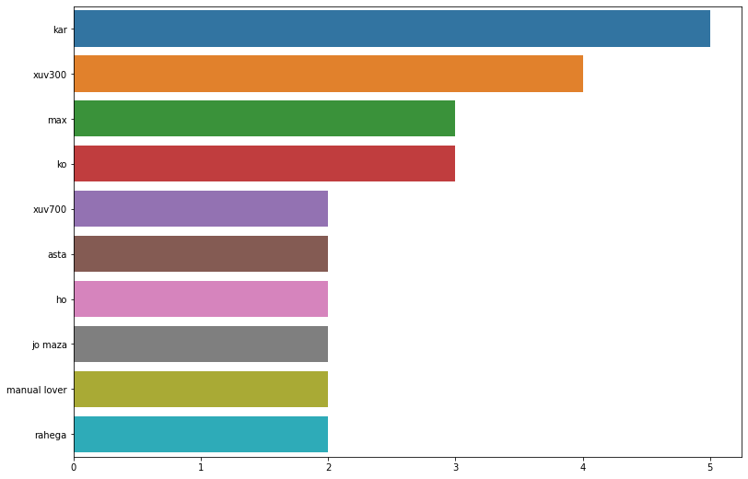
MOST COMMON TOKENS PER ENTITY (GPE)
MOST COMMON TOKENS PER ENTITY (NAME)

Slide 19
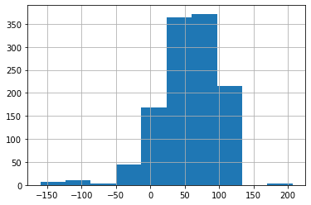
Exploring through text complexity - how readable (difficult to read) the text is

Slide 20
Thank You

