Slide 1

INTRODUCTION
Interpreted
Lightweight
Object Oriented
Client Side Scripting Language

Slide 2
Why JS ?
Input Validation
Event Handling
Animation
Interactive web pages

Slide 3
Where to write?
In <head>
In <body>
External javascript file
<script src=”script.js”>javascript code</script>

Slide 4
JS Output
innerHTML
document.write()
window.alert()
console.log()

Slide 5
Popup boxes
Alert Box
      alert(“I am an alert box”);
Confirm Box
      confirm(“make a confirmation”);
Promt Box
      promt(“Enter amount”,10);

Slide 6
Data Types
Strings
Number
Boolean
Object
      Properties
      Methods
Null
Undefined

Slide 7
Arrays
What is an Array?
Create Array
Access Array element

Slide 8
Scope of Variables
Local variables
Global variables

Slide 9
Conditional Statements
if
if-else
if-elseif-else
switch

Slide 10
Control Statements
while
do while
for
for in

Slide 11
Type Conversion
typeof() operator
Number()
toString()
unary +

Slide 12
Functions
Syntax:
function functionName (parameters)
{
//code to be executed
return
}

Slide 13
Document Object Model (DOM)
Standard for Accesing Document
Represent all of the content and components of a web document
API

Slide 14
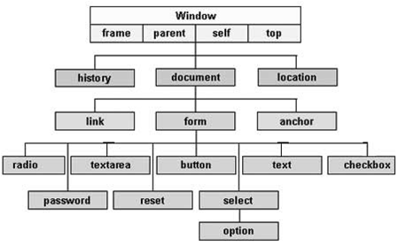
Document Object Model (DOM)

Slide 15
Events
Things that happens to HTML element

Slide 16
Events Types
onchange
onclick
onmouseover
onmouseout
onkeydown
onload

Slide 17
F
Form Validation

Slide 18
AnimationAnimation
Animation

Slide 19
Canavas

