Slide 1

HTML

Slide 2
What is HTML?
HTML stands for HyperText Markup Language
Let's see this one by one
HyperText -
Markup -
Language -

Slide 3
Why HTML?
Basic use of HTML is to create Webpages.
Easy to learn.
Errors can be easily found.
No need of special development environment.
Supports Re-Usability.

Slide 4
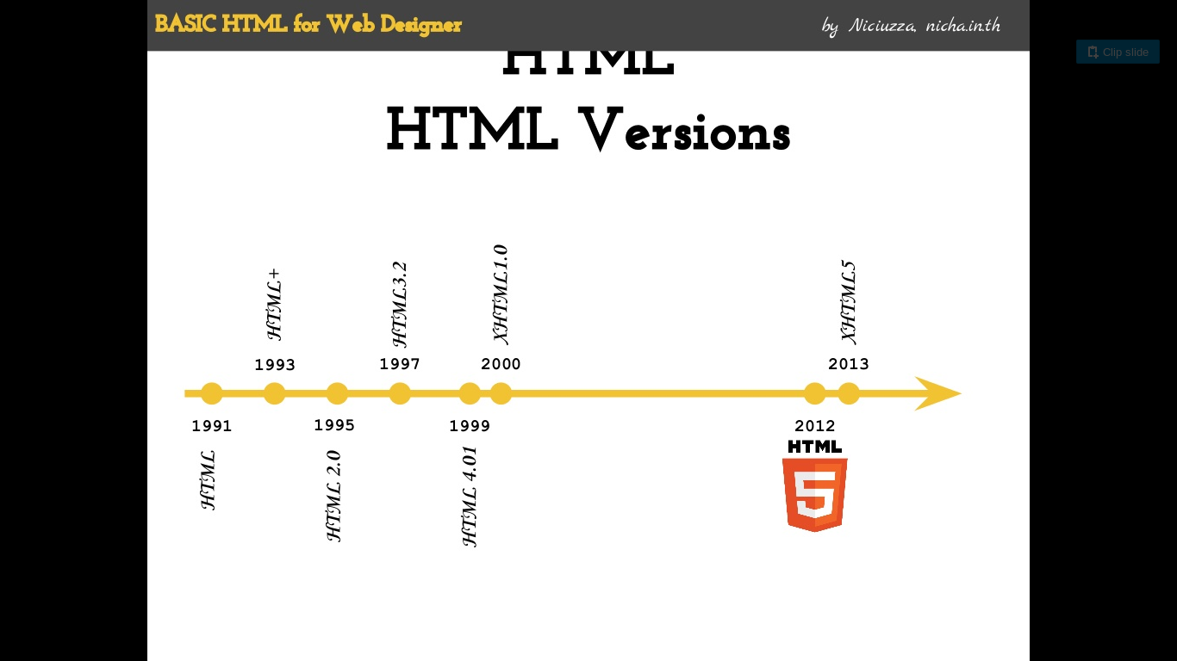
HTML Versions

Slide 5
HTML Tags
Defines the basic structure of the Webpage.
HTML tags normally come in pairs like <p> and </p>
All tags may not have an ending tag
Tags can be nested within one another

Slide 6
HTML Attributes
All HTML elements can have attributes
provide additional information about element
specified in the start tag
attribute_name="value"
Try to use values of the attributes in double quotes

Slide 7
Basic Tags of HTML
<!DOCTYPE html>
<html>
<head>
<title>
<body>

Slide 8
A Simple HTML Document
<!DOCTYPE html>
<html>
<head>
<title>Page Title</title>
</head>
<body>
Hey there! Welcome to the world of HTML!!!
</body>
</html>

Slide 9
HTML Block Level Elements
Headings:
    <h1> to <h6>
Paragraphs:
    <p>
Division:
    <div>

Slide 10
Tables in HTML
The <table> tag is used to insert tables in the webpage, assisted by following tags:
<caption>: Caption/Title of table
<tr>: Table row
<td>: Table data
<th>: Table heading

Slide 11
<rowspan>: Allows table cell to span the height of more than one cell or row
<colspan>: Allows table cell to span the width of more than one cell or column

Slide 12
Lists in HTML
There are three type of lists in HTML -
    Unordered List
    Ordered List
    Definition List

Slide 13
1. Unordered Lists
<ul> tag
<li> tag for list items
The type attribute and its values:

Slide 14
Value | Description
type=”Disc” | Sets the list item marker to a bullet (default)
type=”Circle” | Sets the list item marker to a circle
type=”Square” | Sets the list item marker to a square
type=”None” | The list items will not be marked

Slide 15
2. Ordered List
<ol> tag
<li> tag for list items
The type attribute and its values:

Slide 16
Value | Description
type="1" | The list items will be numbered with numbers (default)
type="A" | The list items will be numbered with uppercase letters
type="a” | The list items will be numbered with lowercase letters
type="I" | The list items will be numbered with uppercase roman numbers
type="i" | The list items will be numbered with lowercase roman numbers

Slide 17
3. Definition Lists
<dl> tag
<dt> and <dd> tags for terms and definitions

Slide 18
Inline Elements
Span:
<span>: Used to group inline element
Hyperlinks:
<a>
Images:
  <img>

Slide 19
Hyperlinks
    The <a> tag
In HTML, links are defined with the <a> tag.
‘a’ stands for ‘anchor’
Syntax:
<a href="url">link text</a>
The attributes are:
href
target

Slide 20
Image
i. The <img> tag
The <img> tag is used to insert images in our webpages
It has the following attributes:
src
alt
width & height
title

Slide 21
HTML Forms
The <form> tag is used to create an HTML form for user input.
The <input> Element:-
  Text input:
      <input type="text">
  Radio Button input:
<input type="radio">

Slide 22
Password Input:
<input type="password">
Date Input:
<input type="date">
Checkbox Input:
<input type="checkbox">

Slide 23
The Submit Button:
  <input type="submit">
The Reset Button:
<input type="reset">

Slide 24
HTML <label> tag:
Defined using the <label> tag
Attribute for=”element_id” is used.
Text Area:
<textarea>

Slide 25
HTML Fieldset:
<fieldset>
<legend>
The Action Attribute:
action

Slide 26
Drop-down List:
<select>
The Method Attribute:
method

Slide 27
GET vs POST
GET | POST
the submitted form data will be visible in the page address field. | does not display the submitted form data in the page address field.
Request is exposed in the URL. | Request is not Exposed in the URL.
Less Secure | More Secure

Slide 28
HTML IFrames
An iframe is used to display a web page within a web page
Defined using the <iframe> tag
Attributes:
  Src
  Width
  Height

Slide 29
Special Elements
HTML defines some special elements for defining text with a special meaning
<b> <strong>
<i> <em>
<del> <ins>
<br> <hr>
<mark> <marquee>
<sub> <sup>

Slide 30
HTML Audio
Before HTML5, audio files could only be played in a browser with a plugin (like flash)
The HTML5 <audio> element specifies a standard way to embed audio in a web page

Slide 31
Elements
    the <audio> element
      The controls attribute.
    The <source> element
      The type attribute.

Slide 32
HTML Video
Before HTML5, a video could only be played in a browser with a plug-in (like flash).
The HTML5 <video> element specifies a standard way to embed a video in a web page.

Slide 33
Elements
    the <video> element
      The controls attribute.
      The autoplay attribute.
    The <source> element
      The type attribute.

Slide 34
Lets Move To CSS...

