Slide 1

TechnoTweet 2K18
Welcome To
Webino

Slide 2
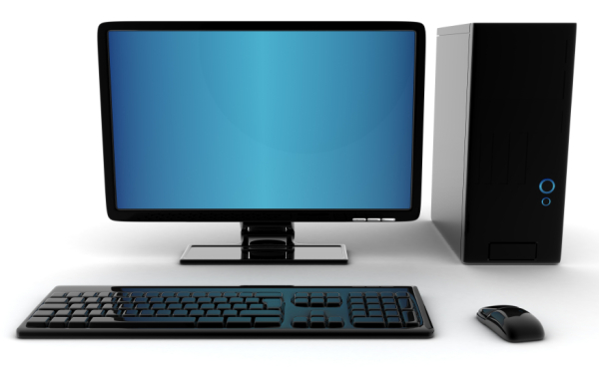
What Is Computer?

Slide 3
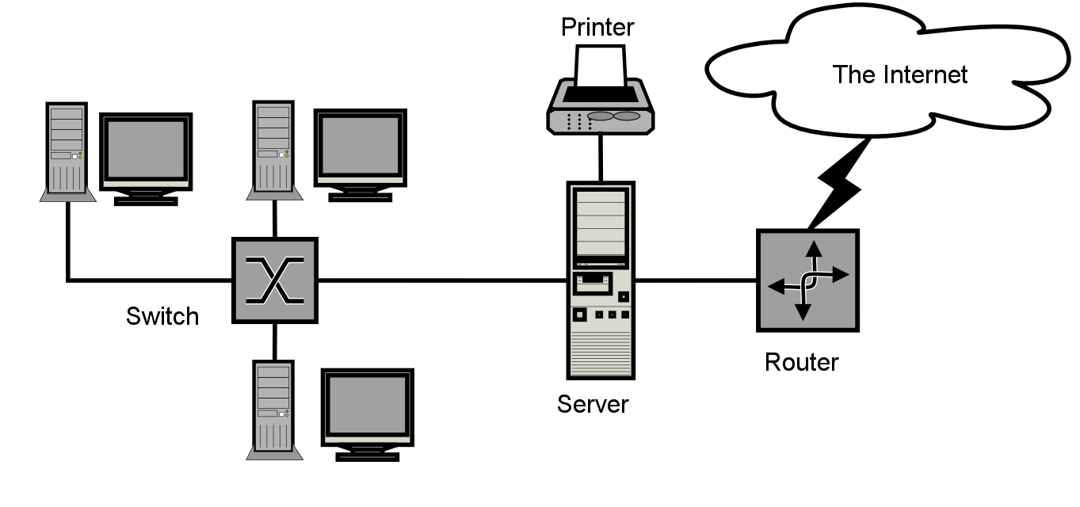
What is Network?
A group of interconnected(via cable and/or wireless) computers that is capable of communication between many users.

Slide 4
Internet
Internet is a network of networks,in which any computer can communicate with any other computer as long as they are both connected to the Internet.

Slide 5
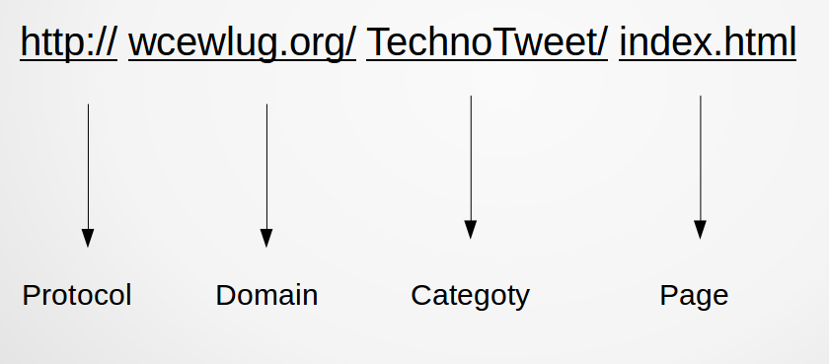
URL
A Uniform Resource Locator (URL), commonly informally termed a web address.

Slide 6
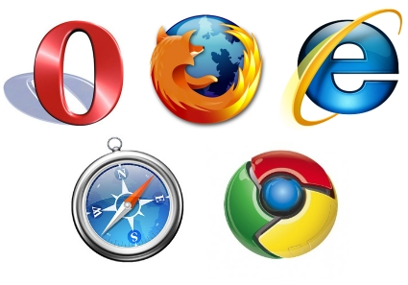
Web Browser

Slide 7
Websites
A website is collection of related web pages, including multimedia content, typically identified with a common domain name (i.e. A bunch of web pages!)

Slide 8
Types of Websites
Static:
Shows exactly same info whenever we load that page.
May contain multimedia,videos and design.
Eg: Reading some institute info.

Slide 9
Types Of Websites
Dynamic :
Produces different content for different visitors for same source code.
We may interact with websites.
Eg: Login Form, Create Account.

Slide 10

World Wide Web

Slide 11
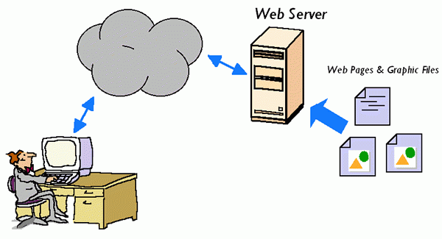
Web Server

