Slide 1

JavaScript

Slide 2
INTRODUCTION
Interpreted
Lightweight
Object Based
Client Side Scripting Language

Slide 3
Why JS ?
Input Validation
Event Handling
Animation
Interactive web pages

Slide 4
Where to write?
In <head>
In <body>
External javascript file
<script src=”script.js”></script>

Slide 5
JS Output
innerHTML
document.write()
window.alert()
console.log()

Slide 6
Popup boxes
Alert Box
      alert(“I am an alert box”);
Confirm Box
      confirm(“make a confirmation”);
Prompt Box
      prompt(“Enter amount”,10);

Slide 7
Data Types
Strings
Number
Boolean
Object
      Properties
      Methods
Null
Undefined

Slide 8
Type Conversion
typeof operator
Number()
toString()
unary +

Slide 9
Arrays
What is an Array?
Create an Array
Access an Array element

Slide 10
Scope of Variables
Local variables
Global variables

Slide 11
Conditional Statements
if
if-else
if-elseif-else
switch

Slide 12
Control Statements
while
do while
for
for in

Slide 13
Document Object Model (DOM)
Standard for Accesing Document
Represents all of the content and components of a web document
API

Slide 14
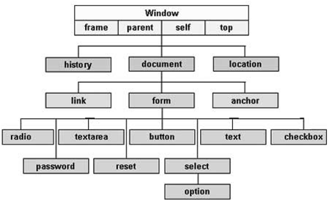
Document Object Model (DOM)

Slide 15
Functions
Syntax:
function functionName (parameters)
{
//code to be executed
return
}

Slide 16
Events
onload
onchange
onclick
onmouseover
onmouseout
onkeydown

Slide 17
Canvas

Slide 18
Form Validation

