Slide 1

PHP

Slide 2
What is PHP?
Open source general-purpose scripting language
Code executed on the server
HTML-embedded
Interpreted language

Slide 3
What can PHP do?
Generate dynamic page content
Create, open, read, write, delete and close files on the
server
Collect Form Data
Send & Receive Cookies
Interact with Different Databases
Encrypt Data

Slide 4
Why Use PHP?
It’s Free
Cross Platform (Linux, Windows)
Compatible with Most Web Servers (Apache, NginX)
Compatible with Many Databases (MySQL, MongoDB)
Large Community

Slide 5
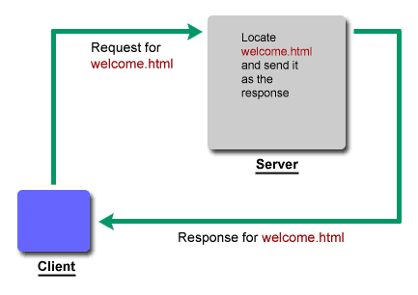
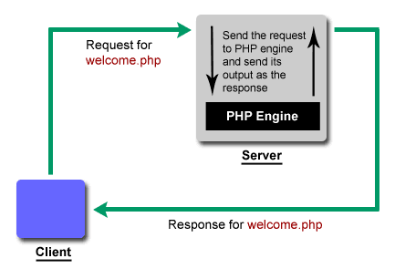
PHP Engine

Slide 6
PHP Syntax
A PHP script starts with <?php and ends with ?>
The default file extension for PHP files is ".php".
PHP statements end with a semicolon (;)
Keywords are not case-sensitive, but variables are case
sensitive!
<?php
// php code goes here
?>

Slide 7
PHP Echo
<?php
echo "<h2>Welcome To WLUG</h2>";
echo "<h2>Welcome To Techno-Tweet</h2>",
"<h2>Welcome To Webino</h2>";
?>

Slide 8
PHP Print
<?php
print "<h2>Welcome To WLUG</h2>";
$output = print "<h2>Welcome To Techno-Tweet</h2>";
print $output;
?>

Slide 9
PHP Comments
Single line comment:
//this is a comment
#this is comment too
Multi-line comment:
/*
This is multiline comment
*/

Slide 10
PHP Variables
A variable starts with the $ sign, followed by the name of the
variable
PHP is a Loosely Typed Language
<?php
$name = "Walchand Linux Users' Group";
$NAME = "Techno Tweet";
$number = 1;
?>

Slide 11
PHP Variables Scope
Global:
A variable declared outside a function
Can only be accessed outside a function.
PHP also stores all global variables in an array called
$GLOBALS[index]

Slide 12
Local:
A variable declared within a function.
Can only be accessed within that function.
Static:
A variable which retains its value within function calls.

Slide 13
PHP Datatypes
Array
Object
NULL
Resource

Slide 14
PHP Operators
Arithmetic operators
Assignment operators
Comparison operators
Increment/Decrement operators
Logical operators
String operators

Slide 15
Control Structures
      if
  if else
  if elseif else
  switch

Slide 16
PHP Loops
    while
    do while
for
foreach

Slide 17
PHP Functions
A block of statements that can be used repeatedly.
A function will not execute immediately when a page loads.
Executed only after a call to the function.
function functionName()
{
//code to be executed;
}

Slide 18
PHP Functions
Functions with arguments
Functions with return values

Slide 19
PHP Arrays
Indexed arrays : Arrays with a numeric index
Associative arrays : Arrays with named keys
Multidimensional arrays : Arrays containing one or more
arrays
array(value1, value2, ..., valueN);

Slide 20
PHP SuperGlobals
$GLOBALS
$_SERVER
$_REQUEST
$_POST
$_GET
$_COOKIE
$_SESSION

Slide 21
PHP Cookies
A cookie is often used to identify a user.
Cookies are stored in client's memory location.
setcookie(name, value, expire, path, domain, secure,
httponly);
$_COOKIE[ ]

Slide 22
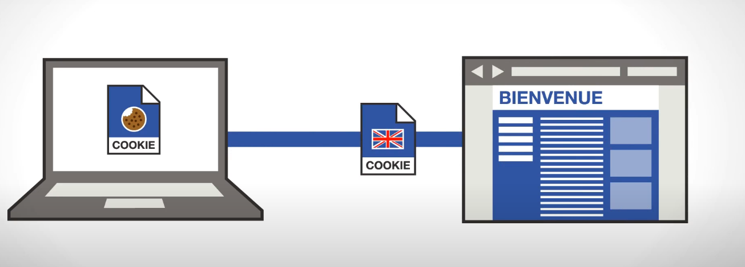

Slide 23
PHP Sessions
A way to store information (in variables) to be used across
multiple pages.
Unlike a cookie, the information is not stored on the user's
Computer.
session_start()
$_SESSION[ ]

Slide 24
Database Handling in PHP
Database
It is a collection of tables.
MySQL
Table
It is a collection of rows and columns.

Slide 25
PhpMyAdmin
  It is a GUI to connect to MySQL database.

Slide 26
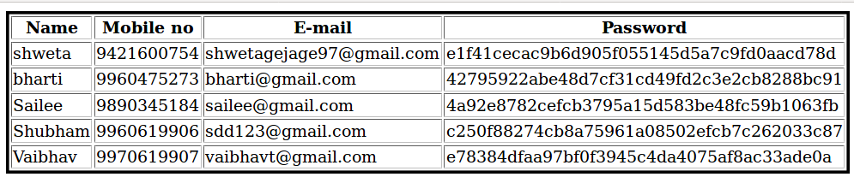
Schema

