Slide 1

Bootstrap
The most popular front-end framework

Slide 2
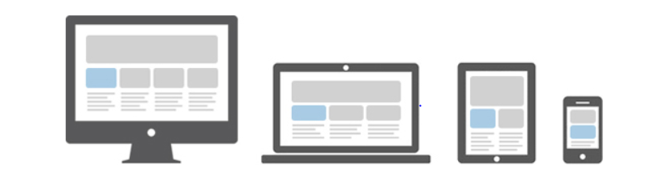
Responsive Web Design
Responsive websites automatically adjust themselves to look good on all sizes of devices.

Slide 3
What is Bootstrap?
Bootstrap is a front-end web development framework.
It provides ability for responsive design.
Also makes websites look more attractive.
It has ready-made HTML and CSS based design templates.

Slide 4
Invention of Bootstrap
Bootstrap was developed by Mark Otto and Jacob Thornton at Twitter.
It was released as Open Source project on Github On August 2011.
In 2014, it was the no.1 project on GitHub.
Current version is Bootstrap 4.

Slide 5
How to use Bootstrap?
Download Bootstrap files on your computer.
Include it from CDN
CDN - Content Delivery Network
Contains minimalistic version of files
eg.- bootstrap.min.css

Slide 6
Starting with simple Bootstrap page
Start with the basic HTML page displaying some text.
Make sure you add HTML5 Doctype to the file.
Include the Bootstrap files with the help of tags like
<link> and <script>.
Include <meta> tag and set width and scale for proper viewing.

Slide 7
Starting with simple Bootstrap page
Bootstrap uses .container class for wrapping all the site contents.
It sets fixed width on web page for displaying contents.
Include .container class in proper <div> tag.

Slide 8
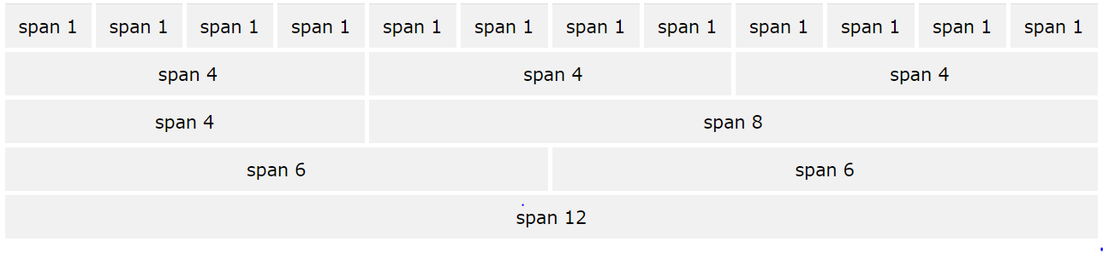
Grid System
Bootstrap allows upto 12 coloumns across the width of page.
Grid System is responsive.

Slide 9
Grid Classes
Bootstrap differentiates the devices based on their screen width.
Class | Device
.col- | small phones - screens less than 576px wide
.col-sm- | phones - screens equal to or greater than 576px wide
.col-md- | tablets - screens equal to or greater than 768px wide
.col-lg- | small laptops and desktops - screens equal to or greater than 992px wide
.col-xl- | laptops and desktops-screen equal to or geater than 1200pxc

Slide 10
Colors in Bootstrap
Special way of assigning colors.
Contextual Classes
- ‘Meaning through colors’
Examples:
.text-primary
.btn-danger

Slide 11
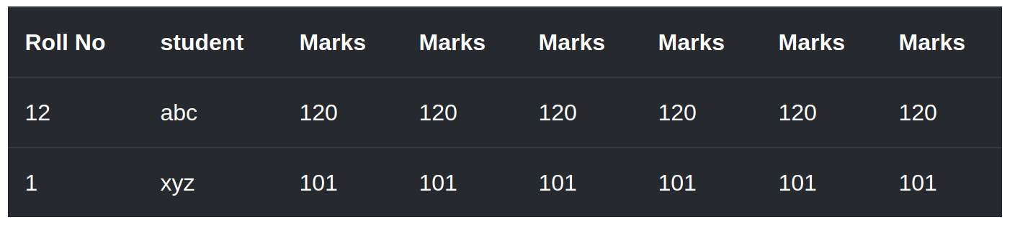
Tables in Bootstrap
The .table class adds basic styling to the table.

Slide 12
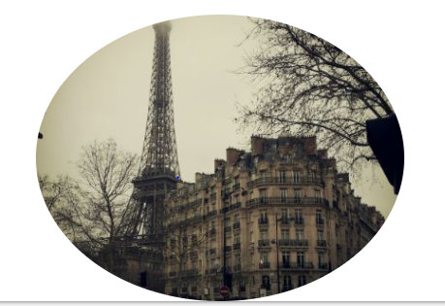
Images
BS provides several styles for image.
eg.- .rounded-circle class makes the image rounded.

Slide 13
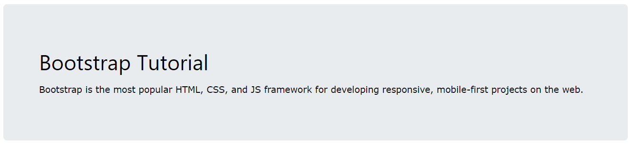
Jumbotron
A jumbotron is a big grey box for calling extra attention to some special content or information.
Including class .jumbotron will create a jumbotron in parent container.

Slide 14

Buttons in Bootstrap
Different styles of button
.btn class adds basic styling to a button.
Contextual classes can be used to give color to buttons.
Buttons can also displayed in different sizes.

Slide 15
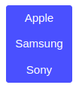

Buttons in Bootstrap
Buttons can be grouped either horizontally or vertically.
.btn-group-vertical class is used.

Slide 16

Dropdown
A dropdown menu is a toggleable menu that allows the user to choose one value from a predefined list.
The .dropdown class indicates a dropdown menu.

Slide 17
Carousel
The Carousel is a slideshow for cycling through images.
Basic corousel= images + indicators + controls
Can add captions to slides.

Slide 18
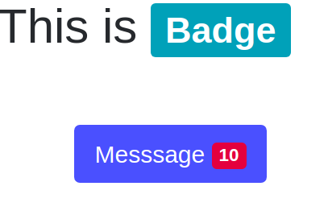
Badges
Badges are used to add additional information to any content.
Use the .badge class within <span> elements to create rectangular badges.

Slide 19
Progress Bars
A progress bar can be used to show a user how far along he/she is in a process.
Add a .progress class to a container element and add the .progress-bar class to its child element.

Slide 20

Pagination
Used with website with lot of pages.
Consists of unordered list of list items i.e. page links.

Slide 21

Navbar
A navigation header that is placed at the top of the page.
Can extend or collapse, depending on the screen size.

Slide 22
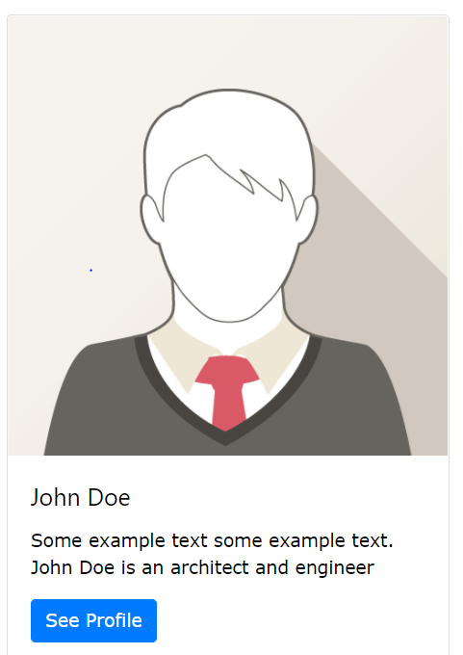
Cards
Bordered box with some padding around its content.
It includes options for headers, footers, content, colors, etc.

Slide 23
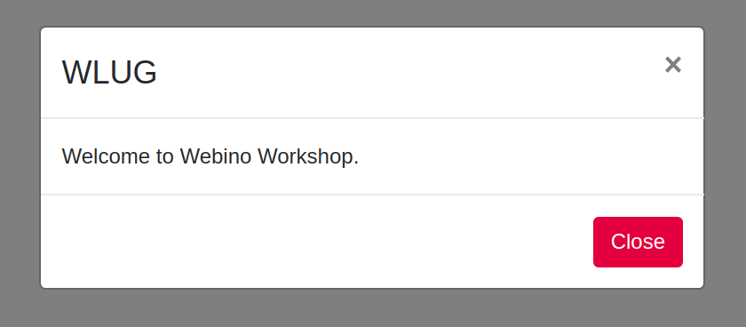
Modal
Modal component is a dialog box/popup window that is displayed on top of the current page

Slide 24
Forms
Form controls automatically receive some global styling with Bootstrap.

Slide 25
Advantages of Bootstrap
Easy to use
Responsive features
Attractive
Its free...

