Slide 1
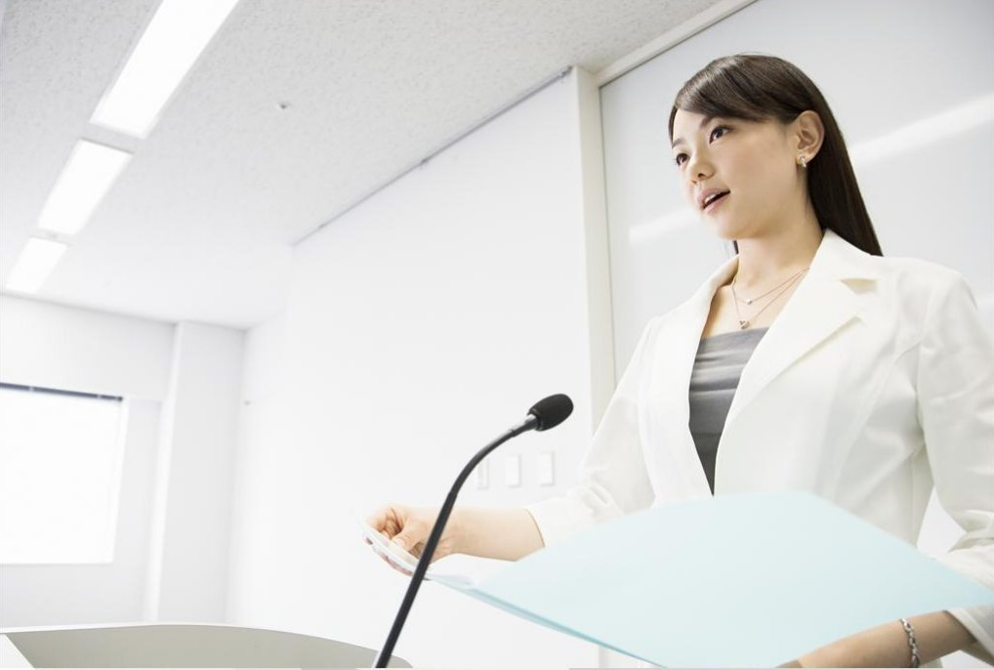
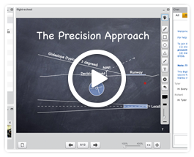
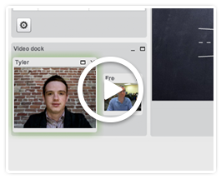
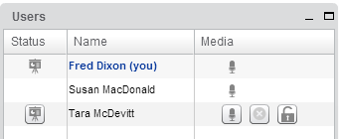
欢迎使用 果实网——视频
Moderator/Presenter
Viewer
You control the audio and can make anyone (including yourself) the presenter.
You can view, chat, and listen. If enabled, you can also unmute and share your webcam..
A green checkmark appears when you have joined the audio bridge. Click to join/leave the audio.
Current presenter
Click to make this user the presenter.
Click to mute/unmute your microphone.
Click to mute/unmute this user’s microphone.
Click to lock this user’s microphone (user can’t mute/unmute).
(launch test applet for testing desktop sharing)

