Slide 1

Human computer interaction
assignment
SIFAT HASAN WAKIB
ID: 17-33699-1
SEC: A

Slide 2

Agenda
Three Design Issues of Microsoft Teams.
Real Life Slip Example.

Slide 3
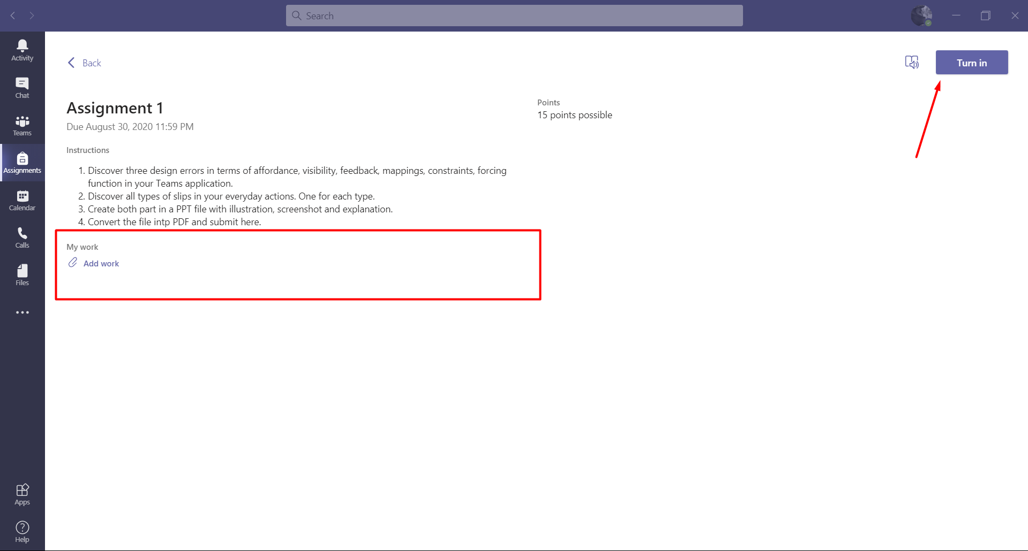
Design issues of Microsoft teams
Affordance: Affordance are properties of objects which show users the actions they can take. Users should be able to perceive affordances without having to consider how to use the items. For instance, a button can be designed to look as if it needs to be turned or pushed.

Slide 4
Design issues of Microsoft teams
In the picture above, It is shown that an assignment has been uploaded. There has been an instruction regarding uploading the assignment. There is a option called add work. When I add my documents there it does not show any notifications about upload status. Moreover, In teams after uploading assignment there is a option called “Turn In” that should be pressed. If the button is not pressed, the faculty does not get any notification. One who is not aware of this option , will upload his/her work and sit back. But the assignment won’t reach to the instructor. Moreover, hovering on the turn in button any instruction is not shown from where any user cannot get a clear understanding about the button.

Slide 5
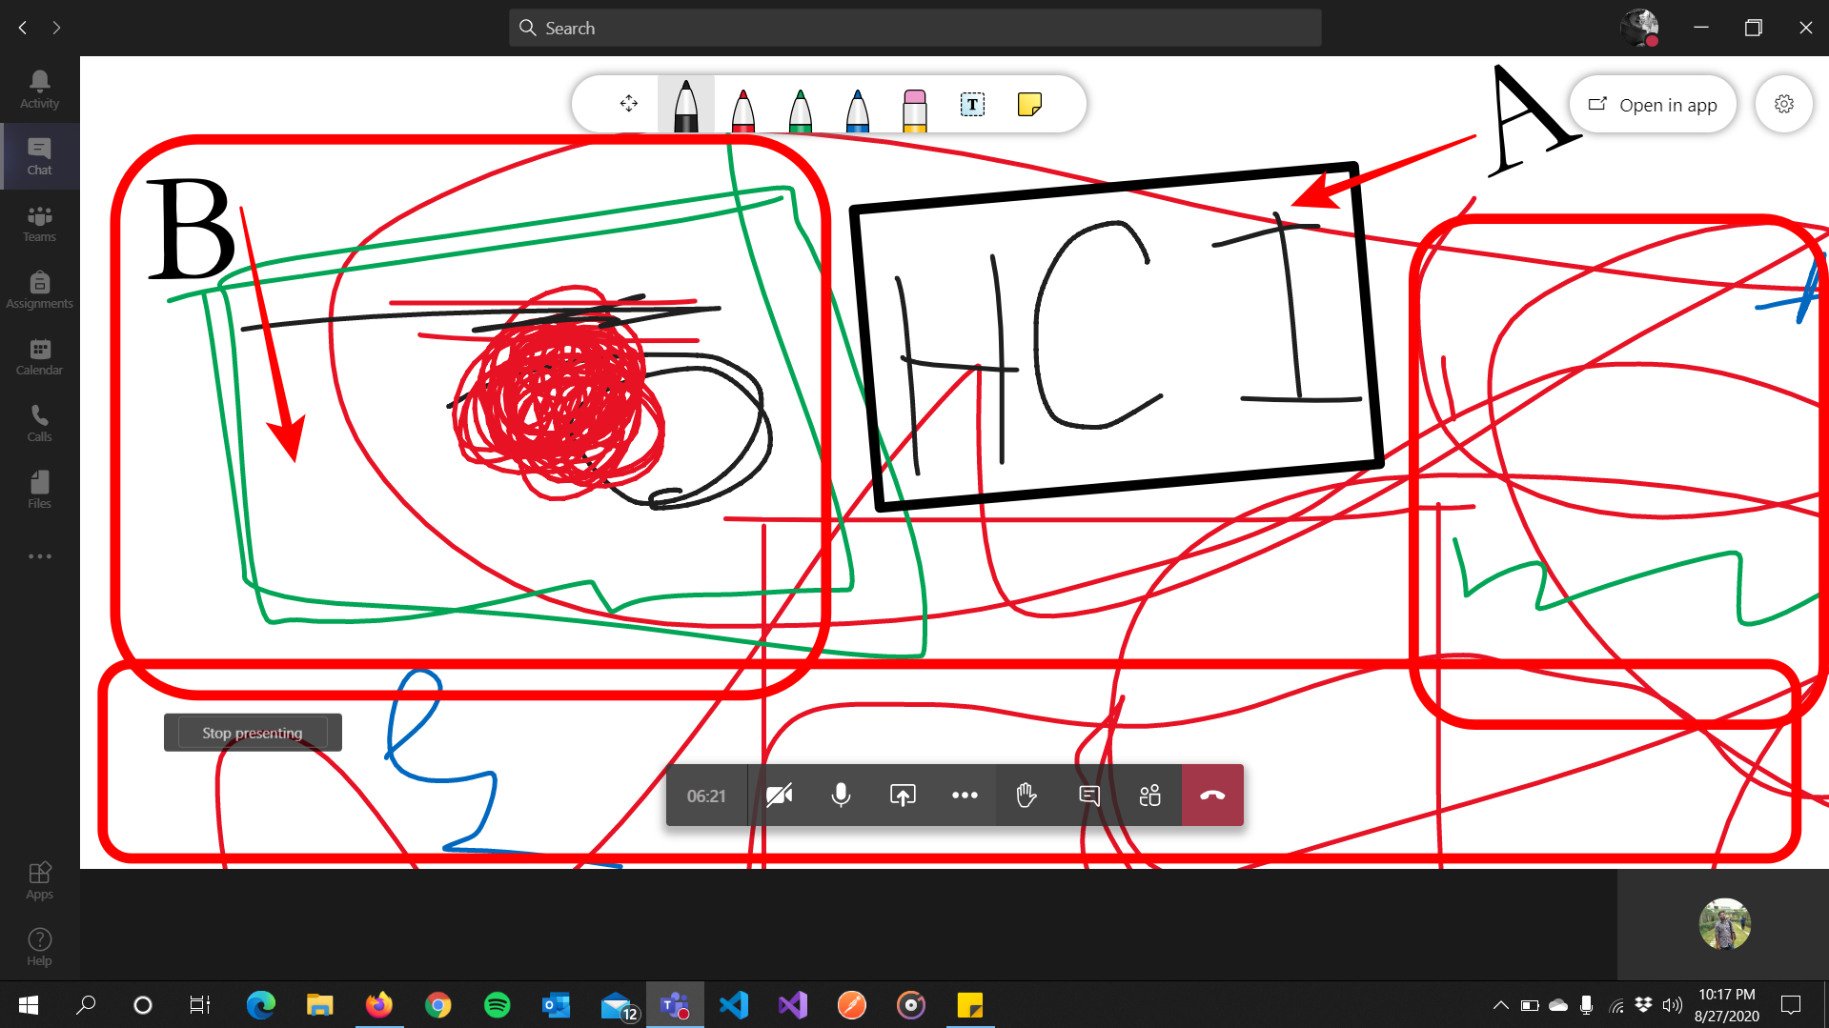
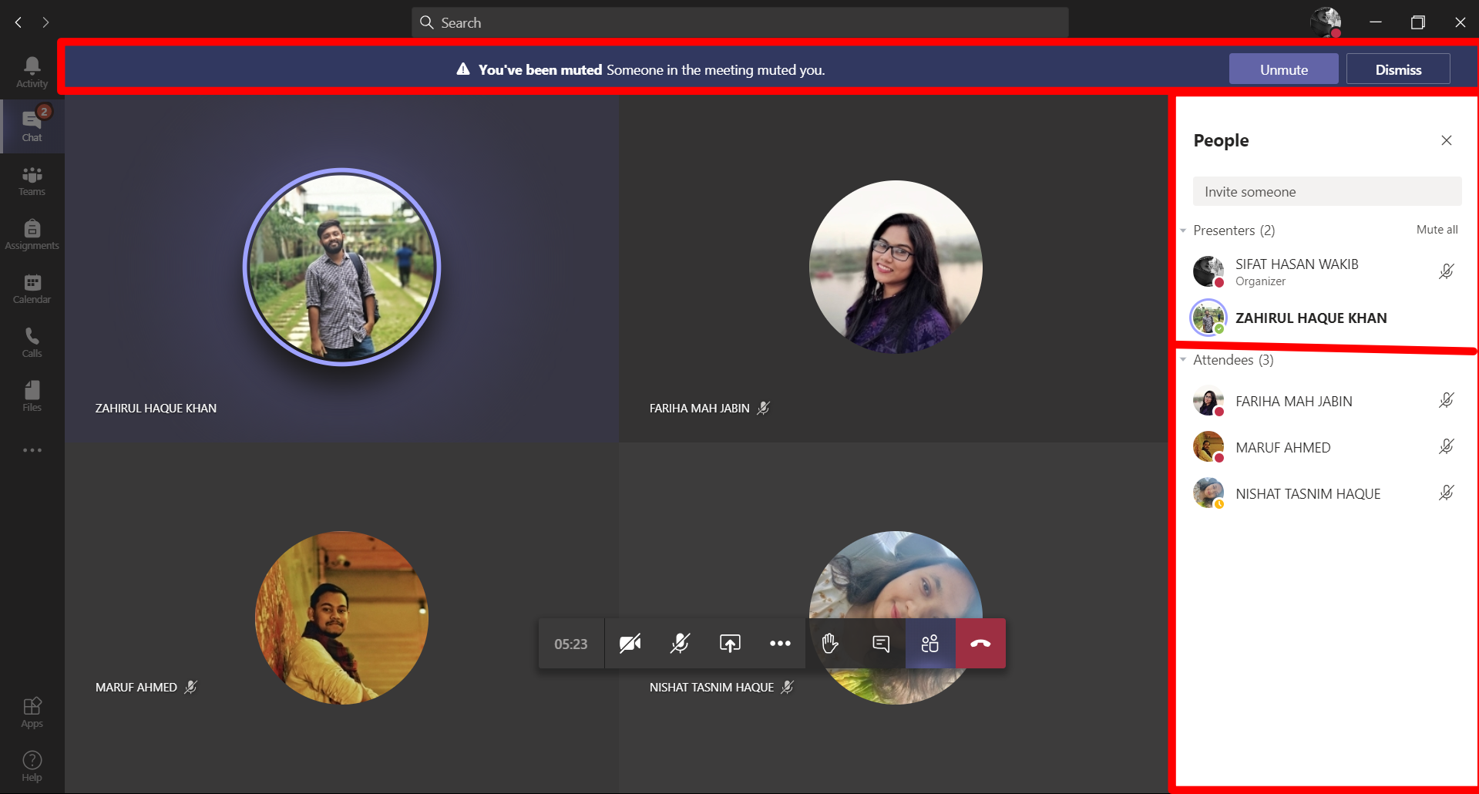
Design issues of Microsoft teams
Picture 2
Picture 3

Slide 6
Design issues of Microsoft teams
Gulf Of Execution : In HCI , the gulf of execution is the gap between a user's goal for action and the means to execute that goal. In picture 2, we can see the whiteboard of microsoft teams. Here the organizer of the meeting is writing/drawing in the whiteboard but the problem is if the organizer makes someone presenter or everyone is presenter everyone can draw/write in the board. Here, Block A which is marked with black rectangle is the organizer's drawing and the Block B is the other presenter's drawing in the middle of the white board. But the main thing would be, no one will be able to write/draw anything without the organizer / organizer's permission. Moreover, In the picture 3, it is shown that there is a organizer of the meeting and there is a presenter which has been made by the organizer. But, in the middle of the meeting the second presenter can mute everyone in the meeting except him. The presenter can mute everyone including the organizer. The functionalities should be like, only the organizer can mute everyone in the meeting. The presenters that will be made by the organizer will be able to share their screen. They wont be able to mute/draw anything in the whiteboard. This is why, there is a big lack of gulf of execution.

Slide 7
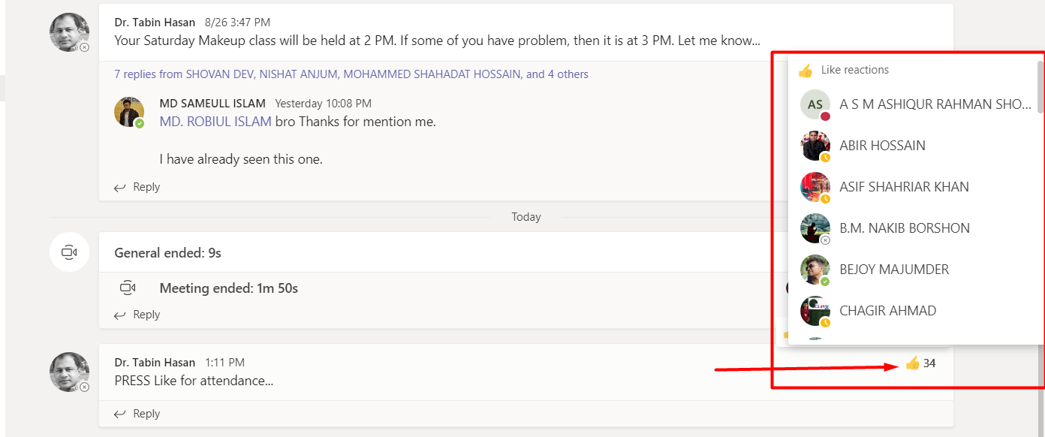
Design issues of Microsoft teams
Visibility : An object's function should be visible so that people can see what it is currently doing and see what buttons or controls are available. Visibility can also be made available through the use of sound or through touch with for example different textures, shapes or vibrations.
In picture 4, it is shown that a message should be reacted with like. But it is difficult for one to understand if he/she has like that before without checking the list that has been marked with a rectangle. Hovering the cursor on the reaction number it gets bold.
Picture: 4

Slide 8
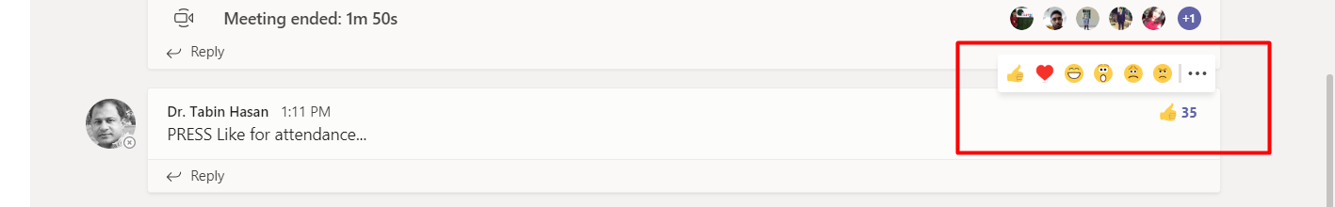
Design issues of Microsoft teams
Picture: 5
As discussed before, hovering the cursor on the number of reactions makes the number bold. After I give a like reaction on the message it also gets bold. But it is difficult to find out who gave which reaction because in teams the arrow marked reaction list does not mark which reaction who has given and one has to go through the list again to check which reaction he/she has given on the message. But if there was a rectangle with a light ash/grey color that will be beside the reaction which one has given it would be very easy to find out which reaction has been given by the user. This is why, there is a lack of visibility.

Slide 9

Human error
So , There are two fundamental categories are:
Slips and
Mistakes
Slips result from automatic behavior, when subconscious actions that are intended to satisfy our goals get waylaid en route.
Mistakes result from conscious deliberations. Form the wrong goal, and you've made a mistake.

Slide 10
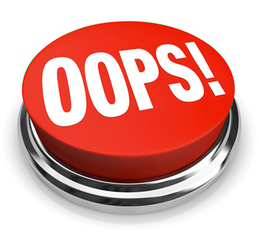
Real life example of slips
Let’s Dive In

Slide 11
Types of slips
CAPTURE ERROR : I was browsing facebook for a long time and suddenly I remembered to check my e-mails. So after closing the facebook tab, I opened facebook again instead of opening Gmail.
DESCRIPTION ERROR : I was cooking in my house and suddenly when I was about to pour salt in the curry. I put sugar in the curry.
DATA DRIVEN : I was in my exam hall and my exam was going good. I decided to write fast as I was running out of time. So I was writing attentively and suddenly someone asked for "extra paper" to the teacher and I wrote in my script "extra paper" as I heard the word at that moment.

Slide 12
Types of slips
LOSS OF ACTIVITIES : I went to my room to bring my laptop. After I enter my room I have forgotten the work for what I have came to this room but my laptop was in front of me.
ASSOCIATE ACTIVATION ERROR : I went outside to meet my friends. I greeted them but I was calling one of my friend by another friend’s name.
MODE ERROR : I was doing project of my academic course and I was writing Javascript code in php extension file and without starting and ending of <script> tag.

