Slide 1
Olympics[2000-2016]
Team: Radha, Shweta, Sequoyah, Mathew

Slide 2

Introduction
Dataset
https://www.kaggle.com/heesoo37/120-years-of-olympic-history-athletes-and-results
The data is in the form of csv sheet. It has the basic bio data of athletes and medals won by them in respective sports.
ELT Process
Data extracted from Kaggle[olympicinfo]
Loaded into a staging table in the PostgreSQL[staging_Olympic]
Transformed and loaded into the target[final_olympicinfo]

Slide 3
Tableau Visualizations
Dashboards

Slide 4
Sr. No. | Title | Work Sheets
Dashboard 1 | Olympic data-Medal Distribution 1 | Total Count of Medals across Cities Medal Distribution by Sports Total Count of Medals across Team Top 5 Total Medal Countries in 5 years
Dashboard 2 | Olympicdata-Treemap | Tree Map
Dashboard 3 | Olympicdata-Medals across Map | Medals across Map
Dashboard 4 | Olympic data-Medal distribution2 | Medal Distribution across Athletes Top 10 by Medal Count Sports played in Cities Medal Distribution across Age Groups
Dashboard 5 | Olympic data-Medal distribution 3 | Athlete Participation Participation Count Map
Dashboard 6 | Olympic Data by age | Summer Male and Female count by age Winter Male and Female count by age Summer Medals by age Winter Medals by age

Slide 5
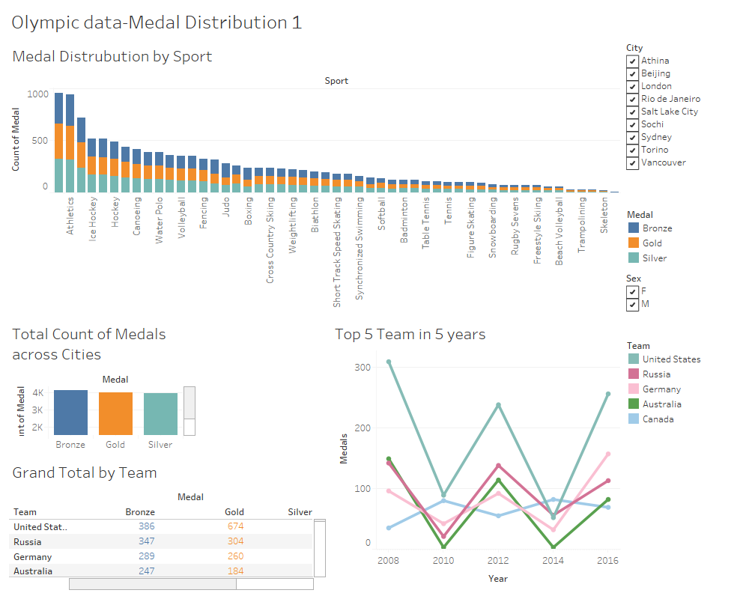

Slide 6
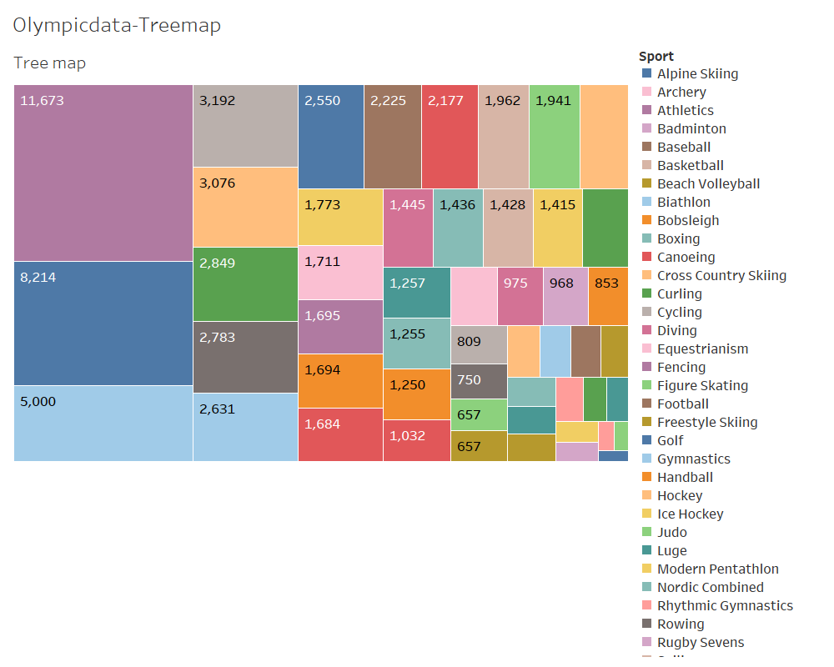

Slide 7
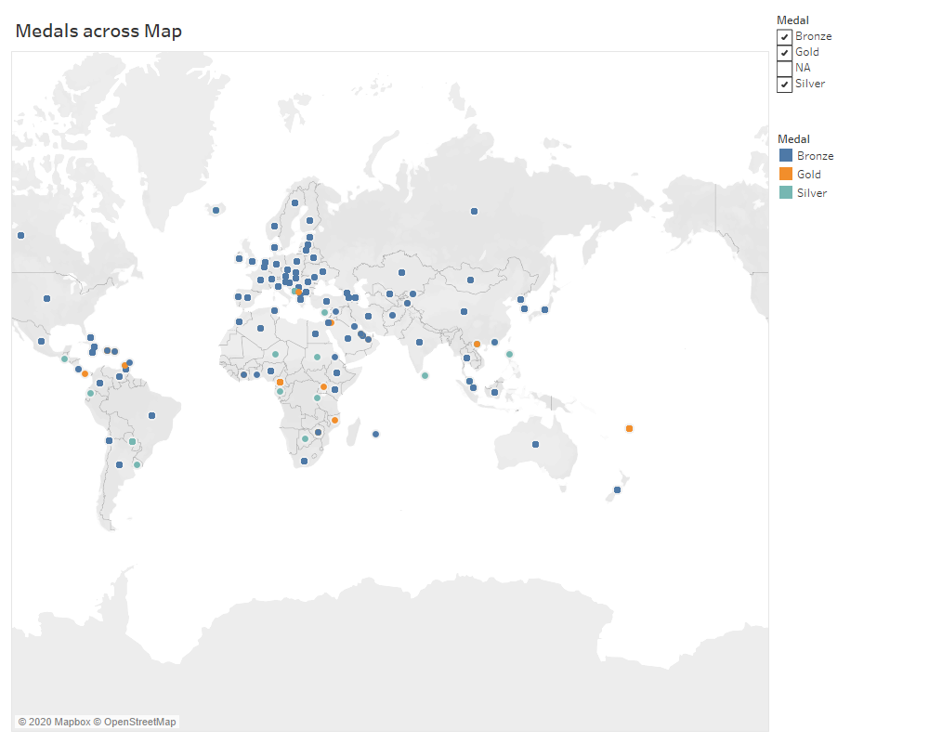

Slide 8
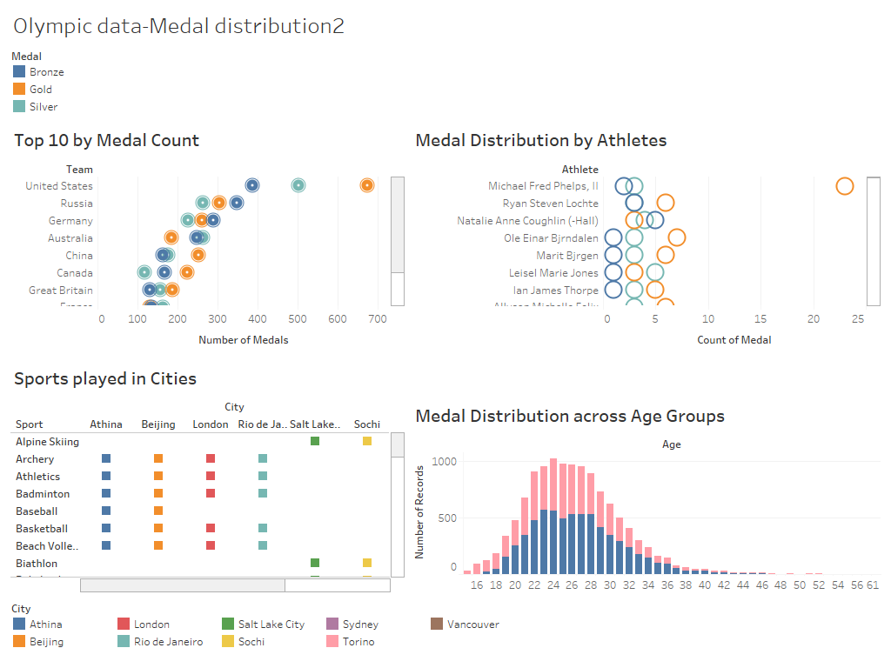

Slide 9
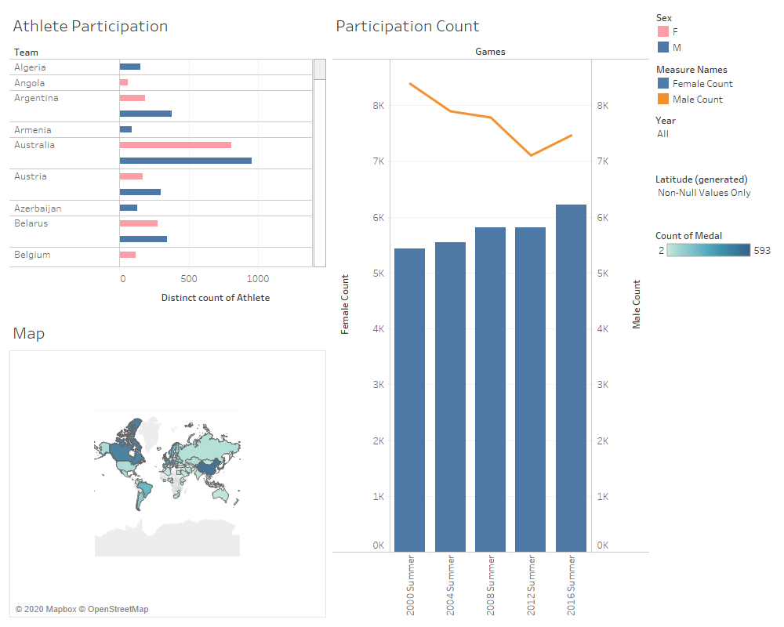

Slide 10
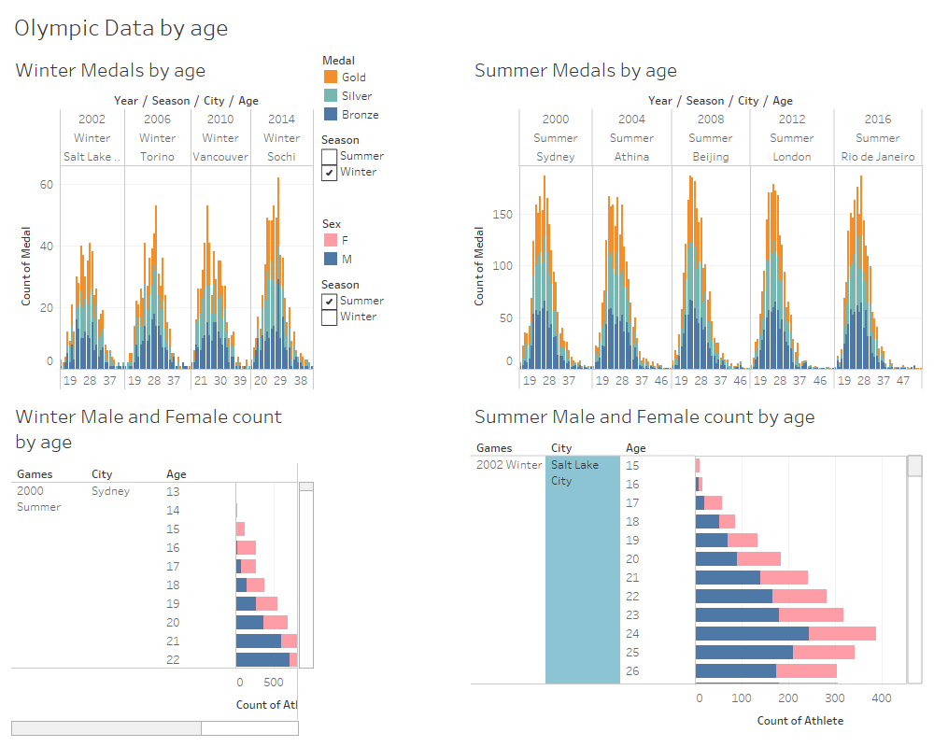

Slide 11
Tableau Visualizations
Story

Slide 12
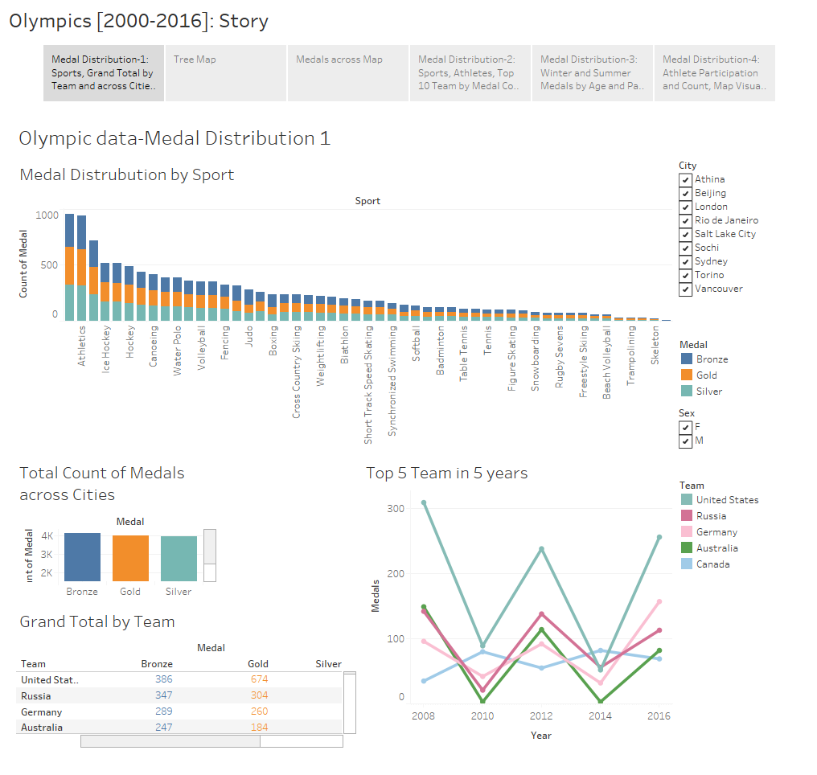

Slide 13
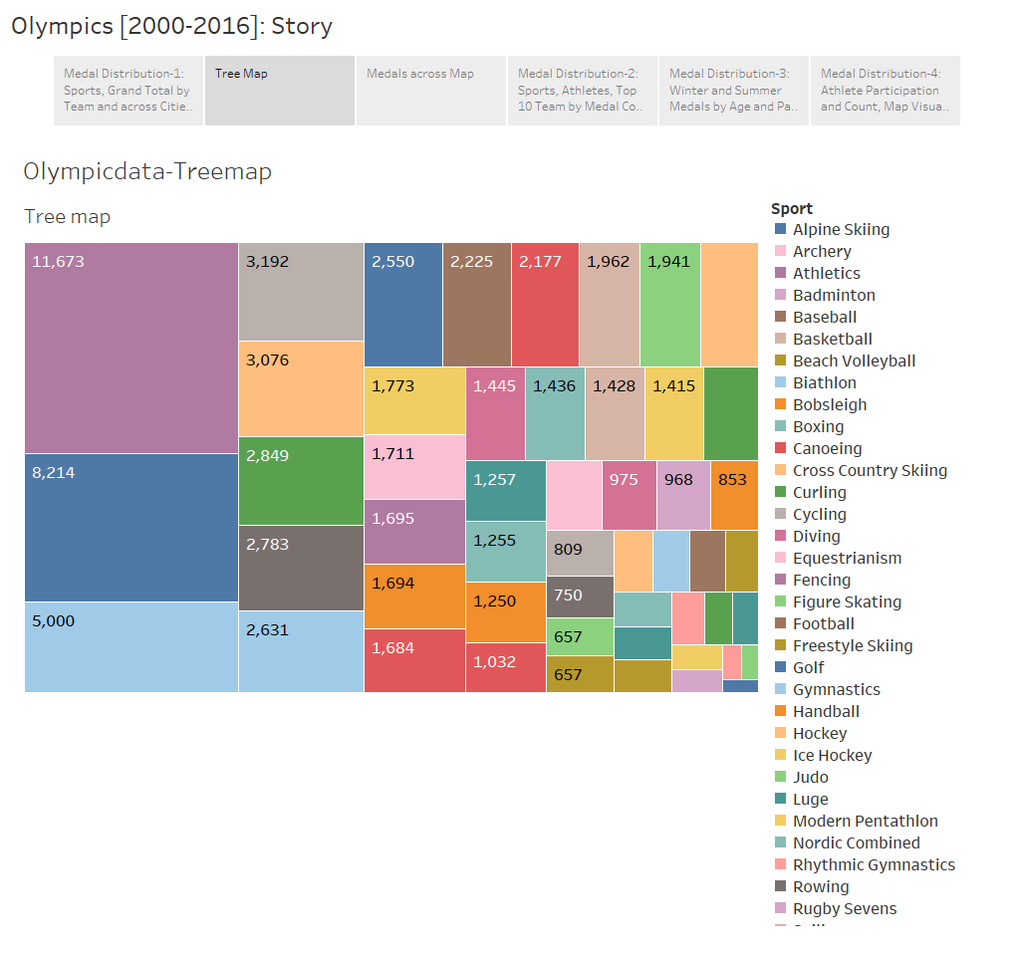

Slide 14
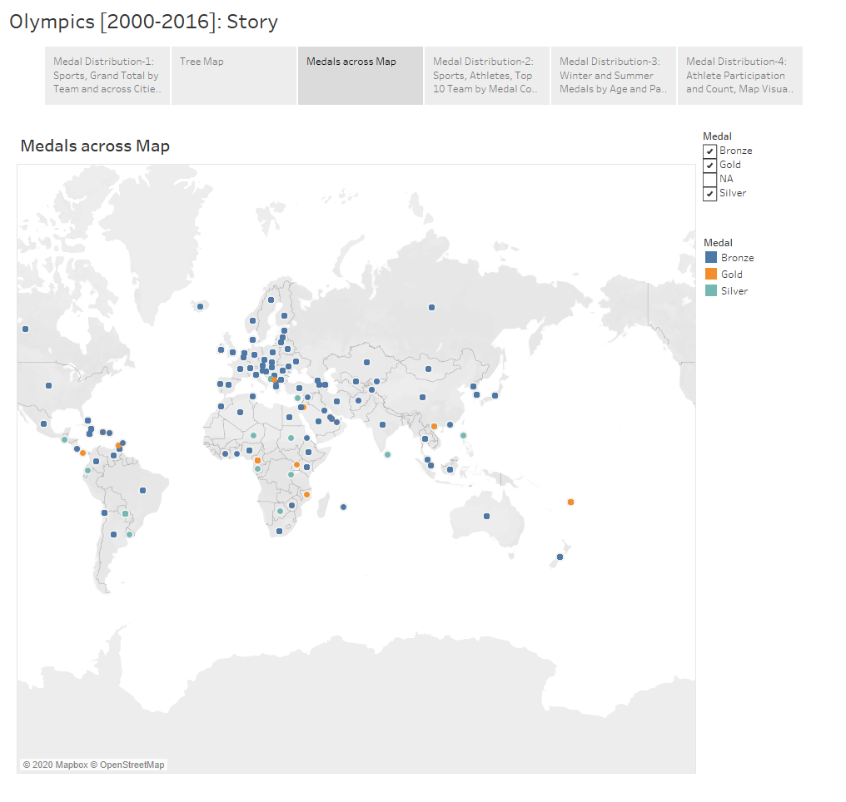

Slide 15
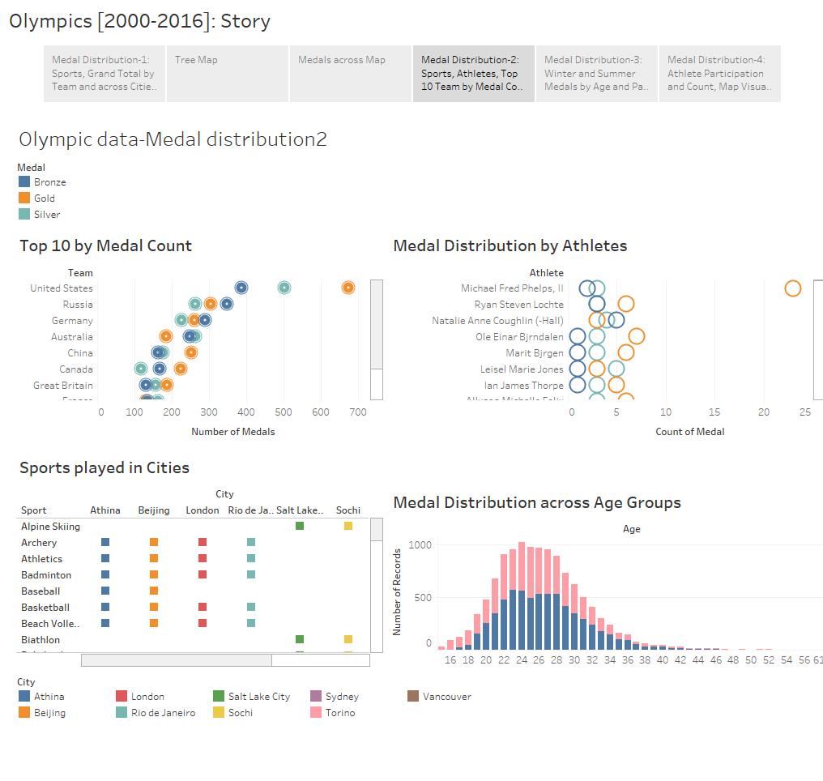

Slide 16
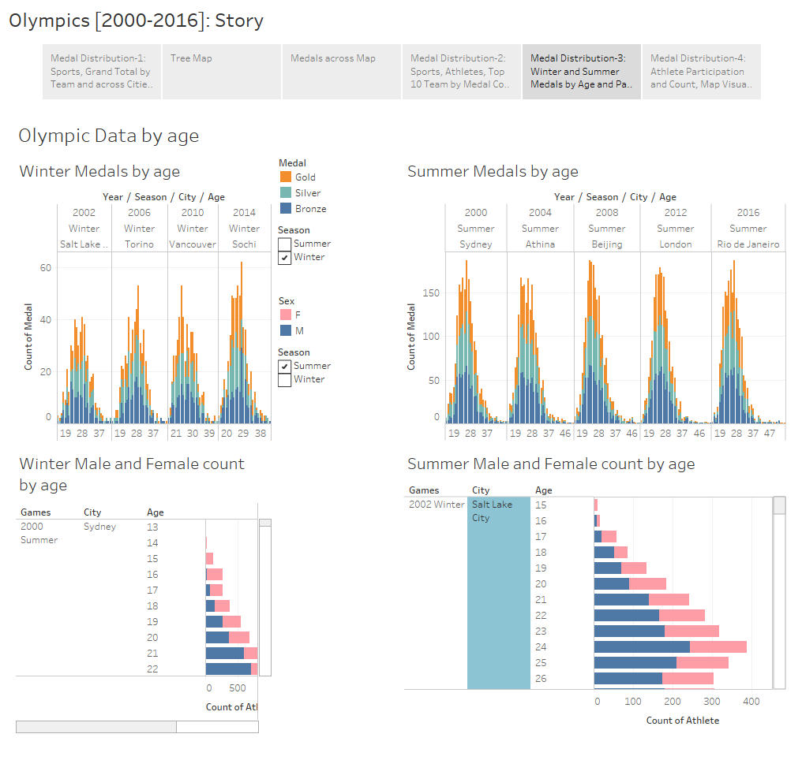

Slide 17
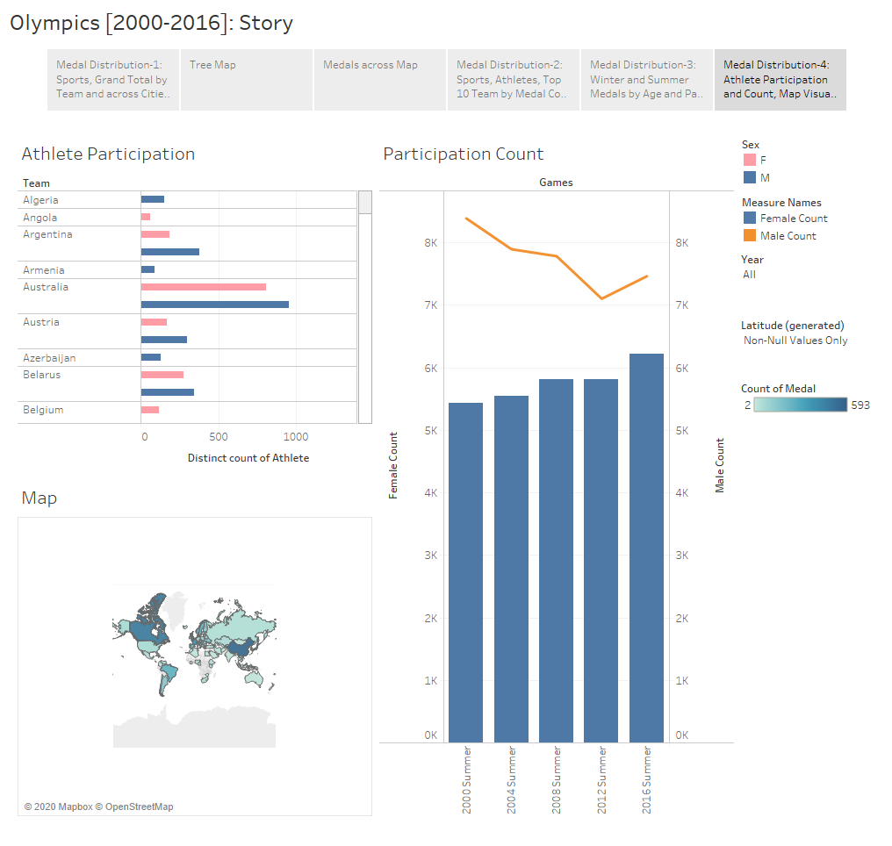

Slide 18
Summary
United States tops the chart with highest no. of medals.
Michael Phelps has won maximum gold medals.
The athletes’ age group ranges between 20-34 years.

Slide 19
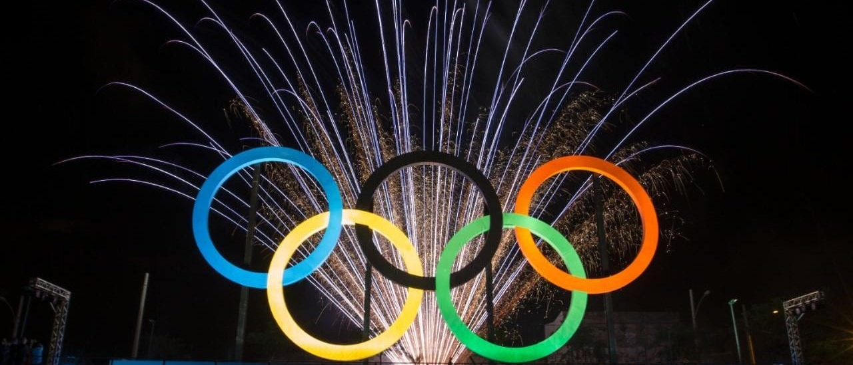
Thank you!
THANK YOU!

