Slide 1
Olympics[2000-2016]
Team: Radha, Shweta, Sequoyah, Mathew

Slide 2
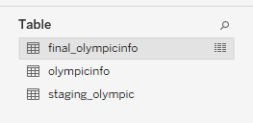
Introduction
Dataset
https://www.kaggle.com/heesoo37/120-years-of-olympic-history-athletes-and-results
The data is in the form of csv sheet. It has the basic bio data of athletes and medals won by them in respective sports.
ELT Process
Data extracted from Kaggle[olympicinfo]
Loaded into a staging table in the PostgreSQL[staging_Olympic]
Transformed and loaded into the target[final_olympicinfo]

Slide 3
Tableau Visualizations
Dashboard 1 | Winter vs Summer Olympics
Dashboard 2 | Medal Distribution
Dashboard 3 | Sports & Athletes Participation and Performance

Slide 4
Dashboard 01 Medal Distributions
Which team has the maximum number of participants in Olympics from 2000 to 2016?
What’s the Female participation overtime?
Which TEAM got maximum number of gold medals?
Which TEAM won the most gold medals? Top 10 Team Performance!

Slide 5
Dashboard 02 Athletes Performance across Age Groups
What’s the medal distribution among various athletes?
What’s the medal distribution across different age groups?
What’s the % of athletes below age 30
What’s the % of athletes below age 40
What’s the average age of participants across various sports?

Slide 6
Dashboard 03 US Winter Vs Summer Olympics
What’s the best year for USA in terms of total number of medals for summer?
What’s the best year for USA in terms of total number of medals for winter?

Slide 7
Summary

Slide 8
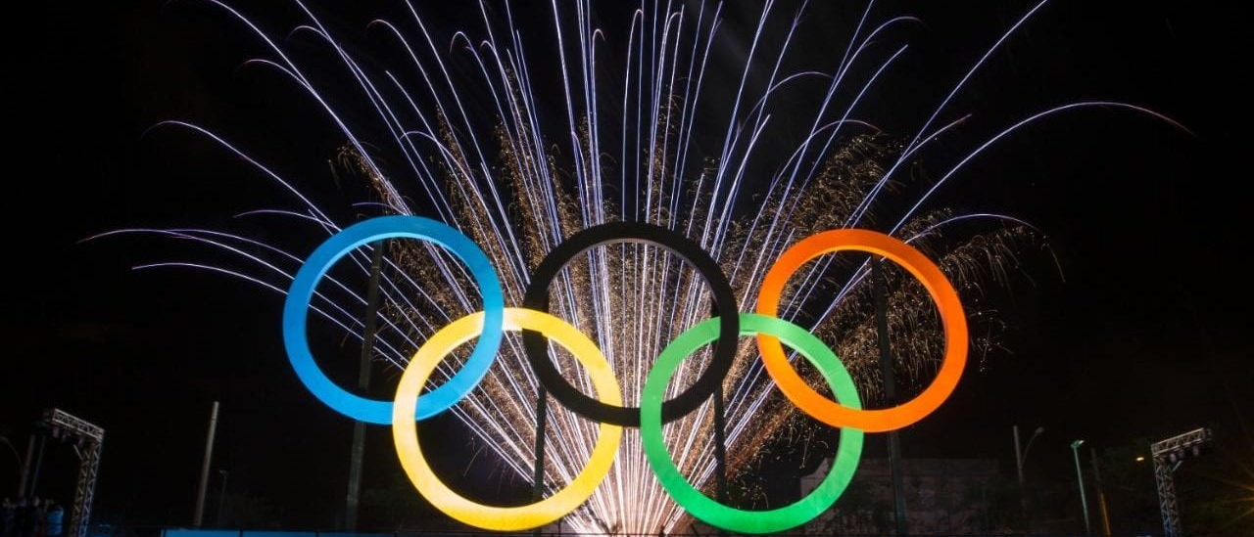
Thank you!
THANK YOU!

