Slide 1
Olympics[2000-2016]
Team: Radha, Shweta, Sequoyah, Mathew

Slide 2

Introduction
Dataset
https://www.kaggle.com/heesoo37/120-years-of-olympic-history-athletes-and-results
The data is in the form of csv sheet. It has the basic bio data of athletes and medals won by them in respective sports.
ELT Process
Data extracted from Kaggle[olympicinfo]
Loaded into a staging table in the PostgreSQL[staging_Olympic]
Transformed and loaded into the target[final_olympicinfo]

Slide 3
Tableau Visualizations
Dashboards
Work Sheets

Slide 4
Sr. No. | Title | Work Sheets
Dashboard 1 | Olympic data-Medal Distribution 1 | Total Count of Medals across Cities Medal Distribution by Sports Total Count of Medals across Team Top 5 Total Medal Countries in 5 years
Dashboard 2 | Olympicdata-Treemap | Tree Map
Dashboard 3 | Olympicdata-Medals across Map | Medals across Map
Dashboard 4 | Olympic data-Medal distribution2 | Medal Distribution across Athletes Top 10 by Medal Count Sports played in Cities Medal Distribution across Age Groups
Dashboard 5 | Olympic data-Medal distribution 3 | Athlete Participation Participation Count Map
Dashboard 6 | Olympic Data by age | Summer Male and Female count by age Winter Male and Female count by age Summer Medals by age Winter Medals by age

Slide 5
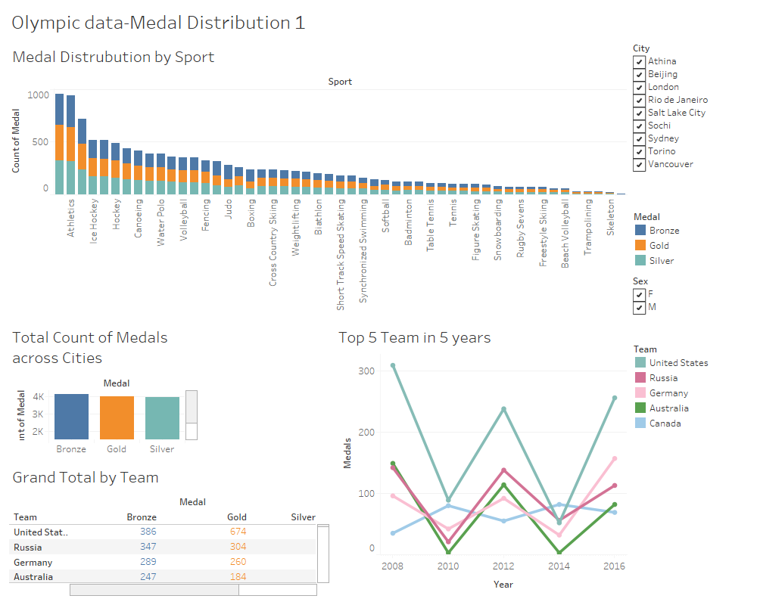

Slide 6
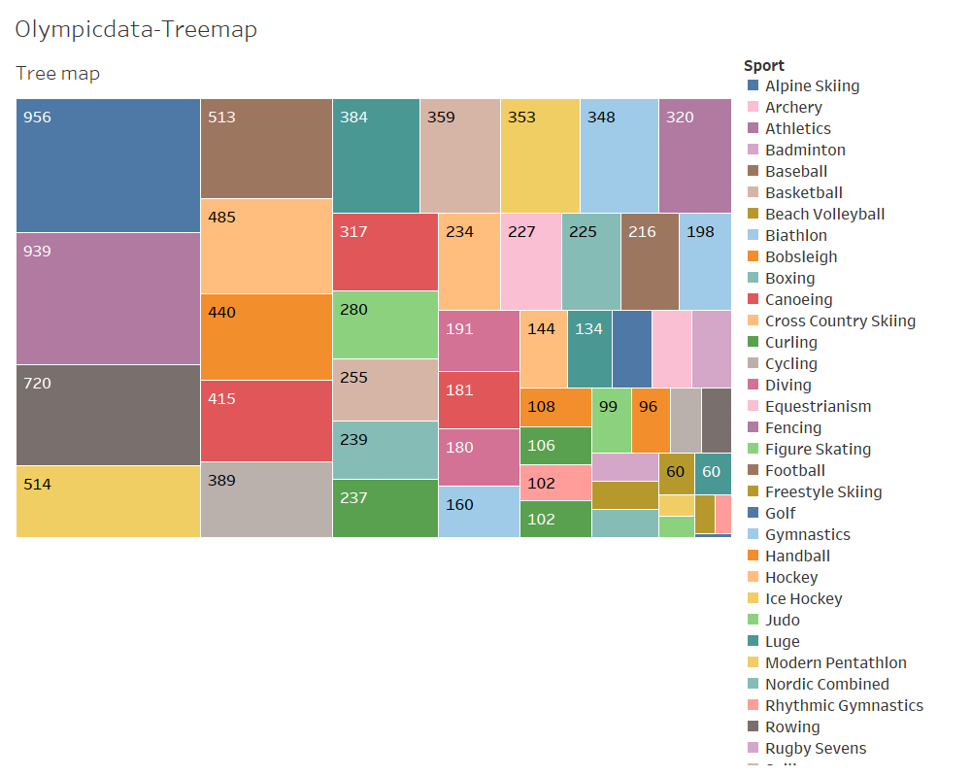

Slide 7
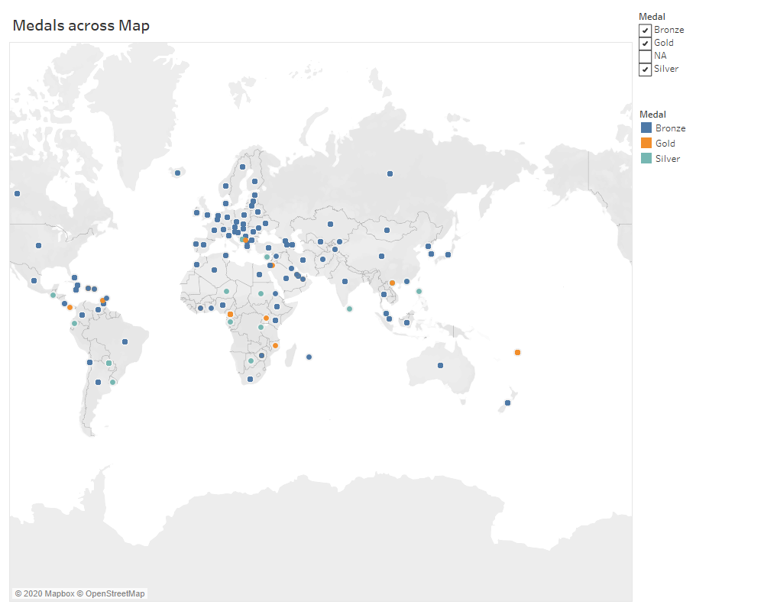

Slide 8
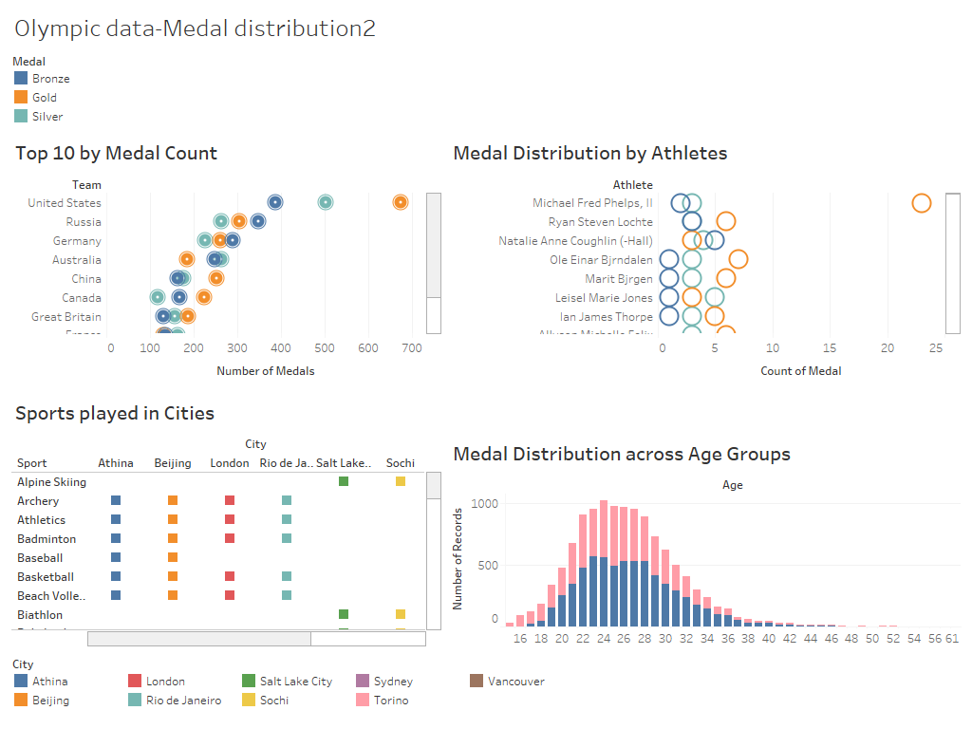

Slide 9
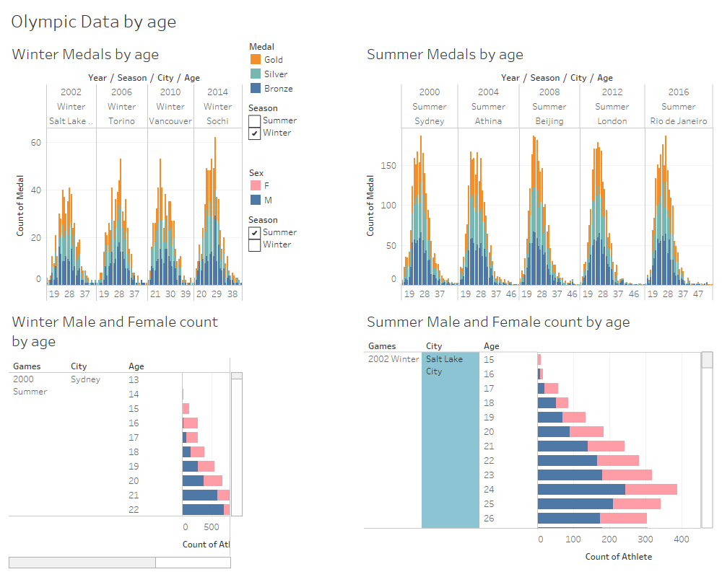

Slide 10
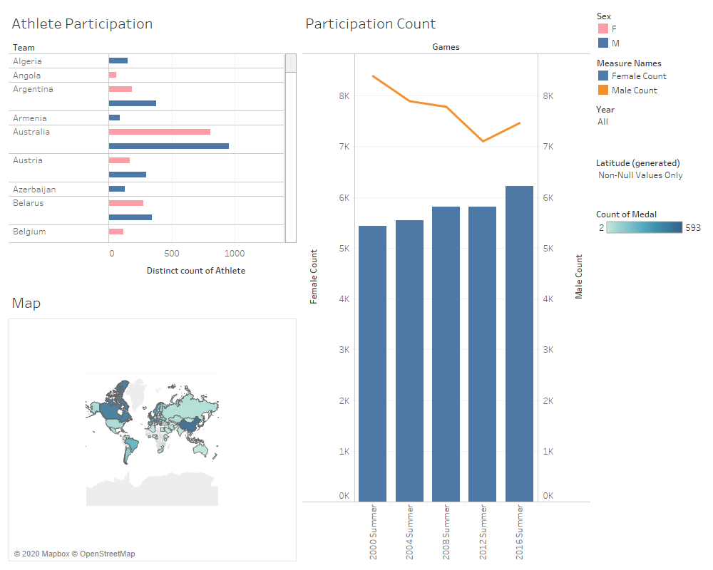

Slide 11
Tableau Visualizations
Story

Slide 12
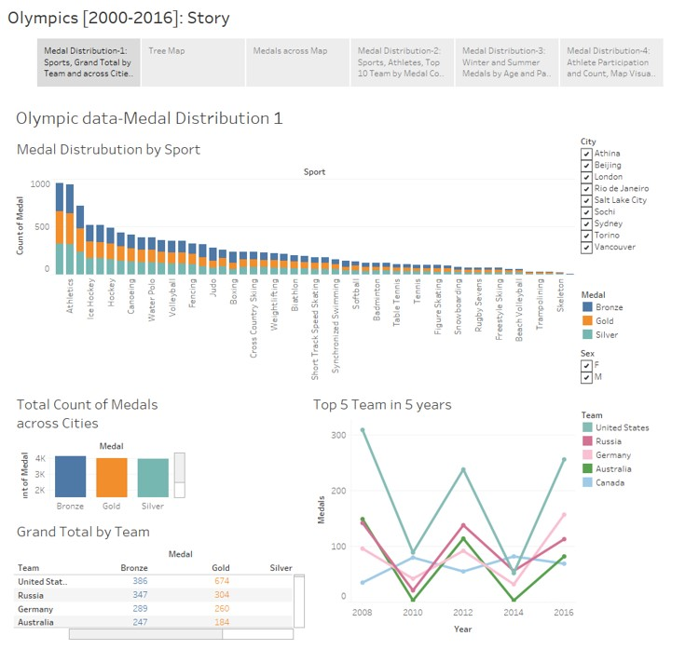
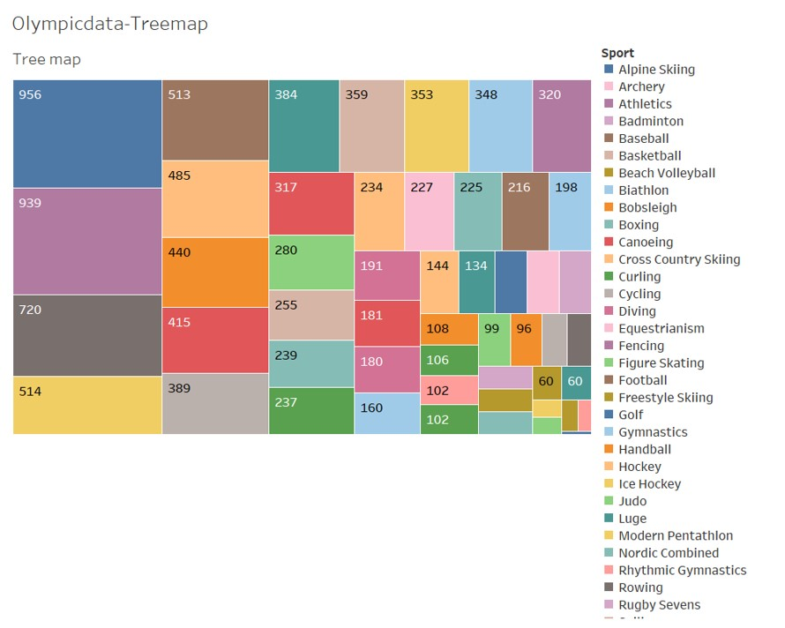
Olympics[2000-2016]

Slide 13
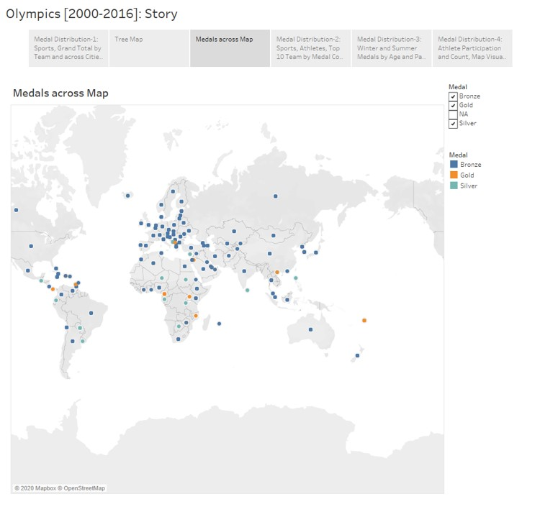
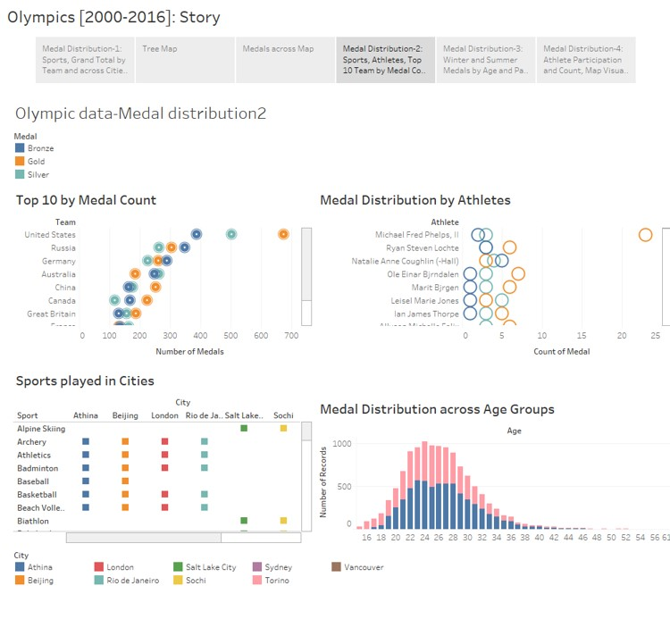
Olympics[2000-2016]

Slide 14
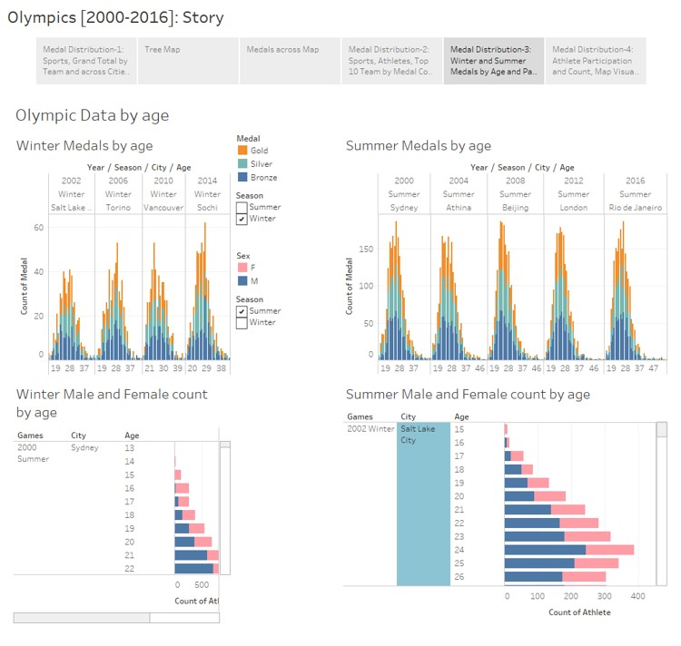
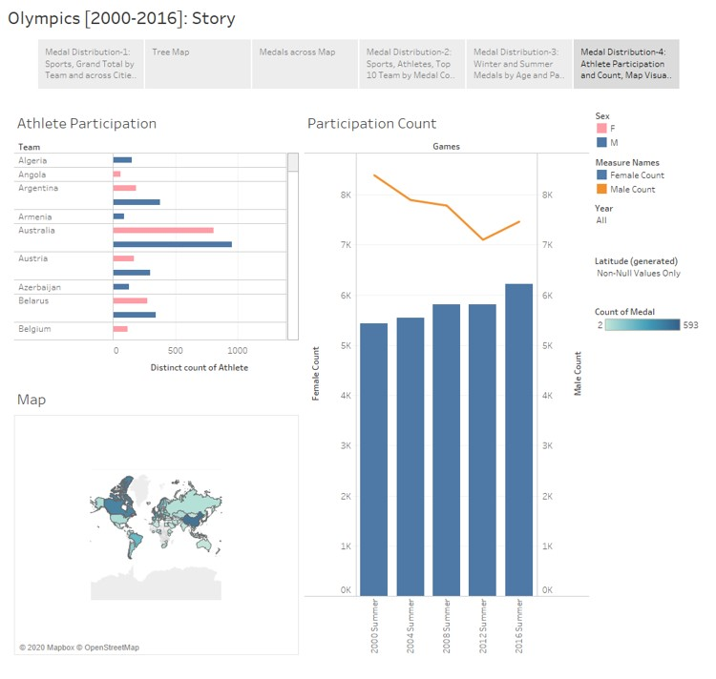
Olympics[2000-2016]

Slide 15
Summary
The increase of women's participation, even as recent as 2000-2016 as a world effort. Most countries have a fairly even number of male and female athletes sent to the Olympics, with no one individual country or set of countries accounting for the recent increase in female participation in the Olympics. | United States tops the chart with highest no. of medals. Swimming athlete, Michael Phelps won maximum no. of gold medals. Athens, Greece hosted maximum no. of sports over the years. The athletes’ age group ranges between 20-34 years. | Swimming has got the highest number of medals and golf stands in last position with two medals. US stands in first position with 1561 medals followed by Russia in second position with 913 medals. There are a couple of counties like Uganda, Togo with just 1 medal and stands in last position. | For the past Olympics (2000-2016) It appears that for almost every age group the number of male athletes are close to two time the female athletes. For each age group the medal distribution is about 1/3 Gold, Silver, and Bronze through out the particular age.

Slide 16
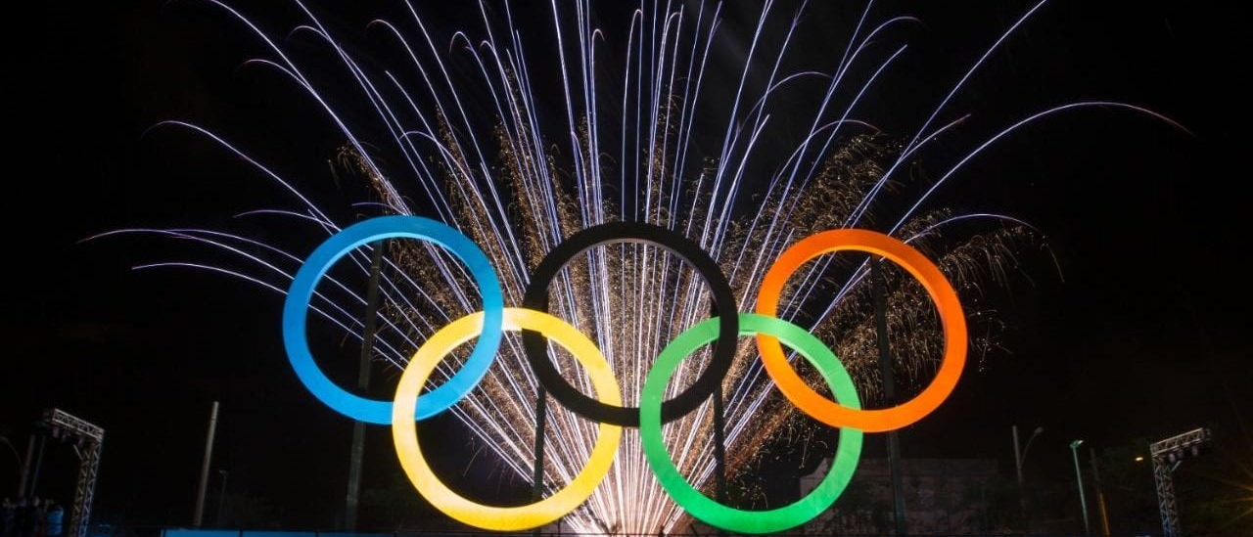
Thank you!
THANK YOU!

