Slide 1
Olympics[2000-2016]
Team: Radha, Shweta, Sequoyah, Mathew

Slide 2
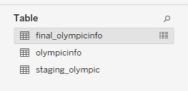
Introduction
Dataset
https://www.kaggle.com/heesoo37/120-years-of-olympic-history-athletes-and-results
The data is in the form of csv sheet. It has the basic bio data of athletes and medals won by them in respective sports.
ELT Process
Data extracted from Kaggle[olympicinfo]
Loaded into a staging table in the PostgreSQL[staging_Olympic]
Transformed and loaded into the target[final_olympicinfo]

Slide 3
Tableau Visualizations
Dashboard 1 | TREE MAP
Dashboard 2 | Total Count of Medals across Cities
 | Medal Distribution by Sports
 | Total Count of Medals across Team
 | Top 5 Total Medal Countries in 5 years
Dashboard 3 | Medal Distribution across Team
 | Top 10 by Medal Count
 | Sports played in Cities
 | Medal Distribution across Age Groups
Dashboard 4 | Summer Male and Female count by age
 | Winter Male and Female count by age
 | Summer Medals by age
 | Winter Medals by age
Dashboard 5

Slide 19
Dashboard 01 Medal Distributions

Slide 20
Dashboard 02 Medal Distributions

Slide 21
Dashboard 03 Medal Distributions

Slide 22
Dashboard 04 Medal Distributions

Slide 23
Dashboard 05 Medal Distributions

Slide 24
Conclusions

Slide 25
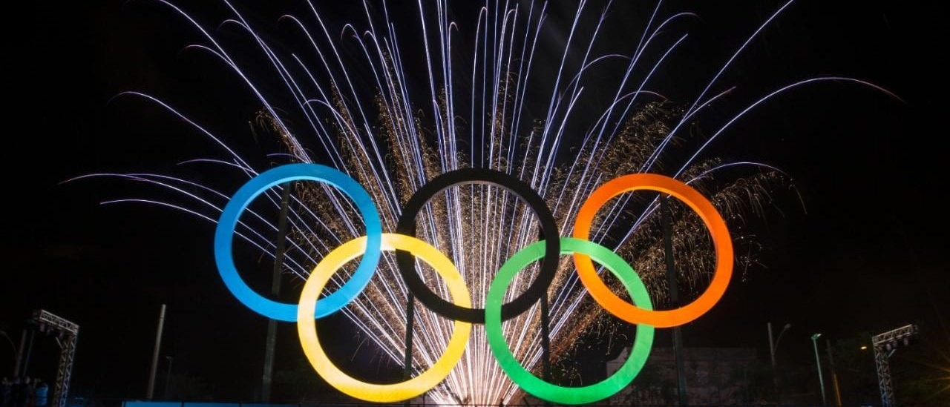
Thank you!
THANK YOU!

