Slide 1
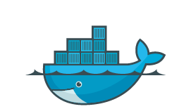
Docker進階
Tommy

Slide 2
Docker Compose
用於定義和運行多容器Docker應用程序的工具
使用一個描述檔(預設名稱是 docker-compose.yml )建置多個容器，同時管理、操作它們
可在所有環境中運作：Production，Development，Testing，和CI

Slide 3
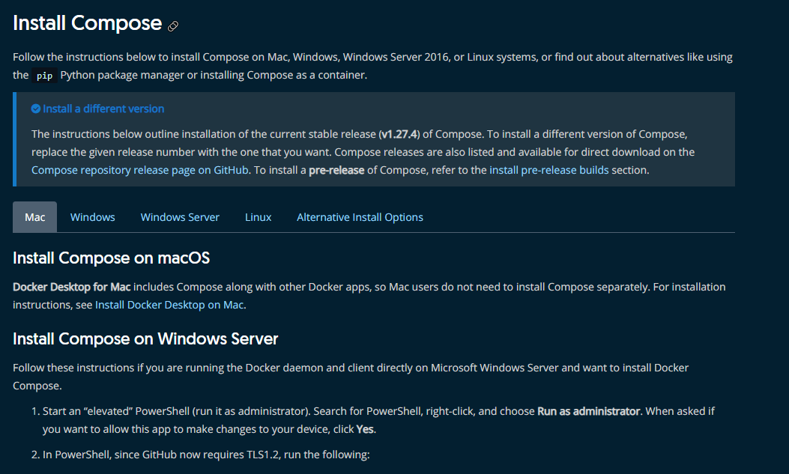
安裝 Docker Compose
https://docs.docker.com/compose/install/

Slide 4
使用四步驟
定義您的app服務的環境，使用Dockerfile以便可以建立。
建立docker-compose.yml定義組成多個app服務以便它們可以在隔離的環境中一起運行
docker-compose build建立所有的app服務之映像檔
docker-compose up 啟動並運行您的整個應用程序。

Slide 5
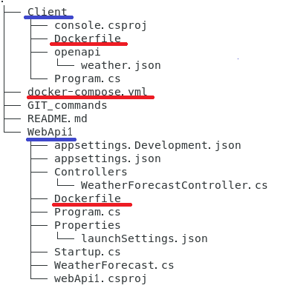
範例展示
Using OpenAPI with .NET Core
https://github.com/shwang1a/OpenAPI
Notes:
本頁請列舉並說明2020會有什麼跟之前不一樣的計畫?包括新產品、新技能培養……etc

Slide 6
docker-compose.yml
version: '3'
services:
webapi1:
image: shwang1a/webapi1
build:
context: ./WebApi1
dockerfile: Dockerfile
ports:
- "5001:5001"
console:
depends_on:
- webapi1
image: shwang1a/client-image
build:
context: ./Client
dockerfile: Dockerfile
environment:
WebApi1Url: "http://webapi1"
Notes:
Image name必須在前頭加Tag

Slide 7
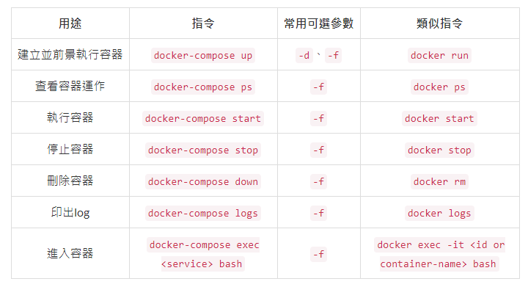
建立及操作Compose
Notes:
https://docs.docker.com/compose/reference/overview/

Slide 8
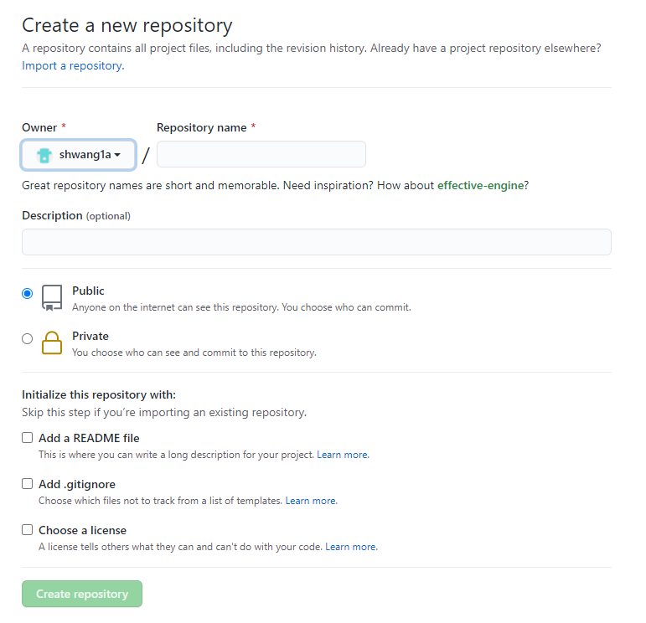
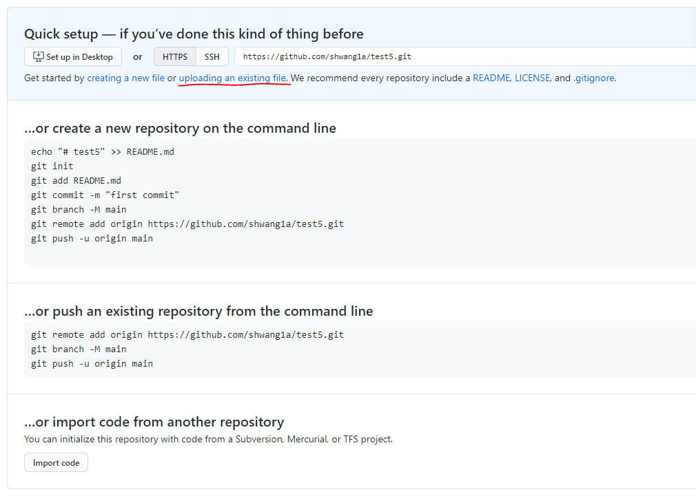
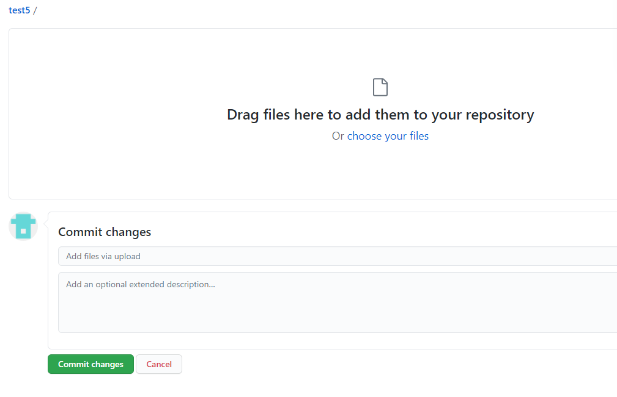
Github上建立Respository
Notes:
https://github.com/new

Slide 9
VS.Code整合Github
Install Git extension
https://marketplace.visualstudio.com/items?itemName=forevolve.git-extensions-for-vs-code
Install Git Exclude
https://marketplace.visualstudio.com/items?itemName=boukichi.git-exclude
Start a new git repository
https://kbroman.org/github_tutorial/pages/init.html
Notes:
A new repo from an existing project
Say you’ve got an existing project that you want to start tracking with git.
Go into the directory containing the project.
Type git init.
Type git add to add all of the relevant files.
You’ll probably want to create a .gitignore file right away, to indicate all of the files you don’t want to track. Use git add .gitignore, too.
Type git commit.
Connect it to github
You’ve now got a local git repository. You can use git locally, like that, if you want. But if you want the thing to have a home on github, do the following.
Go to github.
Log in to your account.
Click the new repository button in the top-right. You’ll have an option there to initialize the repository with a README file, but I don’t.
Click the “Create repository” button.
Now, follow the second set of instructions, “Push an existing repository…”
$ git remote add origin https://github.com/username/new_repo
$ git push -u origin master
Actually, the first line of the instructions will say

Slide 10
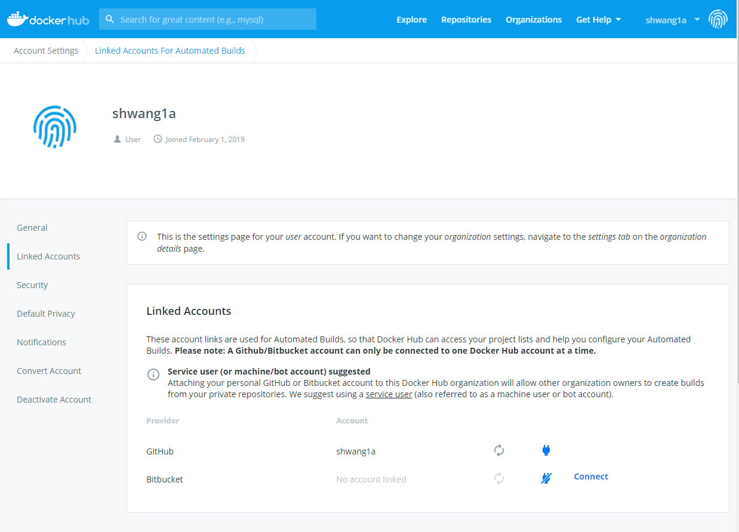
Docker hub auto build
前置條件
Github帳號，並建立專案，且專案內包含有一個Dockerfile檔案
Docker Hub的帳號，並且在其中沒有與之後預計建置的image重複名稱的image
連接帳戶

Slide 11
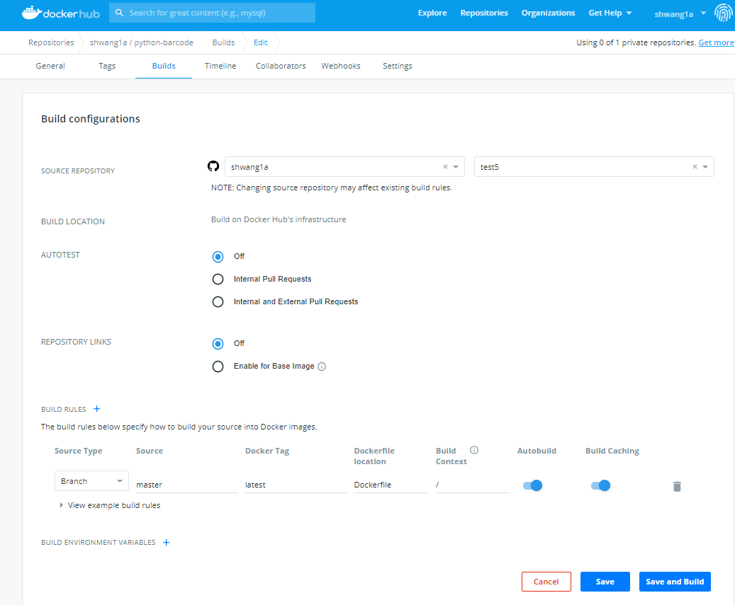
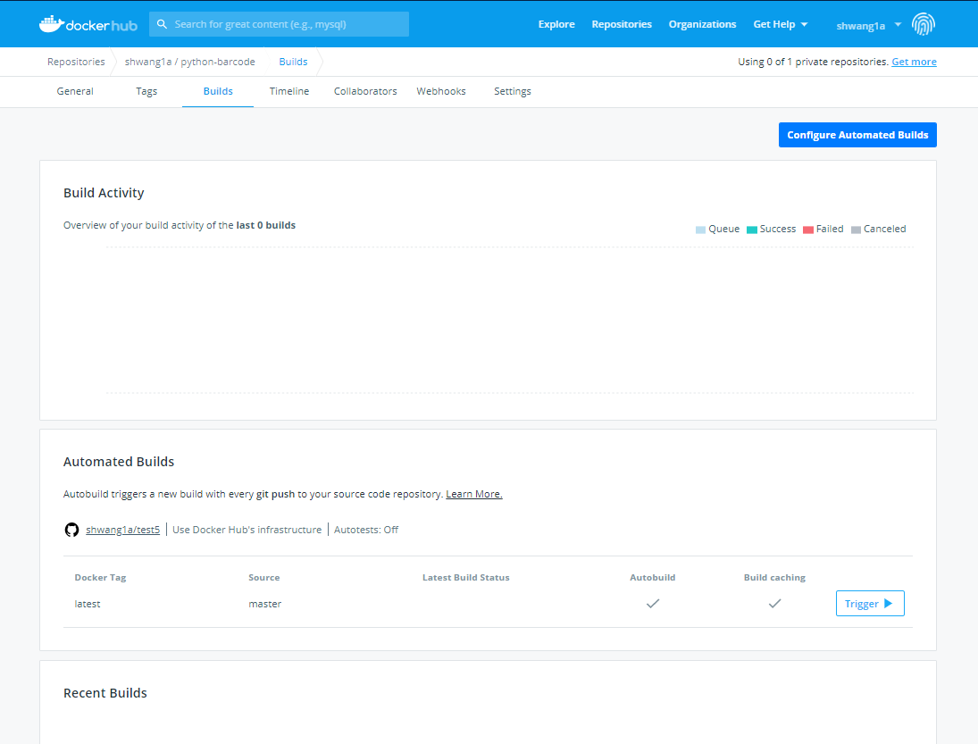
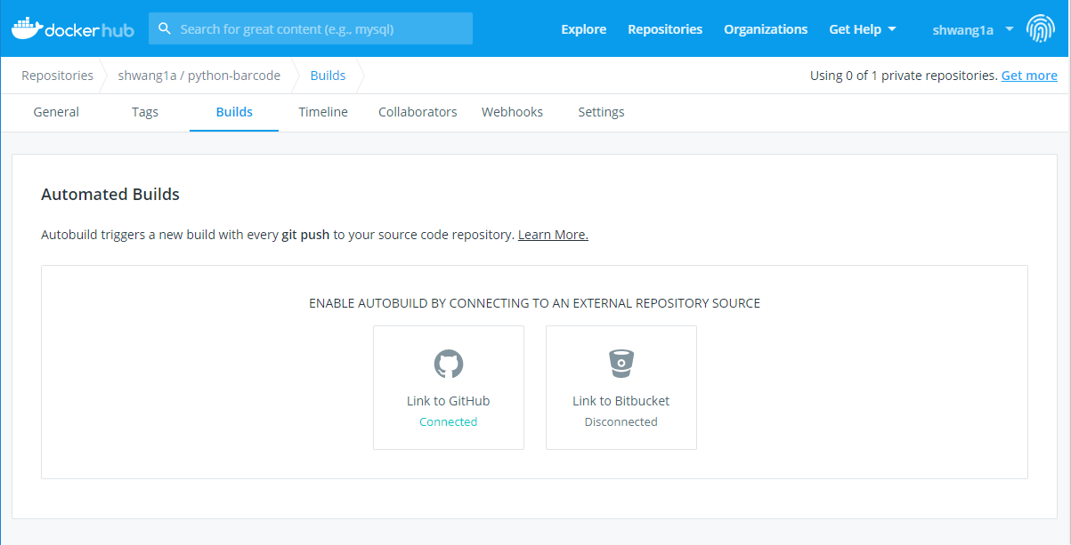
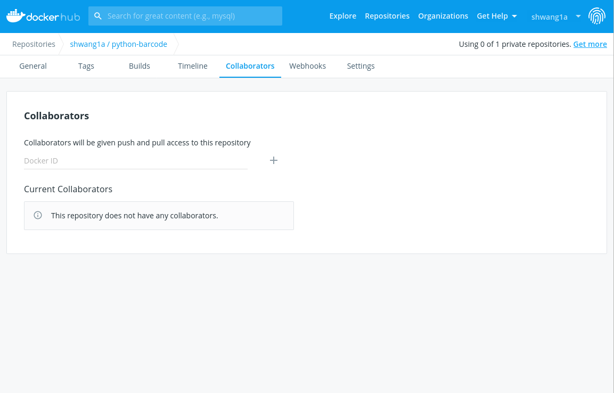
Docker hub auto build

Slide 12
Thank you !

