Slide 1
Lecture #3 Outline
Announcements
AVR Processor Resources
  UART (Universal Asynchronous Receiver/Transmitter)
  SPI (Serial Peripheral Interface)
October 4, 2002
Stanford University - EE281 Lecture #3
#<number>
Notes:
EE281 Lecture #3
October 4, 2002

Slide 2
Announcements
Have you finished Lab #1?
  Due date is: Monday, (5pm?)
Lab#0
  Research your ideas
  Project Idea Discussion (arrange to meet)
  Do you need a group
In-Circuit Emulator (AVR-ICE)
  Works like simulator but on real hardware
  One station available, second one coming soon
October 4, 2002
Stanford University - EE281 Lecture #3
#<number>

Slide 3
AVR Processor Resources
Interrupts
Timers
UART (Universal Asynchronous Receiver/Transmitter)
SPI (Serial Peripheral Interface)
A/D Converters (Analog to Digital)
Analog Comparator
October 4, 2002
Stanford University - EE281 Lecture #3
#<number>

Slide 4
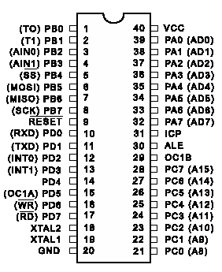
AVR AT90S8515 Pinout
General Purpose Ports
  PORTA
  PORTB
  PORTC
  PORTD
  (Special Functions)
Special Purpose Pins
  Crystal (XTAL1/XTAL2)
  RESET
  ICP, OLE, OC1B
Power (VCC/GND)
October 4, 2002
Stanford University - EE281 Lecture #3
#<number>

Slide 5
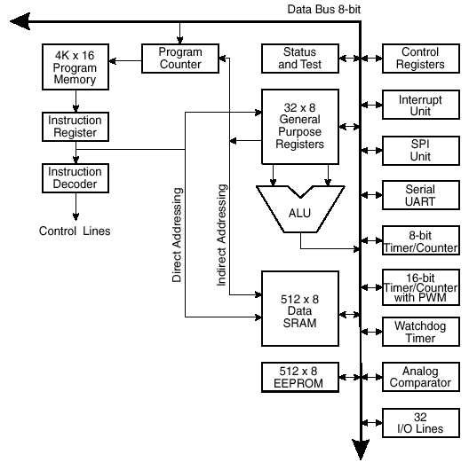
‘8515 Functional Architecture
32 Registers (R0-R31)
4K Prog ROM
512 bytes RAM
512 bytes EEPROM
32 I/O lines
13 Interrupts
Lots of fun built-in peripherals
October 4, 2002
Stanford University - EE281 Lecture #3
#<number>

Slide 6
UART
The UART, or Universal Asynchronous Receiver Transmitter, provides hardware support for a serial port on AVR processors
  Signaling is compatible with PC/Mac/Unix serial (RS-232C)
The UART provides:
  Parallel-to-Serial and Serial-to-Parallel conversion
  Start and Stop Bit framing
  Parity Generation
  Baud-Rate Generation (2400-115.2kbps at 3.686 or 7.37MHz)
  Interrupts
    Transmit Complete
    Transmit Data Register Empty
    Receive Complete
October 4, 2002
Stanford University - EE281 Lecture #3
#<number>

Slide 7
Serial Specification (RS-232C)
Data
  Start bit
  6,7,8,9 data bits
  Parity bit optional (E,O,M,S,N)
  Stop bit
Voltages
  Processor outputs 0/5V logic-level signal
  RS-232C uses +12V/-12V signal
  Level-converter IC provided on STK500 (MAX202)
5V –
0V –
October 4, 2002
Stanford University - EE281 Lecture #3
#<number>

Slide 8
UART Registers
UDR (UART Data Register)
  Write bytes to transmit
  Read received bytes
USR (UART Status Register)
  Rx/Tx complete signal bits
  Framing error, overflow signal bits
UCR (UART Control Register)
  Interrupt enable bits
  Rx/Tx enable bits
  Data format control bits
UBRR (UART Baud Rate Register)
  Baud rate generator division ratio
October 4, 2002
Stanford University - EE281 Lecture #3
#<number>

Slide 9
UART Transmitting
Send a byte by writing to UDR register
  TXC bit in USR is set when the final bit has finished transmitting
  Tx Complete interrupt triggered if enabled in the UCR
  Must wait for current byte to finish transmitting before sending the next one
October 4, 2002
Stanford University - EE281 Lecture #3
#<number>

Slide 10
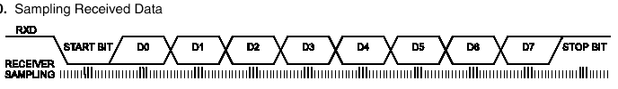
UART Receiving
How do I know a byte has arrived?
  Watch the RXC bit in USR
  Use the Rx Complete interrupt and write an ISR
Read received bytes from the UDR
  UDR is double-buffered, but be sure to read it in time
October 4, 2002
Stanford University - EE281 Lecture #3
#<number>

Slide 11
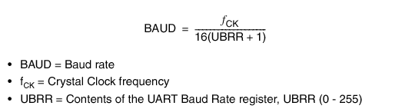
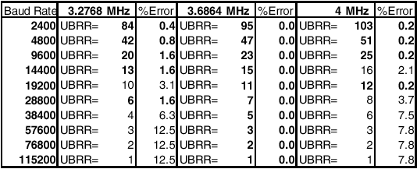
UART Baud Rate
Set by UBRR
Varies with fCK
October 4, 2002
Stanford University - EE281 Lecture #3
#<number>

Slide 12
UART Example Code
echo1.asm
  Echos characters sent over serial port back to the sender
  Shows setup of UART
  Shows non-interrupt use of both serial receive and transmit
echo2.asm
  Echos only printable characters
  Uses interrupt-driven receive
  Implements a 50-byte receive buffer
  Can be used as starter code for Lab#2
Available on the course website
October 4, 2002
Stanford University - EE281 Lecture #3
#<number>

Slide 13
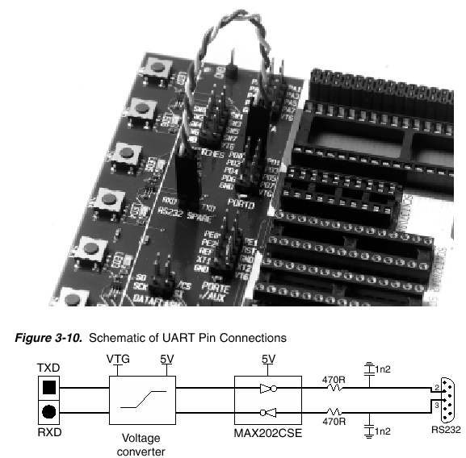
STK500 UART Connection
October 4, 2002
Stanford University - EE281 Lecture #3
#<number>

Slide 14
Serial Peripheral Interface
Allows transfer of information, 8 bits at a time, between microcontroller and any number of peripherals
Read and Write operations happen simultaneously
Using chip selects allows lots of peripherals to be connected to a single SPI bus at the same time
Has no start/stop bit overhead
High data rates: 250Kbit to 2Mbit/sec
Common uses:
  Inter-Processor Network
  Sending MP3 data to MP3 decoders
  Interfacing to external serial RAM/EEPROM/FLASH
  Interfacing to serial graphic LCDs
  Compatible with thousands of chips with SPI, Microwire, I2S, and other serial interfaces
October 4, 2002
Stanford University - EE281 Lecture #3
#<number>

Slide 15
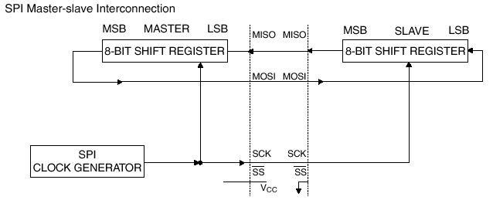
SPI Connections
AVR Microcontroller ← → PERIPHERAL
October 4, 2002
Stanford University - EE281 Lecture #3
#<number>

Slide 16
SPI Pins and Registers
SPI Pins
  MOSI (master out, slave in)
  MISO (master in, slave out)
  SCK (serial clock)
  SS (slave select, optional)
SPI Registers
  SPDR (transferred data read/write register)
  SPCR (control register)
  SPSR (status register)
  SPI Transfer Complete interrupt
October 4, 2002
Stanford University - EE281 Lecture #3
#<number>

