Slide 1

SPI Master Verification Using Cocotb
Project done by: 1.Neha
2.Vishnupriya
3.Deepika

Slide 2
Agenda:
Introduction
Problem Statement
SPI Protocol Overview
Key Functionalities
Application
Outlooks
Conclusion

Slide 3
Introduction:
Serial Peripheral Interface (SPI) is a synchronous, full-duplex communication protocol commonly used for short-distance communication in embedded systems. It enables fast and efficient data exchange between a Master and one or more Slave devices.
SPI is widely used in embedded systems for communication with sensors, memory, and peripheral devices.
Verification ensures the SPI Master module adheres to protocol specifications and performs reliably.
Cocotb simplifies writing testbenches using Python and allows advanced verification features like randomization, assertions, and functional coverage.

Slide 4
Problem Statement:
In embedded systems, SPI (Serial Peripheral Interface) is widely used for high-speed, full-duplex communication between a master device and one or more slave devices. Ensuring correct functionality of the SPI Master is crucial for reliable data exchange with connected peripherals such as memory chips, sensors, and displays.
Traditional verification methods using HDL-based testbenches can be verbose and less flexible when dealing with complex test scenarios. This project aims to address this challenge by using Cocotb, a Python-based verification framework, to verify the functional correctness of an SPI Master module.

Slide 5
SPI Protocol Overview
Full-Duplex Communication Data is simultaneously transmitted and received between Master and Slave.
Master-Slave Architecture The Master initiates and controls data transfer, while the Slave responds.
Four-Wire Interface:
MOSI (Master Out Slave In)
MISO (Master In Slave Out)
SCLK (Serial Clock, generated by Master)
SS/CS (Slave Select/Chip Select)

Slide 6
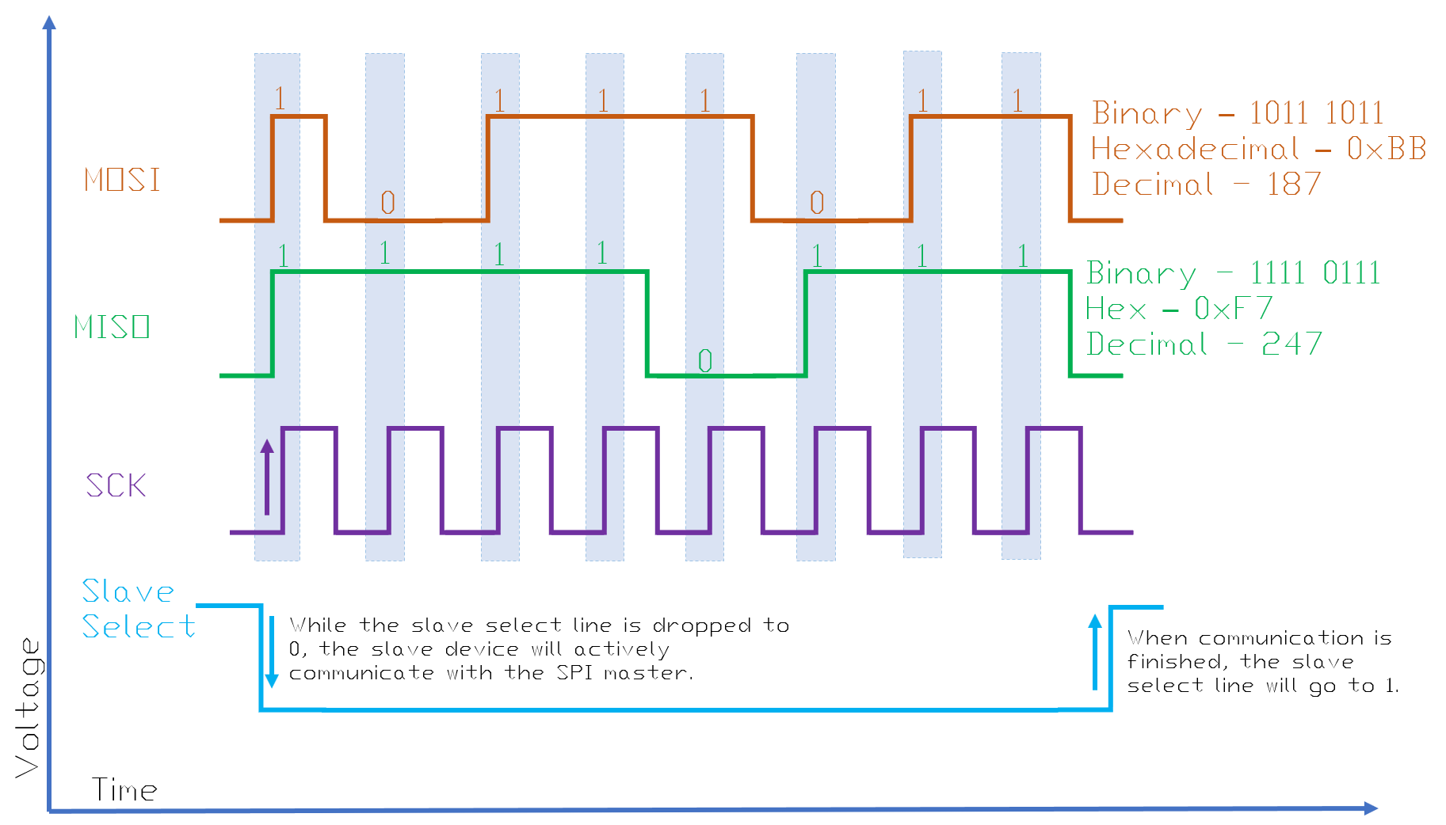
SPI Protocol:

Slide 7
Key Functionalities:
RTL Design
Verilog-based SPI Master with configurable SPI modes and clock.
🧪 Testbench (Cocotb)
Python-based testbench using coroutines and assertions.
Test scenarios cover all SPI modes and edge cases.
✅ Simulation & Verification
Functional simulation using Icarus Verilog.
Pass/fail results and protocol checks via Python logs.
📈 Waveform Analysis (GTKWave)
Signal timing and SPI behavior verified visually.
CPOL, CPHA, MOSI, MISO, and SCLK inspected.
🧵 Synthesis
Synthesized design to check for resource and logic errors.
Ensured RTL was synthesis-ready.
📊 ML-Based Verification
ML classification or test result automation.

Slide 8
APPLICATION:
🔌 Embedded Systems
Connects microcontrollers to peripherals (sensors, displays, memory).
💾 Memory Devices
Interfaces with EEPROM, NOR/NAND Flash for data storage and bootloaders.
📟 Display Drivers
Controls OLED, LCD, and TFT screens in consumer electronics.
📡 Sensor Interfacing
Communicates with SPI-based sensors in IoT and automation systems.
🚗 Industrial & Automotive Systems
Used in diagnostics, motor control, and instrumentation units.
🧪 Lab Instruments & FPGA Projects
Integrates with ADC/DACs, scopes, and waveform generators.

Slide 9
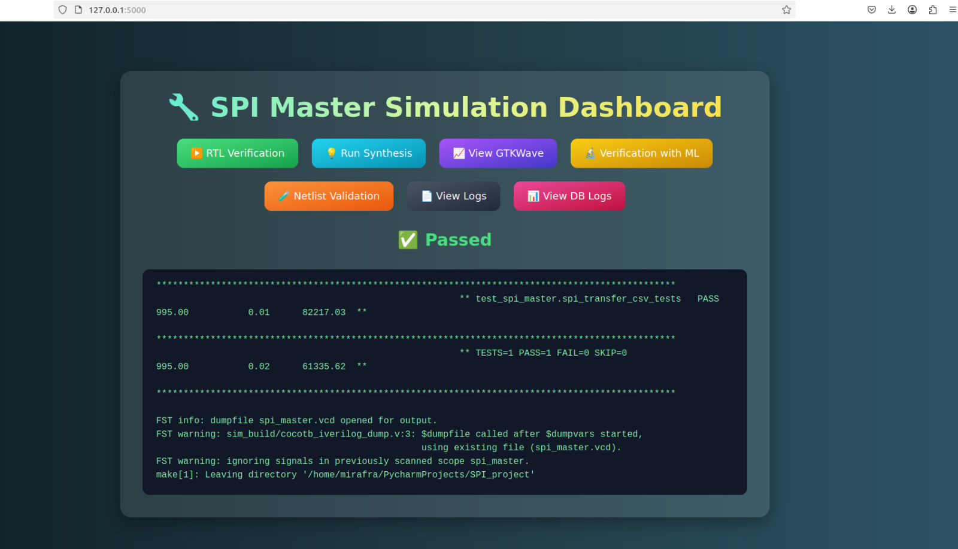
Outlooks: RTL Verification

Slide 10
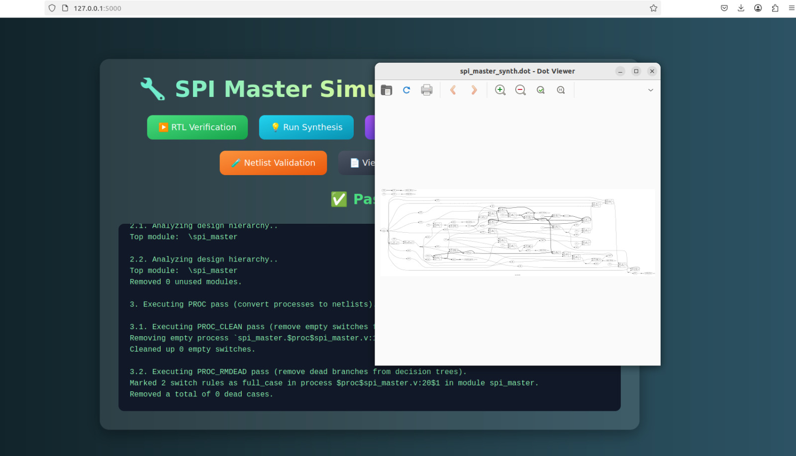
Outlooks: Synthesis

Slide 11
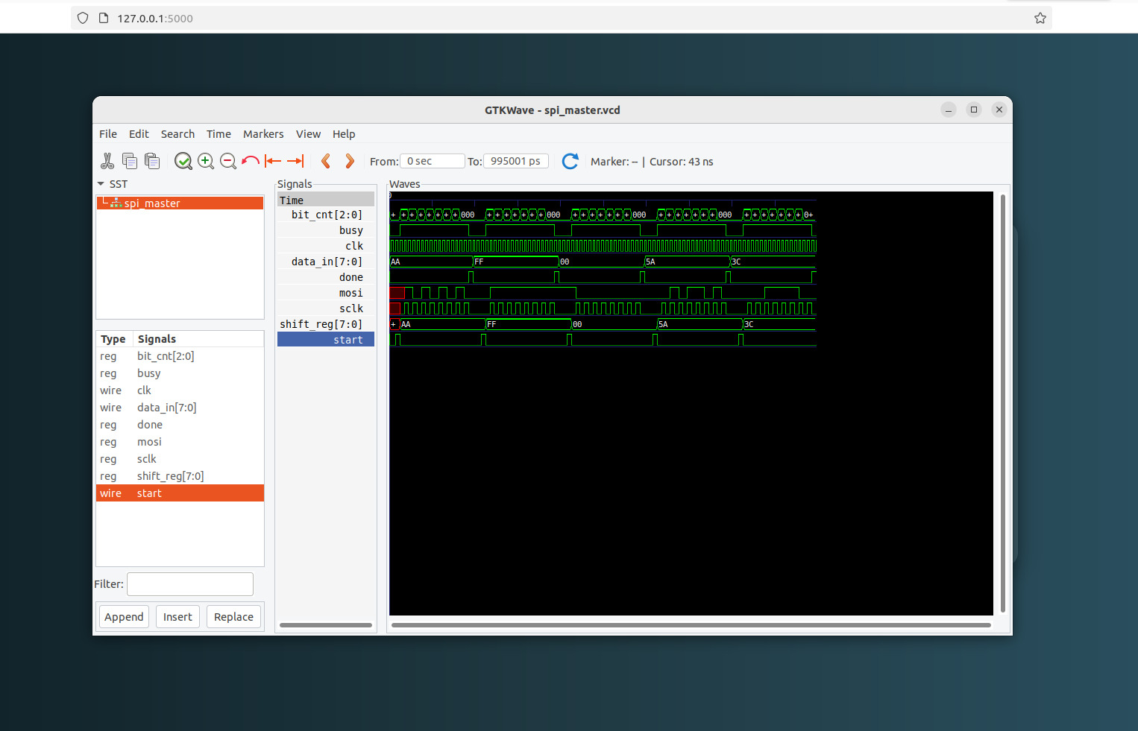
Outlooks: Gtkwave

Slide 12
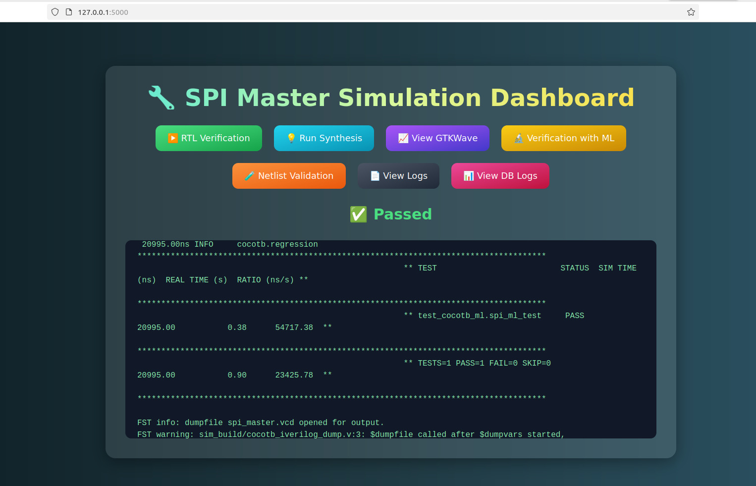
Outlooks: ML Verification

Slide 13
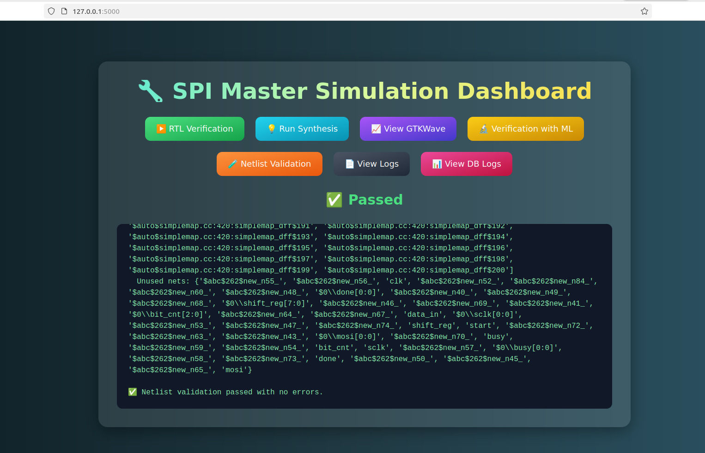
Outlooks: Netlist Validation

Slide 14
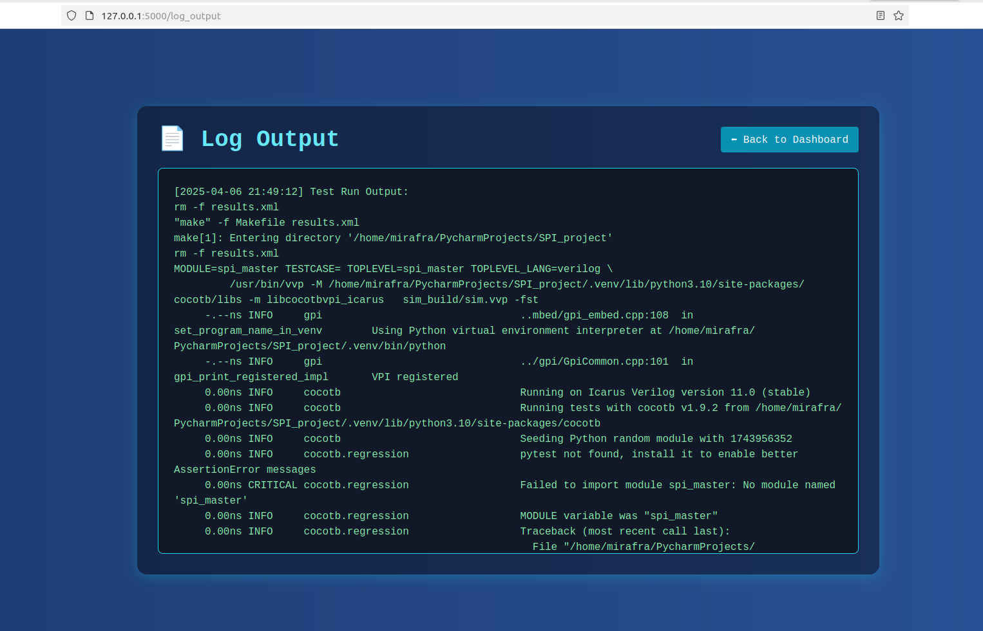
Outlooks: Data Logs

Slide 15
Conclusion:
The SPI Master module was successfully verified using Cocotb with comprehensive test scenarios. Functional correctness was ensured across all SPI modes and edge cases. Waveform analysis confirmed accurate signal timing and protocol behavior. The project demonstrates the effectiveness of Python-based verification for digital designs.
.

Slide 16
THANK YOU

