Slide 1
Secure Real-Time Temperature Monitoring System with Kernel-Level Access Control and Remote Alerts
Team Members :
Ch. Swarna Latha
A. Priyalatha
P. Adi Narayana

Slide 2
Problem Statement
In many industrial and storage environments like chemical storage units, medical vaccine fridges, or food warehouses, maintaining the correct temperature is very critical. A sudden increase can lead to chemical spoilage, medicine becoming ineffective, or food rotting. So there is a strong need for temperature monitoring system with authorization.
Hence, our goal is to build a secure, real-time monitoring system where only verified users can change the threshold and the system gives alerts if the temperature exceeds the limit.
Tools/Concepts Used:
Raspberry Pi 4B, x86 PCs, DS18B20 Sensor, OLED Display, Character Device Drivers, IOCTL, UART, I2C, Sockets, Wait Queue.

Slide 3
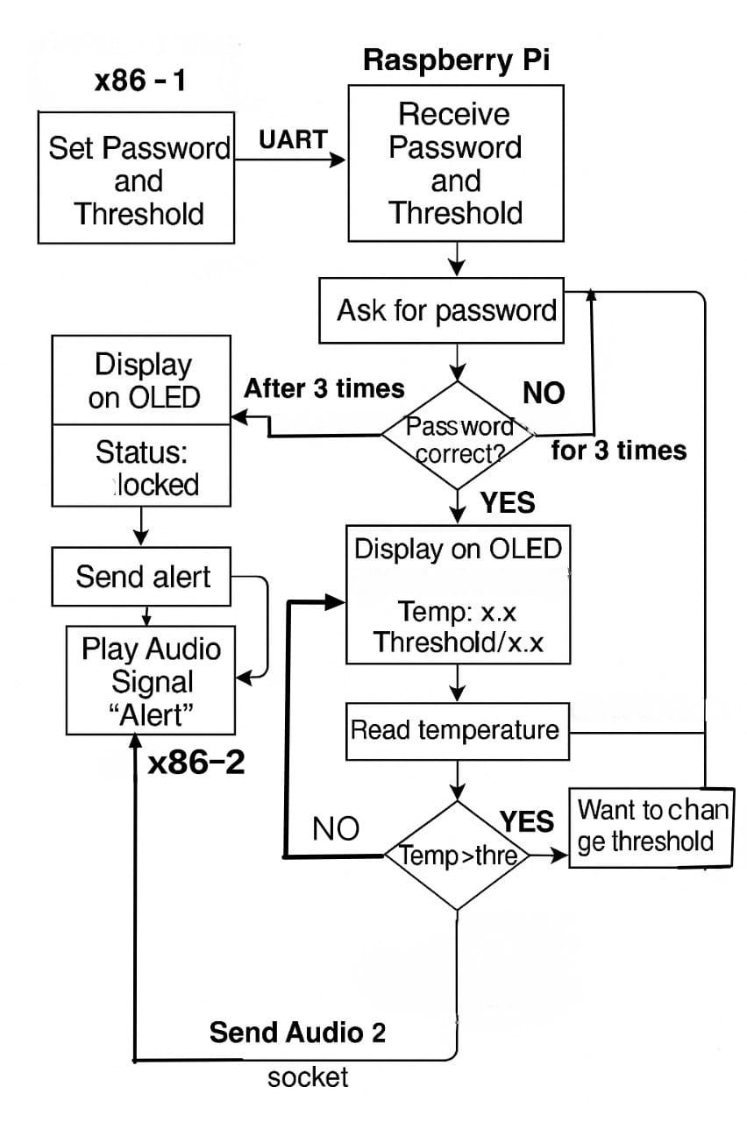

Slide 4
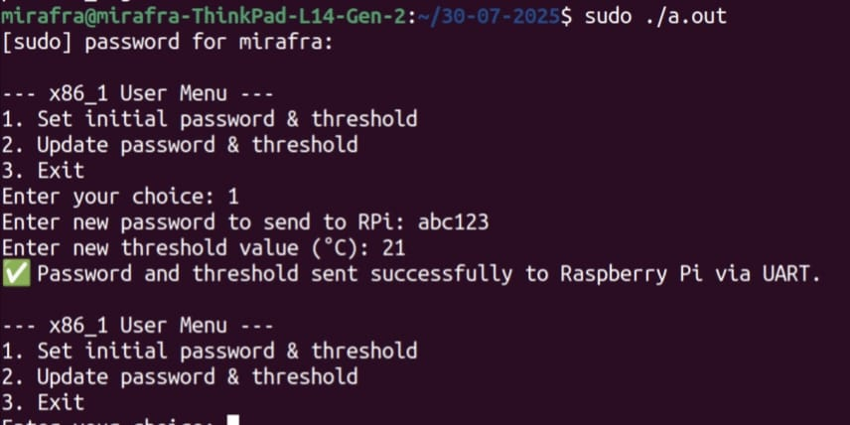
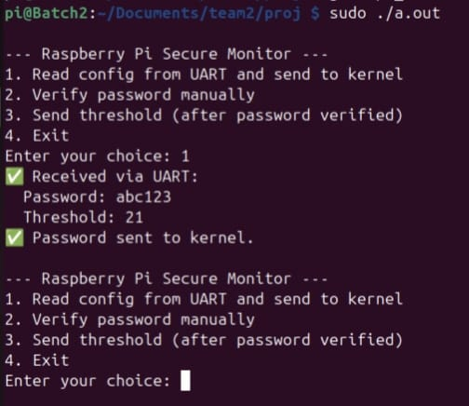
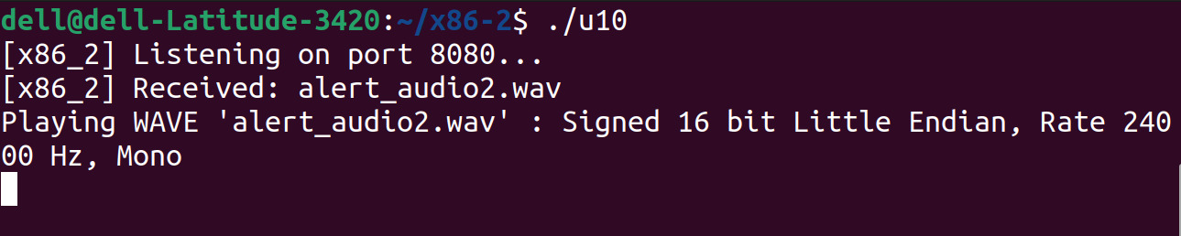
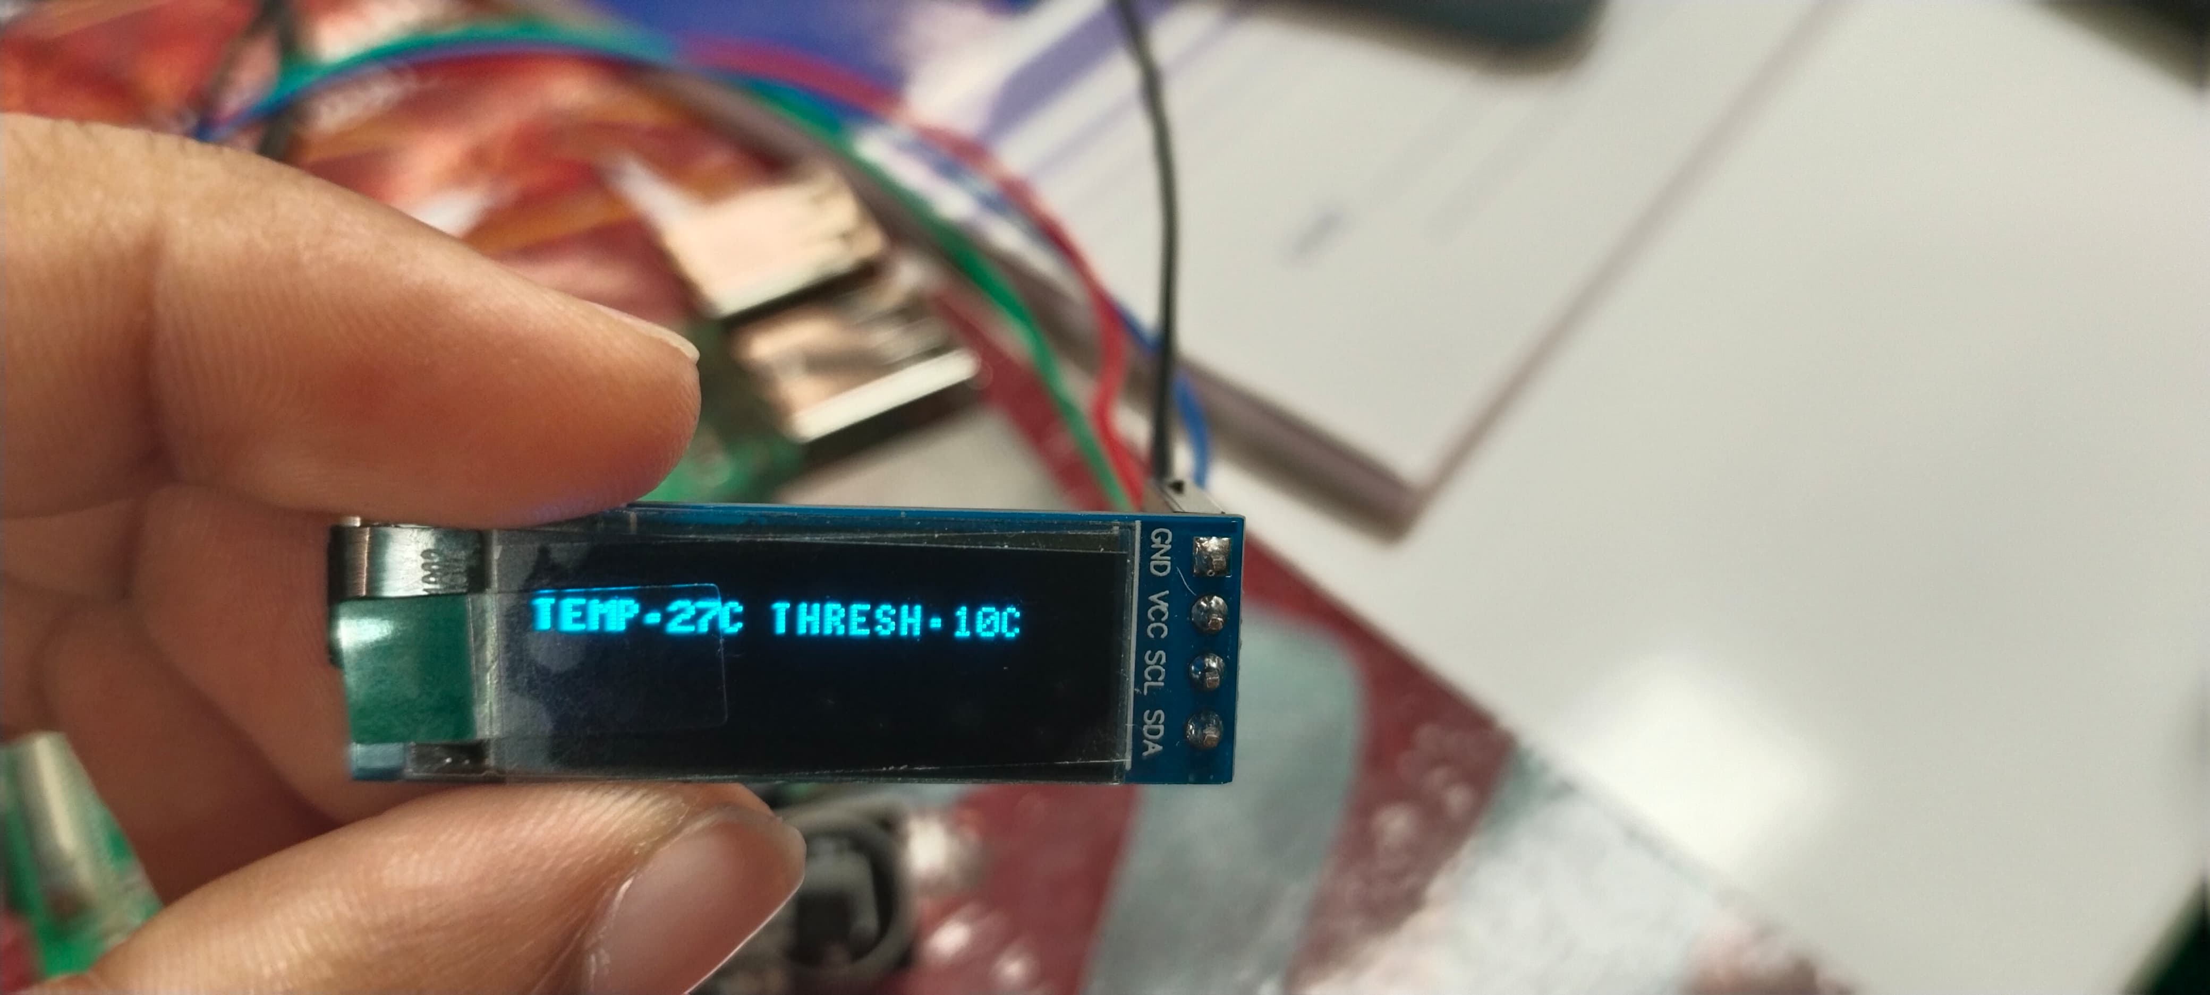

Slide 5
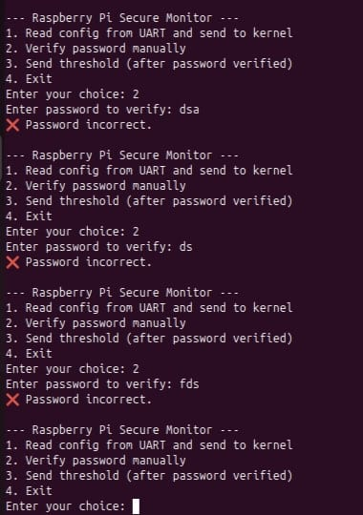
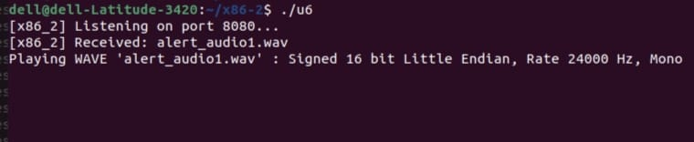
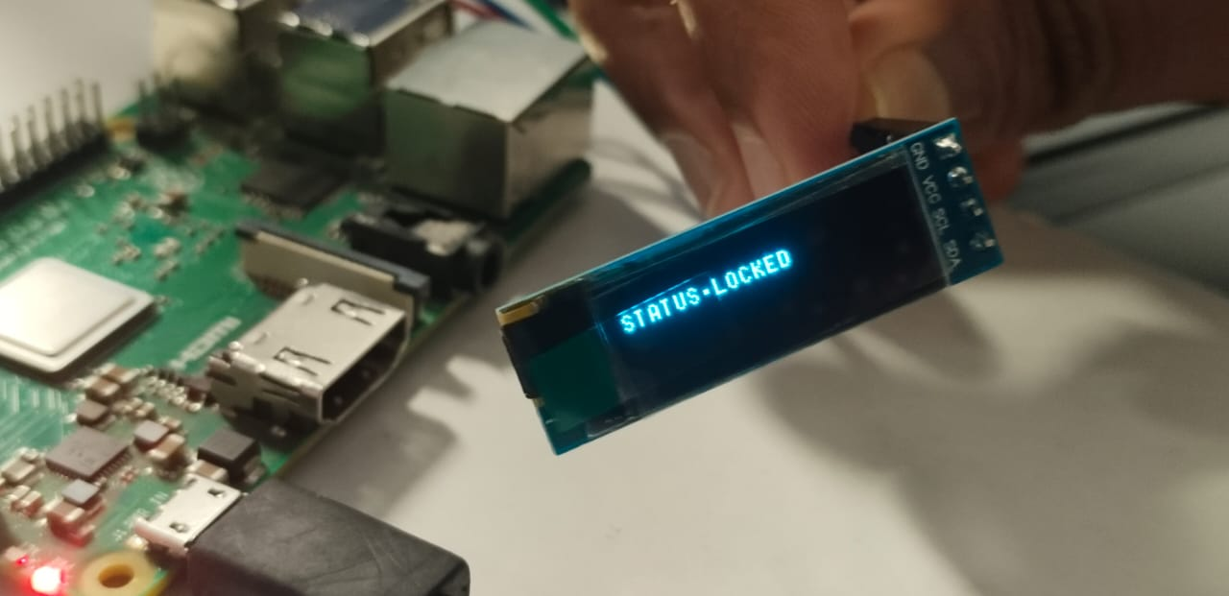

Slide 6


