Slide 1
Real-Time Multimedia Capture, Encoding, Compression, and Synchronized Playback on Raspberry Pi
Team Members:
Adi Narayana
Harsha

Slide 2
Problem Statement
  The goal of this project is to develop a multimedia recording and playback system where audio and video are captured simultaneously for 10 seconds on an x86 system. compress the video using H.265, and Audio with flac transmit it to a Raspberry Pi. On the Raspberry Pi, the system synchronizes playback and displays video frames on an LCD screen.
  Ensuring synchronized audio-video recording, compression, and playback on resource-constrained devices like the Raspberry Pi is challenging. This project aims to capture 10 seconds of multimedia and achieve synchronized playback on an LCD display with multithreading for efficiency.
1

Slide 3
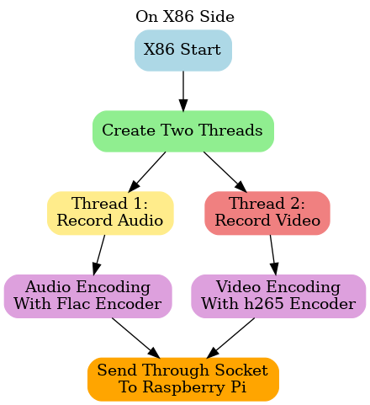
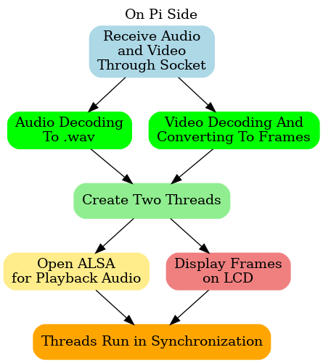
Flow Chart

Slide 4
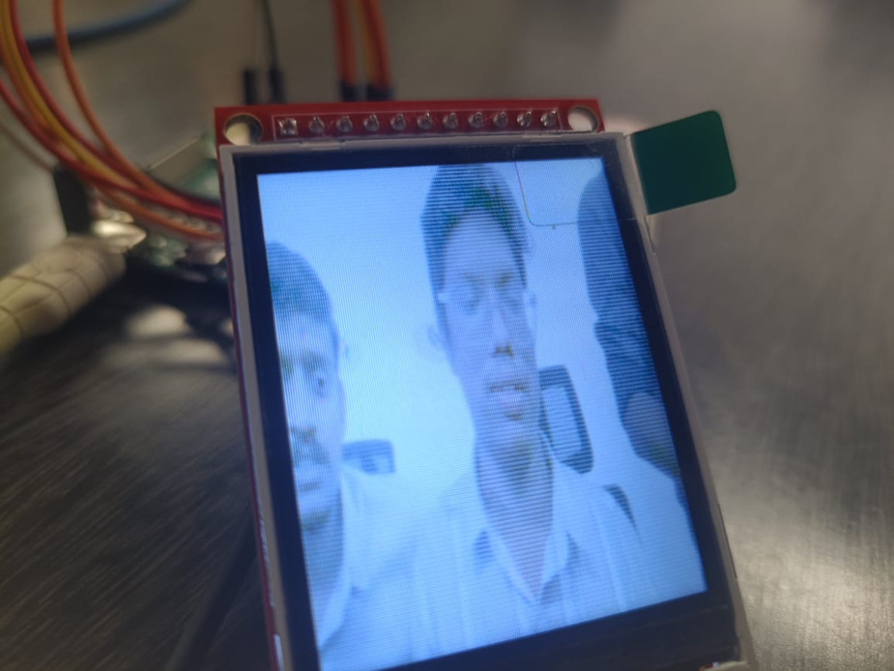
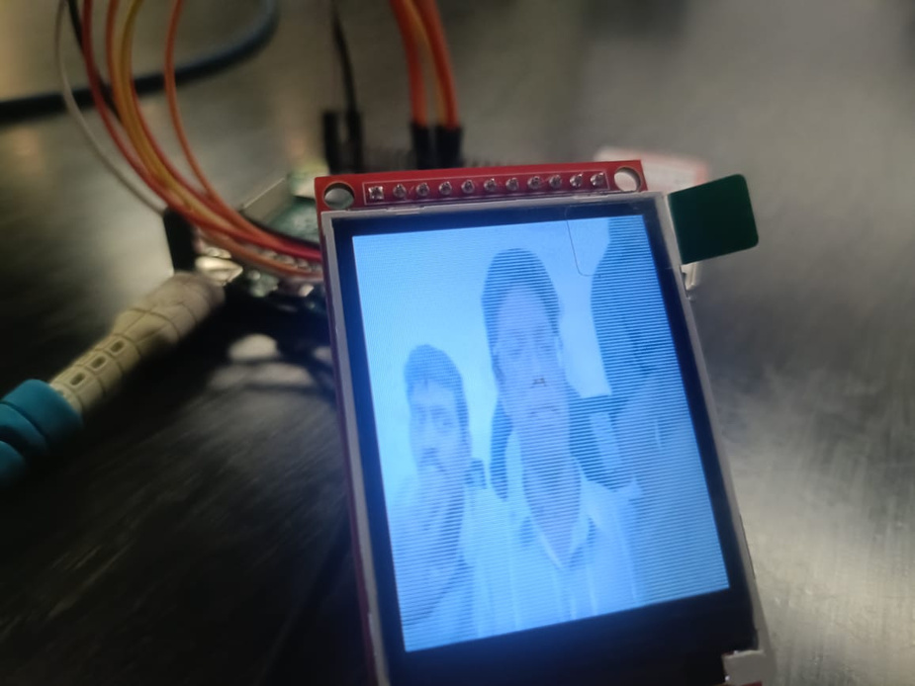
Output

