Slide 1
Automated Audio System Using Custom
Uart , Gpio Interrupt , ALSA , I2C , Socket Interfacing Rasberry Pi , 2 X86 Systems
Team: Swaroop,Harsha

Slide 2
Problem Statement
In Raspberry Pi full-featured audio subsystems such as ALSA are not available. This limitation makes it difficult to build real-time, low-latency audio communication systems directly on the Pi.
So, we develop a communication system where a Raspberry Pi acts as a bridge between two x86 machines, sending control commands over UART and transmitting audio data via sockets.

Slide 3
Tools Used
Raspberry Pi 4
Two x86 Computers
UART Communication (Custom Driver)
Socket Communication
ALSA (Advanced Linux Sound Architecture)
Externel interrupts
OLED using i2c

Slide 4
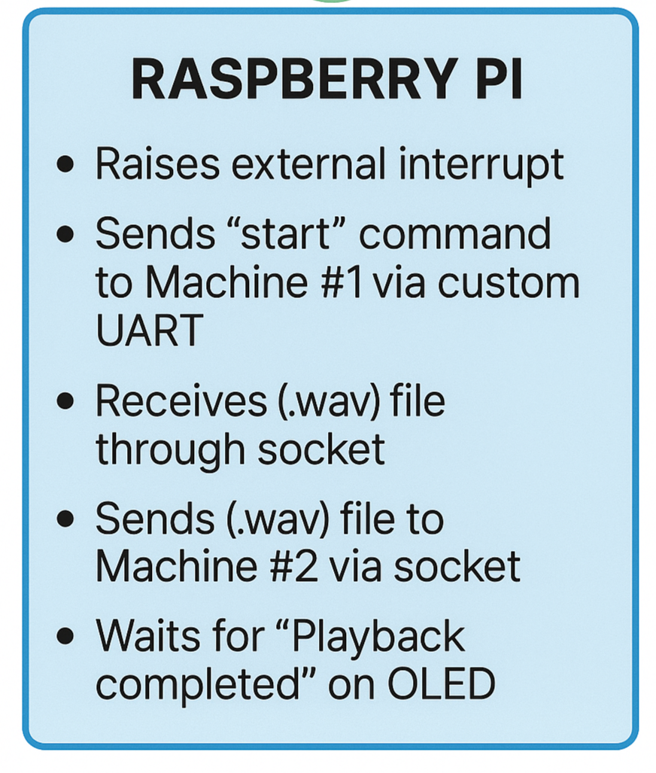
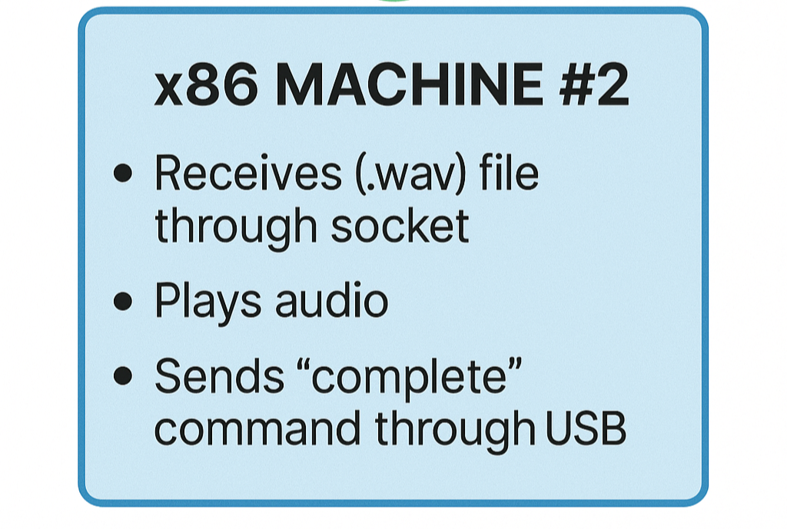
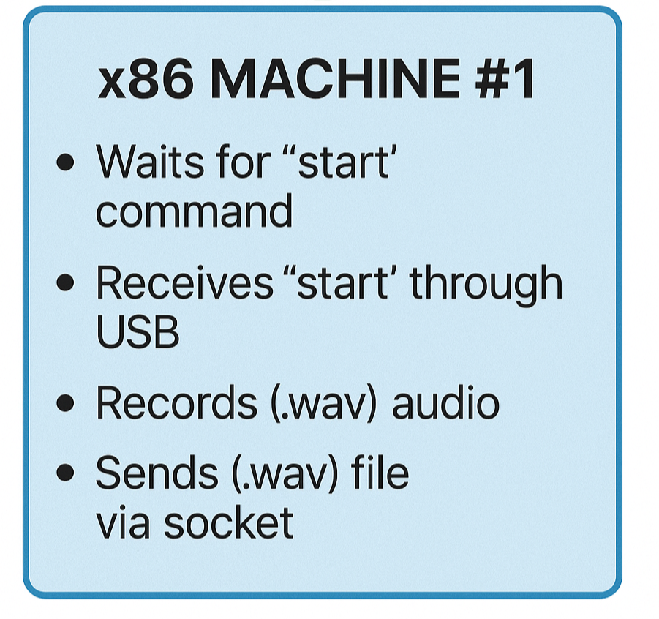
FLOW CHART
UART – USB
(“START”)
(.wav)
socket
(.wav)
socket
USB – UART
(“COMPLETED”)

Slide 5
OUTPUTS

Slide 6
OUTPUT

Slide 7
OUTPUTS

Slide 8
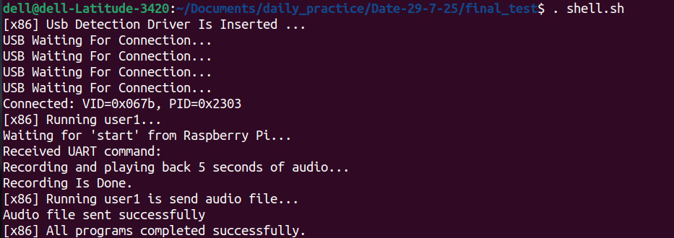
OUTPUTS

Slide 9
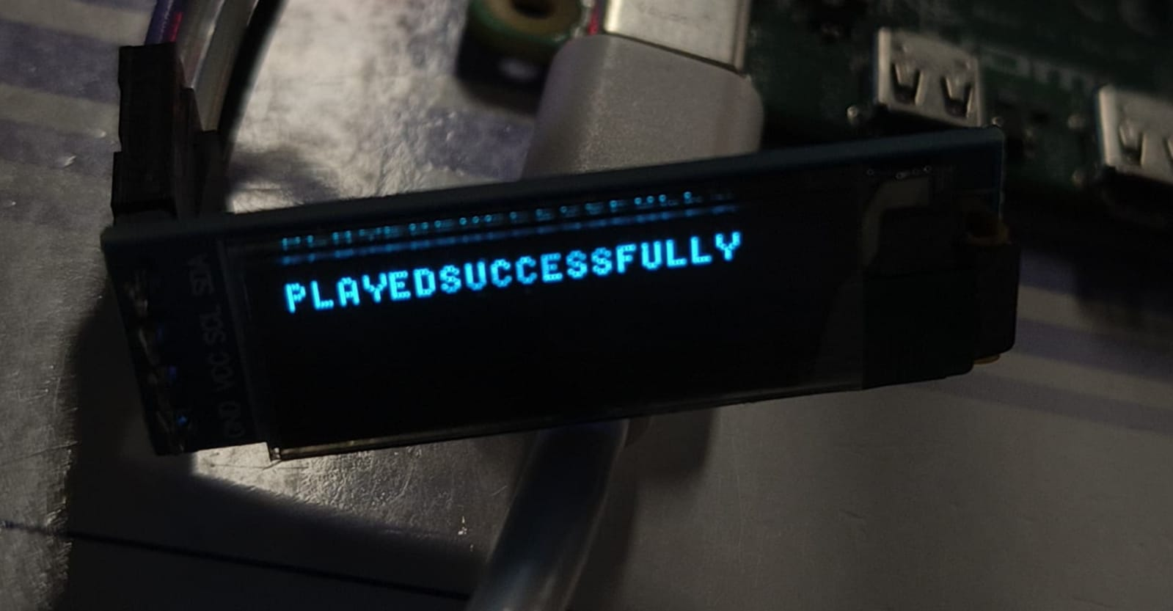
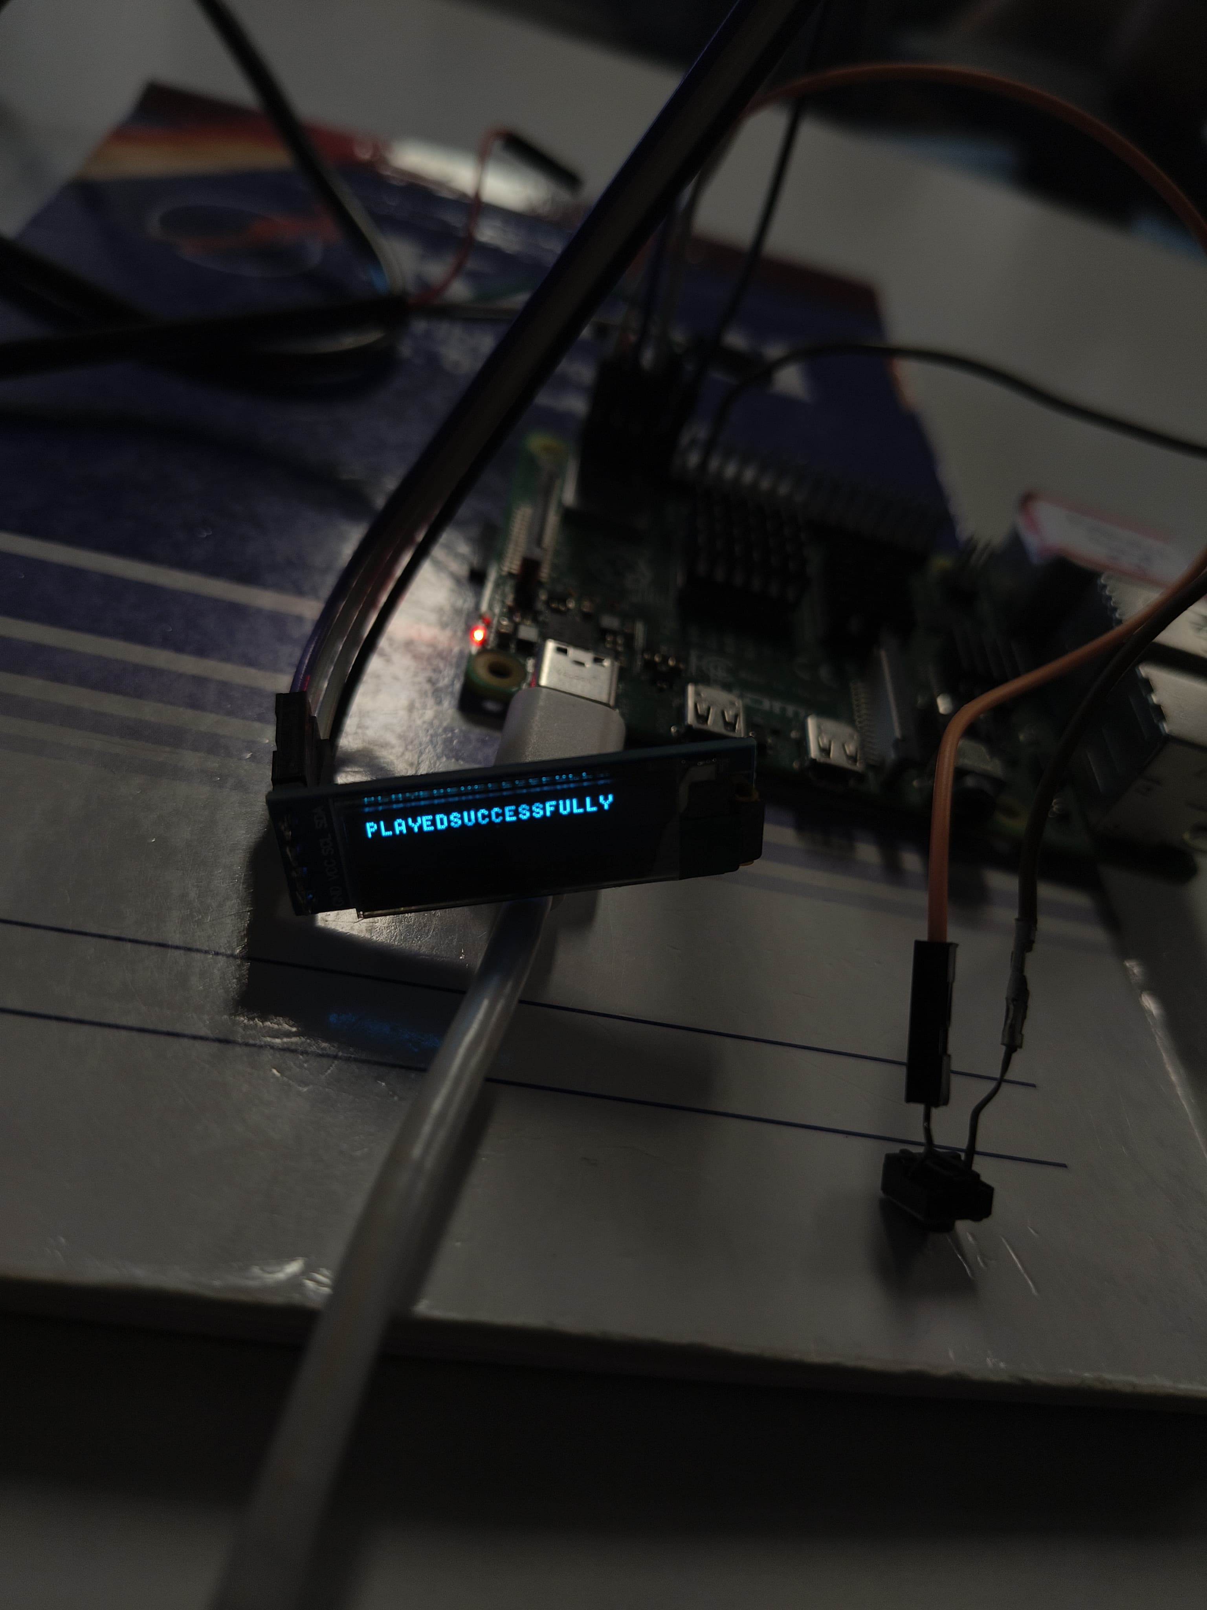
OUTPUTS

