Slide 1
Multi-Client socket LED control system
with audio alert and OLED interface
Presented by,
Snigdha
Afreensha

Slide 2
Problem Statement
The Problem We're Solving
In places like hospitals or factories, quick alerts are vital, but current systems are often manual or fixed. This means delays or confusion when an emergency happens. We need a smarter, faster way to coordinate both visual (lights) and audio (sounds) alerts automatically, especially when different people trigger them.
Our Aim
To create an automated, real-time alert system.
A Raspberry Pi will manage everything.
It will smartly assign light or sound alerts to different computers,and show how fast everything is happening on a display.
Tools
Two Linux X86, Raspberry-Pi
Protocols
I2C, TCP/IP ,Socket
Hardware Components
LED ,OLED & Jumper WIres

Slide 3
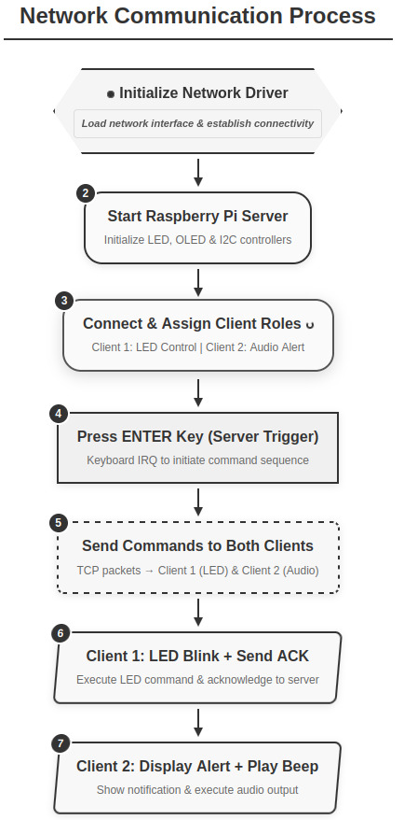
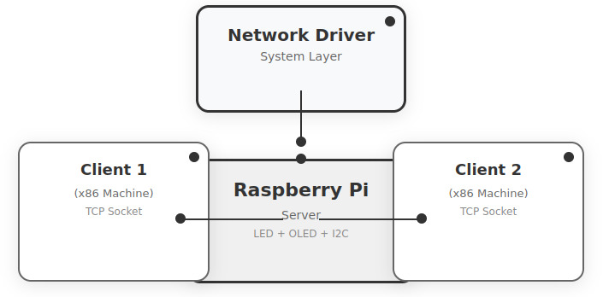
Workflow
Simple Block diagram

Slide 4
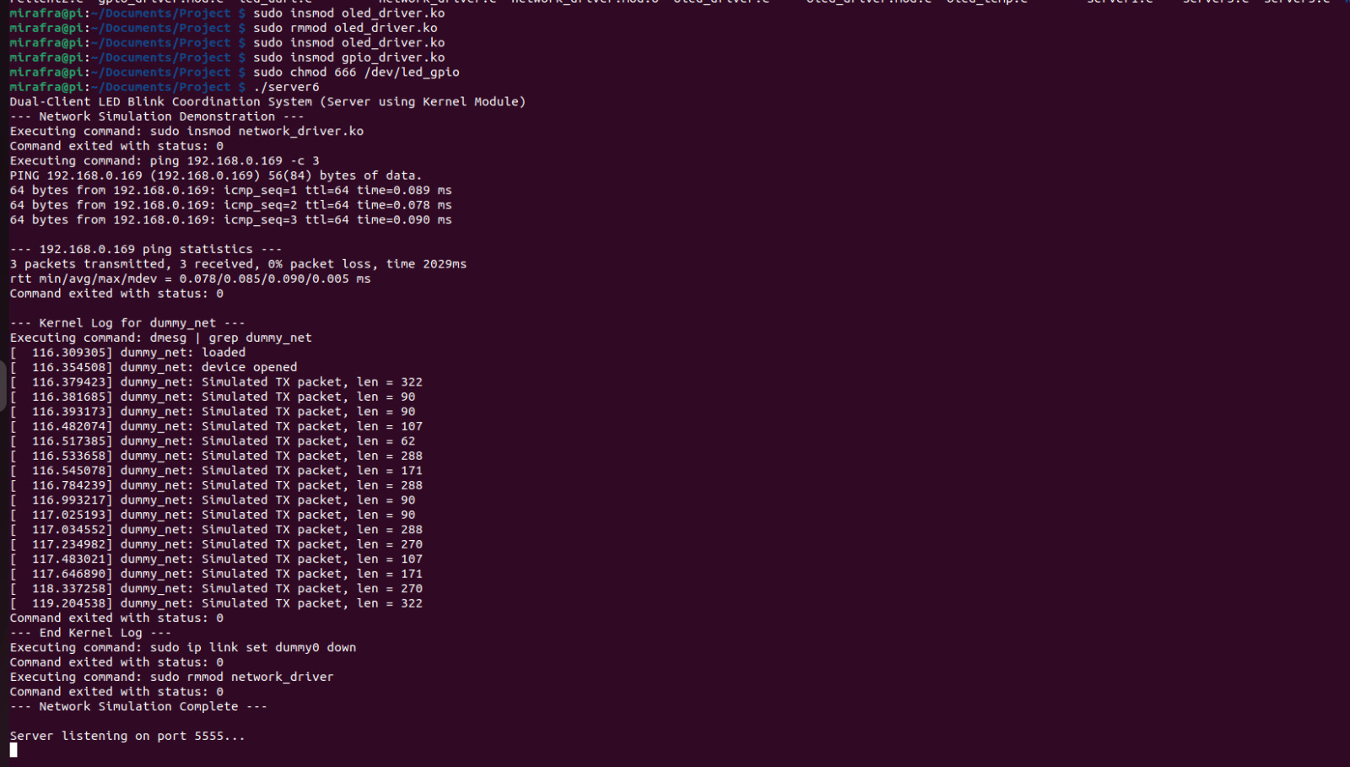
Real-Time Execution Demo
1. Loading OLED, GPIO, and Dummy Network Modules with Server
Loading OLED, GPIO, and Dummy Network Modules with Server

Slide 5
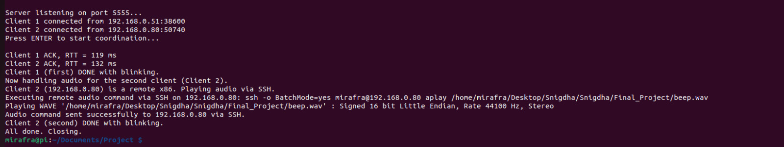
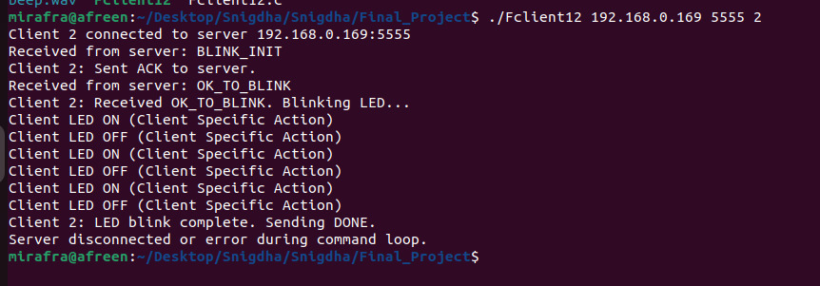
2. Alert System with RTT Tracking and GPIO-Based LED/Audio Control
3. Client-Synchronized LED Blink System Using Command Acknowledgment over Network

Slide 6
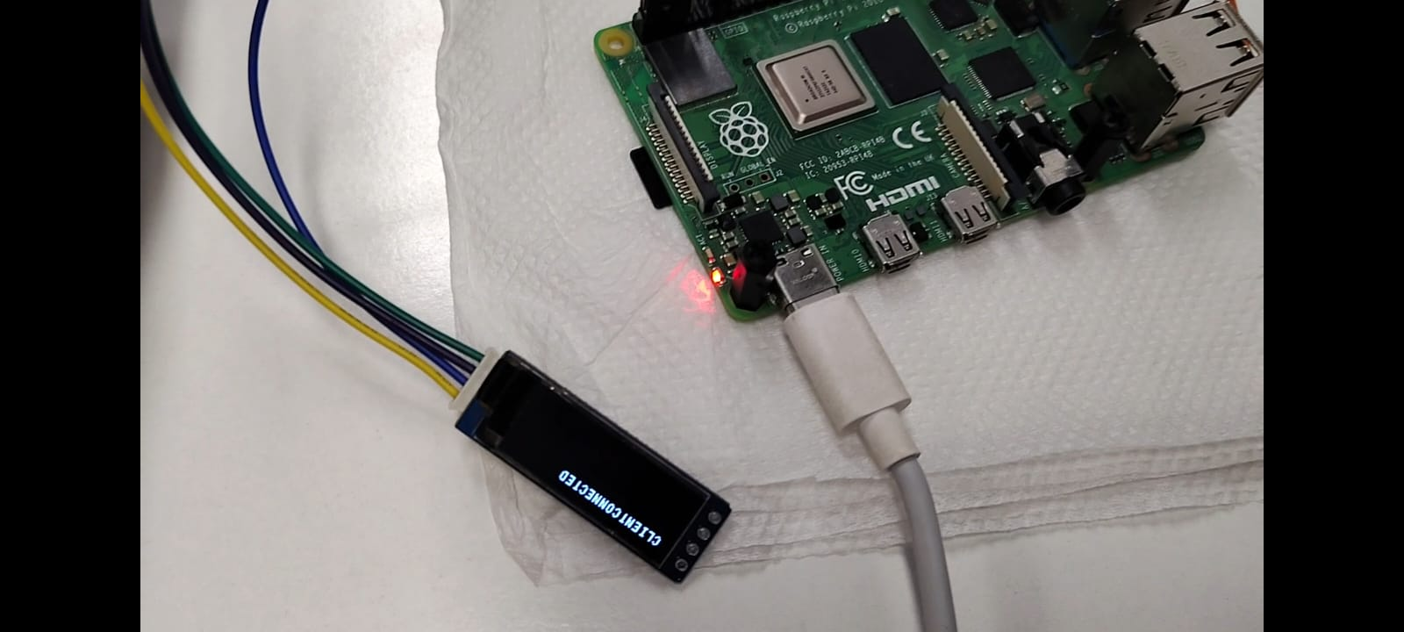
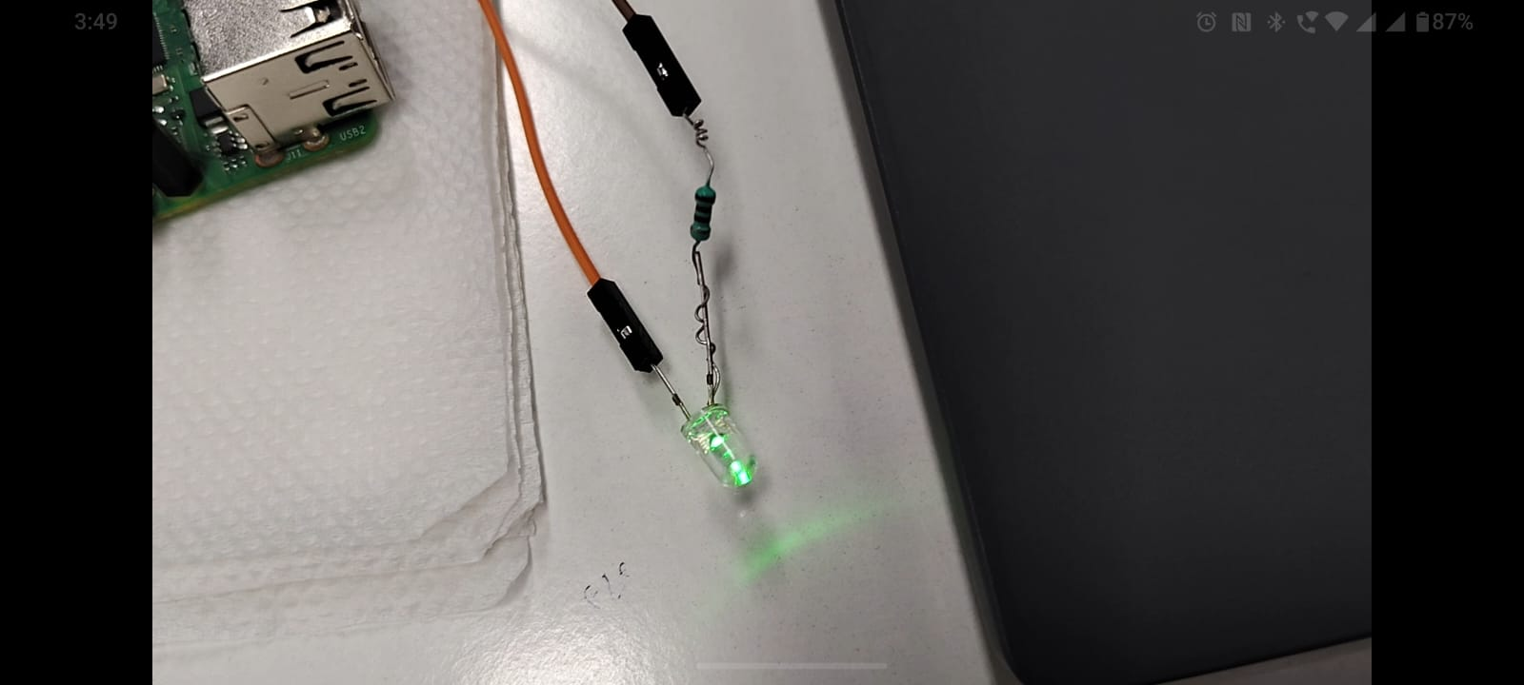
4. RTT Tracking Enabled
5. Visual & Audio Alerts ON

Slide 7


