Slide 1
Cross-Platform Speed Detection via Socket & UART with I2C Display & ALSA Alert
Team Members :
1.Revathi
2.Mamta
3.Hemanth

Slide 2
Problem Statement:
In today’s vehicles, it's very important to keep track of speed in real time to stay safe, follow traffic rules, and run things efficiently.
Because of this, they may react slowly or miss important signals, especially in critical situations.. To fix this, we need a system that runs inside the vehicle.
(Tools: Linux x86 ,TCP Socket,UART,I2C,Raspberry pi4,ALSA)

Slide 3
Keyboard Interrupt
Sending Scancode
X86 Machine #1
Speed Generator / Input
Socket Programming
X86 Machine #2
Receives data via Socket
TTL Cable USB Detection
UART Transmission
Raspberry pi
(Parse speed & Threshold)
Speed < Threshold
Speed > Threshold
Display Speed on LCD via I2C
ALSA Alert Sound

Slide 4
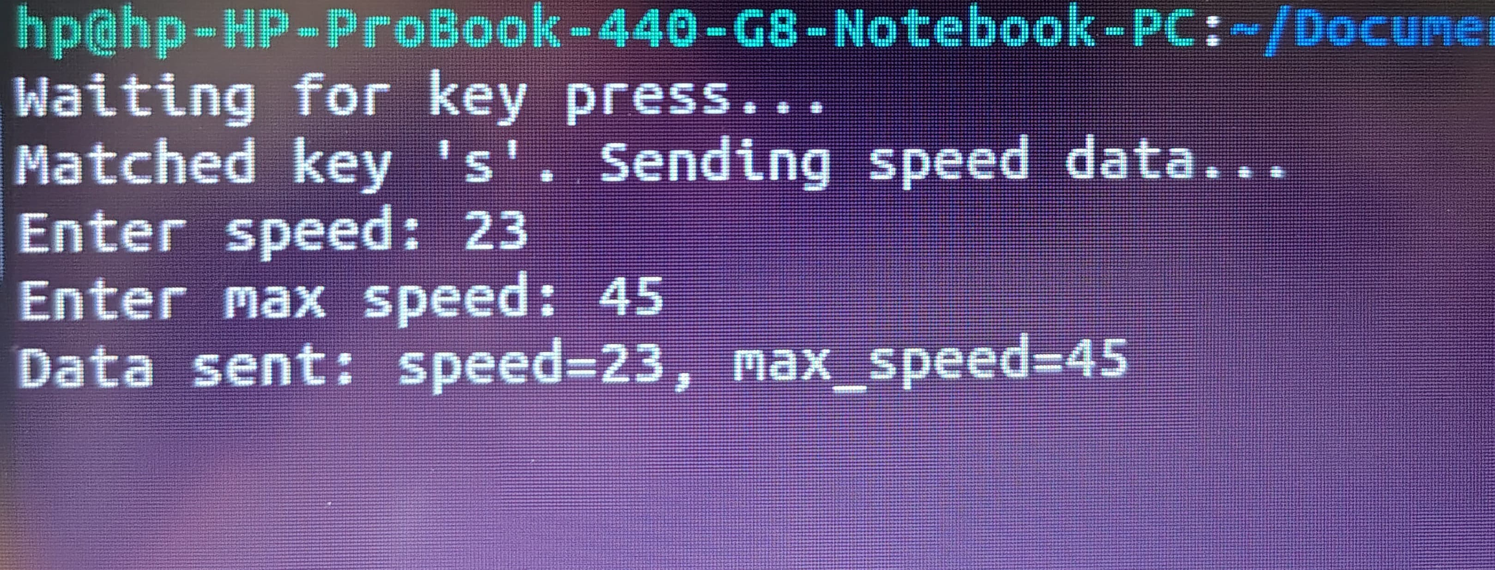
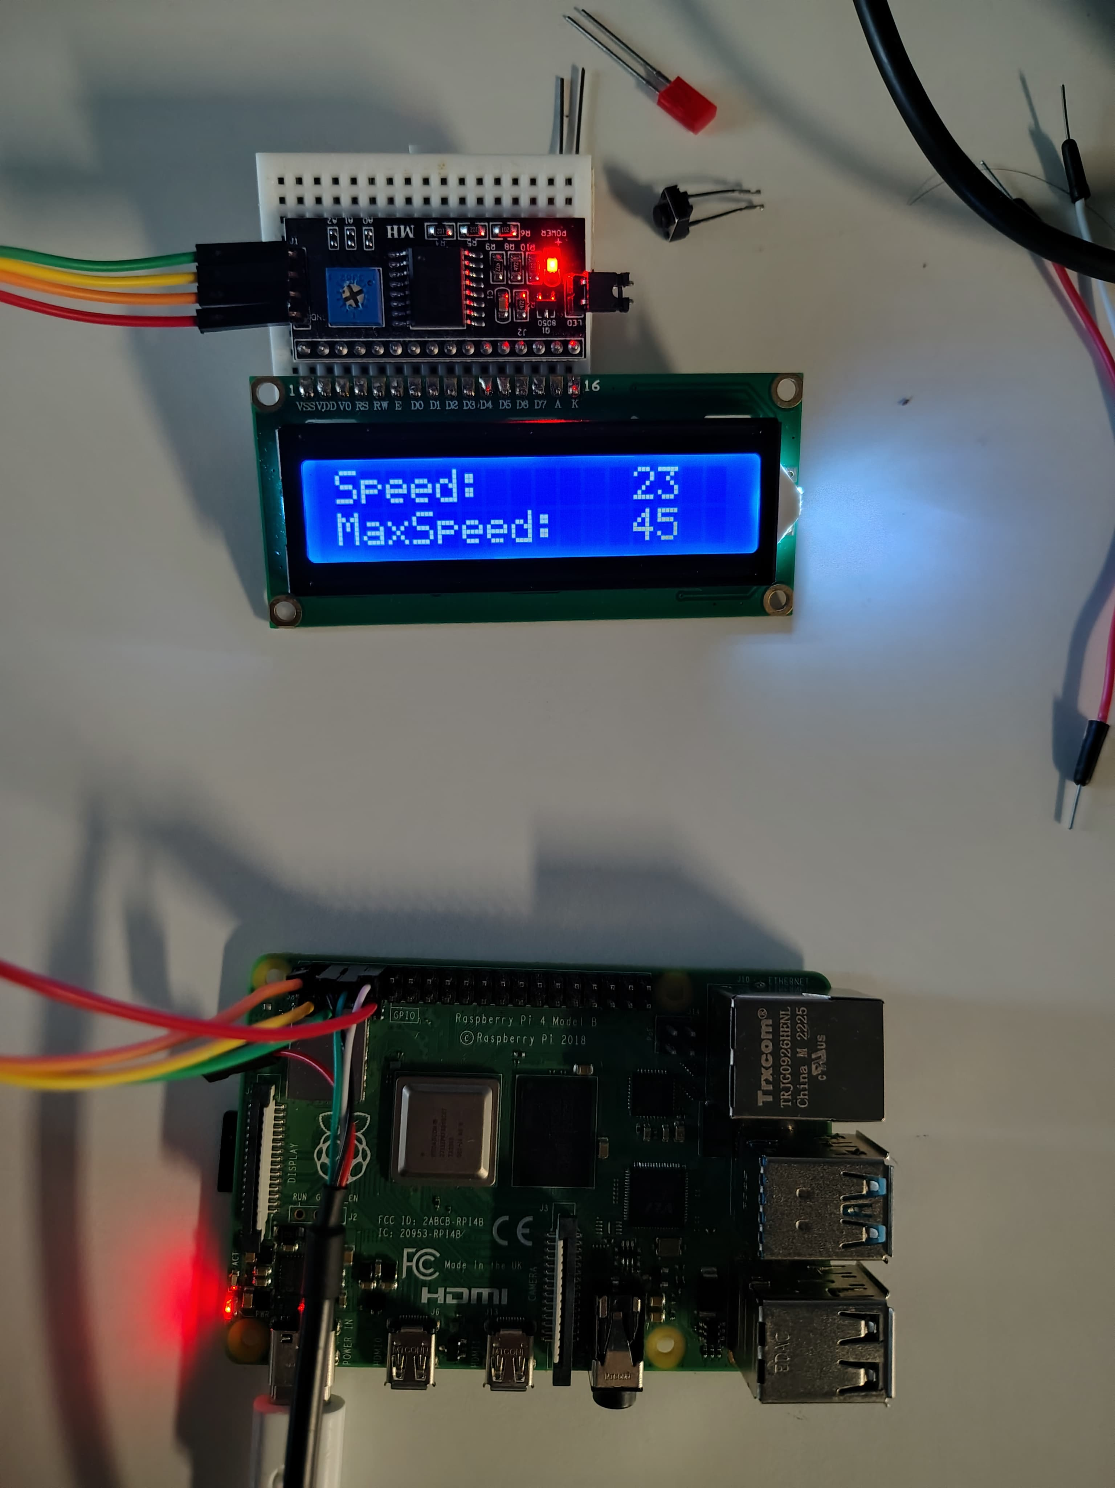
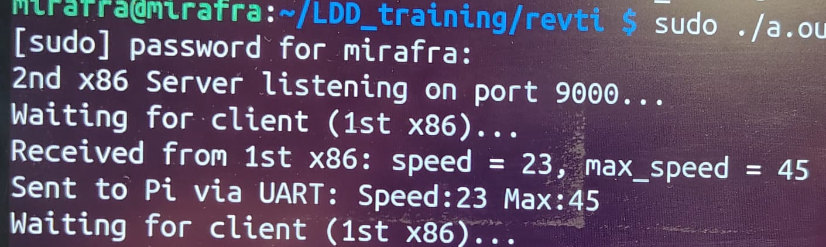
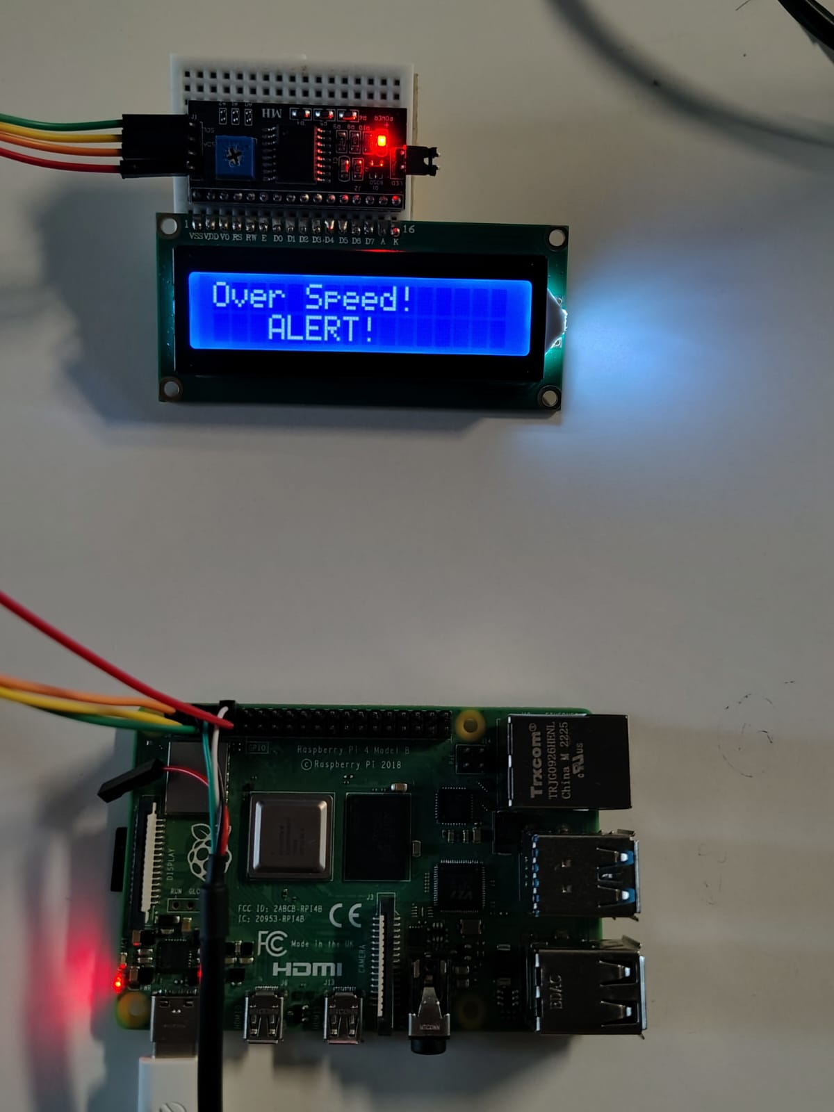
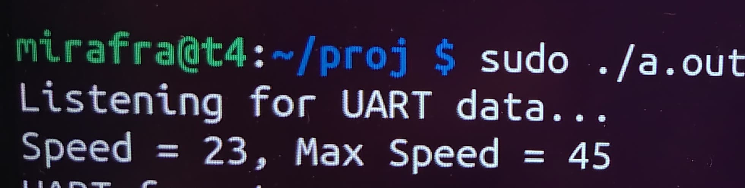
From one x86 sending data
Receiving in 2nd x86
In raspberry pi

