Slide 1
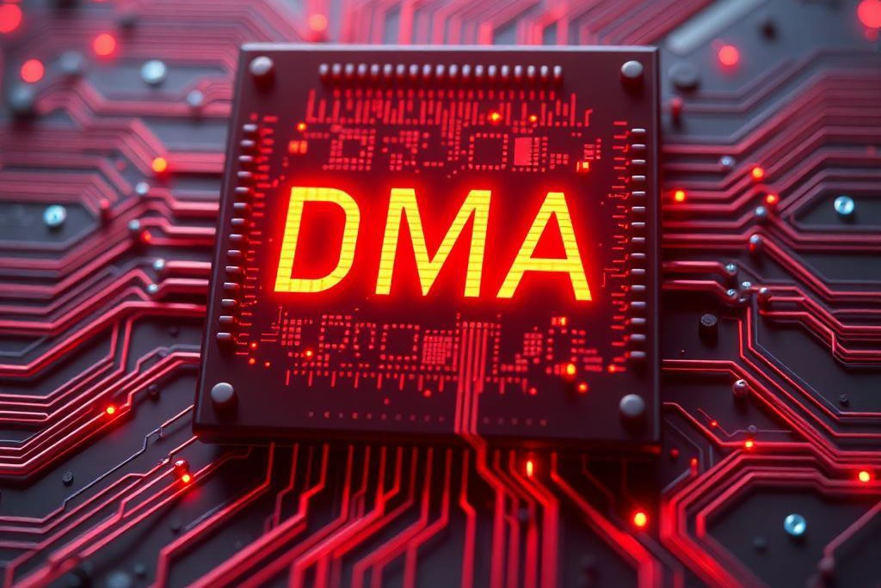
Making Presentations That Stick
A guide by Chip Heath & Dan Heath

Slide 2
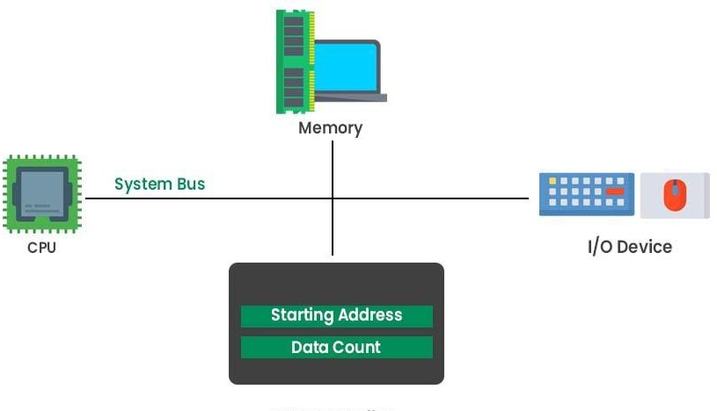
Introduction to DMA
Direct Memory Access (DMA) allows hardware to access system memory without needing the CPU.
Increases system efficiency and speed.
Reduces CPU workload by handling data transfers directly.

Slide 3

How DMA Works
DMA controller manages data transfer directly between devices and memory.
Steps:
CPU initiates the DMA transfer.
DMA controller takes control of the system bus.
Data transfers between the device and memory.
CPU is notified when the transfer is complete.

Slide 4
Types of DMA
Modes:
Burst Mode: Transfers entire blocks of data at once.
Cycle Stealing: Transfers byte-by-byte, alternating with CPU cycles.
Transparent Mode: Transfers occur only when the CPU is idle.
Demand Mode: Waits for a ready signal from the device before transferring data.

Slide 5
Advantages of DMA:
Efficiency: Reduces CPU load, allowing the CPU to perform other tasks while the DMA handles data transfer.
Speed: Faster than programmed I/O since DMA transfers data directly between memory and peripheral devices.
Resource Management: Allows simultaneous data processing, enabling the system to handle more tasks at once.
Disadvantages of DMA:
Complexity: More intricate design is required for implementing DMA.
Cost: Additional circuitry is needed for DMA, which adds to the system cost.
Conflicts: Increased risk of bus contention due to potential multiple devices attempting access simultaneously.

Slide 6
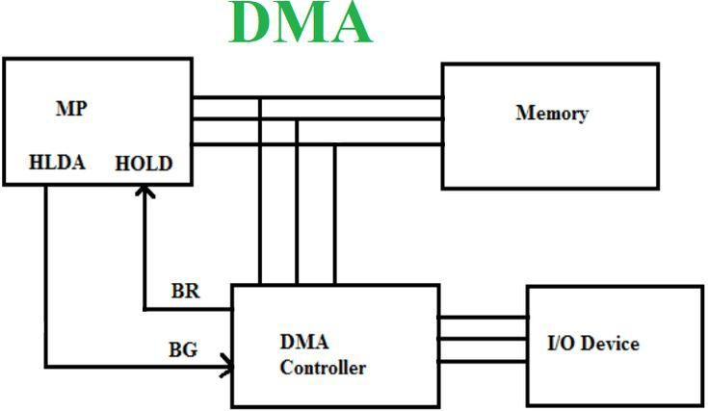

Slide 7
Key Features of Advanced DMA
Scatter-Gather DMA: Efficiently handles non-contiguous memory for fragmented scenarios.
Chain Transfers: Automates sequential transfers, reducing CPU involvement.
Coherent Memory DMA: Maintains memory consistency between CPU and memory.
Prioritization and Arbitration: Assigns priorities to ensure critical task servicing.

Slide 8
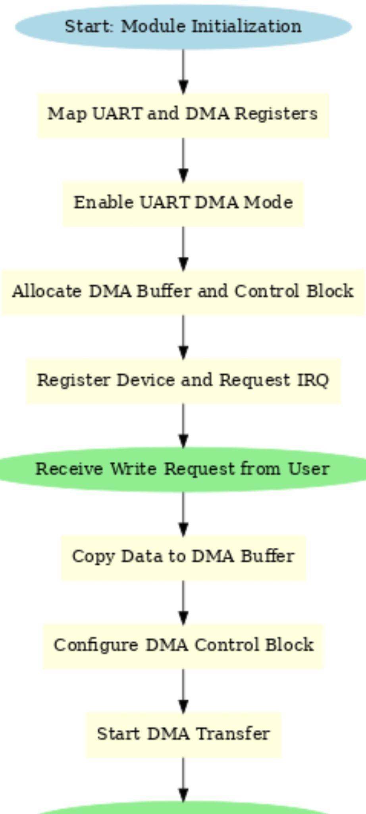

Slide 9
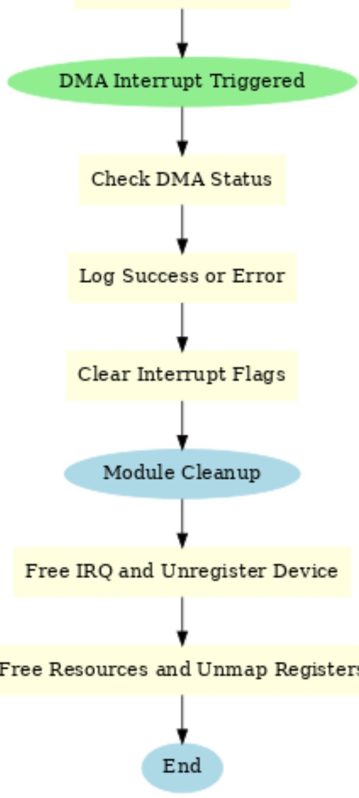
.
●

Slide 10
// DMA Control Block
struct dma_cb
{
uint32_t ti; // Transfer information
uint32_t src_addr; // Source address
uint32_t dest_addr; // Destination address
uint32_t length; // Transfer length
uint32_t stride; // Stride (set to 0)
uint32_t next_cb; // Next control block (set to 0 for no chaining) uint32_t padding[2]; // Padding to make it 32 bytes
};

Slide 11
Overview of Registers in UART-DMA Driver
UART Registers
UART_DR_OFFSET (Data Register)
Purpose: Stores data for UART transmission/reception.
Function: Data is transferred to/from this register during UART operations.
UART_DMACR_OFFSET (DMA Control Register)
Purpose: Controls DMA operations for UART.
Function: Enables/disables DMA and configures transfer settings.
DMA Registers
DMA_CONBLK_AD_OFFSET (Control Block Address Register)
Purpose: Holds the address of the DMA Control Block.
Function: Points to DMA settings (source/destination addresses, length).
DMA_CS_OFFSET (Control & Status Register)
Purpose: Provides DMA transfer status.
Function: Indicates transfer completion or errors.

Slide 12
API,s for UART-DMA
Memory Mapping and I/O Functions
ioremap()
Purpose: Maps physical memory addresses to virtual memory for kernel access.
ioread32()
Purpose: Reads 32-bit data from a mapped I/O register.
iowrite32()
Purpose: Writes 32-bit data to a mapped I/O register.
Memory Allocation and Management
dma_alloc_coherent()
Purpose: Allocates physically contiguous memory for DMA operations.
dma_free_coherent()
Purpose: Frees memory allocated by dma_alloc_coherent().

Slide 13

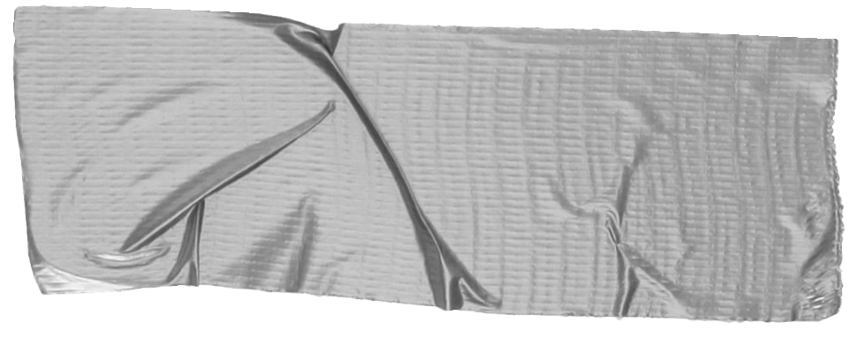
It’s no surprise Marcos uses Google Translate in his shop regularly.
There are 23 officially recognized languages in the EU.
Tip
Don’t let data stand alone. Always relate it back to a story you’ve already told, in this case, Marco’s shop.
theguardian.com

