Slide 1

Cross-Platform Video Streaming via Kernel-Space TCP: x86 to Raspberry Pi
Team Member:
1.Ganga K
2.Putta Bhavitha
3.Vulisha Vaneesha

Slide 2
Introduction:
This project demonstrates a low-level implementation of real-time video transmission between two Linux-based systems — an x86 machine and a Raspberry Pi — using TCP sockets within the kernel space.
The primary goal is to capture a video file on the x86 system, transmit it over a TCP/IP connection, and play it back on the Raspberry Pi.t showcases the feasibility and challenges of inter-device communication, network programming, and video data handling at the kernel level.
This approach is particularly useful in real-time embedded systems, IoT applications, and low-latency multimedia , where direct kernel access can improve performance and reduce overhead.

Slide 3
Objective:
To capture a video file on an x86 system and transmit it over TCP using user-space socket programming, enabling real-time video reception and playback on a Raspberry Pi. This project aims to demonstrate efficient multimedia data transfer between heterogeneous platforms.

Slide 4
Introduction to V4L2:
V4L2 stands for Video4Linux2 — it's the standard Linux kernel framework for handling video capture and output devices.
It provides a common interface for:
Cameras (USB webcams, CSI cameras)
TV tuners
Video encoders/decoders
Kernel Driver :
On the kernel side, the driver registers a v4l2_device structure representing the video hardware.Then it registers a video_device structure that creates the /dev/videoX device node. The driver sets up a vb2_queue to handle buffer allocation and management.It must implement the vb2_ops callbacks for buffer lifecycle operations.The driver also defines v4l2_ioctl_ops to handle ioctl requests coming from user space.

Slide 5
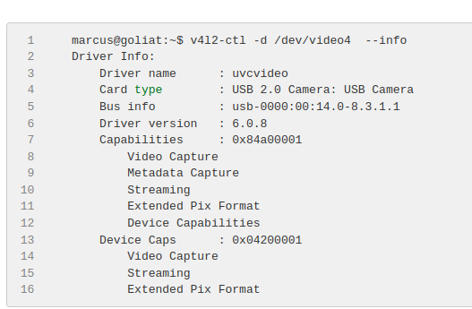
V4L2 IOCTL Operations
Query capabilities (VIDIOC_QUERYCAP) Set/get formats (VIDIOC_S_FMT, VIDIOC_G_FMT) Request buffers (VIDIOC_REQBUFS) Queue/dequeue buffers (VIDIOC_QBUF, VIDIOC_DQBUF) Start/stop streaming (VIDIOC_STREAMON, VIDIOC_STREAMOFF)

Slide 6
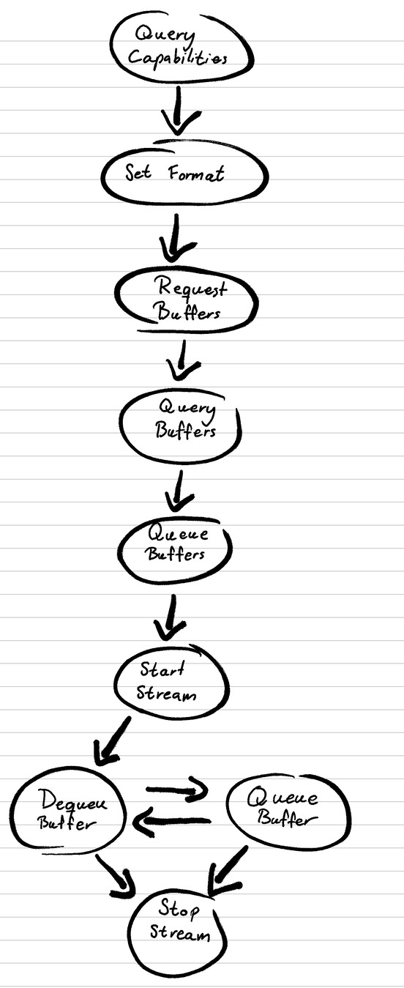
V4L2 Programming model and We will follow these steps in order to acquire frames from the camera:

Slide 7
TCP Protocol:
TCP (Transmission Control Protocol) is a connection-oriented, reliable transport protocol used for data communication.
┌───────────────┐ ┌─────────────────┐
│ Kernel Client│ TCP Packets │ User-Space Server │
│ (Sender) │===============>│ (Receiver) │
└───────────────┘ └─────────────────┘
Read video file ↔ Write to file
Send chunks ↔ Acknowledge each

Slide 8
1. Create Socket
(sock_create_kern)
|
v
2. Connect to Server
(sock->ops->connect)
|
v
3. Open File
(filp_open)
|
v
4. Allocate Buffer
(kmalloc)
|
v
5. Read File Chunk
(kernel_read)
|
v
6. Send Chunk
(kernel_sendmsg)
|
v
7. Repeat Until End of File
|
v
8. Cleanup
(filp_close,
sock_release, kfree)

Slide 9
1. Start Server Program
|
v
2. Create Socket
|
3. Bind Socket
v
4. Listen for Connections
|
v
5. Accept Client Connection
|
v
6. Open File for Writing
|
v
7. Receive Data in Loop
|
v
8. Write Data to File
|
v
9. Repeat Until All Data
|
v
10. Close File and Sockets
(close()) |

Slide 10
Conclusion:
This project not only achieved reliable video transmission between an x86 system and a Raspberry Pi but also strengthened understanding of user-space socket programming, file handling, and inter-device communication. It highlights the potential of simple network-based methods for multimedia applications in embedded systems, setting a foundation for future enhancements like live streaming or kernel-level optimization.

Slide 11
THANK YOU

