Slide 1
Critical intruder detection using linux device driver with the help of serial communication and RTC
By:
1.Hemalatha Terli
2.Varshitha S

Slide 2
Objective
The main objective of this project is to design and implement a real-time critical intruded detection system and display alert and timestamp using Linux kernel device driver mechanisms.
Developed a Linux kernel device driver capable of handling real-time intrusion detection using GPIO-based interrupt mechanisms.
Designed GPIO-based interrupt handling for sensor detection. Implemented interrupt service routines(ISR) with proper top-half and bottom-half mechanisms to ensure low-latency event handling and avoid prolonged execution in interrupt context.
Interfaced with an RTC module (DS3231) using the I²C protocol, enabling accurate time-stamping of intrusion events.
Interfaced with an ILI9225 TFT display using the SPI protocol, allowing real-time display of intrusion alerts and timestamp information.
Integrated serial communication support, enabling alert message with low-level hardware interaction to build a reliable and responsive security monitoring system.

Slide 3
Tools and Technology
Linux Kernel Programming with C
Raspberry Pi
KY-032 Avoidence Sensor
I2C(DS3231 RTC)
SPI(ILI9225 IFT LCD)
GPIO Interrupts, Workqueue
DTS, Make.

Slide 4
Work flow
LCD &RTC
Initialized
GPIO configured
Module
Loaded
Object
Detected
GPIO Intr
triggered
RTC Module
for fetching
time
Workqueue
Execution
started
Display on
LCD

Slide 5
Working principle
Designed to detect the object using sensor and give required alert message on the LCD.
Once the module is loaded it activates LCD,RTC and GPIO is configured.
When the sensor detects object in range it triggers interrupt and workqueue is initiated.
In workqueue fetching time from RTC using I2C driver.
The fetched time with the required alert message is displayed on LCD using SPI driver

Slide 6
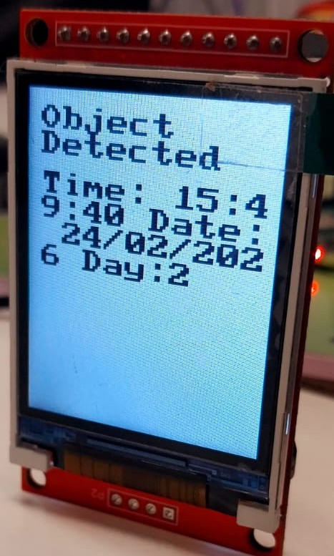
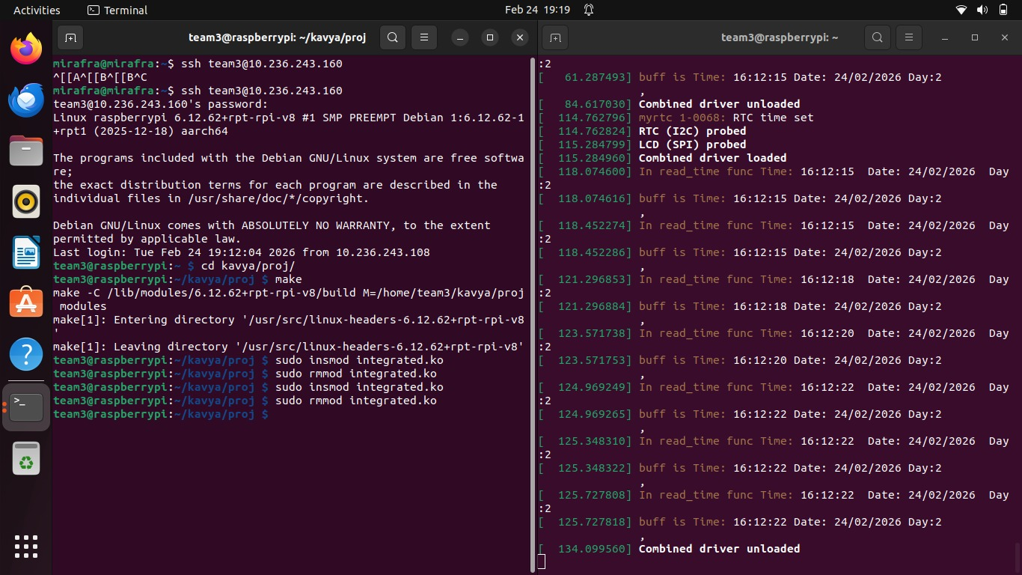
Outcome
The system accurately detect intrusion events using GPIO interrupts with minimal latency.It displays real-time alerts along with timestamp information obtained from the RTC module.The system reliably communicate event details through serial communication while maintaining stable kernel operation.

Slide 7
Conclusion
The Critical Intruder Detection Using Linux Device Driver with Serial Communication and RTC project successfully demonstrates the integration of multiple hardware interfaces to build a real-time embedded security system.
Overall, the project highlights the practical implementation of multi-protocol communication like GPIO interrupt, I²C and SPI within the Linux kernel environment. The developed system is reliable, scalable, and can be extended further into advanced security monitoring applications in embedded Linux platforms.

Slide 8
Thank you

