Slide 1
Ultrasonic based advanced linux sub system
For speed detection /monitoring and Alert
Team Members:
S.Gurunath
K .Likitha
A Jagadishwarudu.

Slide 2
Objective:
The project develops a Linux Device Driver for the HC-SR04 with interrupt-based speed monotoring and controlling LEDs. It also includes an SPI-based ILI9225 LCD driver to display distance and speed, demonstrating kernel-level GPIO and SPI control.
Tools and Technologies Used:
1.Linux Device Drivers(SPI Subsystem,GPIO Subsystem,Interrupt Handling ).
2.Device Tree (DTS Overlays).
3. HC-SR04 Ultrasonic Sensor.
4.ILI9225 SPI TFT LCD Display (176x220).
5.LEDs (Close & Far indication).
6.Raspberry Pi ( BCM2711 based board).

Slide 3
Work flow
Start insmod .ko
intialize the spi and gpio pins through the dts
Wait for user to read under /proc file
Wait for object detection
Display the speed and distance on LCD display and led blinking according to the direction
Calculate the distance and speed
Generate the interrupt

Slide 4
Working Principle
.
1.Embedded system uses ILI9225 SPI LCD and HC-SR04 ultrasonic sensor
2. LCD initializes via SPI, sets registers, and displays text using bitmap fonts.
3.Ultrasonic sensor sends a 10 µs trigger pulse and measures echo duration.
4.Distance calculated as Distance(cm) = Duration(µs)/58.
5.Speed calculated from change in distance over time.
6.LEDs and buzzer give visual/audio alerts based on proximity

Slide 5
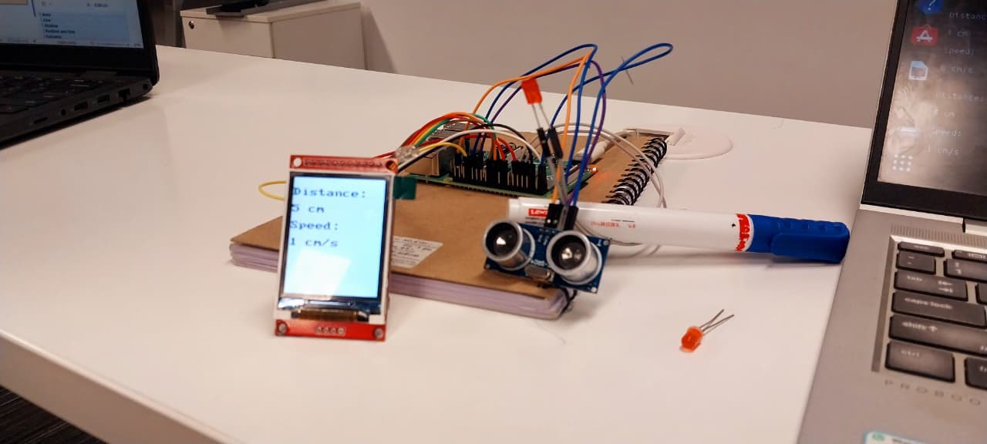
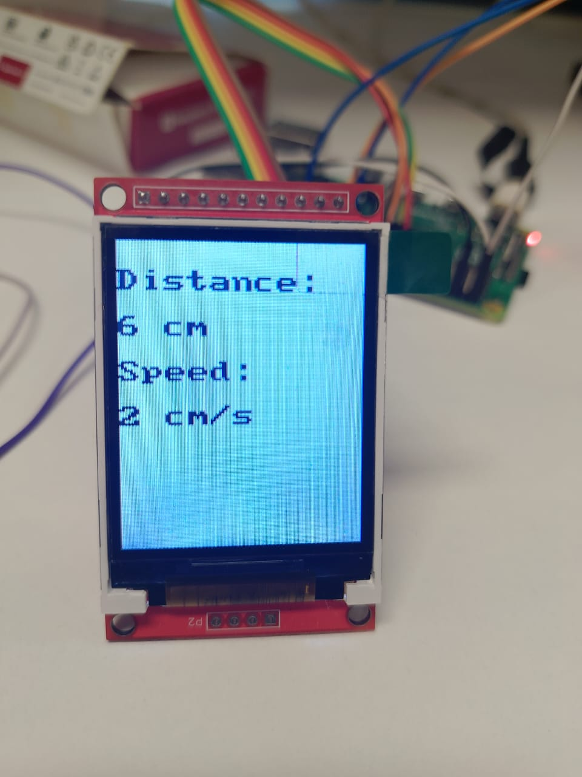
Outcomes
The system measures distance and speed in real time using the HC-SR04 sensor, displays the data on the ILI9225 LCD along with LED indicators, and demonstrates efficient integration of sensors and display within an embedded system.

Slide 6
Conclusion
The project successfully implemented a real-time distance and speed monitoring
system, effectively integrating the ILI9225 LCD, HC-SR04 sensor, and embedded control for applications such as obstacle detection and robotics.

